Slide 1
Statistics – O. R. 891 Object Oriented Data Analysis
J. S. Marron
Dept. of Statistics and Operations Research
University of North Carolina

Slide 2
Support Vector Machines
Motivation:
Find a linear method that “works well”
for embedded data
Note: Embedded data are
very non-Gaussian
Classical Statistics: “Use Prob. Dist’n”
Looks Hopeless

Slide 3
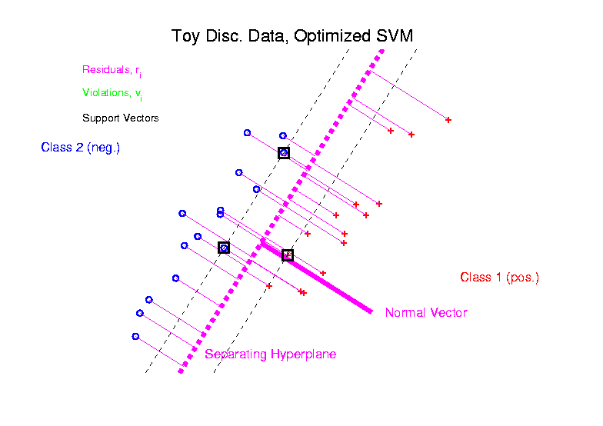
Support Vector Machines
Graphical View, using Toy Example:

Slide 4
SVMs, Computation
Major Computational Point:
Classifier only depends on data through inner products!
Thus enough to only store inner products
Creates big savings in optimization
Especially for HDLSS data
But also creates variations in kernel embedding (interpretation?!?)
This is almost always done in practice

Slide 5
SVMs, Comput’n & Embedding
Implicit Embedding:
Maximize:
Note Difference from Explicit Embedding:

Slide 6
Distance Weighted Discrim’n
2-d Visualization:
Pushes Plane
Away From
Data
All Points
Have Some
Influence

Slide 7
Distance Weighted Discrim’n
Maximal Data Piling
Notes:
BatchEffect1fig4Big.ps

Slide 8
Why Not Adjust by Means?

Slide 9
DWD in Face Recognition
Face Images as Data
(with M. Benito & D. Peña)
Male – Female Difference?
Discrimination Rule?
Represented as long vector of pixel gray levels
Registration is critical

Slide 10
DWD in Face Recognition, (cont.)
Registered Data
Shifts and scale
Manually chosen
To align eyes and mouth
Still large variation
See males vs. females???

Slide 11
DWD in Face Recognition , (cont.)
DWD Direction
Good separation
Images “make sense”
Garbage at ends?
(extrapolation effects?)

Slide 12
DWD in Face Recognition , (cont.)
Unregistered Version
Much blurrier
Since features don’t properly line up
Nonlinear Variation
But DWD still works
Can see M-F differ’ce?

Slide 13
DWD in Face Recognition , (cont.)
Interesting summary:
Jump between means
(in DWD direction)
Clear separation of
Maleness vs. Femaleness

Slide 14
DWD in Face Recognition , (cont.)
Fun Comparison:
Jump between means
(in SVM direction)
Also distinguishes
Maleness vs. Femaleness
But not as well as DWD

Slide 15
DWD in Face Recognition , (cont.)
Analysis of difference: Project onto normals
SVM has “small gap” (feels noise artifacts?)
DWD “more informative” (feels real structure?)

Slide 16
DWD in Face Recognition, (cont.)
Current Work:
Focus on “drivers”:
(regions of interest)
Relation to Discr’n?
Which is “best”?
Lessons for human perception?

Slide 17
Outcomes Data
Breast Cancer Study (C. M. Perou):
Outcome of interest = death or survival
Connection with gene expression?
Approach:
Treat death vs. survival during study as “classes”
Find “direction that best separates the classes”

Slide 18
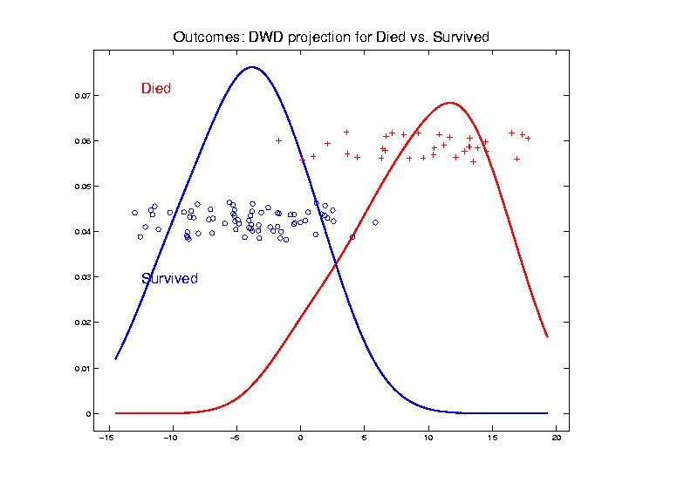
Outcomes Data
Find “direction that best separates the classes”
Notes:
18

Slide 19
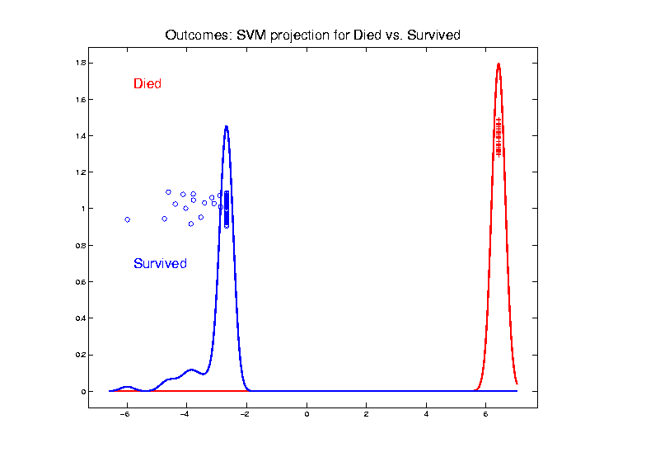
Outcomes Data
Find “direction that best separates the classes”
Notes:
19

Slide 20
Outcomes Data
Find “direction that best separates classes”
DWD Projection
SVM Projection
Notes:
SVM is “better separated”?
(recall “data piling” problems….)
DWD gives “more spread between sub-populations”???
(perhaps “more stable”?)
Notes:
20

Slide 21
Outcomes Data
Which is “better”?
Approach:
Find “genes of interest”
To maximize loadings of direction vectors
(reflects pointing in gene direction)
Show intensity plot (of gene expression)
Using top 20 genes in each direction
Notes:
21

Slide 22
Outcomes Data
Which is “better”?
Study with gene intensity plot
Order cases by DWD score (proj’n)
Order genes by DWD loading (vec. entry)
Reduce to top & bottom 20
Color map shows gene expression
Shows genes that drive classification
Gene names also available
Notes:
22

Slide 23
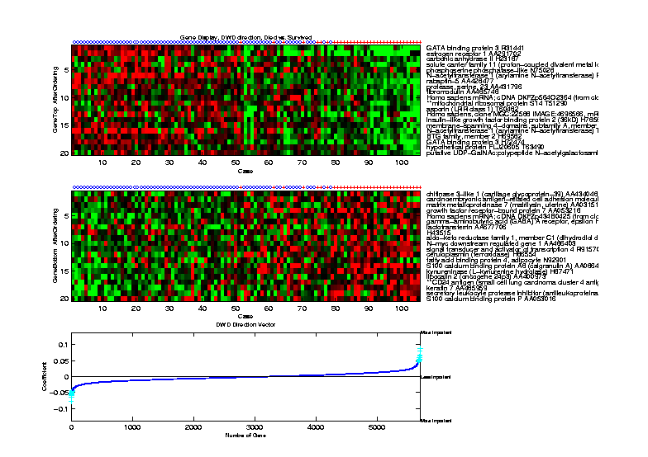
Outcomes Data
Which is “better”? DWD direction
Notes:
23

Slide 24
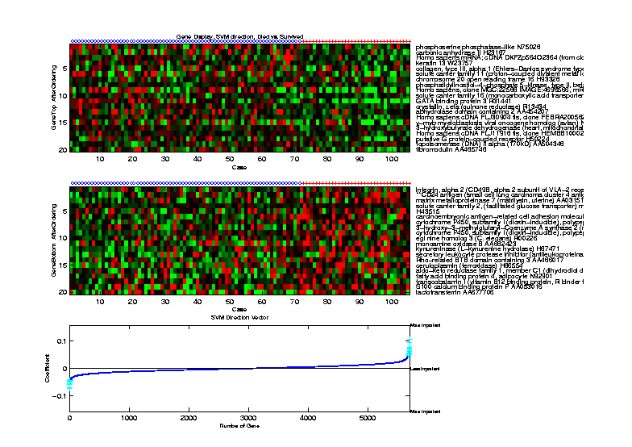
Outcomes Data
Which is “better”? SVM direction
Notes:
24

Slide 25
Outcomes Data
Which is “better”?
DWD finds genes showing better separation
SVM genes are less informative
Notes:
25

Slide 26
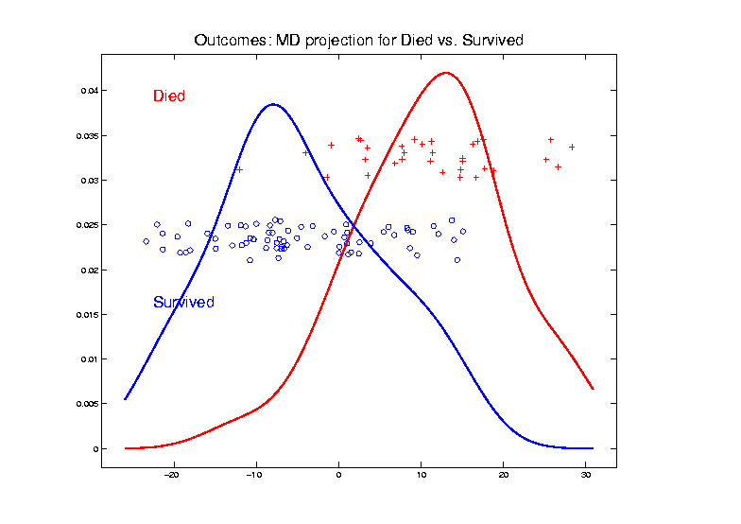
Outcomes Data
How about Centroid (Mean Diff’nce) Method?
Notes:
26

Slide 27
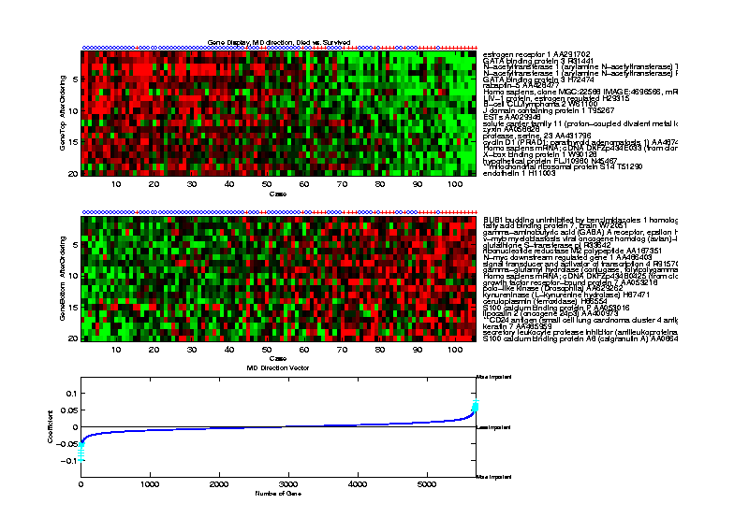
Outcomes Data
How about Centroid (Mean Diff’nce) Method?
Notes:
27

Slide 28
Outcomes Data
Compare to DWD direction
Notes:
28

Slide 29
Outcomes Data
How about Centroid (Mean Diff’nce) Method?
Best yet, in terms of red – green plot?
Projections unacceptably mixed?
These are two different goals…
Try for trade-off?
Scale space approach???
Interesting philosophical point:
Very simple things often “best”
Notes:
29

Slide 30
Outcomes Data
Weakness of above analysis:
Some with “genes prone to disease” have not died yet
Perhaps can see in DWD expression plot?
Better analysis:
More sophisticated survival methods
Notes:
30

Slide 31
HDLSS Discrim’n Simulations
Main idea:
Comparison of
SVM (Support Vector Machine)
DWD (Distance Weighted Discrimination)
MD (Mean Difference, a.k.a. Centroid)
Linear versions, across dimensions
Notes:
31

Slide 32
HDLSS Discrim’n Simulations
Overall Approach:
Study different known phenomena
Spherical Gaussians
Outliers
Polynomial Embedding
Common Sample Sizes
But wide range of dimensions

Slide 33
HDLSS Discrim’n Simulations
Spherical Gaussians:
Notes:
DWD1figEBig.ps

Slide 34
HDLSS Discrim’n Simulations
Spherical Gaussians:
Same setup as before
Means shifted in dim 1 only,
All methods pretty good
Harder problem for higher dimension
SVM noticeably worse
MD best (Likelihood method)
DWD very close to MD
Methods converge for higher dimension??

Slide 35
HDLSS Discrim’n Simulations
Outlier Mixture:
Notes:
DWD1figFBig.ps

Slide 36
HDLSS Discrim’n Simulations
Outlier Mixture:
80% dim. 1 , other dims 0
20% dim. 1 ±100, dim. 2 ±500, others 0
MD is a disaster, driven by outliers
SVM & DWD are both very robust
SVM is best
DWD very close to SVM (insig’t difference)
Methods converge for higher dimension??
Ignore RLR (a mistake)

Slide 37
HDLSS Discrim’n Simulations
Wobble Mixture:
Notes:
DWD1figGBig.ps

Slide 38
HDLSS Discrim’n Simulations
Wobble Mixture:
80% dim. 1 , other dims 0
20% dim. 1 ±0.1, rand dim ±100, others 0
MD still very bad, driven by outliers
SVM & DWD are both very robust
SVM loses (affected by margin push)
DWD slightly better (by w’ted influence)
Methods converge for higher dimension??
Ignore RLR (a mistake)

Slide 39
HDLSS Discrim’n Simulations
Nested Spheres:
Notes:
DWD1figHBig.ps

Slide 40
HDLSS Discrim’n Simulations
Nested Spheres:
1st d/2 dim’s, Gaussian with var 1 or C
2nd d/2 dim’s, the squares of the 1st dim’s
(as for 2nd degree polynomial embedding)
Each method best somewhere
MD best in highest d (data non-Gaussian)
Methods not comparable (realistic)
Methods converge for higher dimension??
HDLSS space is a strange place
Ignore RLR (a mistake)

Slide 41
HDLSS Discrim’n Simulations
Conclusions:
Everything (sensible) is best sometimes
DWD often very near best
MD weak beyond Gaussian
Caution about simulations (and examples):
Very easy to cherry pick best ones
Good practice in Machine Learning
“Ignore method proposed, but read
paper for useful comparison of others”

Slide 42
HDLSS Discrim’n Simulations
Caution: There are additional players
E.g. Regularized Logistic Regression
looks also very competitive
Interesting Phenomenon:
All methods come together
in very high dimensions???

Slide 43
HDLSS Discrim’n Simulations
Can we say more about:
All methods come together
in very high dimensions???
Mathematical Statistical Question:
Mathematics behind this???
(will answer later)
Notes:
43

Slide 44
SVM & DWD Tuning Parameter
Main Idea:
Handling of Violators (“Slack Variables”),
Controlled by Tuning Parameter, C
Larger C → Try Harder to Avoid Violation
Notes:
44

Slide 45
SVM Tuning Parameter
Recall Movie for SVM:
Notes:
45

Slide 46
SVM & DWD Tuning Parameter
Possible Approaches:
Visually Tuned
(Can be Effective,
But Takes Time,
Requires Expertise)
Notes:
46

Slide 47
SVM & DWD Tuning Parameter
Possible Approaches:
Visually Tuned
Simple Defaults
DWD: 100 / median pairwise distance
(Surprisingly Useful, Simple Answer)
SVM: 1000
(Works Well Sometimes, Not Others)
Notes:
47

Slide 48
SVM & DWD Tuning Parameter
Possible Approaches:
Visually Tuned
Simple Defaults
(Works Well for DWD,
Less Effective for SVM)
Notes:
48

Slide 49
SVM & DWD Tuning Parameter
Possible Approaches:
Visually Tuned
Simple Defaults
Cross Validation
Measure Classification Error Rate
Leaving Some Out (to Avoid Overfitting)
Choose C to Minimize Error Rate
Notes:
49

Slide 50
SVM & DWD Tuning Parameter
Possible Approaches:
Visually Tuned
Simple Defaults
Cross Validation
(Very Popular – Useful for SVD,
But Comes at Computational Cost)
Notes:
50

Slide 51
SVM & DWD Tuning Parameter
Possible Approaches:
Visually Tuned
Simple Defaults
Cross Validation
Scale Space
(Work with Full Range of Choices)
Notes:
51

Slide 52
Melanoma Data
Study Differences Between
(Malignant) Melanoma & (Benign) Nevi
Use Image Features as Before
(Recall from Transformation Discussion)

Slide 53
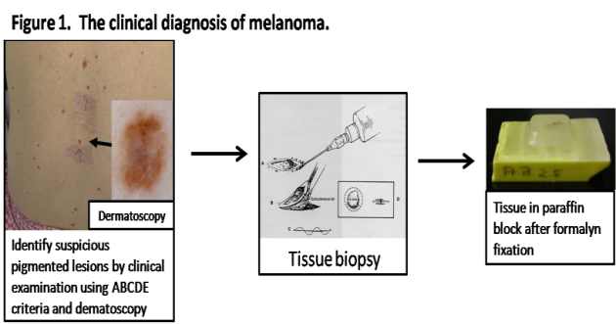
Introduction
Background
Clinical diagnosis

Slide 54
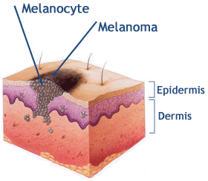
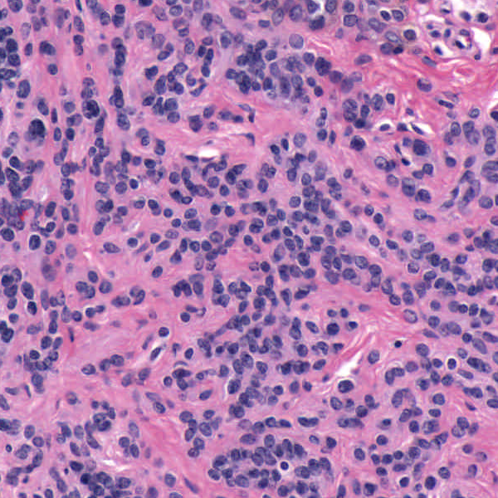
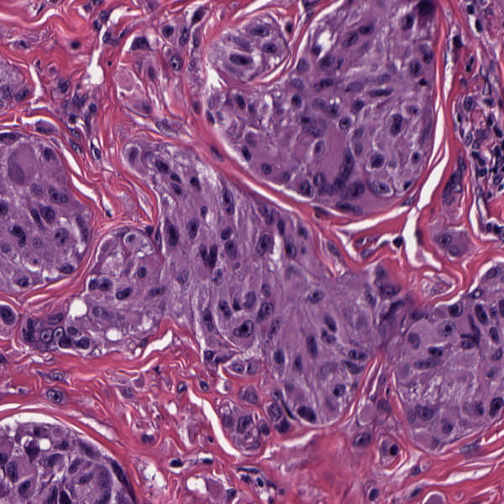
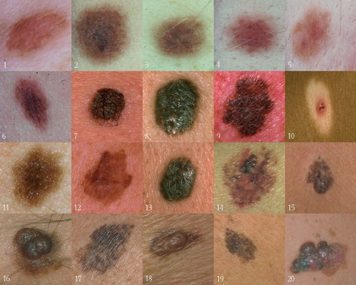
Background
Goal
Image Analysis of Histology Slides
Image: www.melanoma.ca
Benign
Melanoma
1 in 75 North Americans will develop a
malignant melanoma in their lifetime.
Initial goal: Automatically segment nuclei.
Challenge: Dense packing of nuclei.
Ultimately: Cancer grading and patient survival.
Image: melanoma.blogsome.com

Slide 55
Feature Extraction
Features from Cell Nuclei
Feature Extraction
Extract various features based on color and morphology
Example “high-level” concepts:
Stain intensity
Nuclear area
Density of nuclei
Regularity of nuclear shape

Slide 56
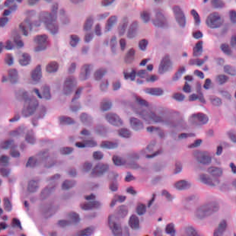
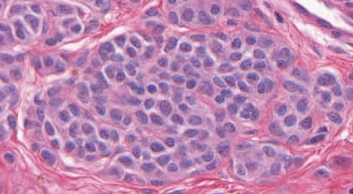
Feature Extraction
Features from Cell Nuclei
Labeled Nuclei
Conventional Nevus
Superficial Spreading Melanoma

Slide 57
Feature Extraction
Features from Cell Nuclei
Nuclear Regions
Conventional Nevus
Superficial Spreading Melanoma
Generated by growing nuclei out from boundary
Used for various color and density features:
Region Stain 2, Region Area Ratio, etc.

Slide 58
Feature Extraction
Features from Cell Nuclei
Delaunay Triangulation
Conventional Nevus
Superficial Spreading Melanoma
Triangulation of nuclear centers
Used for various density features:
Mean Delaunay, Max. Delaunay, etc.

Slide 59
Melanoma Data
Study Differences Between
(Malignant) Melanoma & (Benign) Nevi
Explore with PCA View

Slide 60
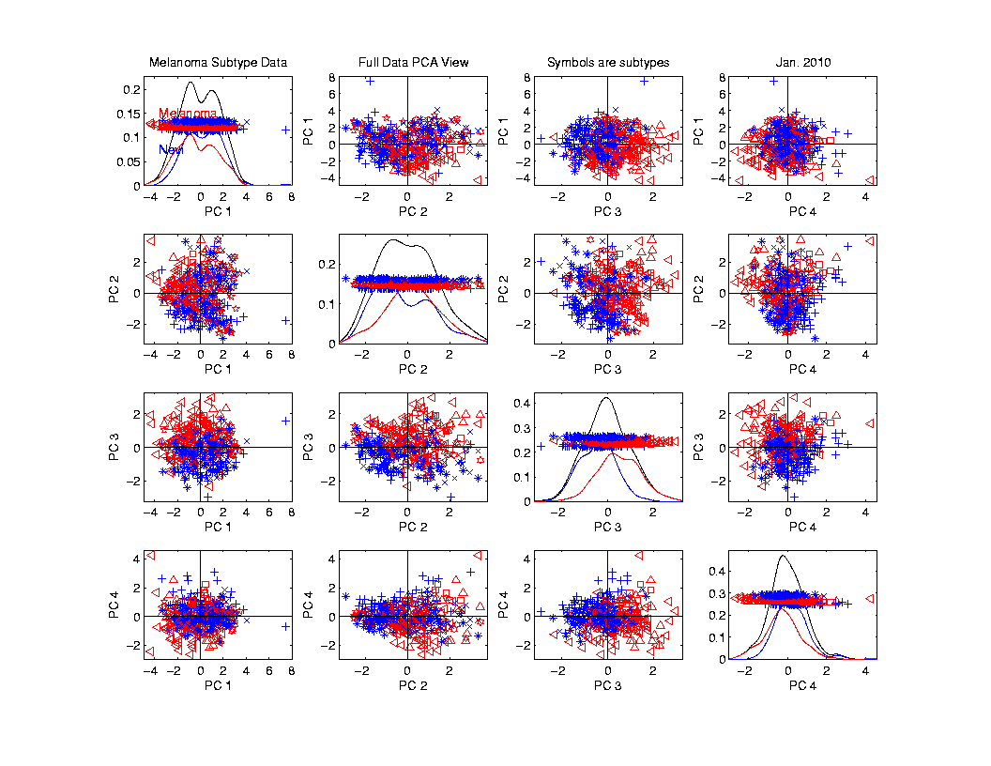
Melanoma Data
PCA
View

Slide 61
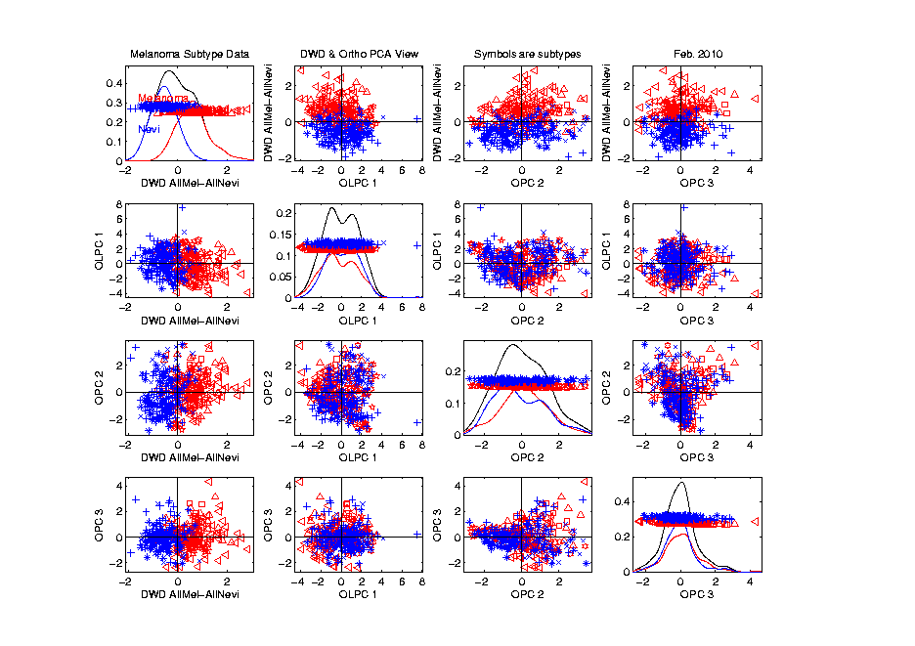
Melanoma Data
Rotate
To DWD
Direction

Slide 62
Melanoma Data
Rotate
To DWD
Direction
“Good”
Separation
???

Slide 63
Melanoma Data
Rotate
To DWD
Direction
Orthogonal
PCs
Avoid
Strange
Projections

Slide 64
Melanoma Data
Return
To
PCA
View
And
Focus
On
Subtypes

Slide 65
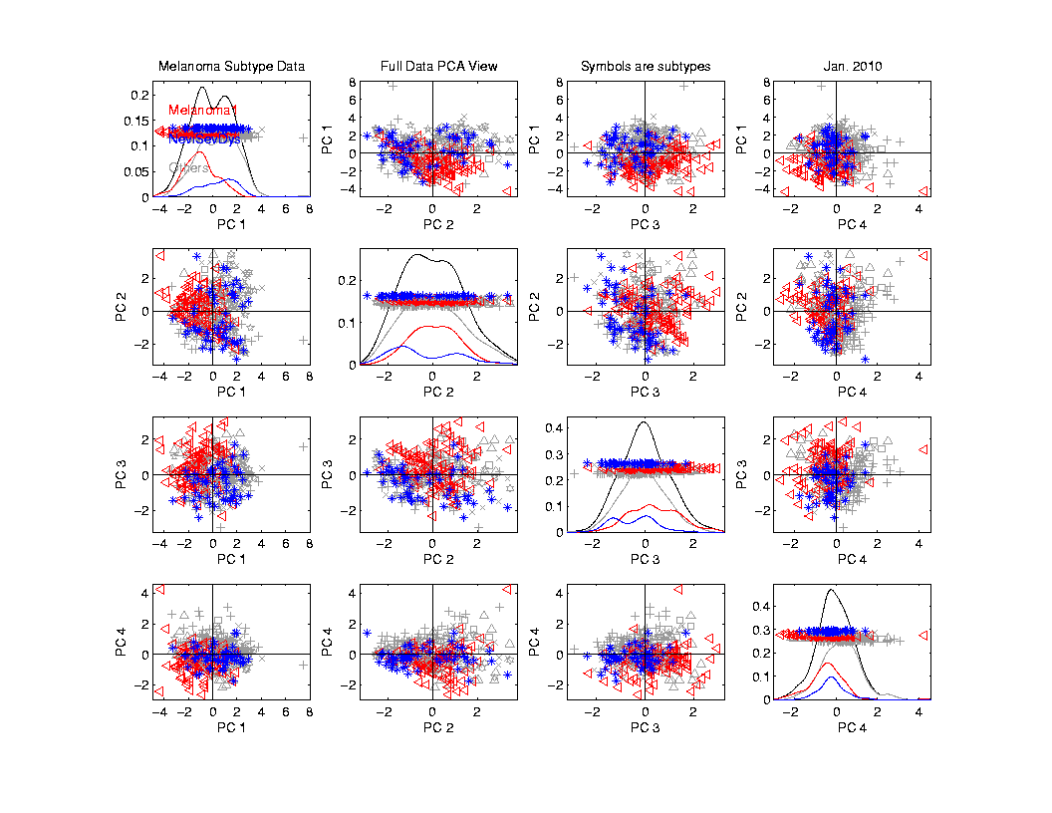
Melanoma Data
Focus
On
Subtypes:
Melanoma 1
Sev. Dys.
Nevi
Gray Out
Others

Slide 66
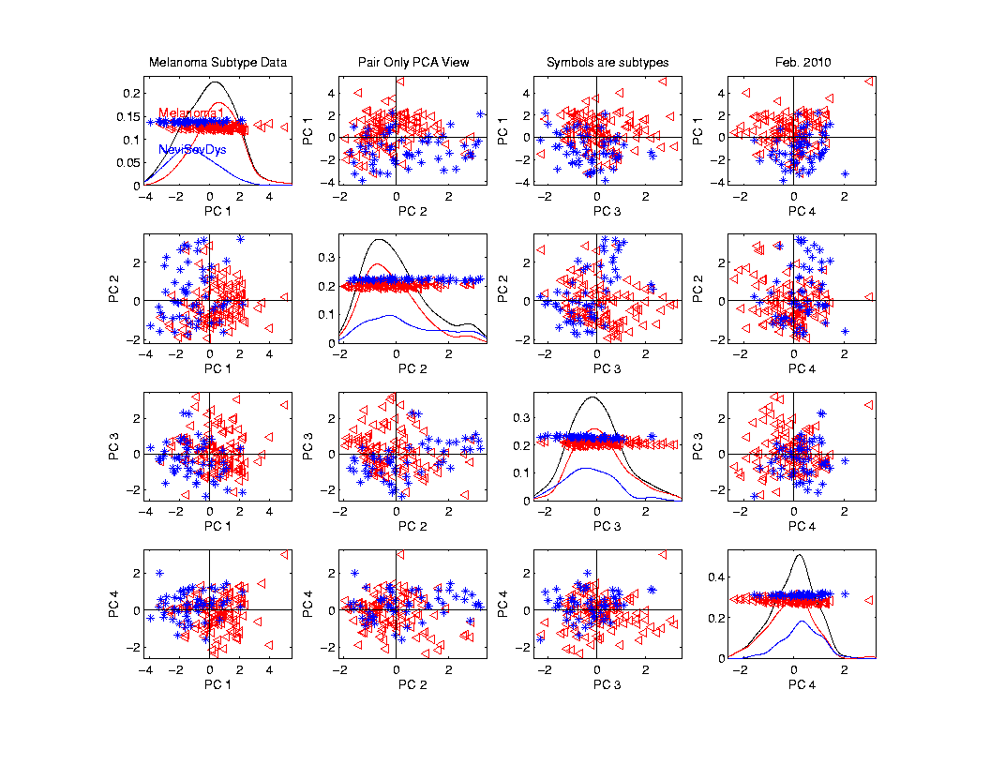
Melanoma Data
Rotate
To
Pairwise
Only
PCA

Slide 67
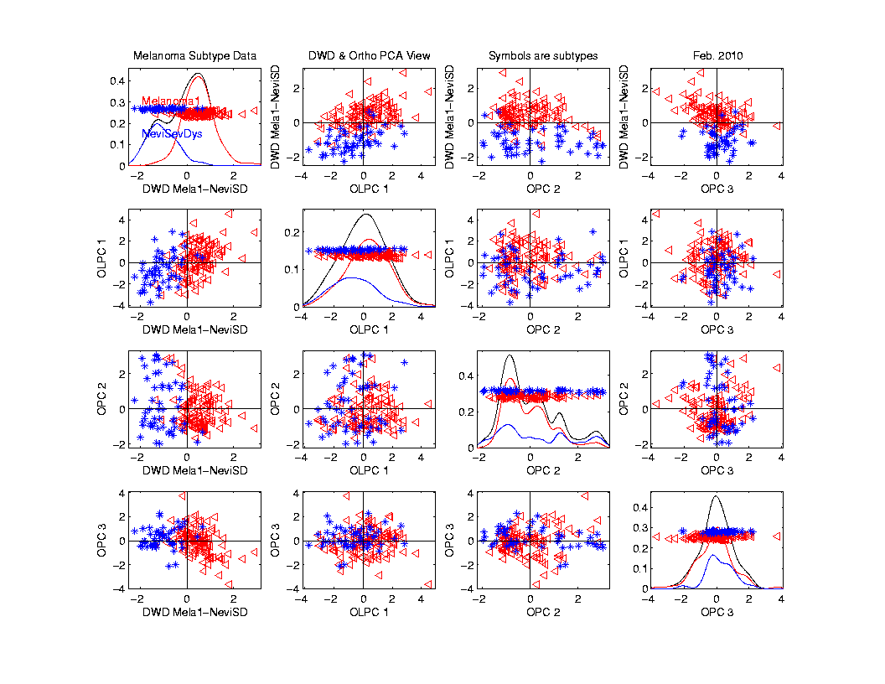
Melanoma Data
Rotate
To DWD
& Ortho PCs

Slide 68
Melanoma Data
Rotate
To DWD
& Ortho PCs
Better
Separation
Than Full
Data???

Slide 69
Melanoma Data
Full Data
DWD
Direction
“Good”
Separation
???

Slide 70
Melanoma Data
Challenge:
Measure “Goodness of Separation”
Approach from Signal Detection:
Receiver Operator Characteristic
(ROC) Curve

Slide 71
ROC Curve
Challenge:
Measure “Goodness of Separation”
Approach from Signal Detection:
Receiver Operator Characteristic
(ROC) Curve
Developed in WWII, History in
Green and Swets (1966)

Slide 72
ROC Curve
Challenge:
Measure “Goodness of Separation”
Idea: For Range of Cutoffs
Plot:
Prop’n +1’s Smaller than Cutoff
Vs.
Prop’n -1s Smaller than Cutoff

Slide 73
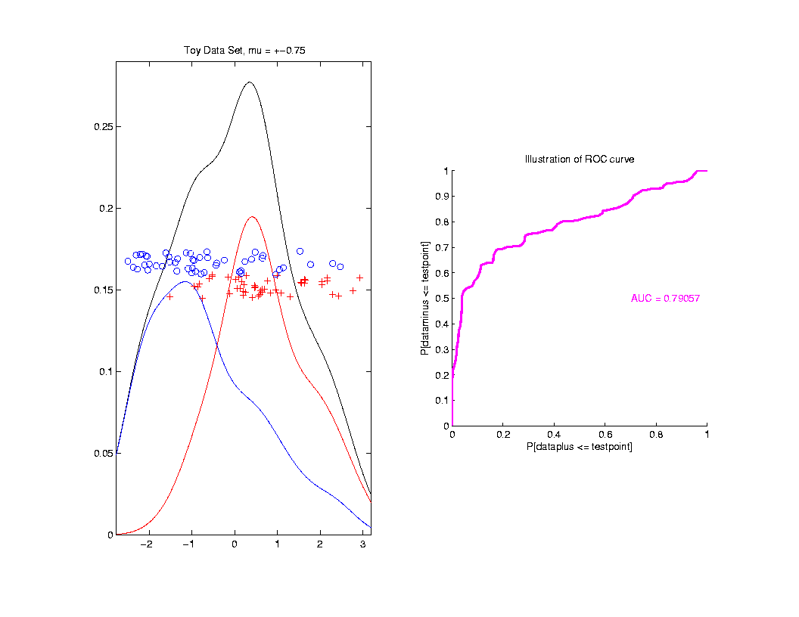
ROC Curve
Aim:
Quantify
“Overlap”

Slide 74
ROC Curve
Aim:
Quantify
“Overlap”
Approach
Consider
Series
Of Cutoffs

Slide 75
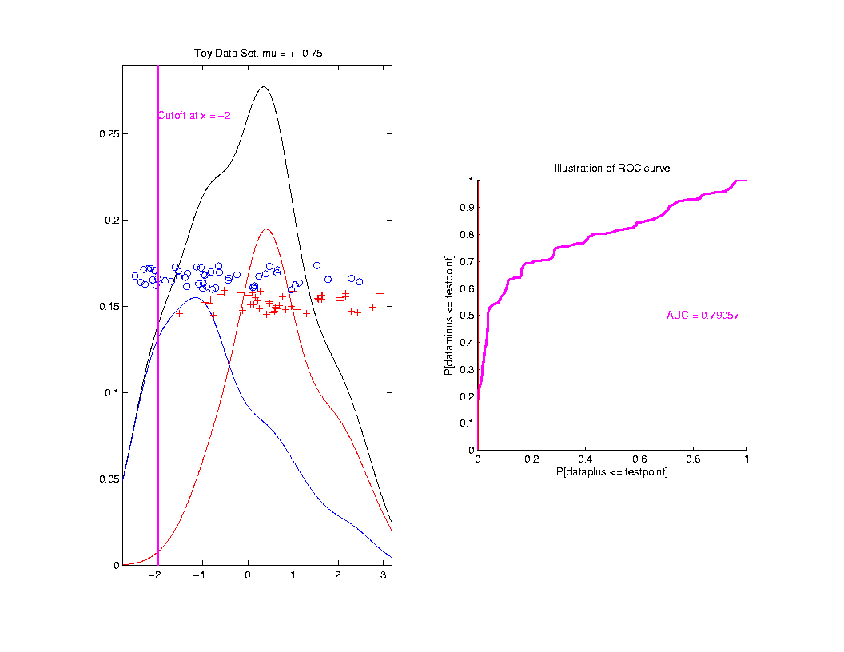
ROC Curve
Approach
Consider
Series
Of Cutoffs

Slide 76
ROC Curve
X-coord
Is Prop’n
Of Reds
Smaller

Slide 77
ROC Curve
X-coord
Is Prop’n
Of Reds
Smaller
Y-coord
Is Prop’n
Of Blues
Smaller

Slide 78
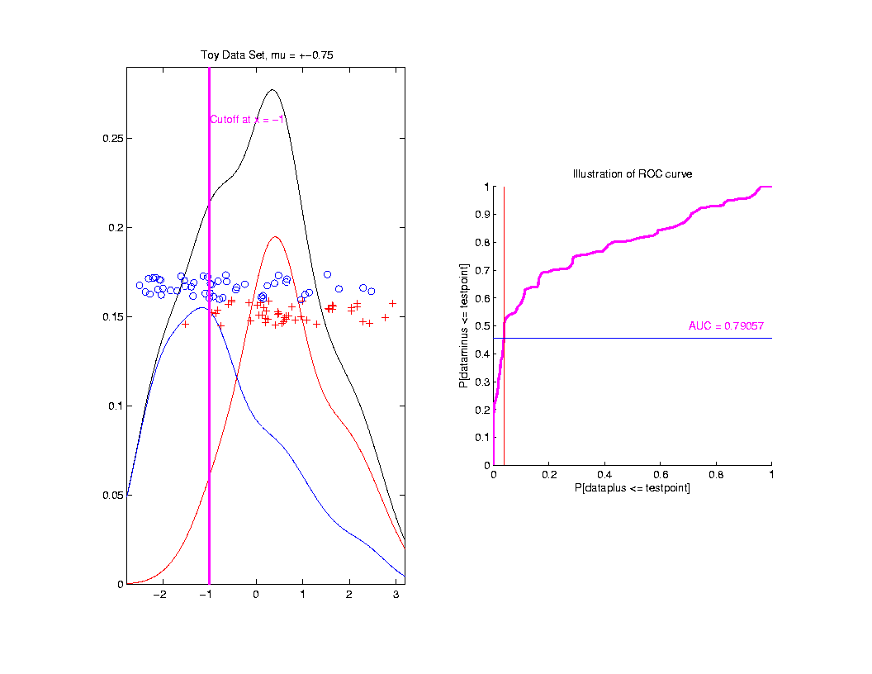
ROC Curve
Slide
Cutoff
To
Trace
Out
Curve

Slide 79
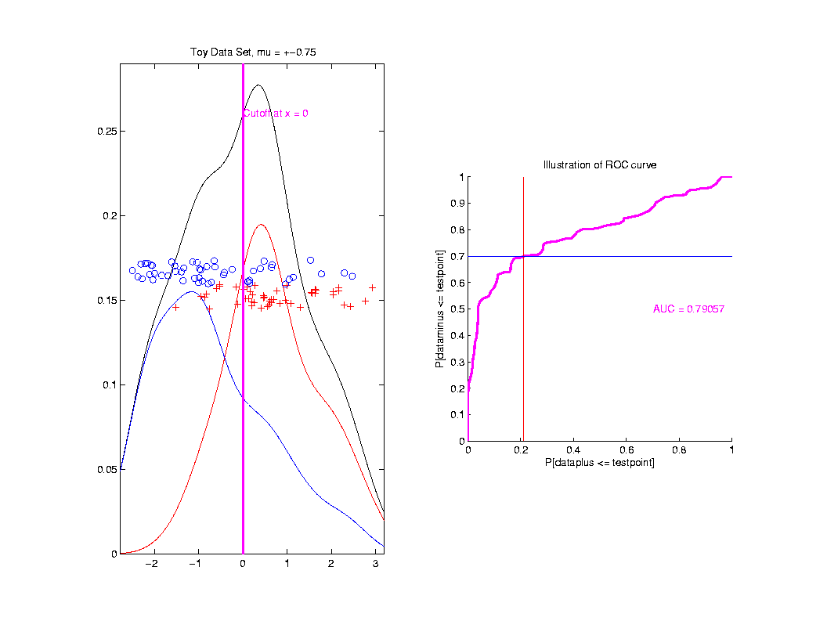
ROC Curve
Slide
Cutoff
To
Trace
Out
Curve

Slide 80
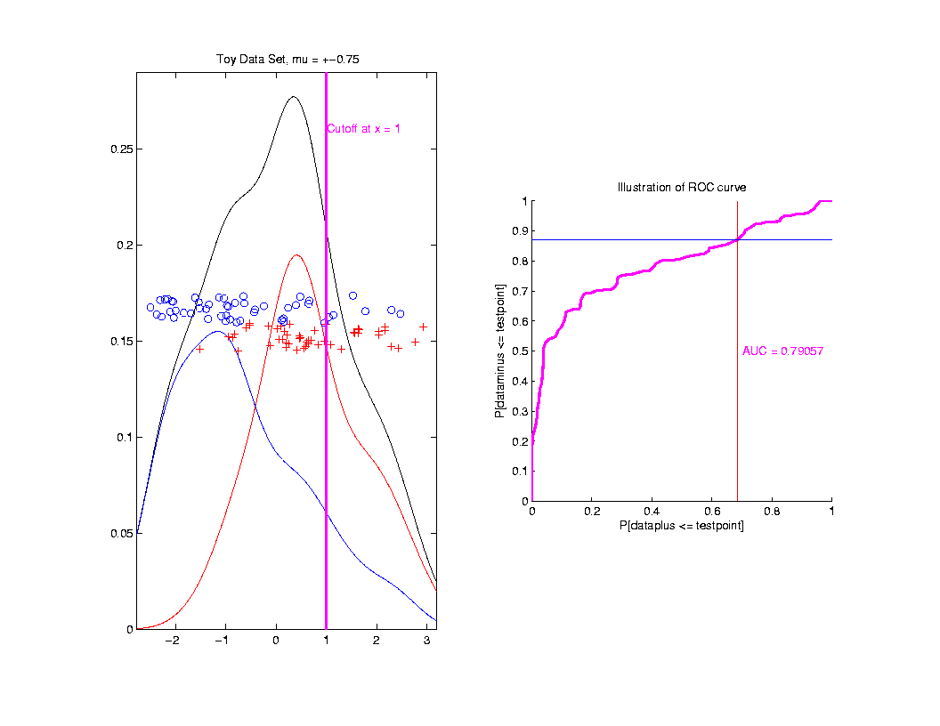
ROC Curve
Slide
Cutoff
To
Trace
Out
Curve

Slide 81
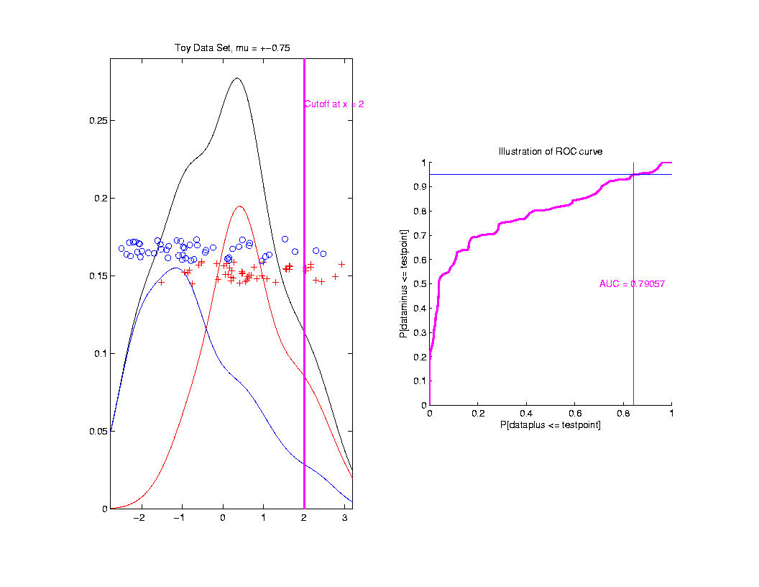
ROC Curve
Slide
Cutoff
To
Trace
Out
Curve

Slide 82
ROC Curve
Better
Separation
Is “More
To Upper
Left”

Slide 83
ROC Curve
Summarize
& Compare
Using
Area
Under
Curve
(AUC)

Slide 84
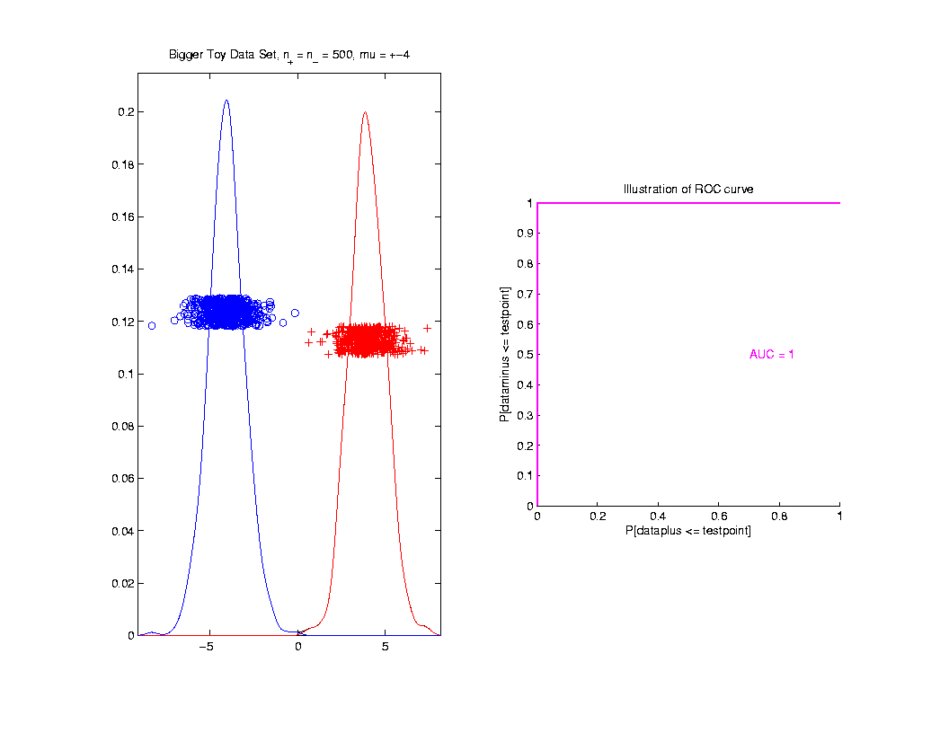
ROC Curve
Toy
Example
Perfect
Separation

Slide 85
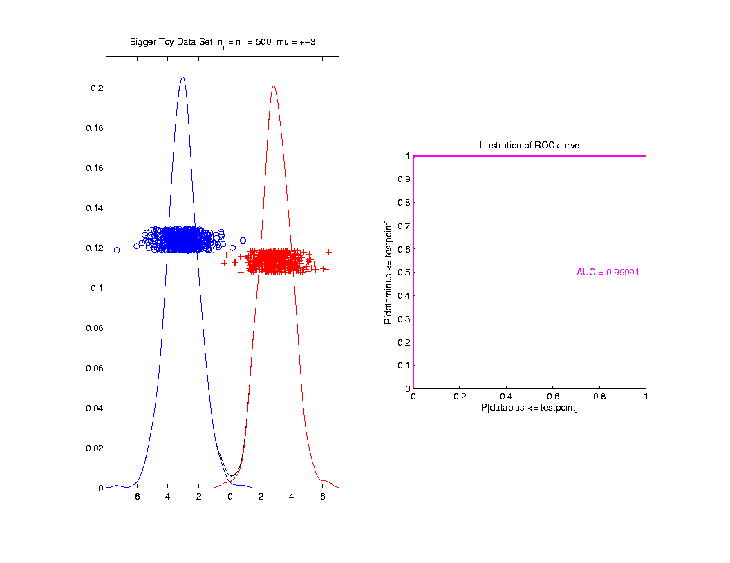
ROC Curve
Toy
Example
Very
Slight
Overlap

Slide 86
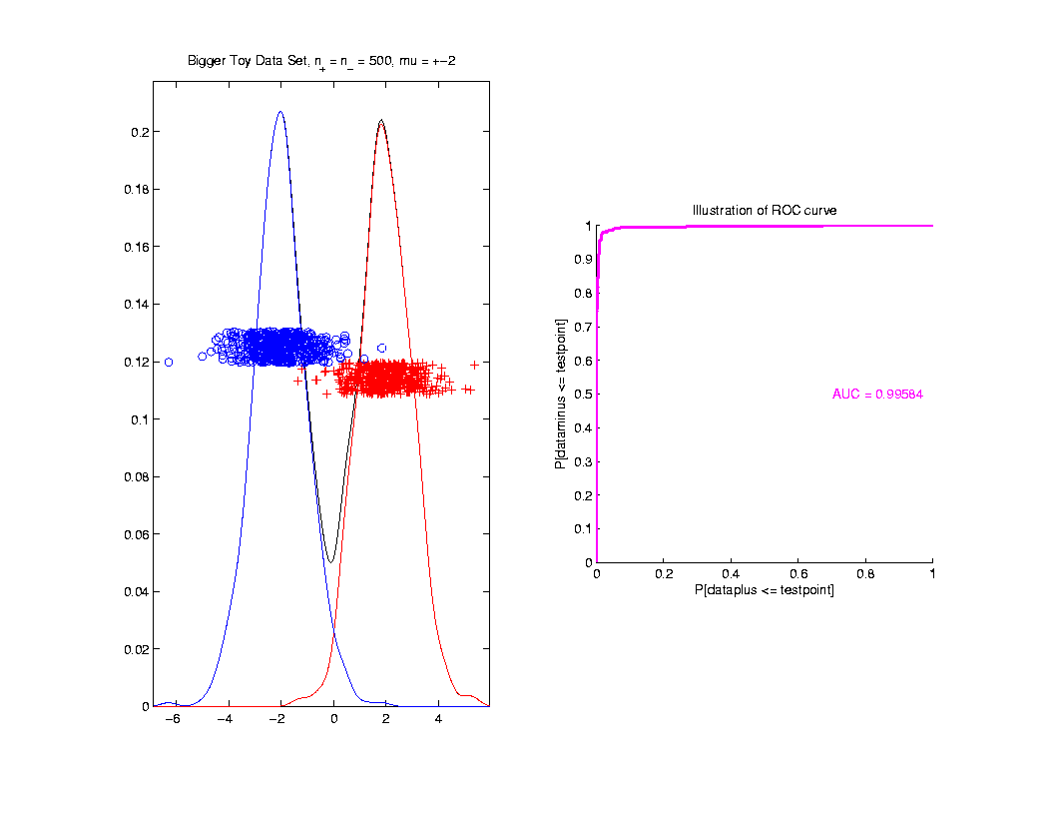
ROC Curve
Toy
Example
Little
More
Overlap

Slide 87
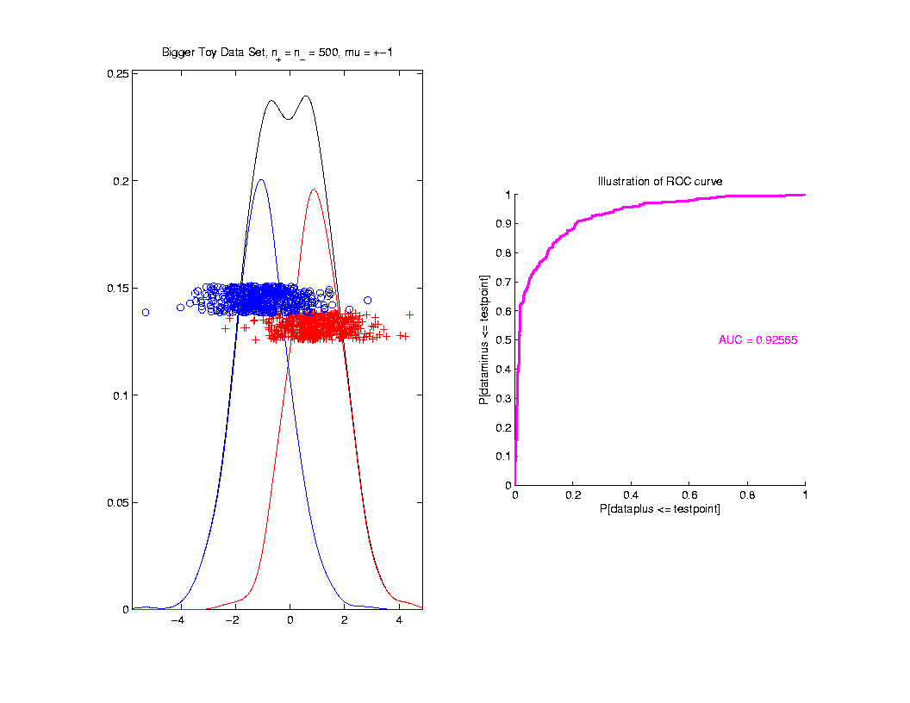
ROC Curve
Toy
Example
More
Overlap

Slide 88
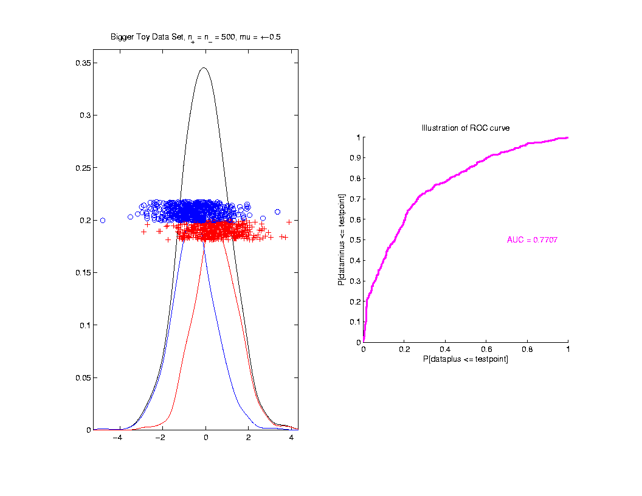
ROC Curve
Toy
Example
Much
More
Overlap

Slide 89
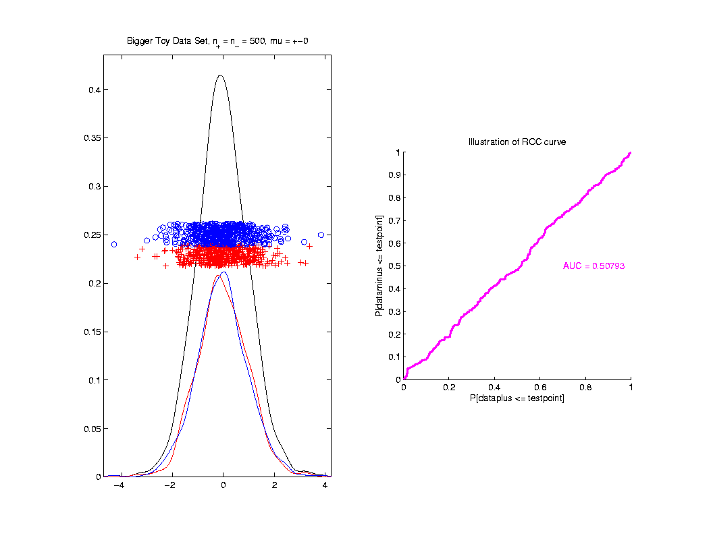
ROC Curve
Toy
Example
Complete
Overlap

Slide 90
ROC Curve
Toy
Example
Complete
Overlap
AUC ≈ 0.5 Reflects “Coin Tossing”

Slide 91
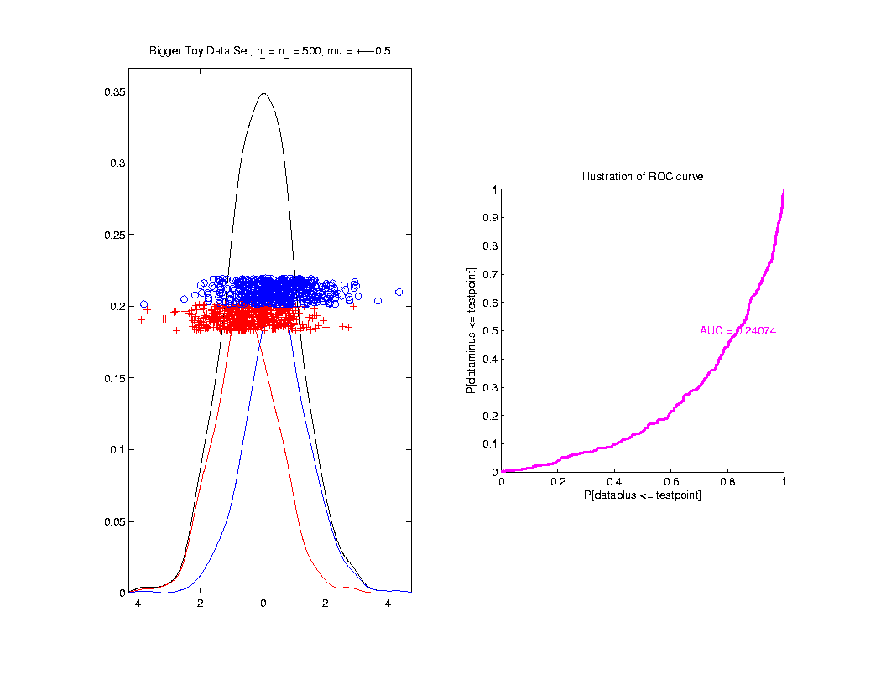
ROC Curve
Toy
Example
Can
Reflect
“Worse
Than Coin
Tossing”

Slide 92
ROC Curve
Interpretation of AUC:
Very Context Dependent
Radiology:
“> 70% has Predictive Usefulness”
Bigger is Better

Slide 93
Melanoma Data
Recall Question:
Which Gives Better Separation of
Melanoma vs. Nevi
DWD on All Melanoma vs. All Nevi
DWD on Melanoma 1 vs. Sev. Dys. Nevi

Slide 94
Melanoma Data
Subclass
DWD
Direction

Slide 95
Melanoma Data
Full Data
DWD
Direction

Slide 96
Melanoma Data
Recall Question:
Which Gives Better Separation of
Melanoma vs. Nevi
DWD on All Melanoma vs. All Nevi
DWD on Melanoma 1 vs. Sev. Dys. Nevi

Slide 97
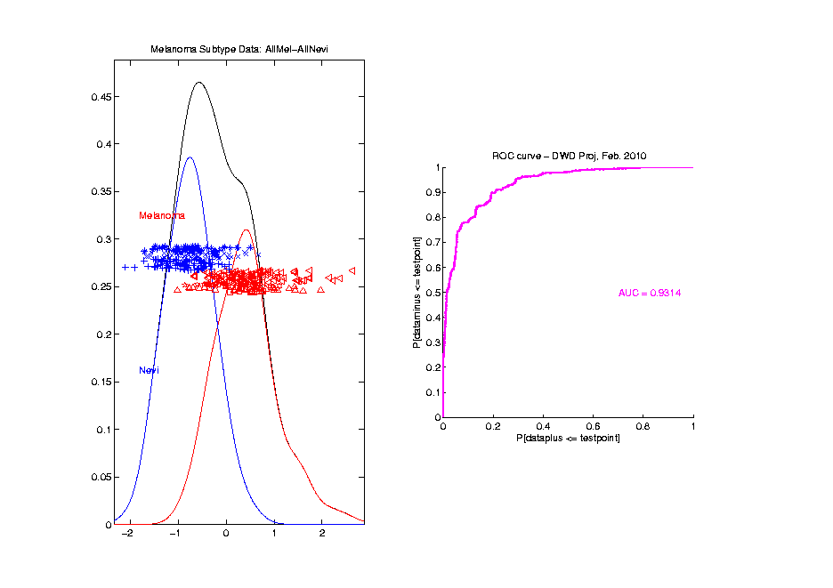
Melanoma Data
Full Data
ROC
Analysis
AUC = 0.93

Slide 98
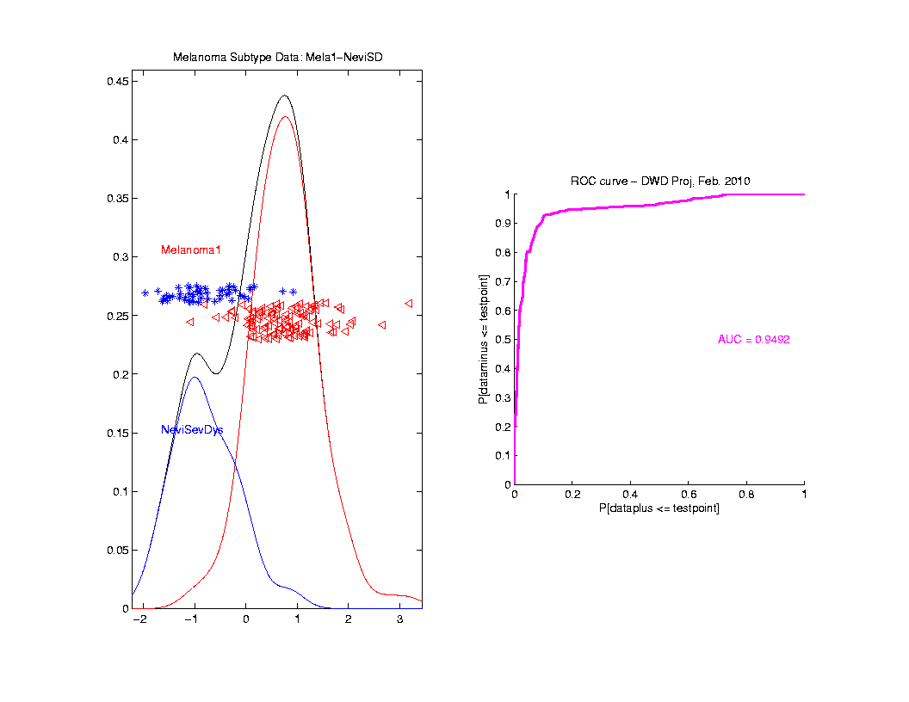
Melanoma Data
SubClass
ROC
Analysis
AUC = 0.95
Better,
Makes
Intuitive
Sense

Slide 99
Melanoma Data
What About Other Subclasses?
Looked at Several
Best Separation Was:
Melanoma 2 vs. Conventional Nevi

Slide 100
Melanoma Data
Full
Data
PCA

Slide 101
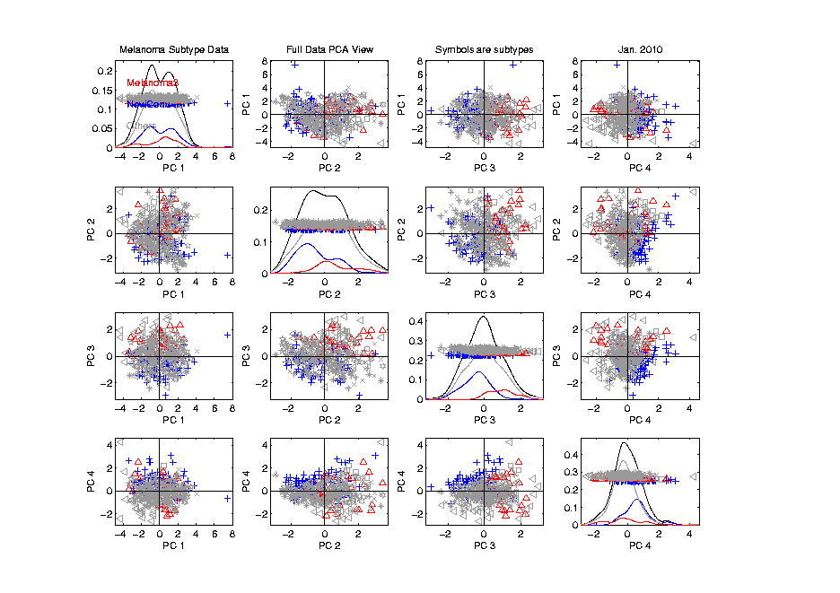
Melanoma Data
Full
Data
PCA
Gray
Out
All
But
Subclasses

Slide 102
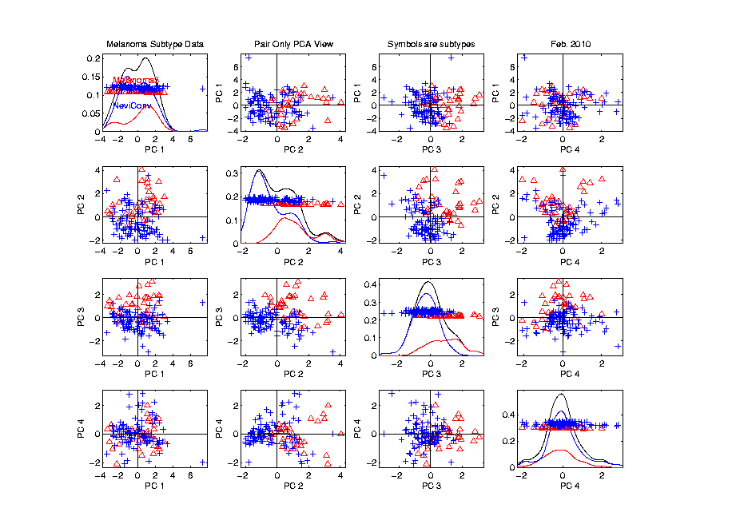
Melanoma Data
Rotate to
SubClass
PCA

Slide 103
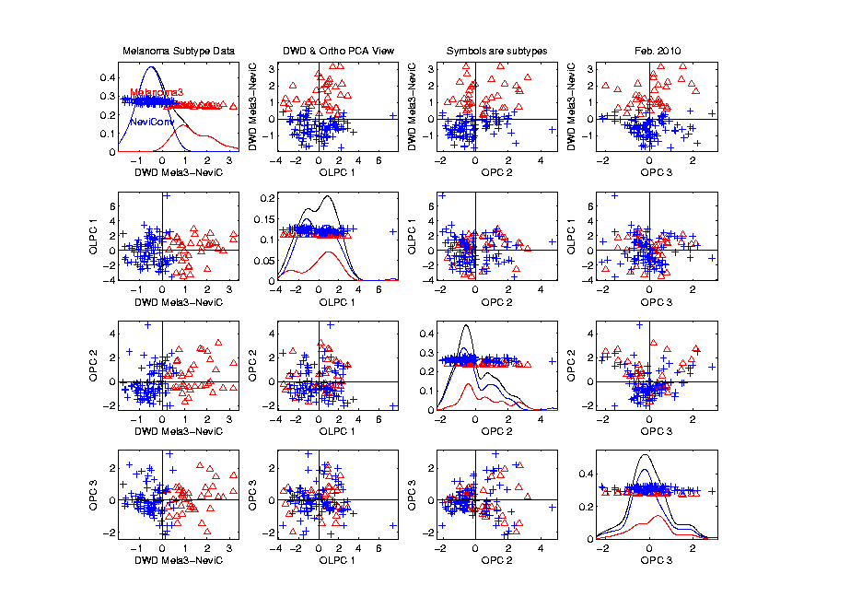
Melanoma Data
Rotate to
SubClass
DWD

Slide 104
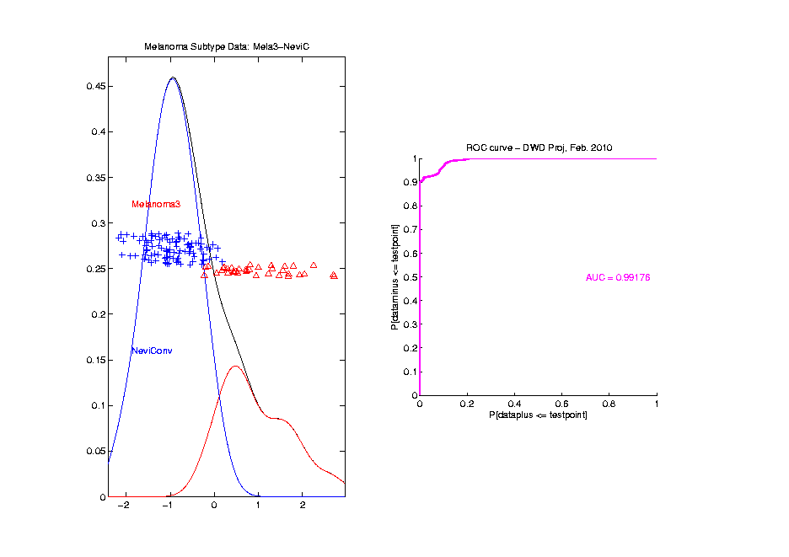
Melanoma Data
ROC
Analysis
AUC = 0.99

Slide 105
Clustering
Idea: Given data
Assign each object to a class

Slide 106
Clustering
Idea: Given data
Assign each object to a class
Of similar objects
Completely data driven

Slide 107
Clustering
Idea: Given data
Assign each object to a class
Of similar objects
Completely data driven
I.e. assign labels to data
“Unsupervised Learning”

Slide 108
Clustering
Idea: Given data
Assign each object to a class
Of similar objects
Completely data driven
I.e. assign labels to data
“Unsupervised Learning”
Contrast to Classification (Discrimination)
With predetermined classes
“Supervised Learning”

Slide 109
Clustering
Important References:
MacQueen (1967)
Hartigan (1975)
Gersho and Gray (1992)
Kaufman and Rousseeuw (2005)

Slide 110
K-means Clustering
Main Idea: for data
Partition indices
among classes

Slide 111
K-means Clustering
Main Idea: for data
Partition indices
among classes
Given index sets
that partition

Slide 112
K-means Clustering
Main Idea: for data
Partition indices
among classes
Given index sets
that partition
represent clusters by “class means”
i.e, (within class means)

Slide 113
K-means Clustering
Given index sets
Measure how well clustered, using
Within Class Sum of Squares

Slide 114
K-means Clustering
Common Variation:
Put on scale of proportions (i.e. in [0,1])

Slide 115
K-means Clustering
Common Variation:
Put on scale of proportions (i.e. in [0,1])
By dividing “within class SS”
by “overall SS”

Slide 116
K-means Clustering
Common Variation:
Put on scale of proportions (i.e. in [0,1])
By dividing “within class SS”
by “overall SS”
Gives Cluster Index:

Slide 117
K-means Clustering
Notes on Cluster Index:
CI = 0 when all data at cluster means

Slide 118
K-means Clustering
Notes on Cluster Index:
CI = 0 when all data at cluster means
CI small when gives tight clustering
(within SS contains little variation)

Slide 119
K-means Clustering
Notes on Cluster Index:
CI = 0 when all data at cluster means
CI small when gives tight clustering
(within SS contains little variation)
CI big when gives poor clustering
(within SS contains most of variation)

Slide 120
K-means Clustering
Notes on Cluster Index:
CI = 0 when all data at cluster means
CI small when gives tight clustering
(within SS contains little variation)
CI big when gives poor clustering
(within SS contains most of variation)
CI = 1 when all cluster means are same

Slide 121
K-means Clustering
Clustering Goal:
Given data
Choose classes
To miminize

Slide 122
2-means Clustering
Study CI, using simple 1-d examples
Varying Standard Deviation

Slide 123
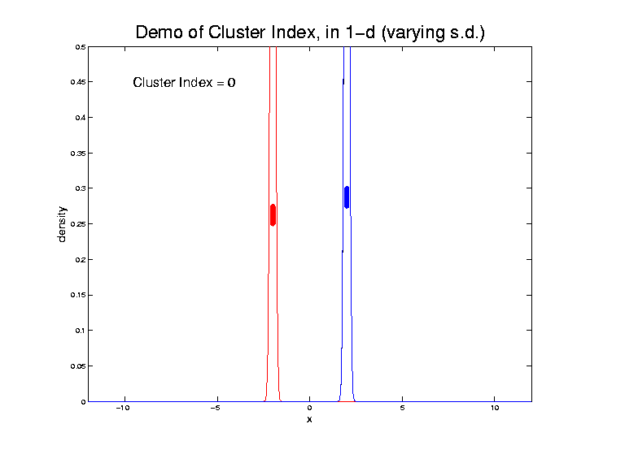
2-means Clustering

Slide 124
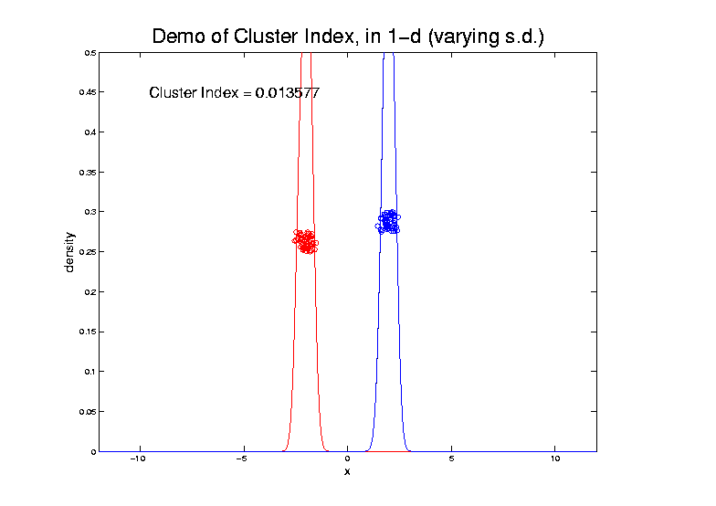
2-means Clustering

Slide 125
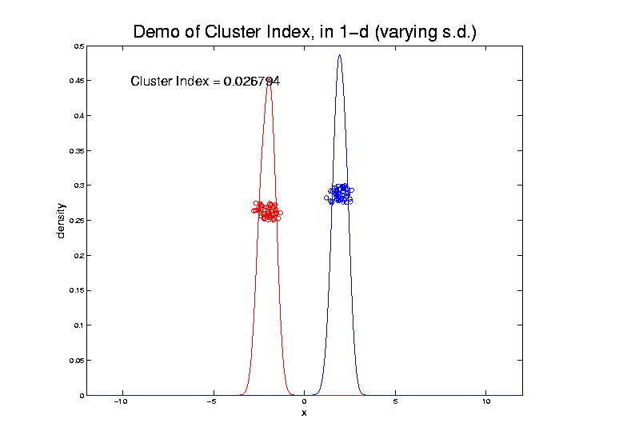
2-means Clustering

Slide 126
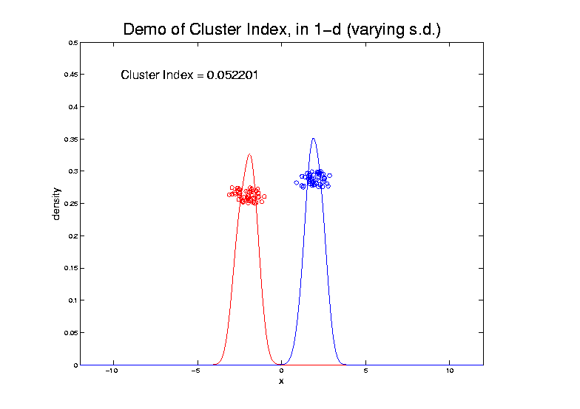
2-means Clustering

Slide 127
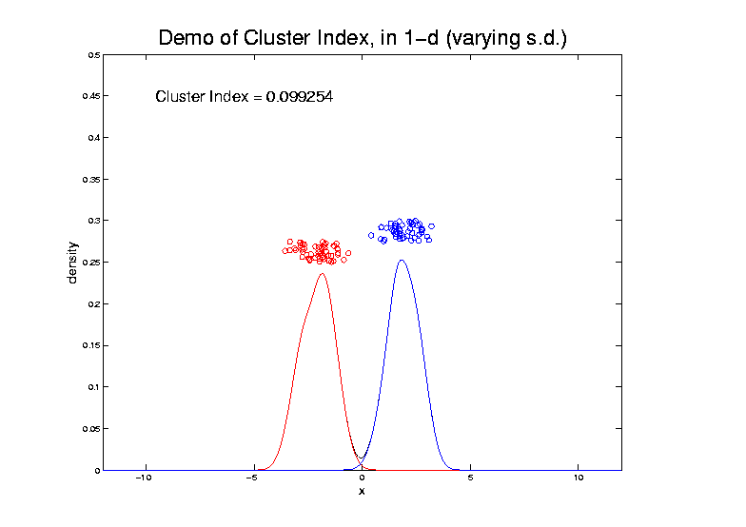
2-means Clustering

Slide 128
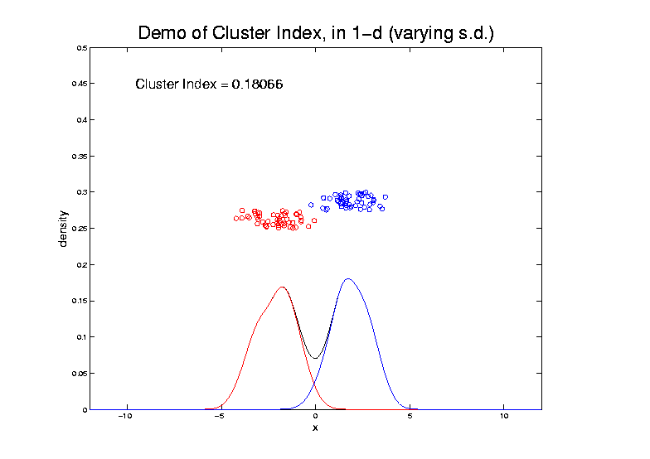
2-means Clustering

Slide 129
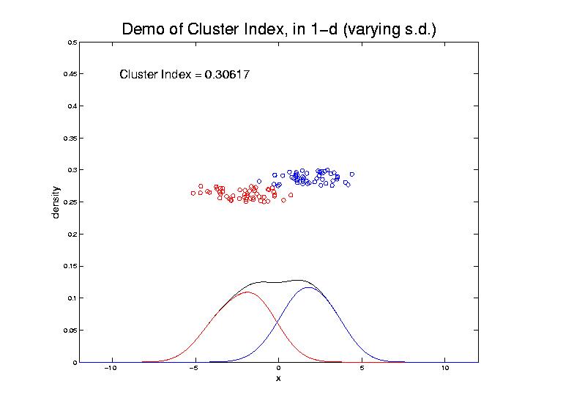
2-means Clustering

Slide 130
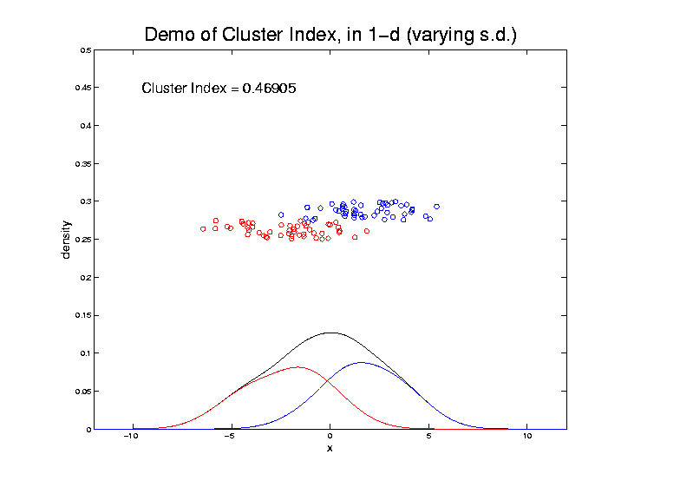
2-means Clustering

Slide 131
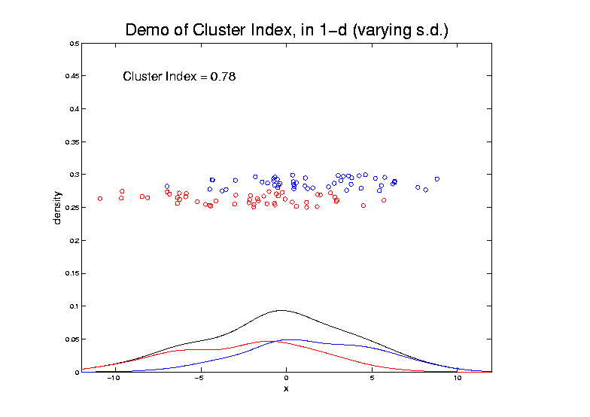
2-means Clustering

Slide 132
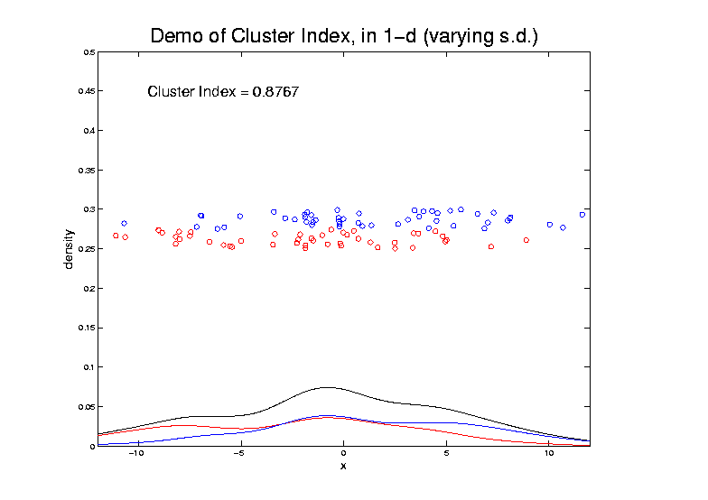
2-means Clustering

Slide 133
2-means Clustering
Study CI, using simple 1-d examples
Varying Standard Deviation
Varying Mean

Slide 134
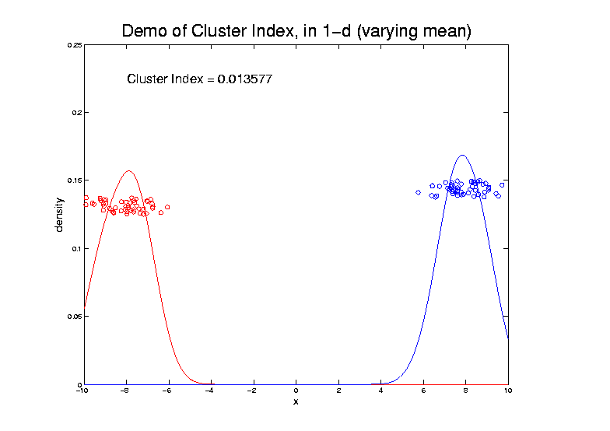
2-means Clustering

Slide 135
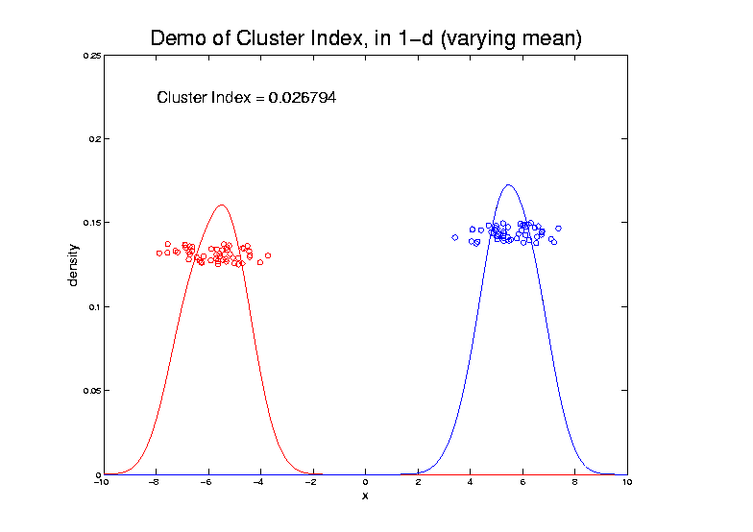
2-means Clustering

Slide 136
2-means Clustering

Slide 137
2-means Clustering

Slide 138
2-means Clustering

Slide 139
2-means Clustering

Slide 140
2-means Clustering

Slide 141
2-means Clustering

Slide 142
2-means Clustering

Slide 143
2-means Clustering

Slide 144
2-means Clustering

Slide 145
2-means Clustering

Slide 146
2-means Clustering
Study CI, using simple 1-d examples
Varying Standard Deviation
Varying Mean
Varying Proportion

Slide 147
2-means Clustering

Slide 148
2-means Clustering

Slide 149
2-means Clustering

Slide 150
2-means Clustering

Slide 151
2-means Clustering

Slide 152
2-means Clustering

Slide 153
2-means Clustering

Slide 154
2-means Clustering

Slide 155
2-means Clustering

Slide 156
2-means Clustering

Slide 157
2-means Clustering

Slide 158
2-means Clustering

Slide 159
2-means Clustering

Slide 160
2-means Clustering

Slide 161
2-means Clustering
Study CI, using simple 1-d examples
Over changing Classes (moving b’dry)

Slide 162
2-means Clustering

Slide 163
2-means Clustering

Slide 164
2-means Clustering

Slide 165
2-means Clustering

Slide 166
2-means Clustering

Slide 167
2-means Clustering

Slide 168
2-means Clustering

Slide 169
2-means Clustering

Slide 170
2-means Clustering

Slide 171
2-means Clustering

Slide 172
2-means Clustering
Study CI, using simple 1-d examples
Over changing Classes (moving b’dry)
Multi-modal data → interesting effects
Multiple local minima (large number)
Maybe disconnected
Optimization (over ) can be tricky…
(even in 1 dimension, with K = 2)

Slide 173
2-means Clustering

Slide 174
2-means Clustering
Study CI, using simple 1-d examples
Over changing Classes (moving b’dry)
Multi-modal data → interesting effects
Can have 4 (or more) local mins
(even in 1 dimension, with K = 2)

Slide 175
2-means Clustering

Slide 176
2-means Clustering
Study CI, using simple 1-d examples
Over changing Classes (moving b’dry)
Multi-modal data → interesting effects
Local mins can be hard to find
i.e. iterative procedures can “get stuck”
(even in 1 dimension, with K = 2)

Slide 177
2-means Clustering
Study CI, using simple 1-d examples
Effect of a single outlier?

Slide 178
2-means Clustering

Slide 179
2-means Clustering

Slide 180
2-means Clustering

Slide 181
2-means Clustering

Slide 182
2-means Clustering

Slide 183
2-means Clustering

Slide 184
2-means Clustering

Slide 185
2-means Clustering

Slide 186
2-means Clustering

Slide 187
2-means Clustering

Slide 188
2-means Clustering

Slide 189
2-means Clustering
Study CI, using simple 1-d examples
Effect of a single outlier?
Can create local minimum
Can also yield a global minimum
This gives a one point class
Can make CI arbitrarily small
(really a “good clustering”???)

