Slide 1
Statistics – O. R. 891
Object Oriented Data Analysis
J. S. Marron
Dept. of Statistics and Operations Research
University of North Carolina

Slide 2
Blood vessel tree data
Big Picture: 3 Approaches
Purely Combinatorial
Euclidean Orthant
Dyck Path

Slide 3
Geodesic Paths
  Given 2 trees,
  Shortest path
  Some math:
  Can show unique in this space
  Both geodesics & shortest paths

Slide 4
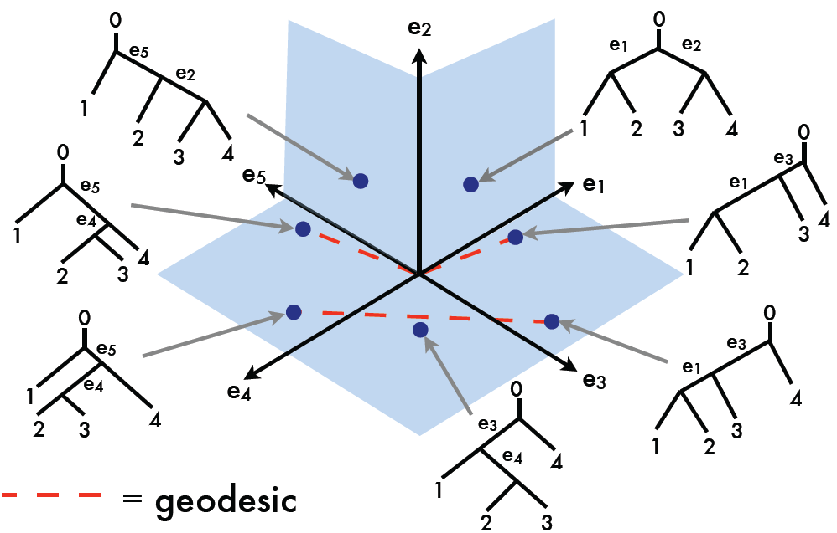
Geodesic Examples, T-4
Endpoints
In Same
Orthants
Thanks to Megan Owen

Slide 5
Geodesic Paths
  Given 2 trees,
  Shortest path between is called the
  geodesic
  Fast Computation (polynomial time):
Owen M &, Provan JS (2011)

Slide 6
Geodesics for Artery Trees
Summarize Lessons:
Very few Common Edges (only 5)
Most edges swap out
Edges get much shorter (bottom plot)
Recall this Later
# of edges roughly constant (middle plot)

Slide 7
Metric in Euclidean Orthant Space
Consequences of metric:
Useful for statistical analyses
Fréchet (Geodesic) Mean
Multi-Dimensional Scaling

Slide 8
Fréchet Mean
Given data:
Define:
Major Challenge in Euclidean Orthant Space:
Fast Computation
Because of combinatorial complexity

Slide 9
Sturm Algorithm
Raw Data
1st Sturm step
2nd Sturm step
3rd Sturm step
In Euclidean Space,
can show:
convergence to
in n-1 steps
X₁
X₂
X₃
X₄

Slide 10
Fréchet Mean in T-3
Can show: When no m_{i} is dominant
e₁
Geodesic mean = 0
the “Star Tree”
e₂ e₃

Slide 11
Fréchet Mean in T-3
Note: For no dominant m_{i}
Can “perturb P” and still have
Geodesic mean = 0
Very unusual behavior:
Not true in Euclidean space
(where mean “non-robust”)
(very sensitive to perturbations)
Phenomenon is called stickiness

Slide 12
Sturm Algorithm
Application to brain artery data:
Didn’t converge after 50,000 steps
How good was it?
So tree at origin (“star tree”) is best seen
Very consistent with stickiness at origin

Slide 13
Kernel Smoothing
Weighted (Running) Local Averages
Can find unexpected structure in data
E.g. Bralower Fossil data

Slide 14
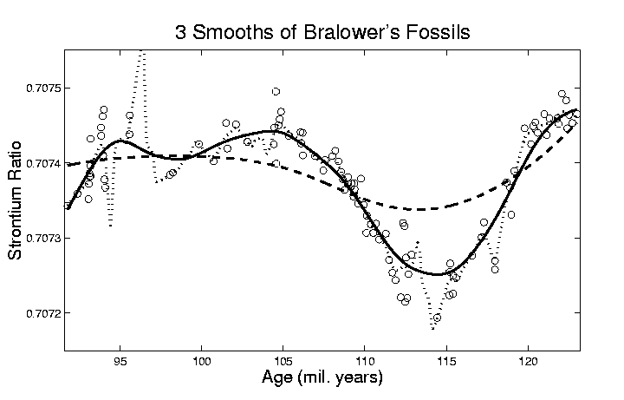
Kernel Smoothing

Slide 15
Kernel Smoothing
Weighted (Running) Local Averages
Can find unexpected structure in data
E.g. Bralower Fossil data
Window width is important issue

Slide 16
Euclidean Orthant Smoothing
Want (Running) Local Average
Given data
Can formulate Frechet local average:
Challenge: How to compute?

Slide 17
Euclidean Orthant Smoothing
Reach way back in smoothing history:
Tukey (1977) Exploratory Data Analysis
Box Plots
Pencil & Paper Smoothing
(Iterated Pairwise Smoothing)

Slide 18
Euclidean Orthant Smoothing
Application of Iterative Pairwise Smoothing
Idea: Use geodesic midpoint (avg of pair):
Level 1: S_{1,i} = avg(X_{i} , X_{i+1}) …
Level 2: S_{2,i} = avg(S_{1,i} , S_{1,i+1}) …
etc.
Thanks to Sean Skwerer

Slide 19
Euclidean Orthant Smoothing
First consider Level 2
Still small window width …

Slide 20
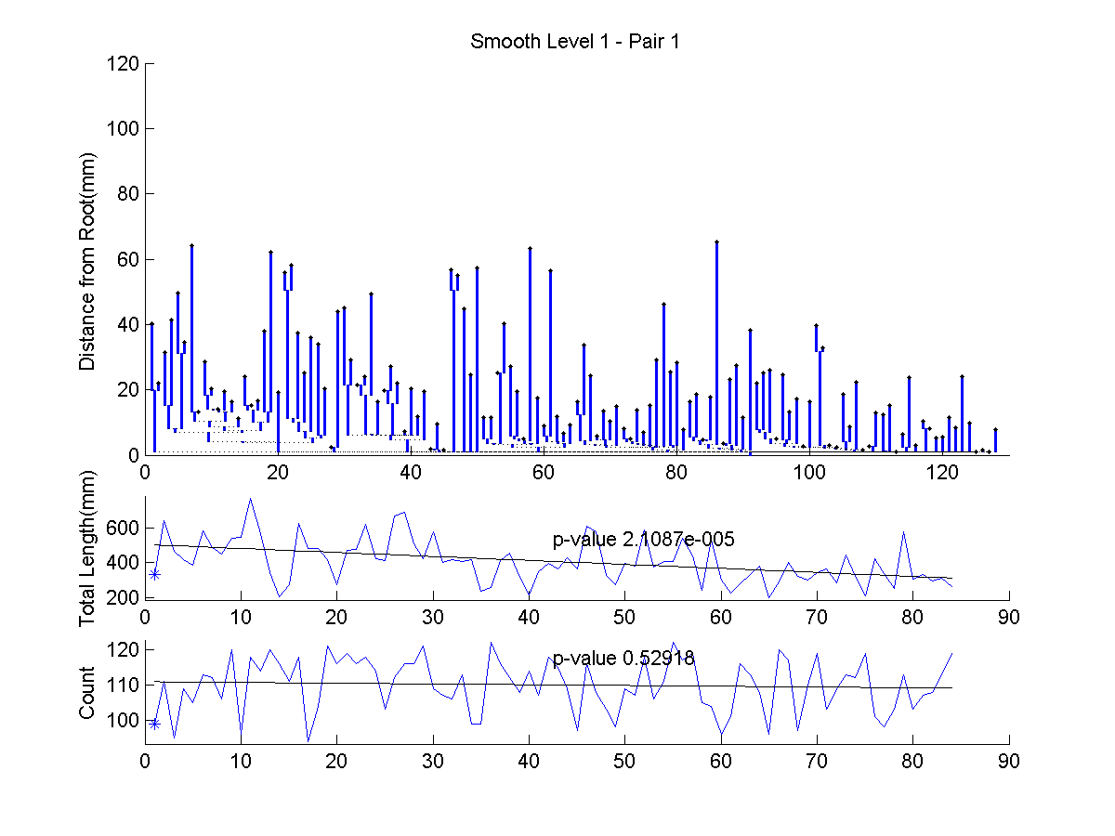
Euclidean Orthant Smoothing
Thanks to Sean Skwerer

Slide 21
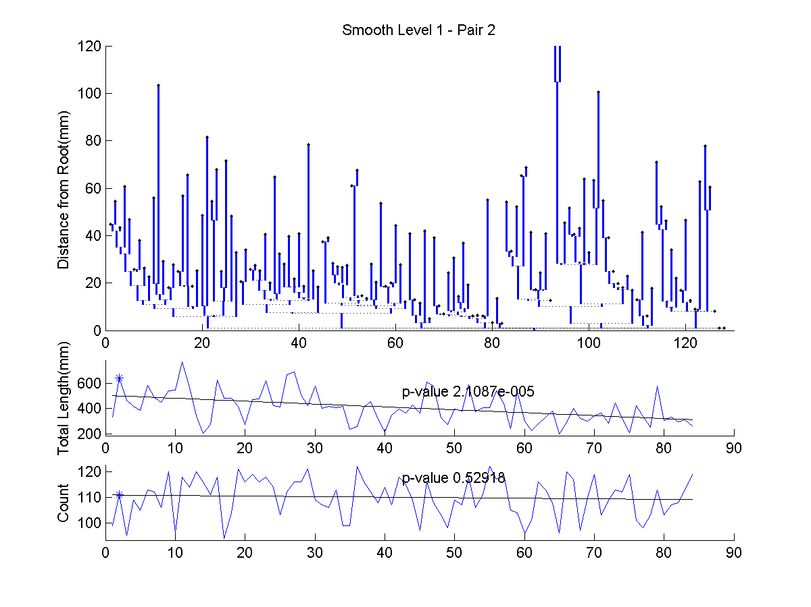
Euclidean Orthant Smoothing

Slide 22
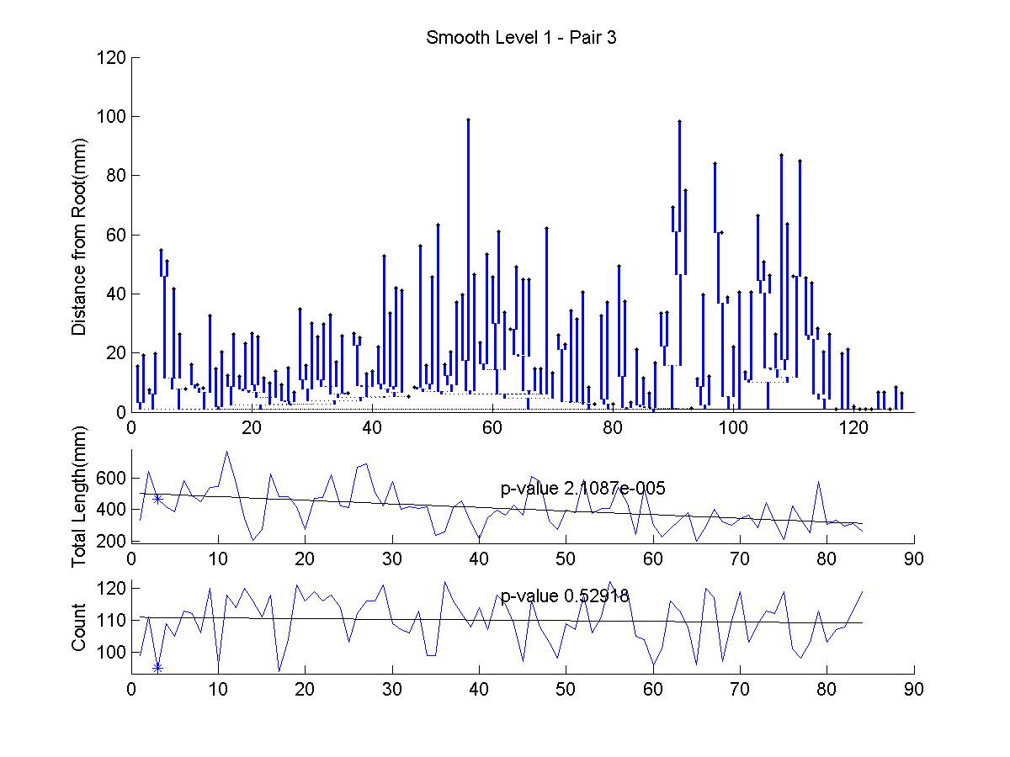
Euclidean Orthant Smoothing

Slide 23
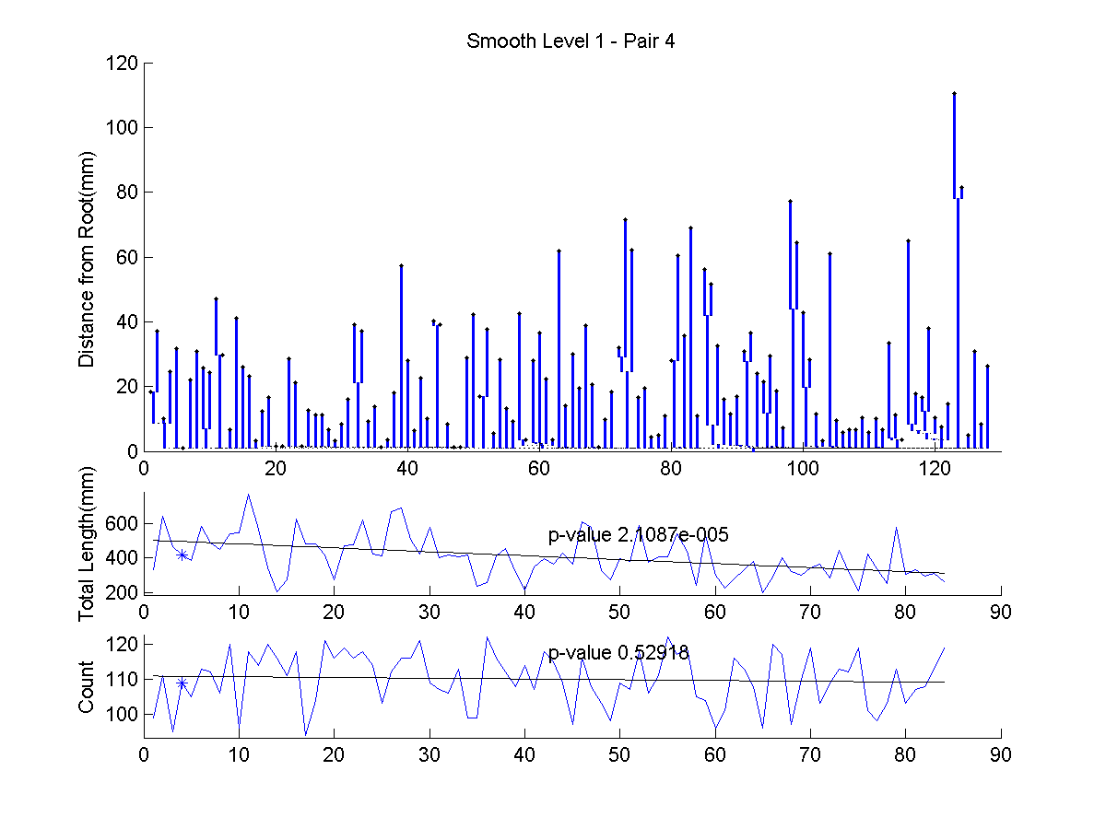
Euclidean Orthant Smoothing

Slide 24
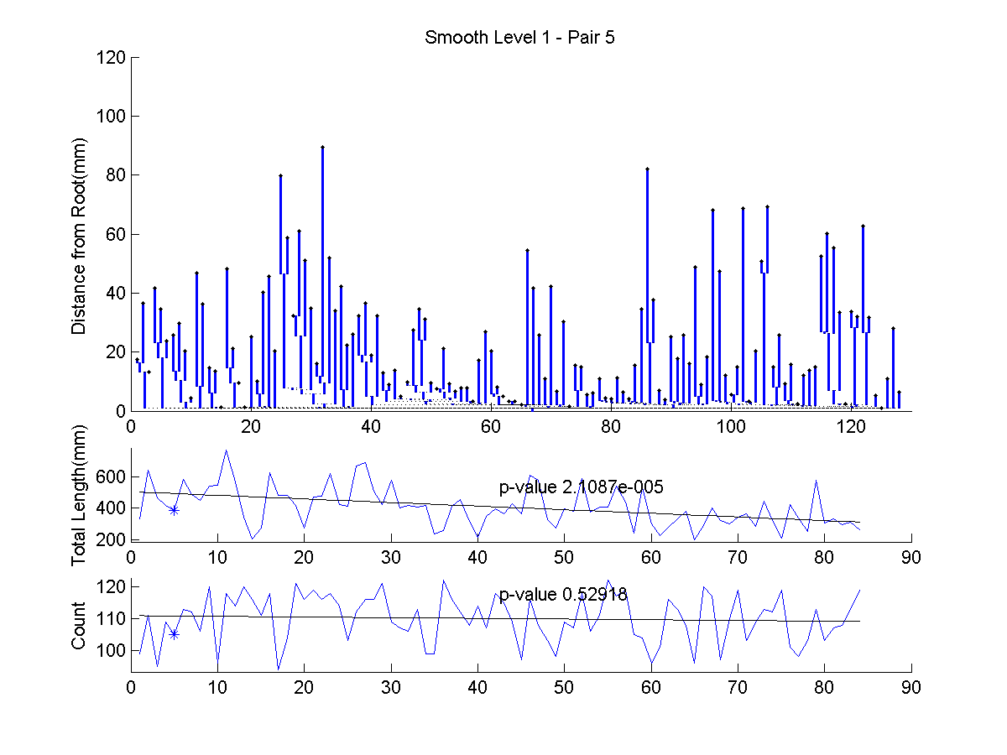
Euclidean Orthant Smoothing

Slide 25
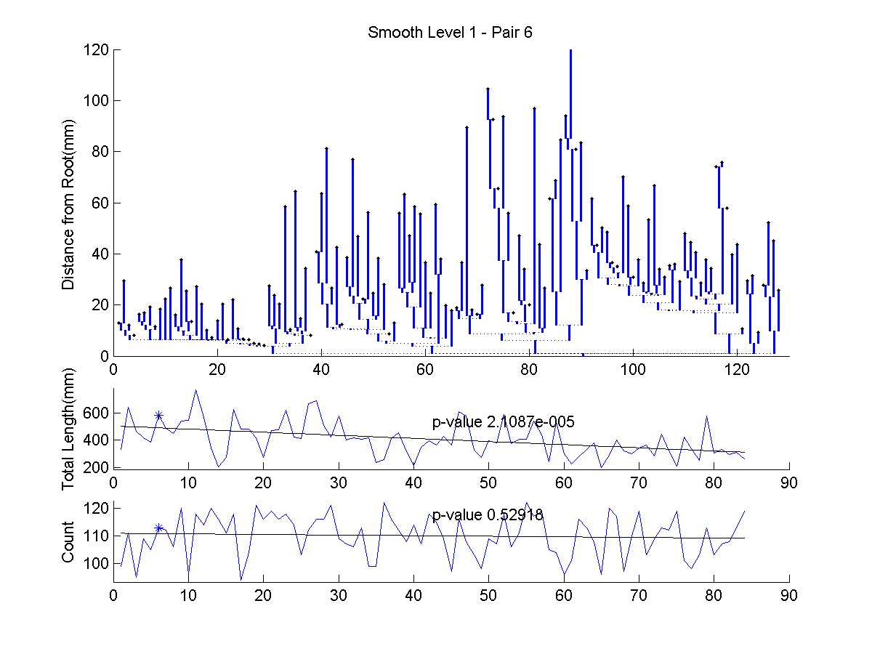
Euclidean Orthant Smoothing

Slide 26
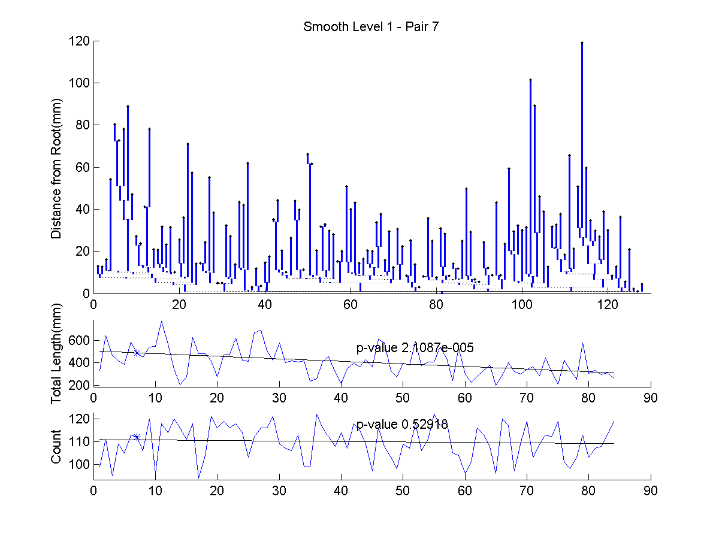
Euclidean Orthant Smoothing

Slide 27
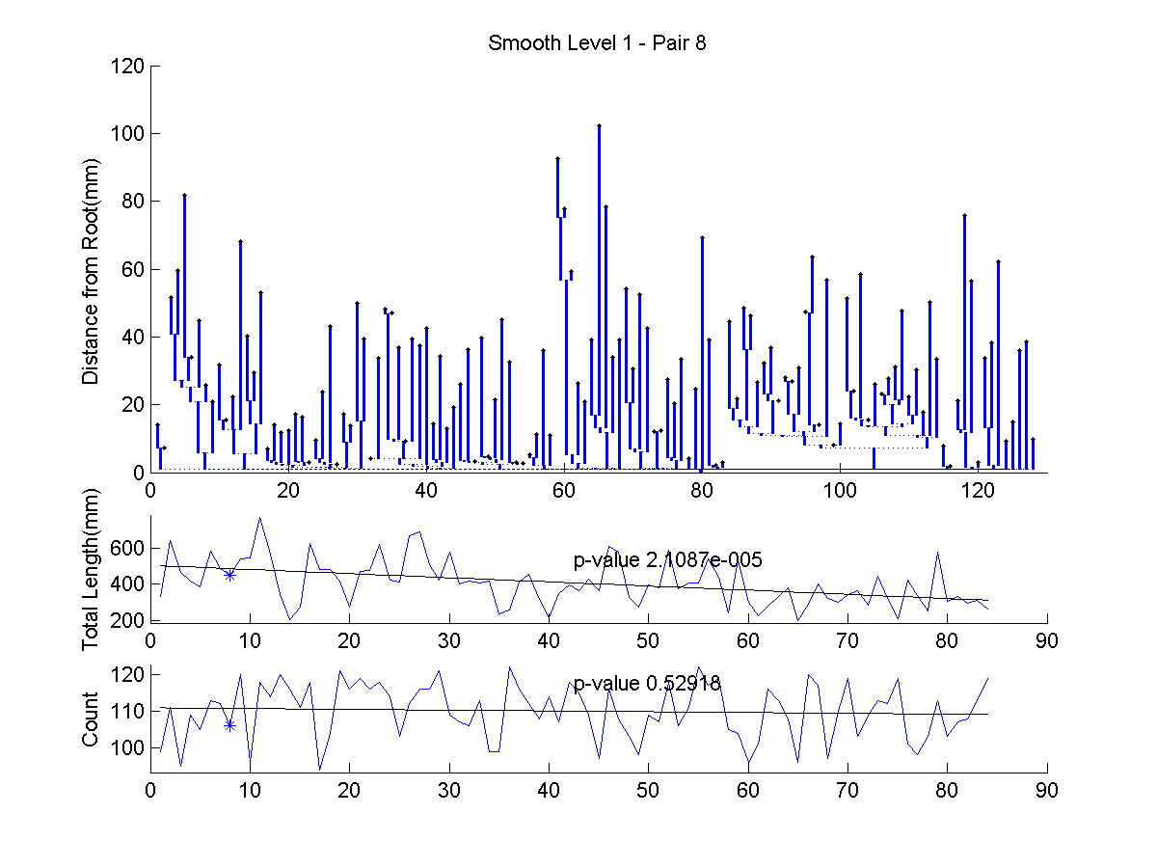
Euclidean Orthant Smoothing

Slide 28
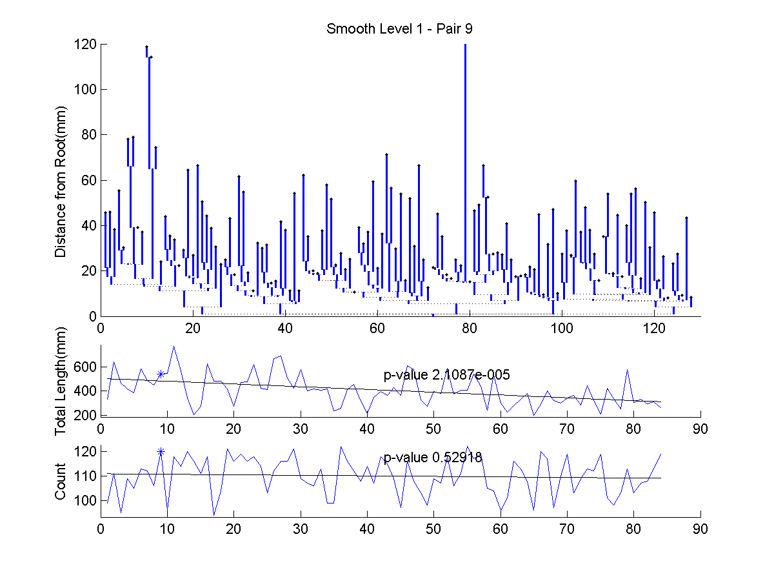
Euclidean Orthant Smoothing

Slide 29
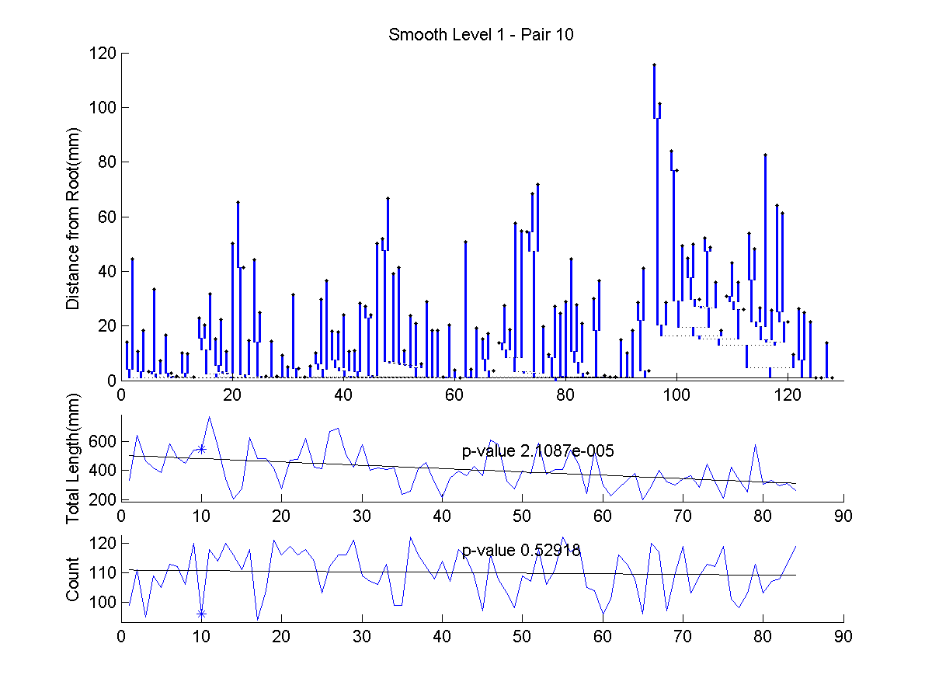
Euclidean Orthant Smoothing

Slide 30
Euclidean Orthant Smoothing
First consider Level 2
Still small window width,
Looks “pretty rough”
Try more smoothing (deeper level)

Slide 31
Euclidean Orthant Smoothing
Next try Level 15
Much bigger window width,

Slide 32
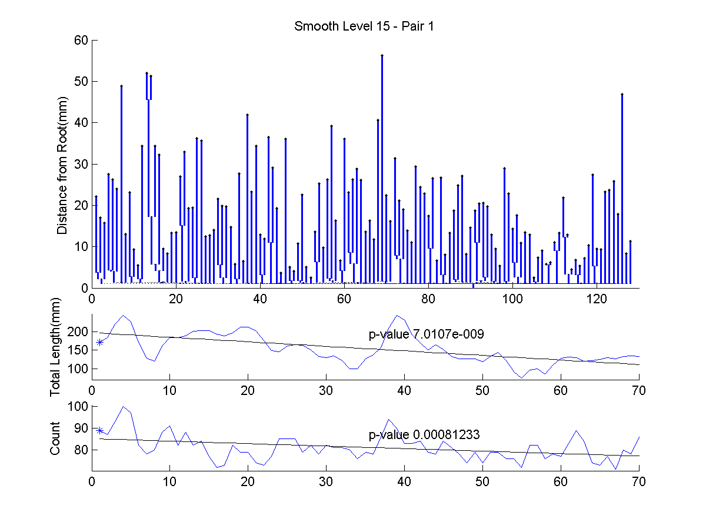
Euclidean Orthant Smoothing

Slide 33
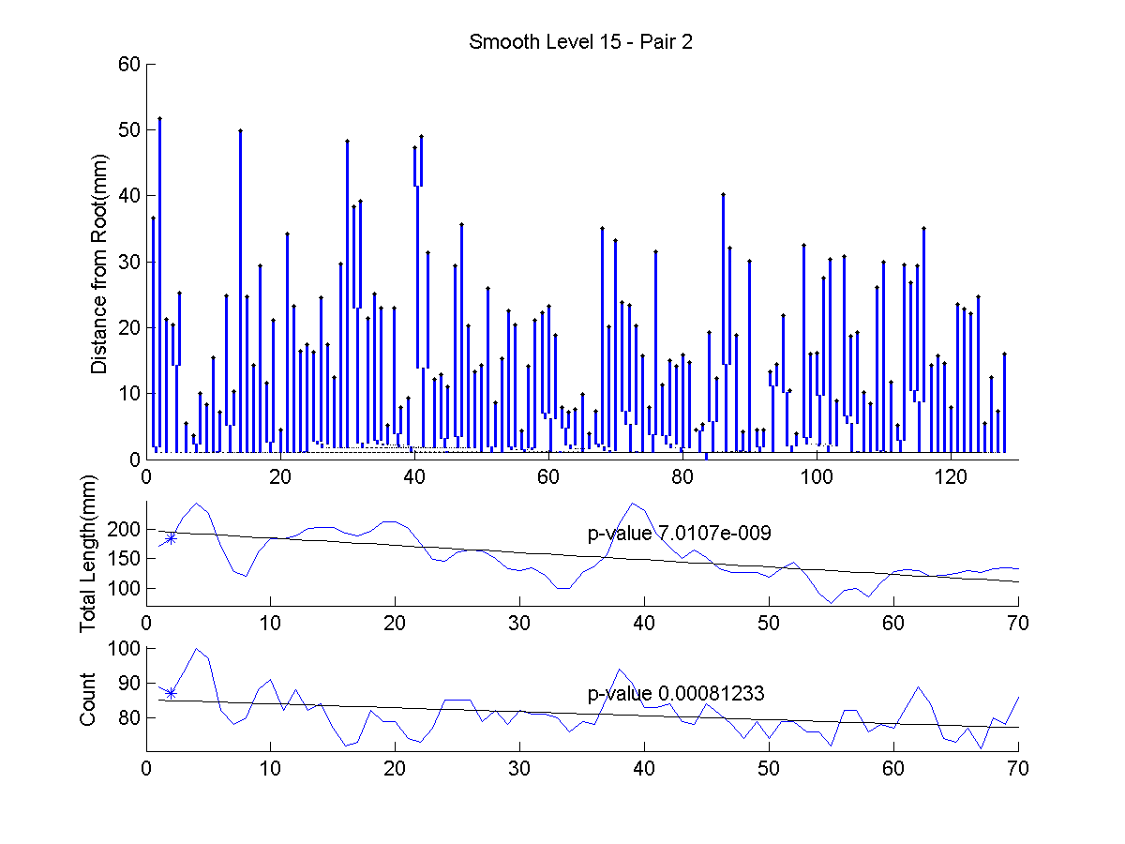
Euclidean Orthant Smoothing

Slide 34
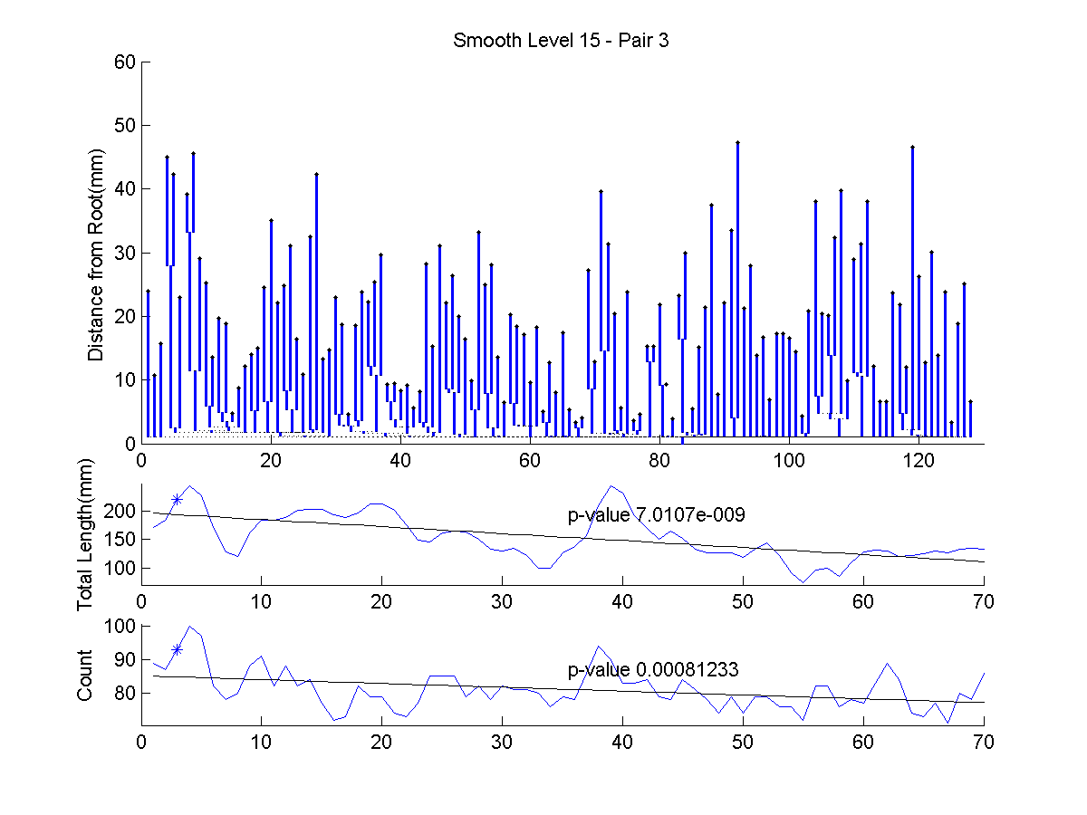
Euclidean Orthant Smoothing

Slide 35
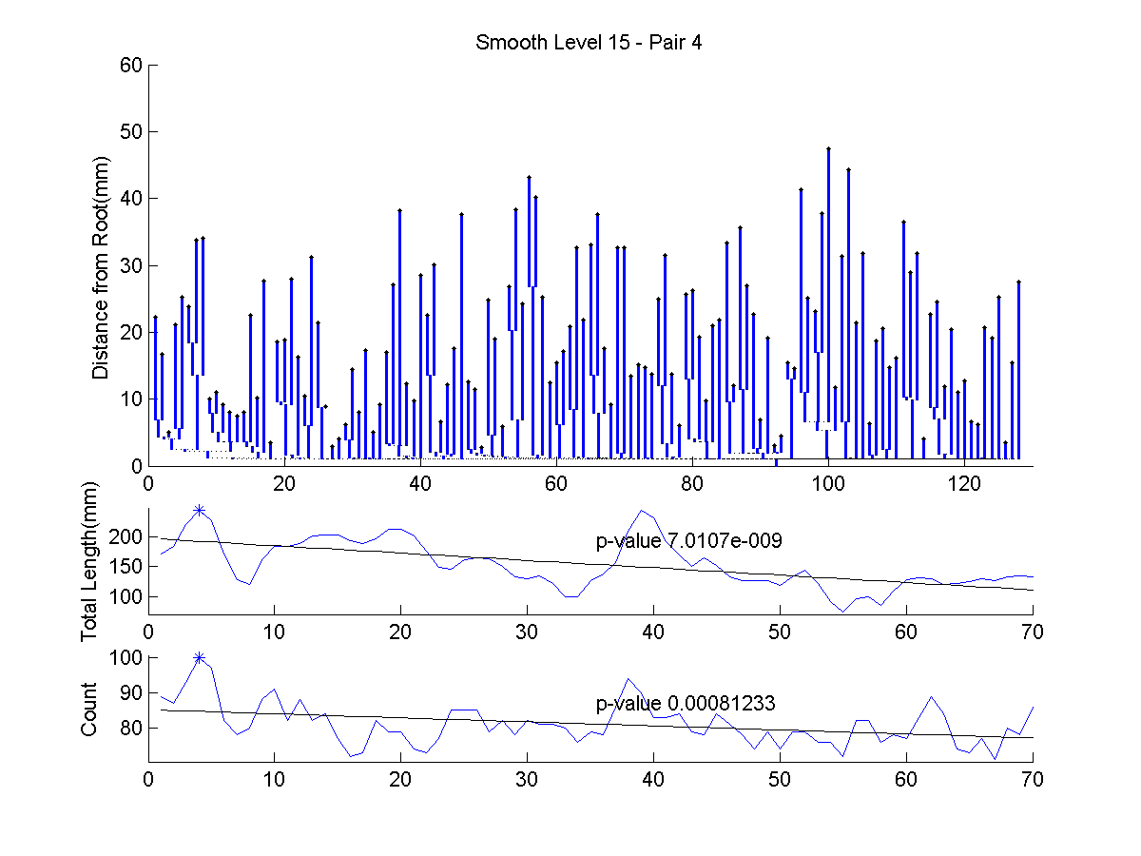
Euclidean Orthant Smoothing

Slide 36
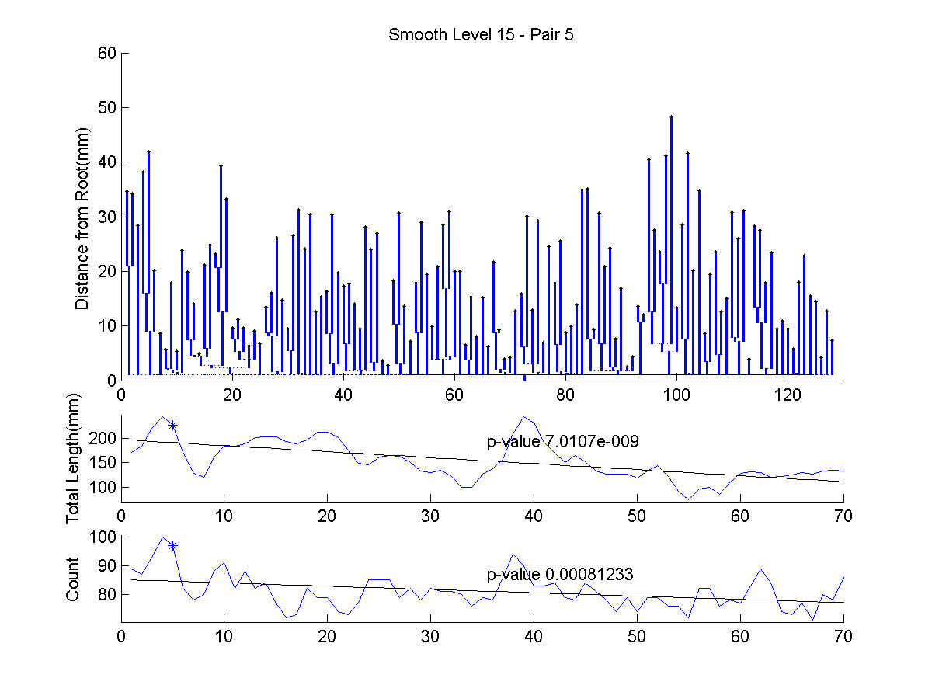
Euclidean Orthant Smoothing

Slide 37
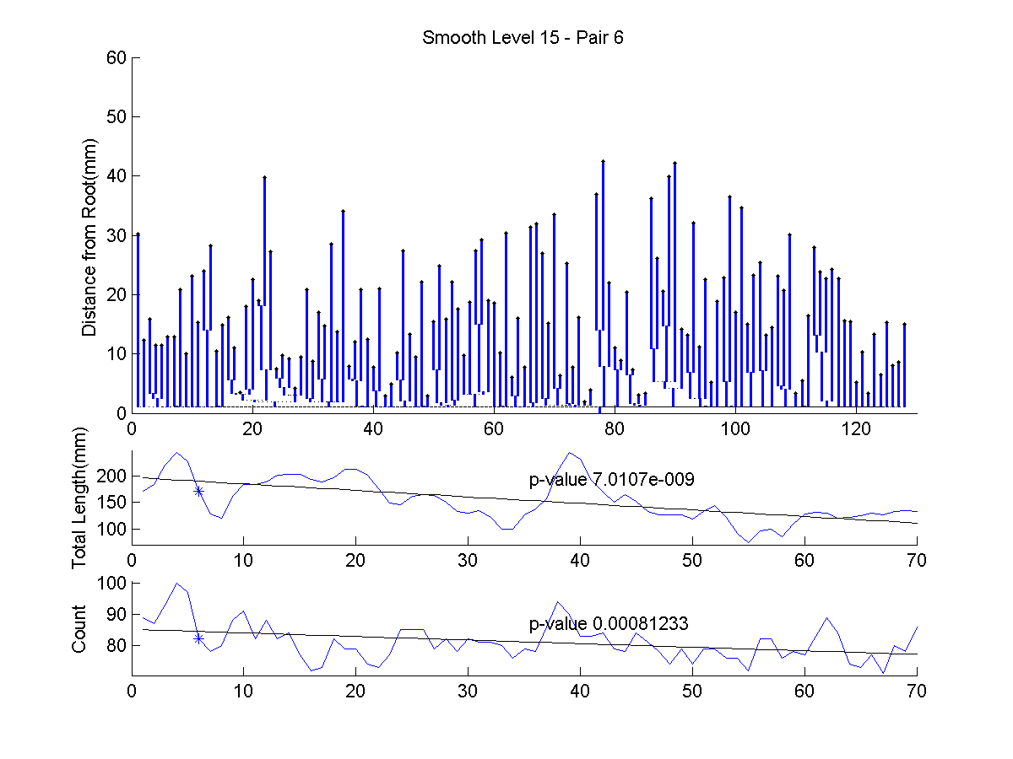
Euclidean Orthant Smoothing

Slide 38
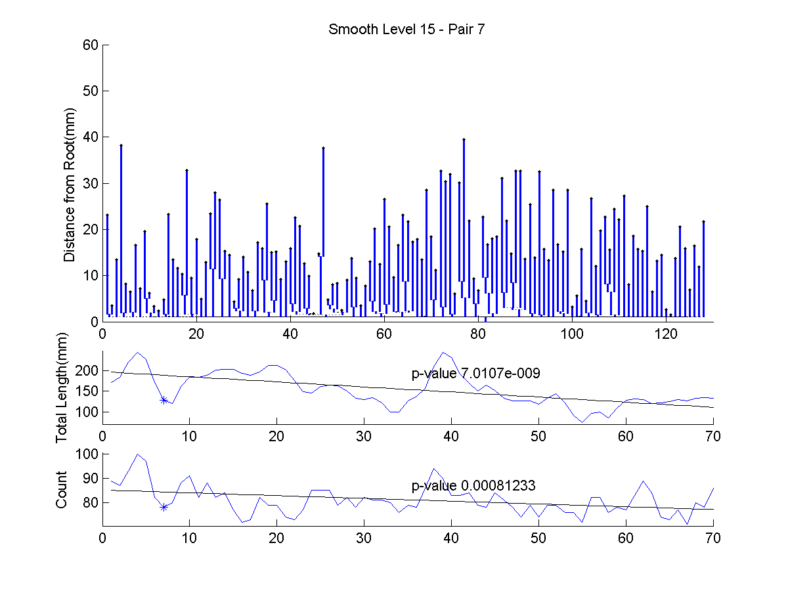
Euclidean Orthant Smoothing

Slide 39
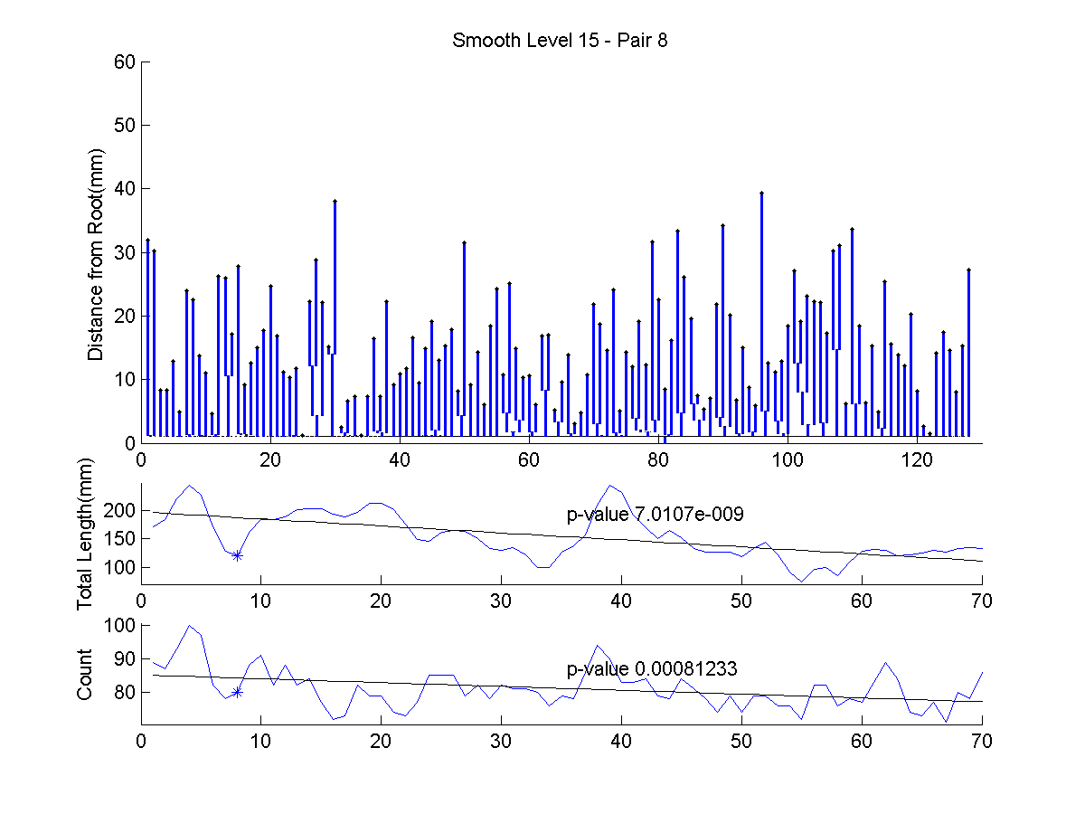
Euclidean Orthant Smoothing

Slide 40
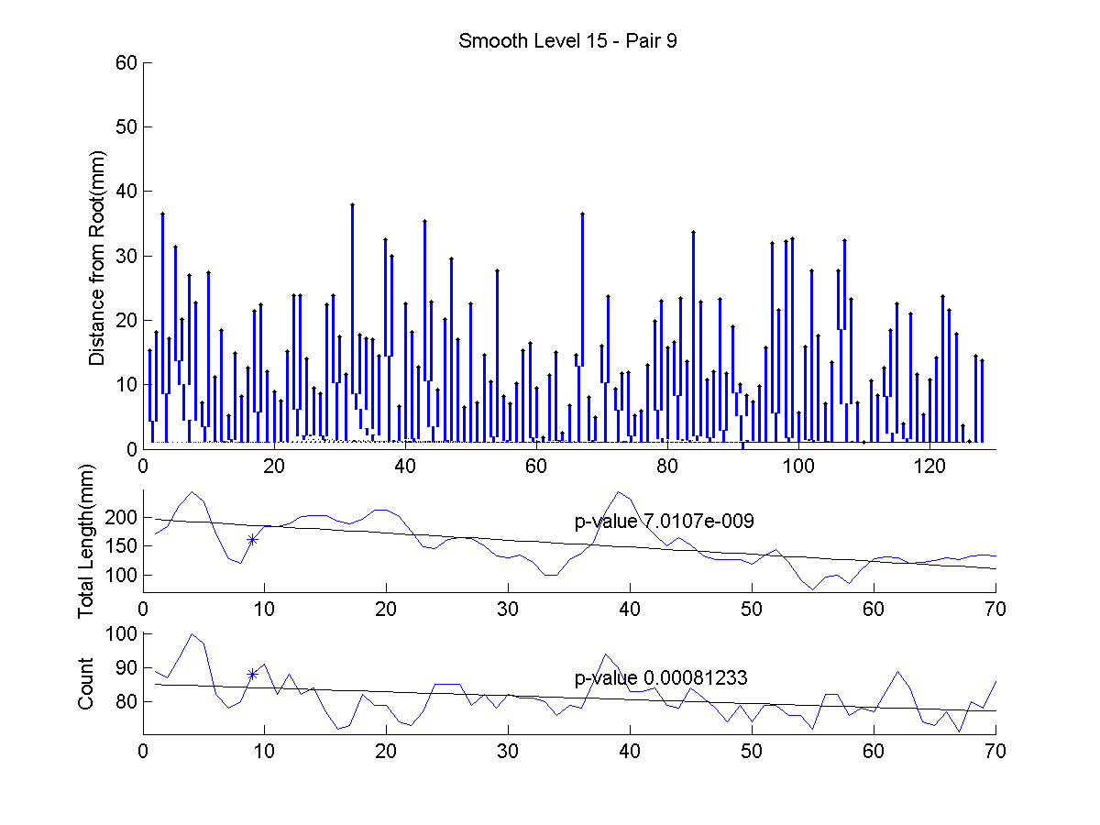
Euclidean Orthant Smoothing

Slide 41
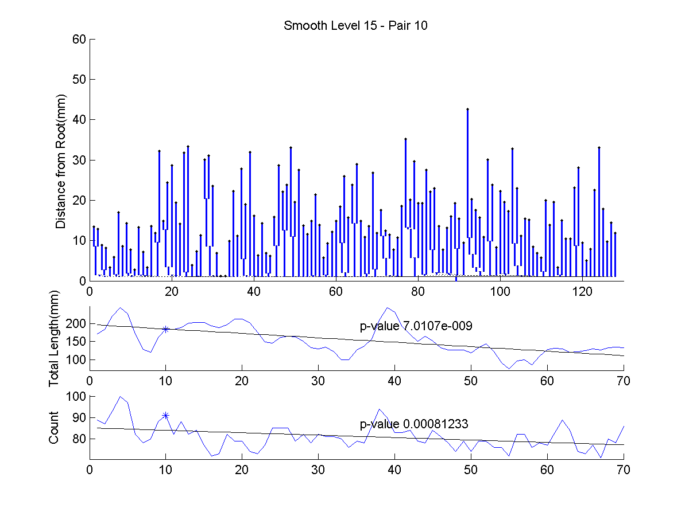
Euclidean Orthant Smoothing

Slide 42
Euclidean Orthant Smoothing
Next try Level 15
Much bigger window width,
Everything smoother?
Closer to Star Tree? (recall stickiness)
Stronger connection to age

Slide 43
Multi-Dimensional Scaling
Idea: Variation of PCA
Not based on covariance matrix
Torgerson (1952)
Kruskal (1964)

Slide 44
Multi-Dimensional Scaling
Idea: Variation of PCA
Not based on covariance matrix
Instead on Pairwise distances
Solves STRAIN optimization problem

Slide 45
Multi-Dimensional Scaling
Idea: Variation of PCA
Not based on covariance matrix
Instead on Pairwise distances
Solves STRAIN optimization problem
Works on any metric space
(Actually only need Similarity Matrix)

Slide 46
Multi-Dimensional Scaling
Idea: Variation of PCA
Not based on covariance matrix
Instead on Pairwise distances
Solves STRAIN optimization problem
Works on any metric space
Matrix of Euclidean Distances → PCA

Slide 47
Multi-Dimensional Scaling
Application: Brain Artery Trees
Pairwise Geodesic Distances
Color code for age (as before)
Displays distribution
Include Star tree (best guess at mean)

Slide 48
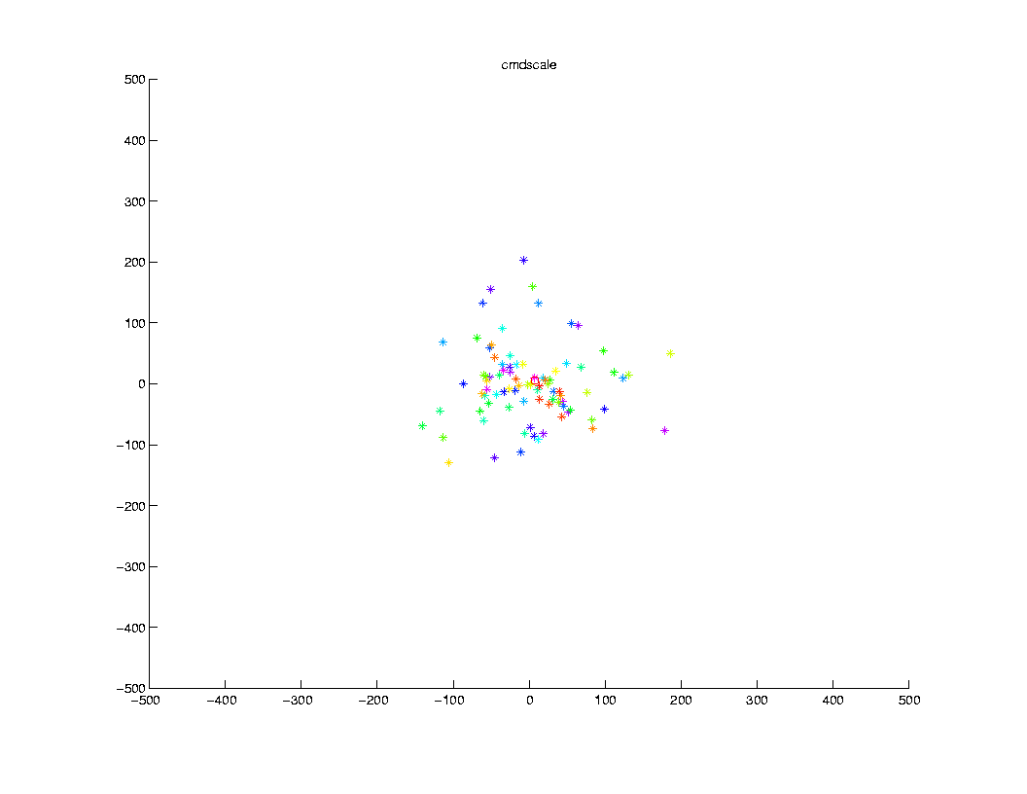
Multi-Dimensional Scaling

Slide 49
Multi-Dimensional Scaling
Shows variation
Not easy to interpret
Star Tree near center
Next study curvature of space

Slide 50
Multi-Dimensional Scaling
Next study curvature of space

Slide 51
Multi-Dimensional Scaling
Next study curvature of space, by:
Adding points into MDS

Slide 52
Multi-Dimensional Scaling
Next study curvature of space, by:
Adding points into MDS
That lie along triangle
Equally spaced along 3 geodesics
Between triple of data points

Slide 53
Multi-Dimensional Scaling
Next study curvature of space, by:
Adding points into MDS
That lie along triangle
Equally spaced along 3 geodesics
Between triple of data points
Choose triple as “median curvature”

Slide 54
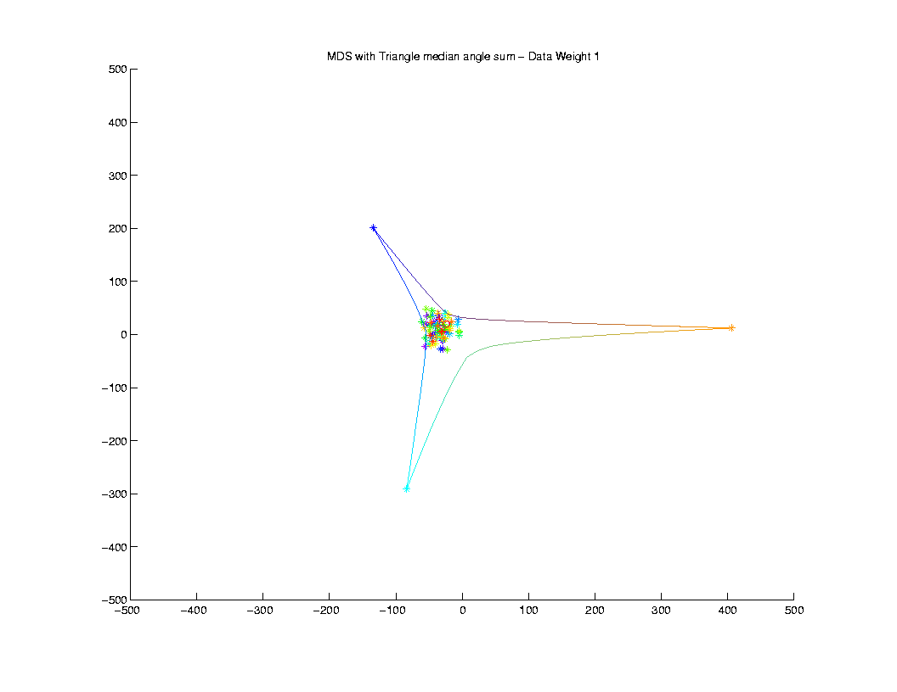
Multi-Dimensional Scaling
Thanks to Sean Skwerer

Slide 55
Multi-Dimensional Scaling
Adding Triangle gives triple more weight
So they take over MDS directions
Triangle shows negative curvature
Angle Sum << 180º
Recall on Sphere: Angle Sum > 180º
(Positive Curvature)

Slide 56
Multi-Dimensional Scaling
Adding Triangle gives triple more weight
So they take over MDS directions
Triangle shows negative curvature
Consistent with Euclidean Orthant Space

Slide 57
Multi-Dimensional Scaling
Adding Triangle gives triple more weight
So they take over MDS directions
Triangle shows negative curvature
Consistent with Euclidean Orthant Space
Next try adding more weight to other points

Slide 58
Multi-Dimensional Scaling

Slide 59
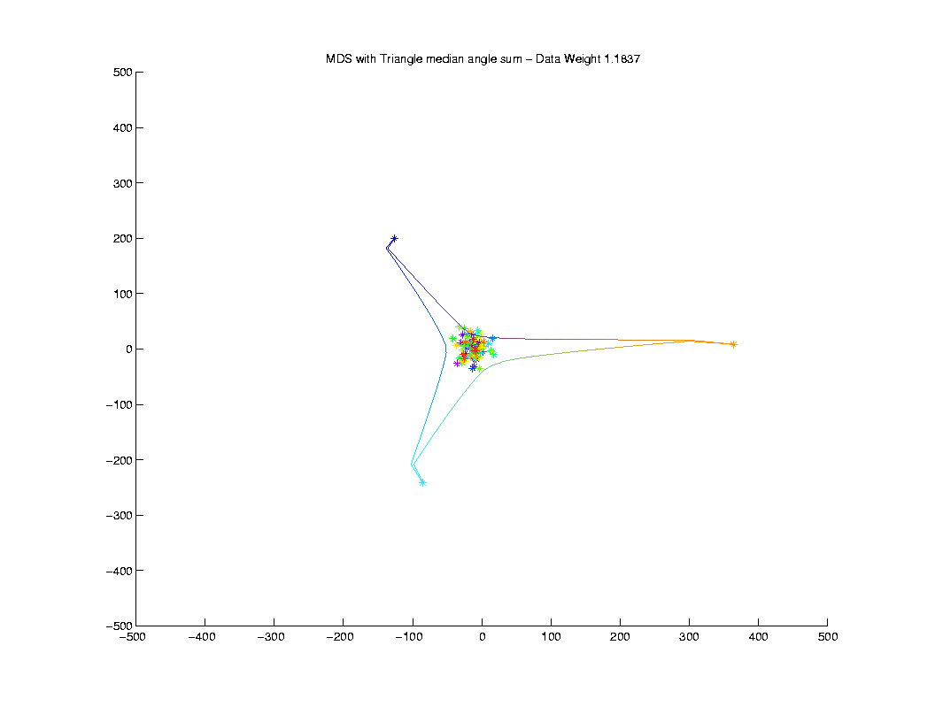
Multi-Dimensional Scaling

Slide 60
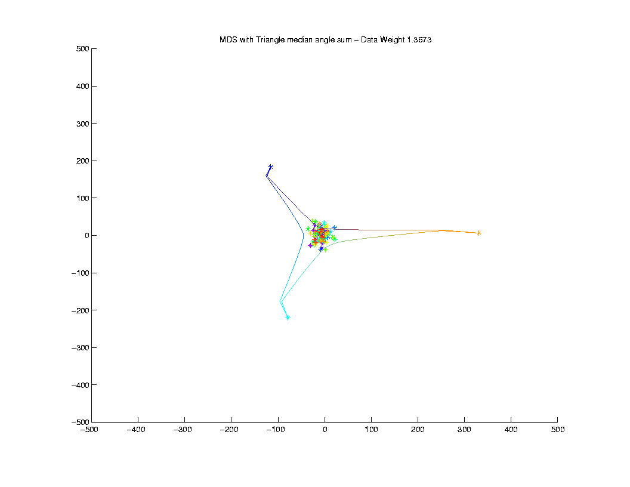
Multi-Dimensional Scaling

Slide 61
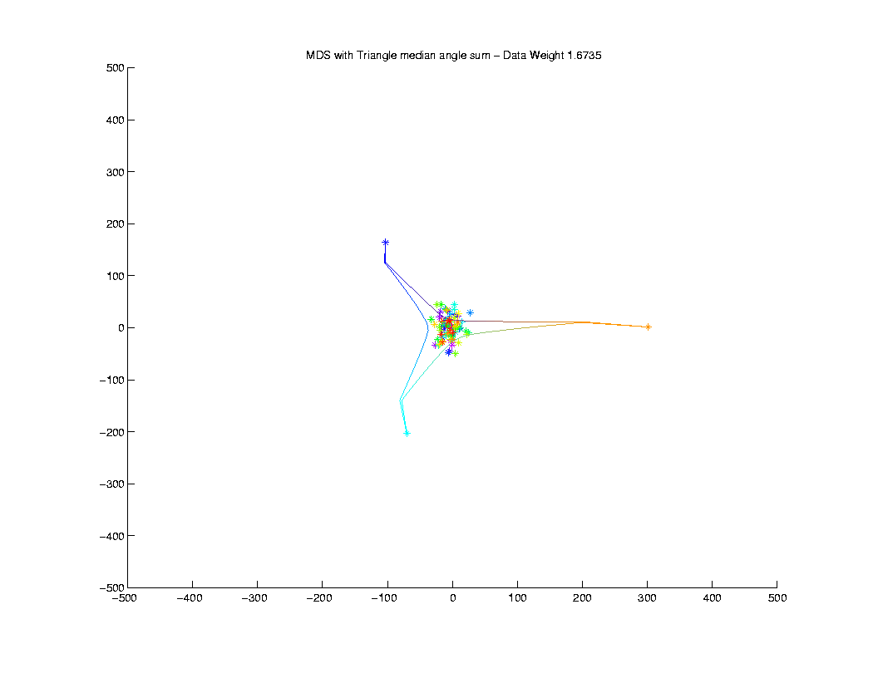
Multi-Dimensional Scaling

Slide 62
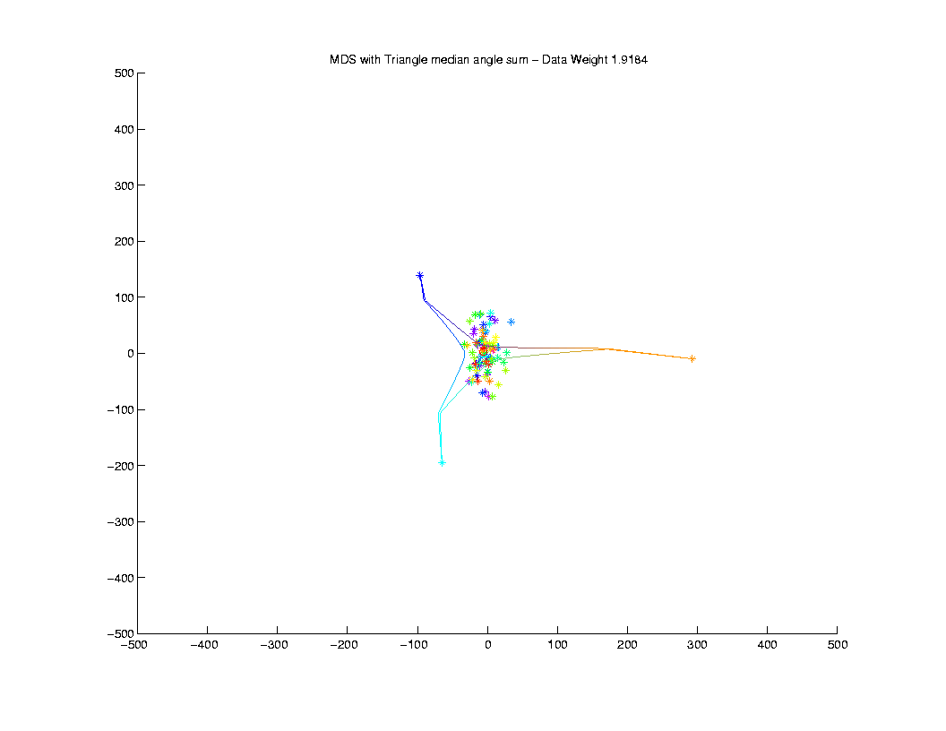
Multi-Dimensional Scaling

Slide 63
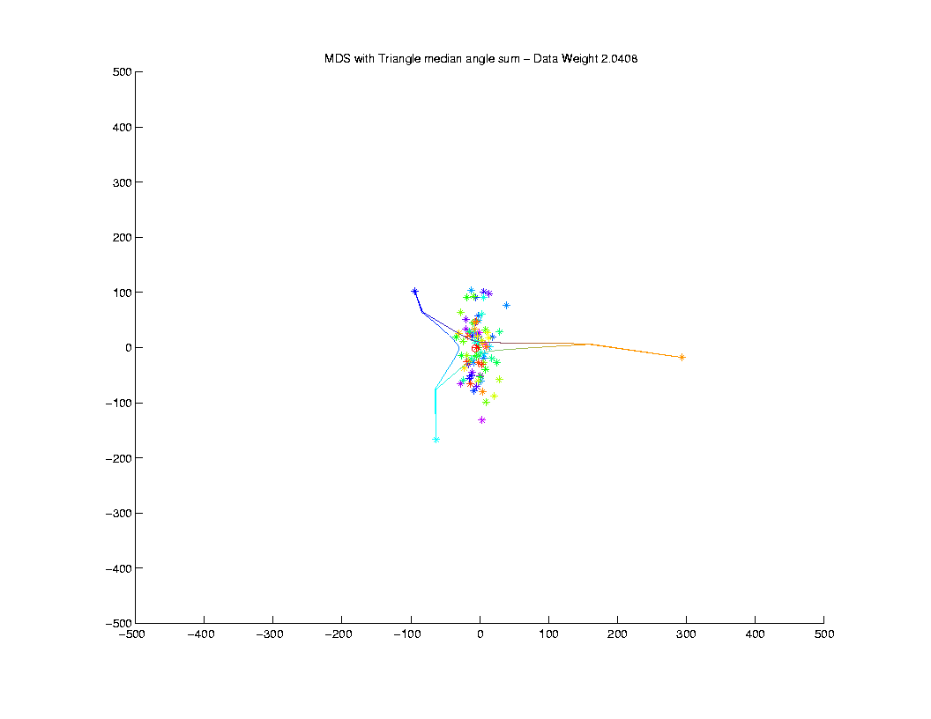
Multi-Dimensional Scaling

Slide 64
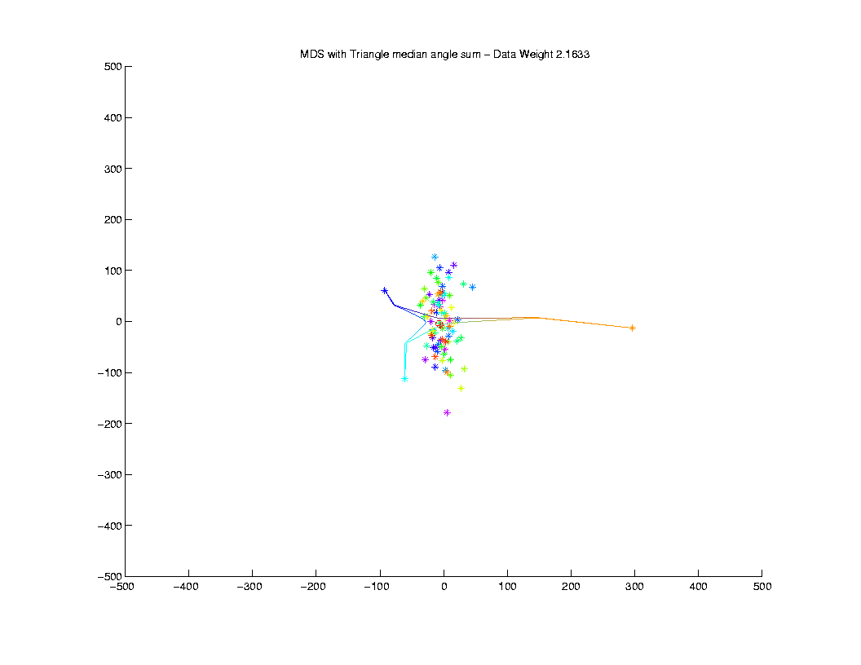
Multi-Dimensional Scaling

Slide 65
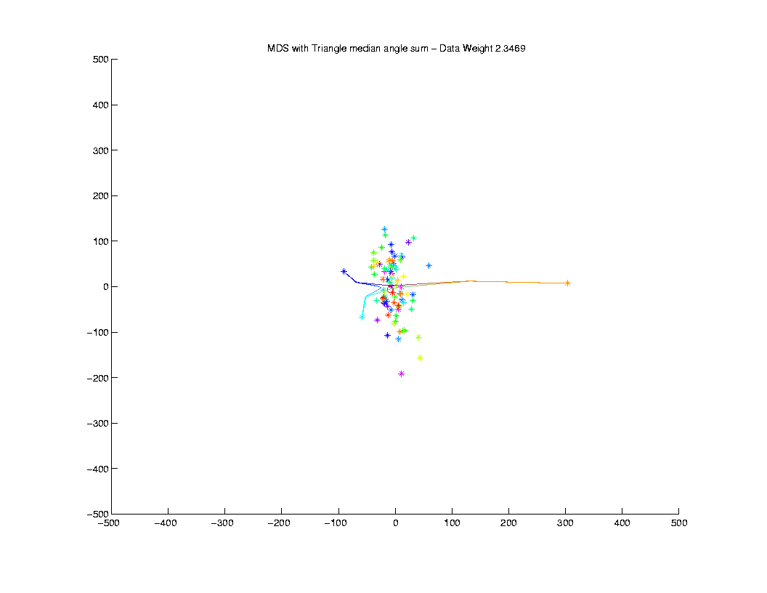
Multi-Dimensional Scaling

Slide 66
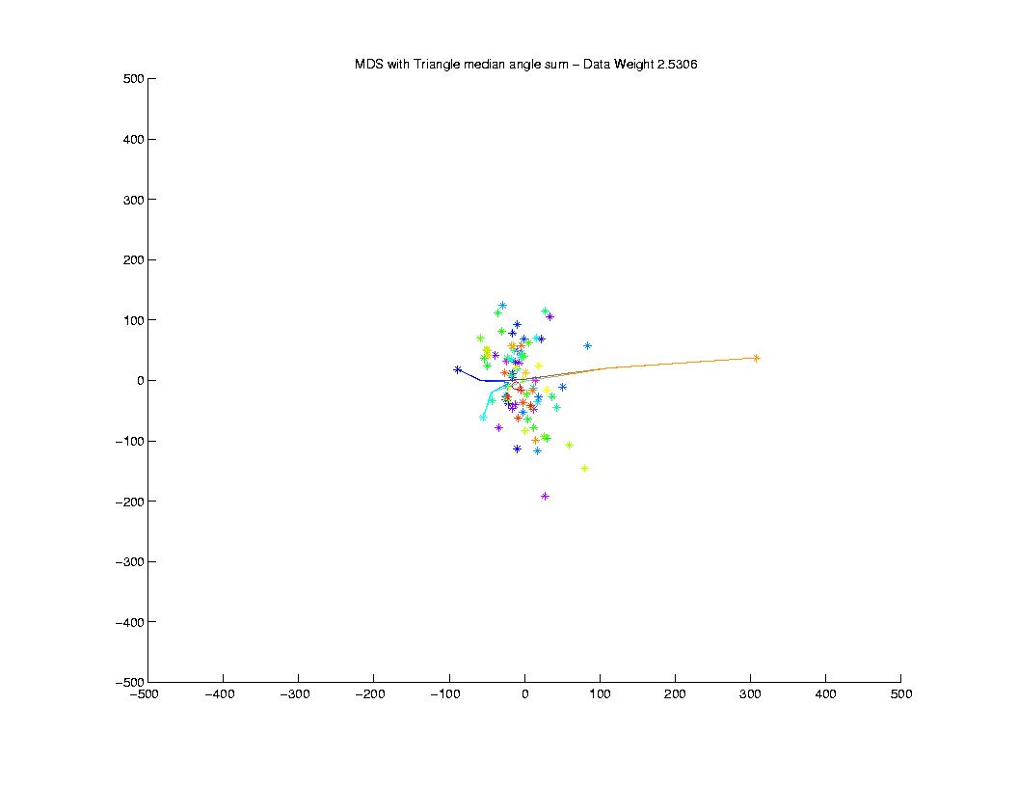
Multi-Dimensional Scaling

Slide 67
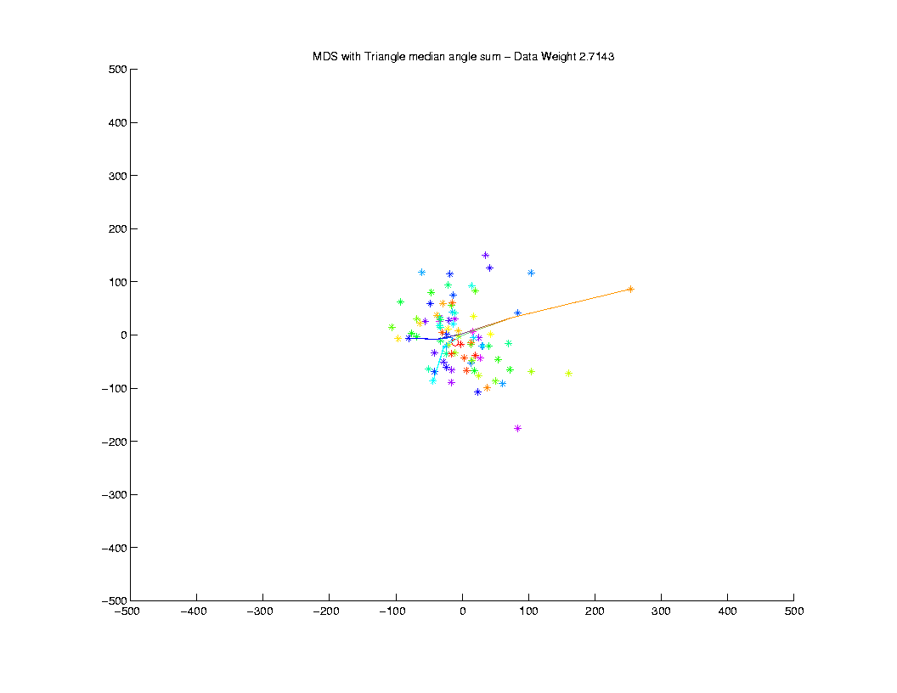
Multi-Dimensional Scaling

Slide 68
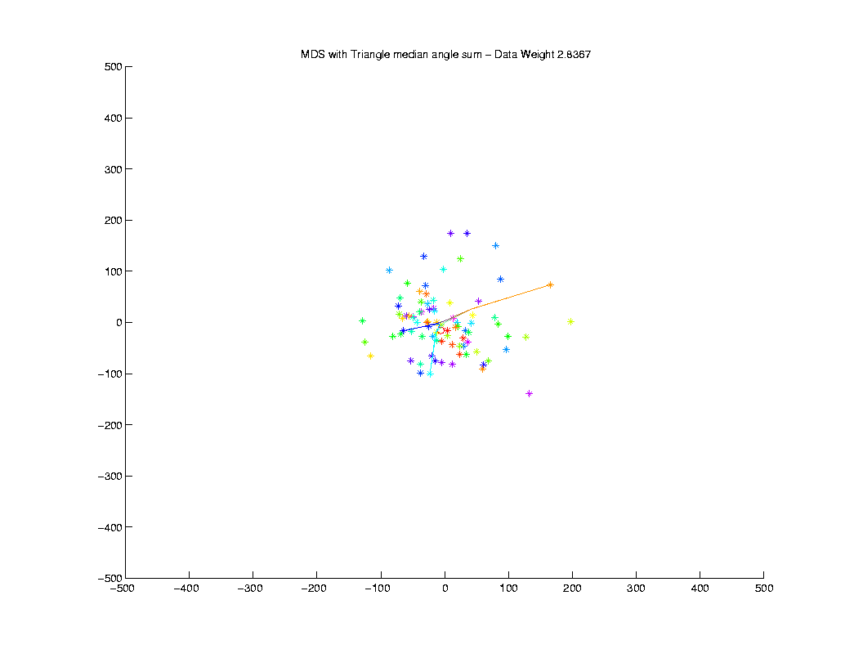
Multi-Dimensional Scaling

Slide 69
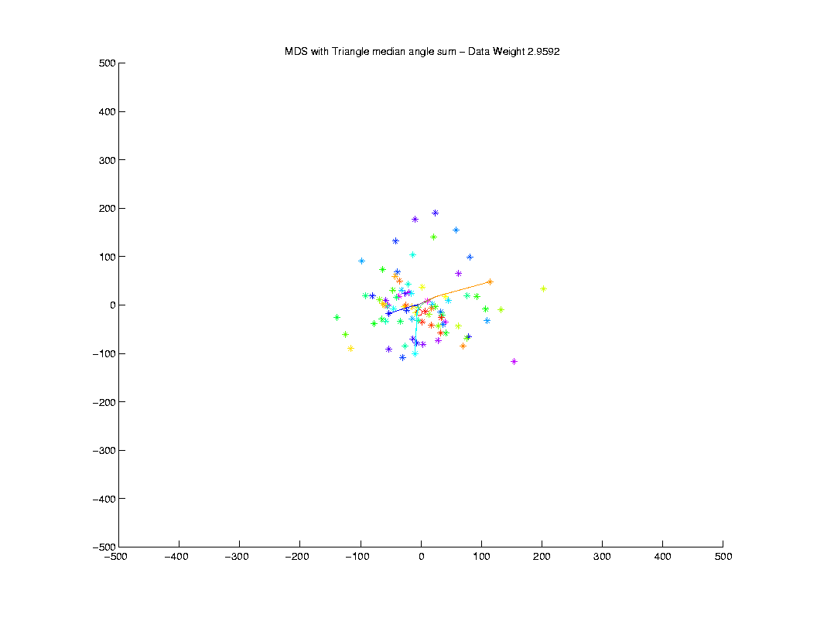
Multi-Dimensional Scaling

Slide 70
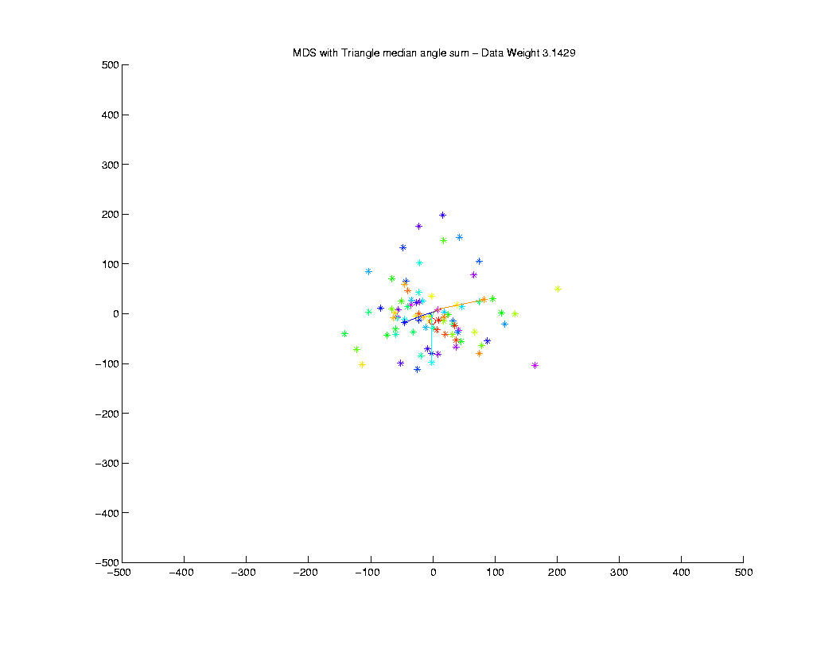
Multi-Dimensional Scaling

Slide 71
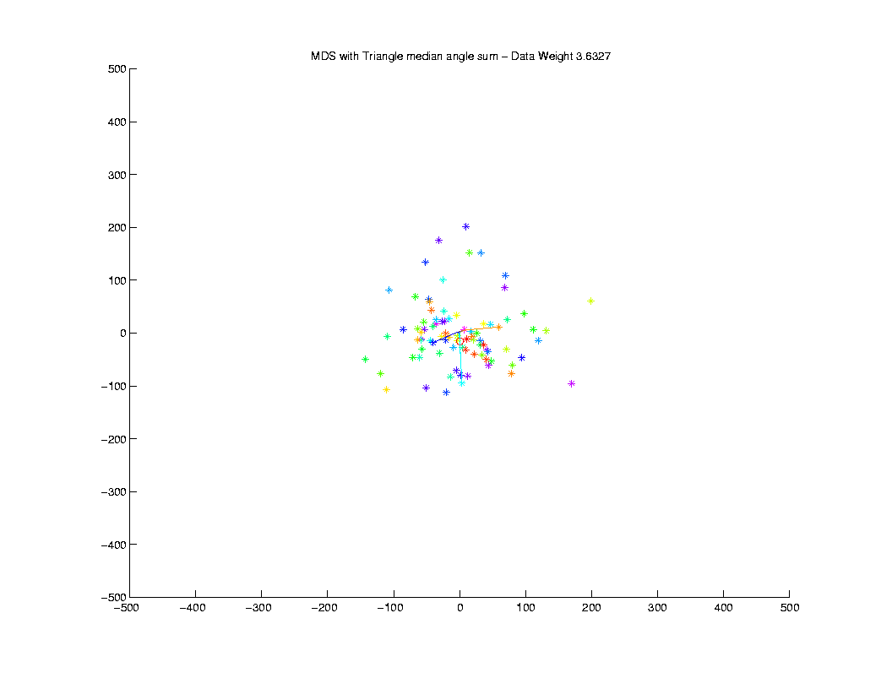
Multi-Dimensional Scaling

Slide 72

Multi-Dimensional Scaling

Slide 73
Multi-Dimensional Scaling

Slide 74
Multi-Dimensional Scaling
Now explore other triangles
With differing “local curvature”
Determined by angle sums
(recall 180º in Euclidean space)
Min angle sum

Slide 75
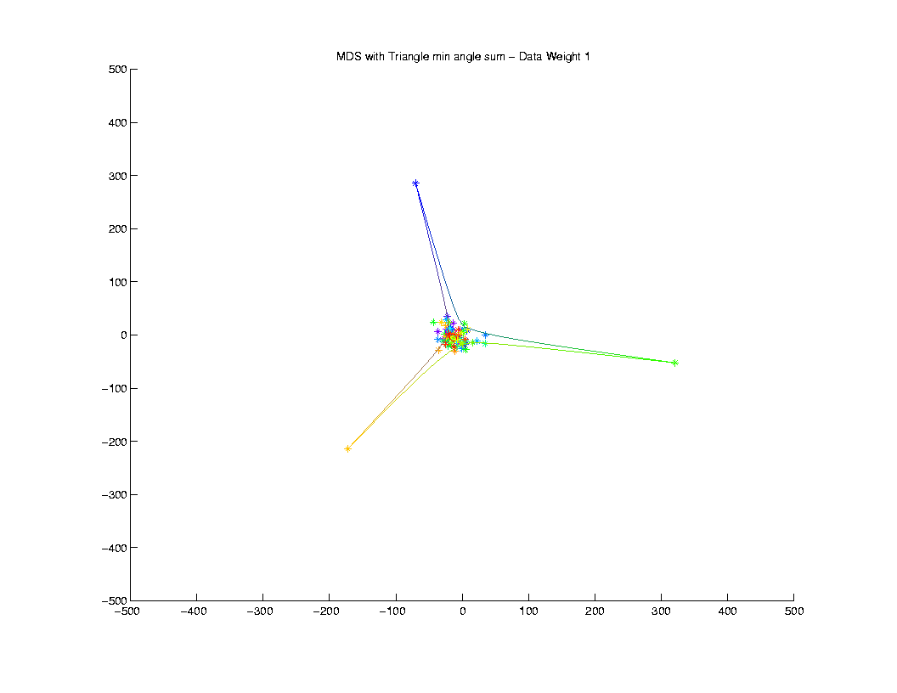
Multi-Dimensional Scaling
Very
Small
Angle
Sum

Slide 76
Multi-Dimensional Scaling
Now explore other triangles
With differing “local curvature”
Determined by angle sums
(recall 180º in Euclidean space)
Min angle sum
Median angle sum

Slide 77
Multi-Dimensional Scaling
Pretty
Small
Angle
Sum

Slide 78
Multi-Dimensional Scaling
Now explore other triangles
With differing “local curvature”
Determined by angle sums
(recall 180º in Euclidean space)
Min angle sum
Median angle sum
Max angle sum

Slide 79
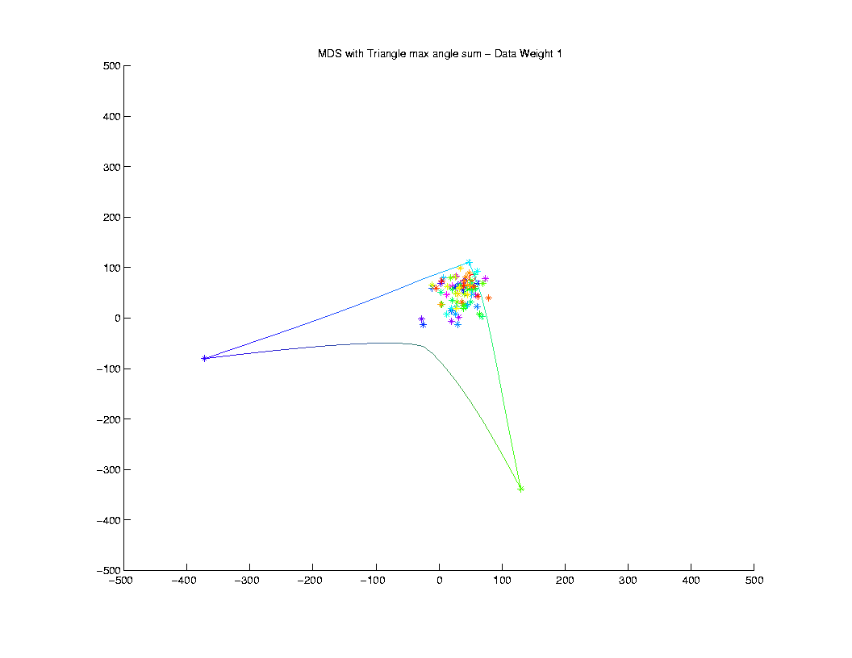
Multi-Dimensional Scaling
Largest
Angle
Sum???

Slide 80
Euclidean Orthant Approach
Next tasks: Statistical Analysis, e.g.
  Calculation of Mean
(No Closed Form,
Apparently Reasonable
Sturm + Gradient Descent,
Sean Skwerer)

Slide 81
Euclidean Orthant Approach
Next tasks: Statistical Analysis, e.g.
  Calculation of Mean
  PCA (“Backwards” approach???)

Slide 82
Euclidean Orthant Approach
Next tasks: Statistical Analysis, e.g.
  Calculation of Mean
  PCA (“Backwards” approach???)
  Classification (“linear method” ???)
(Analog of SVM & DWD?)

Slide 83
Euclidean Orthant Approach
Next tasks: Statistical Analysis, e.g.
  Calculation of Mean
  PCA (“Backwards” approach???)
  Classification (“linear method” ???)
Work in Progress
  Heavy & Specialized Optimization

Slide 84
Concept to Watch
Manifold Stratified Spaces

Slide 85
Concept to Watch
Manifold Stratified Spaces
People (in Statistics):
Vic Patrangenaru, Statistics, Florida S. U.
Ezra Miller, Mathematics, Duke U.
Stephan Huckemann, U. Göttingen

Slide 86
Concept to Watch
Manifold Stratified Spaces
People (in Statistics):
Vic Patrangenaru, Statistics, Florida S. U.
Ezra Miller, Mathematics, Duke U.
Stephan Huckemann, U. Göttingen
More Precise Mathematics:
“Whitney Stratification”

Slide 87
Concept to Watch
Manifold Stratified Spaces
Idea:
Manifolds of Different Dimension
i. e. “Strata”
Glued Together

Slide 88
Concept to Watch
Manifold Stratified Spaces
Example 1: Phylogenetic Trees
Orthants = Highest Dim’al Strata

Slide 89
Concept to Watch
Manifold Stratified Spaces
Example 1: Phylogenetic Trees
Orthants = Highest Dim’al Strata
Glued at Edges

Slide 90
Concept to Watch
Manifold Stratified Spaces
Example 1: Phylogenetic Trees
Orthants = Highest Dim’al Strata
Glued at Edges
Edges are Lower Dim’al Strata

Slide 91
Concept to Watch
Manifold Stratified Spaces
Example 1: Phylogenetic Trees
Orthants = Highest Dim’al Strata
Glued at Edges
Edges are Lower Dim’al Strata
{Star Tree} = 0 Dim’al Stratum

Slide 92
Concept to Watch
Manifold Stratified Spaces
Example 2: Covariance Matrices
As Data Objects
e.g. Diffusion Tensor Imaging

Slide 93
Concept to Watch
Manifold Stratified Spaces
Example 2: Covariance Matrices
{Pos. Def.} = Highest Dim’al Stratum
(Manifold is “Right Way” to Handle
Non-Negative Definiteness)

Slide 94
Concept to Watch
Manifold Stratified Spaces
Example 2: Covariance Matrices
{Pos. Def.} = Highest Dim’al Stratum
{k non-0 E.V.s} Lower Dim’al Strata

Slide 95
Concept to Watch
Manifold Stratified Spaces
Example 2: Covariance Matrices
{Pos. Def.} = Highest Dim’al Stratum
{k non-0 E.V.s} Lower Dim’al Strata
Glue: lim as smallest E.V. → 0

Slide 96
Concept to Watch
Manifold Stratified Spaces
Example 2: Covariance Matrices
{Pos. Def.} = Highest Dim’al Stratum
{k non-0 E.V.s} Lower Dim’al Strata
Glue: lim as smallest E.V. → 0
{0 Matrix} = 0 Dim’al Stratum

