Slide 1
Statistics – O. R. 891
Object Oriented Data Analysis
J. S. Marron
Dept. of Statistics and Operations Research
University of North Carolina

Slide 2
PCA Simulation
Idea: given
Mean Vector
Eigenvectors
Eigenvalues
Simulate data from Corresponding Normal Distribution
Approach: Invert PCA Data Represent’n
where

Slide 3
PCA & Graphical Displays
How to “fix directions”?
Personal approach:
Use ± 1 flip that gives:
Max(Proj(X_{i})) > |Min(Proj(X_{i}))|
(assumes 0 centered)

Slide 4
Alternate PCA Computation
Issue: for HDLSS data (recall )
May be Quite Large,
Thus Slow to Work with, and to Compute
What About a Shortcut?
Approach: Singular Value Decomposition
(of (centered, scaled) Data Matrix )

Slide 5
Alternate PCA Computation
Aside on Row-Column Data Object Choice:
Personal Choice: (~Matlab,Linear Algebra)
Another Choice: (~SAS,R, Linear Models)
Careful When Discussing!
Col’ns as Data Objects
&
Rows as Data Objects

Slide 6
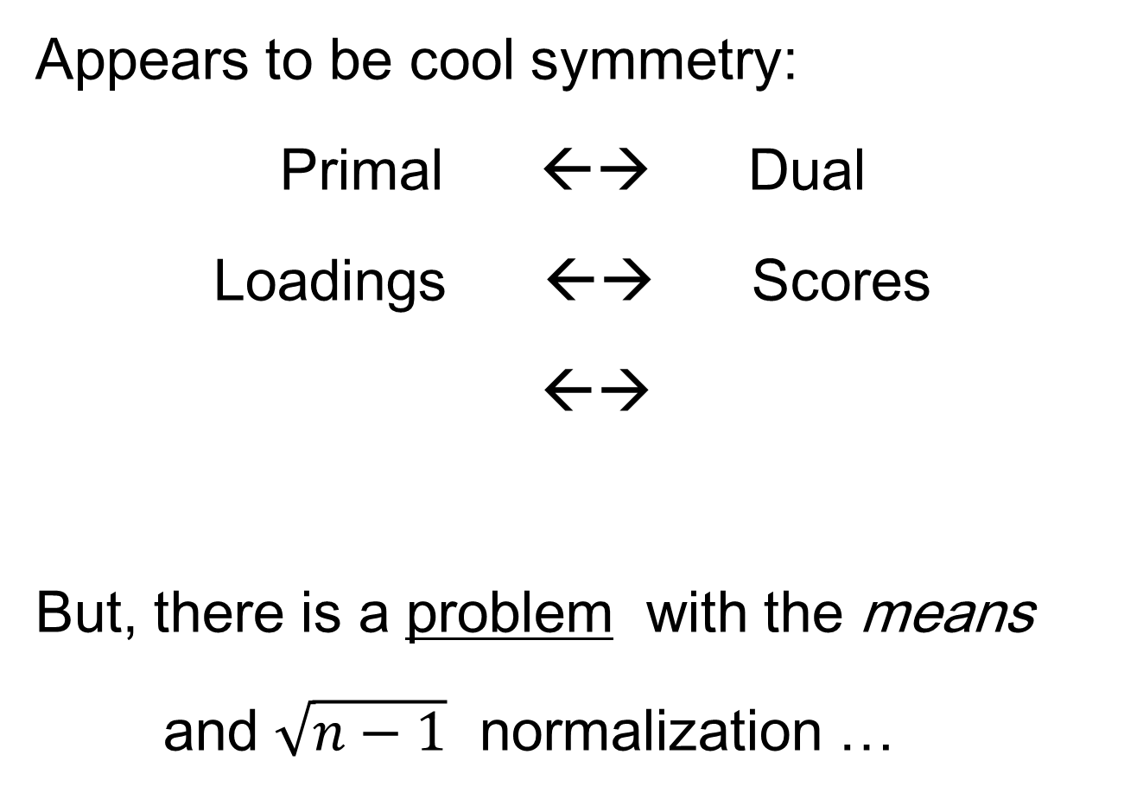
Alternate PCA Computation
Appears to be cool symmetry:
Primal ←→ Dual
Loadings ←→ Scores
←→
But, there is a problem with the means
and $\sqrt{n−1}$ normalization …

Slide 7
Primal / Dual PCA
Consider
“Data Matrix”
Primal Analysis:
Columns are data vectors
Notes:
7

Slide 8
Primal / Dual PCA
Consider
“Data Matrix”
Dual Analysis:
Rows are data vectors
Notes:
8

Slide 9
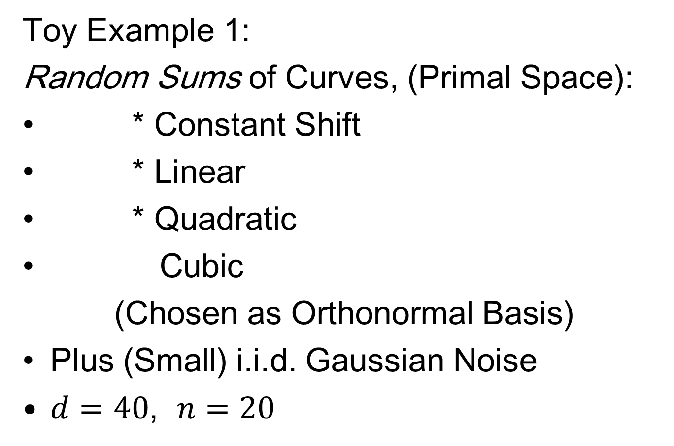
Primal - Dual PCA
Toy Example 1:
Random Sums of Curves, (Primal Space):
* Constant Shift
* Linear
* Quadratic
Cubic
(Chosen as Orthonormal Basis)
Plus (Small) i.i.d. Gaussian Noise
$d=40$, $n=20$
Notes:
9

Slide 10
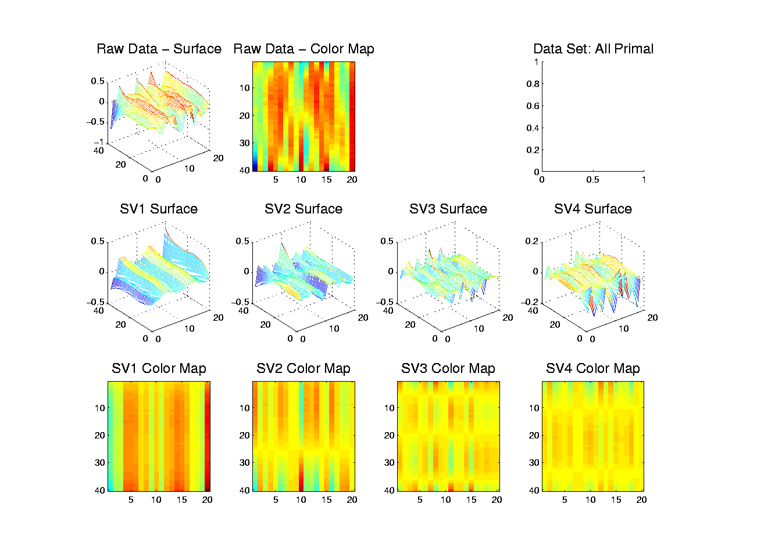
Primal - Dual PCA
Toy Example 1: SVD – Mesh-Image View
Decomposition
Into Modes of
Variation
Const x Gauss
Linear x Gauss
Parab. x Gauss
Cubic x Gauss
Notes:
10

Slide 11
Primal - Dual PCA
Toy Example 3:
Random Curves, all in Dual Space:
1 * Constant Shift
2 * Linear
4 * Quadratic
8 * Cubic
Same Curves, But Different Magnitudes
(Thus Expect Different Ordering)
Notes:
11

Slide 12
Primal - Dual PCA
Toy Example 3:
Random Curves, all in Dual Space:
1 * Constant Shift
2 * Linear
4 * Quadratic
8 * Cubic
(chosen to be orthonormal)
Plus (small) i.i.d. Gaussian noise
d = 40, n = 20
Notes:
12

Slide 13
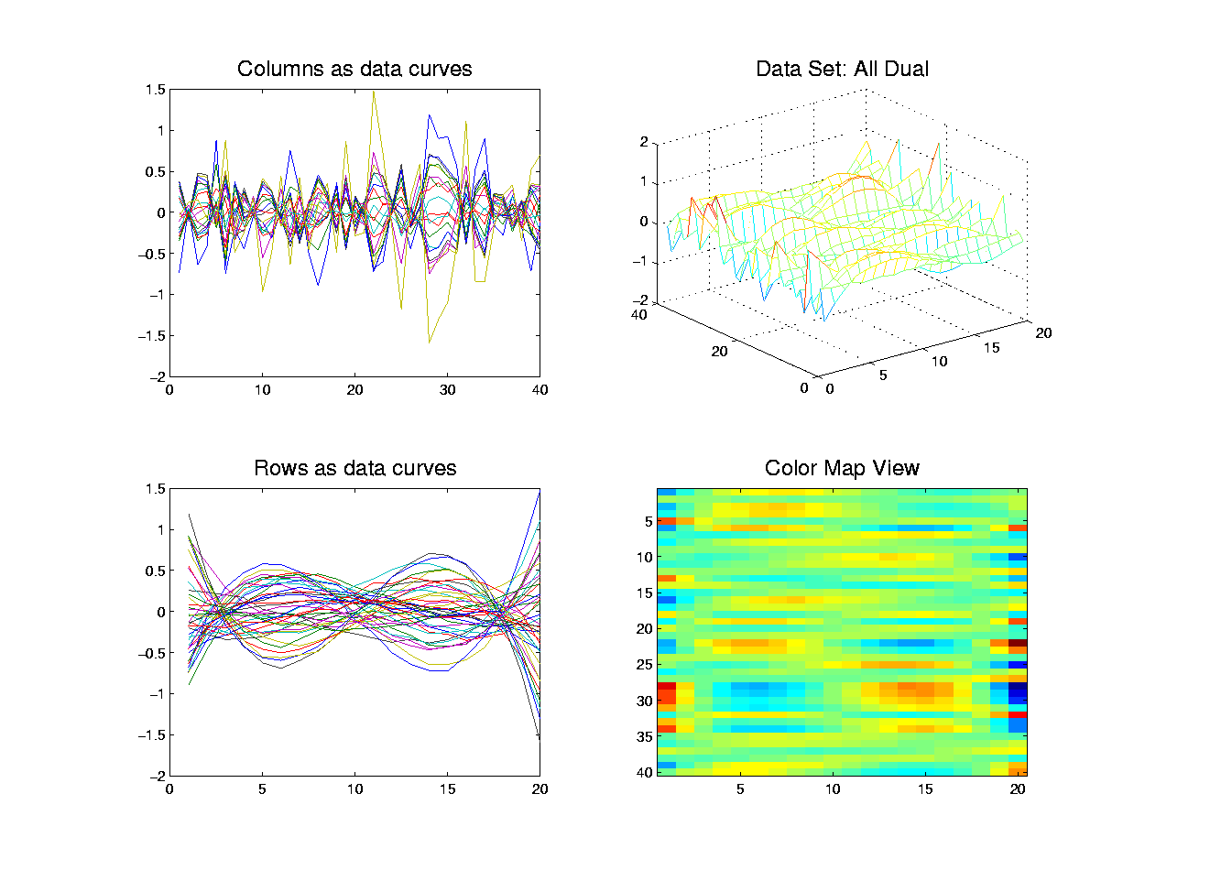
Primal - Dual PCA
Toy Example 3: Raw Data
Similar to Eg. 1
Rows – Cols
Swapped
Cubics Now
Dominant
(as Exp’d)
Notes:
13

Slide 14
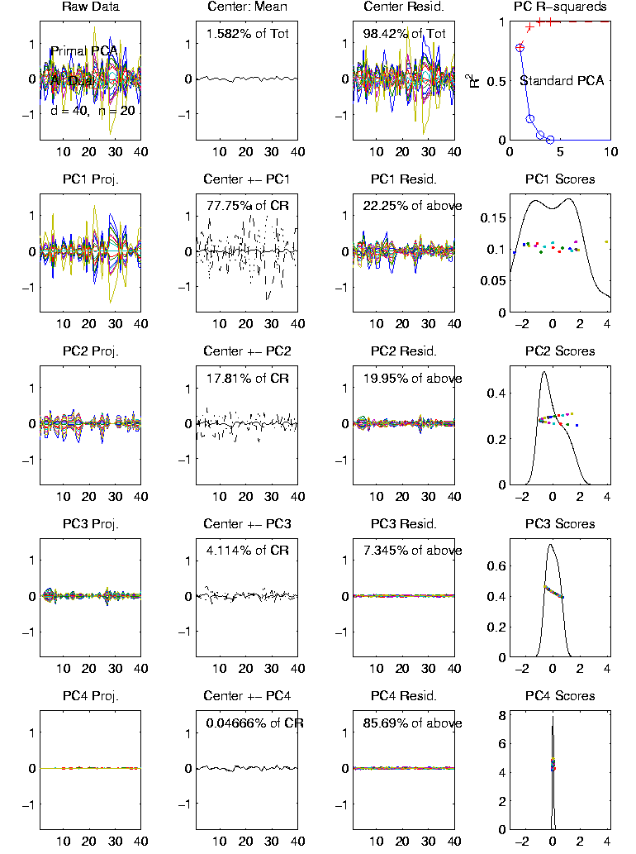
Primal - Dual PCA
Toy Example 3:
Primal PCA
Column Curves
as Data
Gaussian Noise
Only 3 components
Poly Scores
(in order,
as expected)
Notes:
14

Slide 15
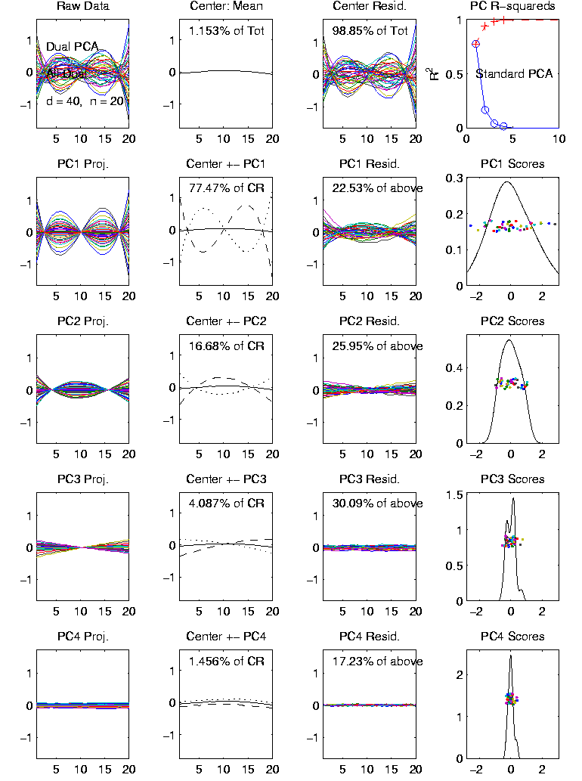
Primal - Dual PCA
Toy Example 3:
Dual PCA
Row Curves
as Data
Components as
expected
No Gram-Schmidt
(since stronger
signal)
Notes:
15

Slide 16
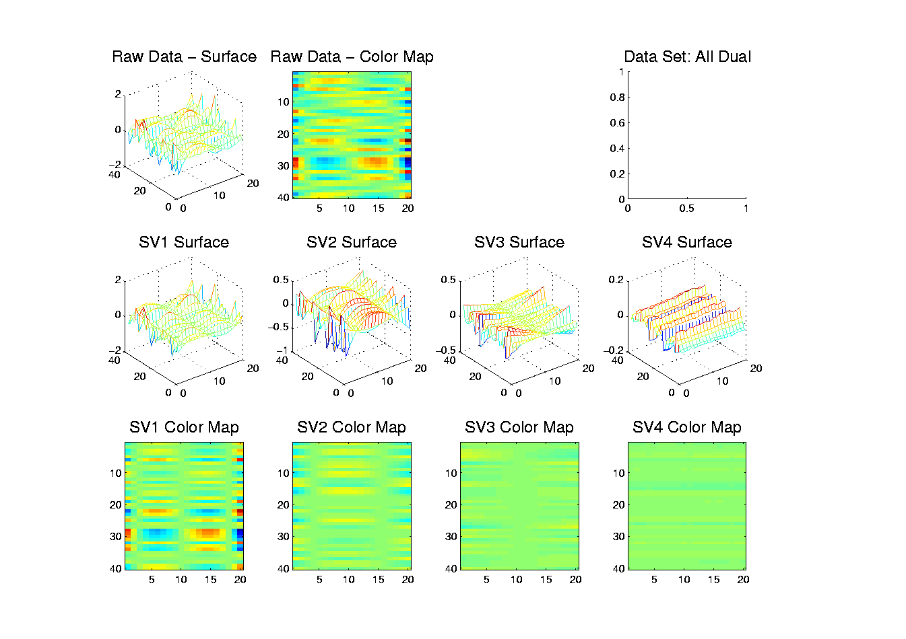
Primal - Dual PCA
Toy Example 3: SVD – Matrix-Image
Nicely Shows
Components
In Right
Order
Notes:
16

Slide 17
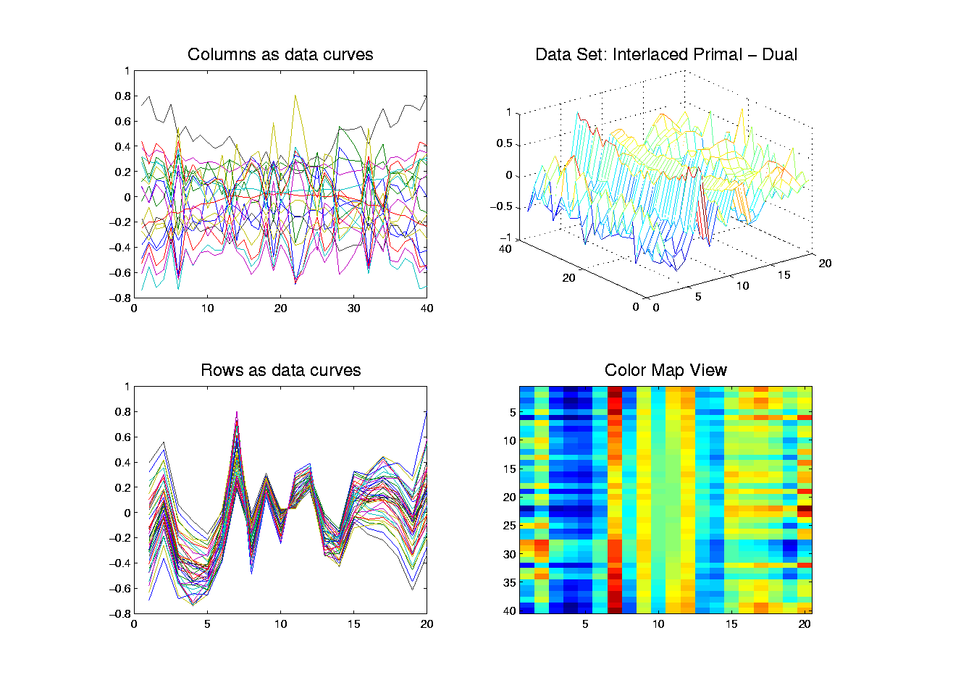
Primal - Dual PCA
Toy Example 4: Mystery #1
What is
Structure?
Notes:
17

Slide 18
Primal - Dual PCA
Toy Example 4: Mystery #1
What is
Structure?
Find From
Decomposition?
Notes:
18

Slide 19
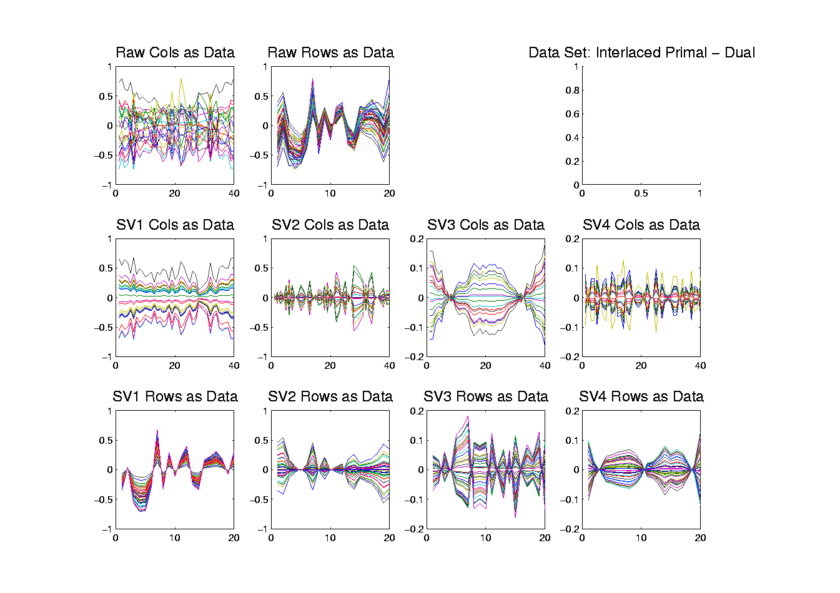
Primal - Dual PCA
Toy Example 4: SVD – Curves View
See
Structure?
Notes:
19

Slide 20
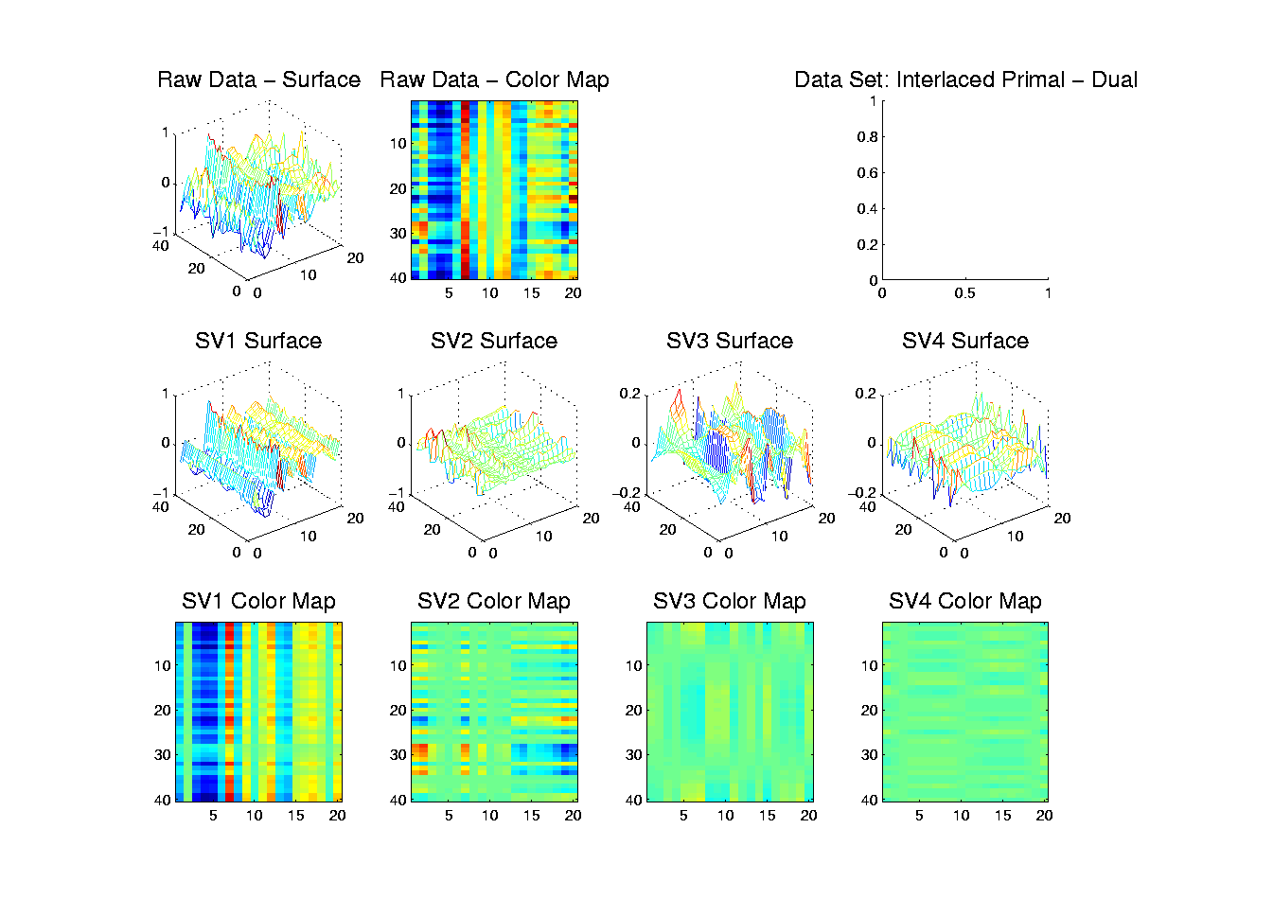
Primal - Dual PCA
Toy Example 4: SVD – Matrix-Image
Better View?
Notes:
20

Slide 21
Primal - Dual PCA
Toy Example 4: SVD – Matrix-Image
Better View?
Gauss x Const.
Notes:
21

Slide 22
Primal - Dual PCA
Toy Example 4: SVD – Matrix-Image
Better View?
Gauss x Const.
Linear x Gauss
Notes:
22

Slide 23
Primal - Dual PCA
Toy Example 4: SVD – Matrix-Image
Better View?
Gauss x Const.
Linear x Gauss
Gauss x Parab.
Notes:
23

Slide 24
Primal - Dual PCA
Toy Example 4: SVD – Matrix-Image
Better View?
Gauss x Const.
Linear x Gauss
Gauss x Parab.
Cubic x Gauss
Notes:
24

Slide 25
Primal - Dual PCA
Toy Example 4: Mystery #1
Structure: Primal - Dual
Constant Gaussian
Gaussian Linear
Parabola Gaussian
Gaussian Cubic
Nicely revealed by Full Matrix decomposition and views
Notes:
25

Slide 26
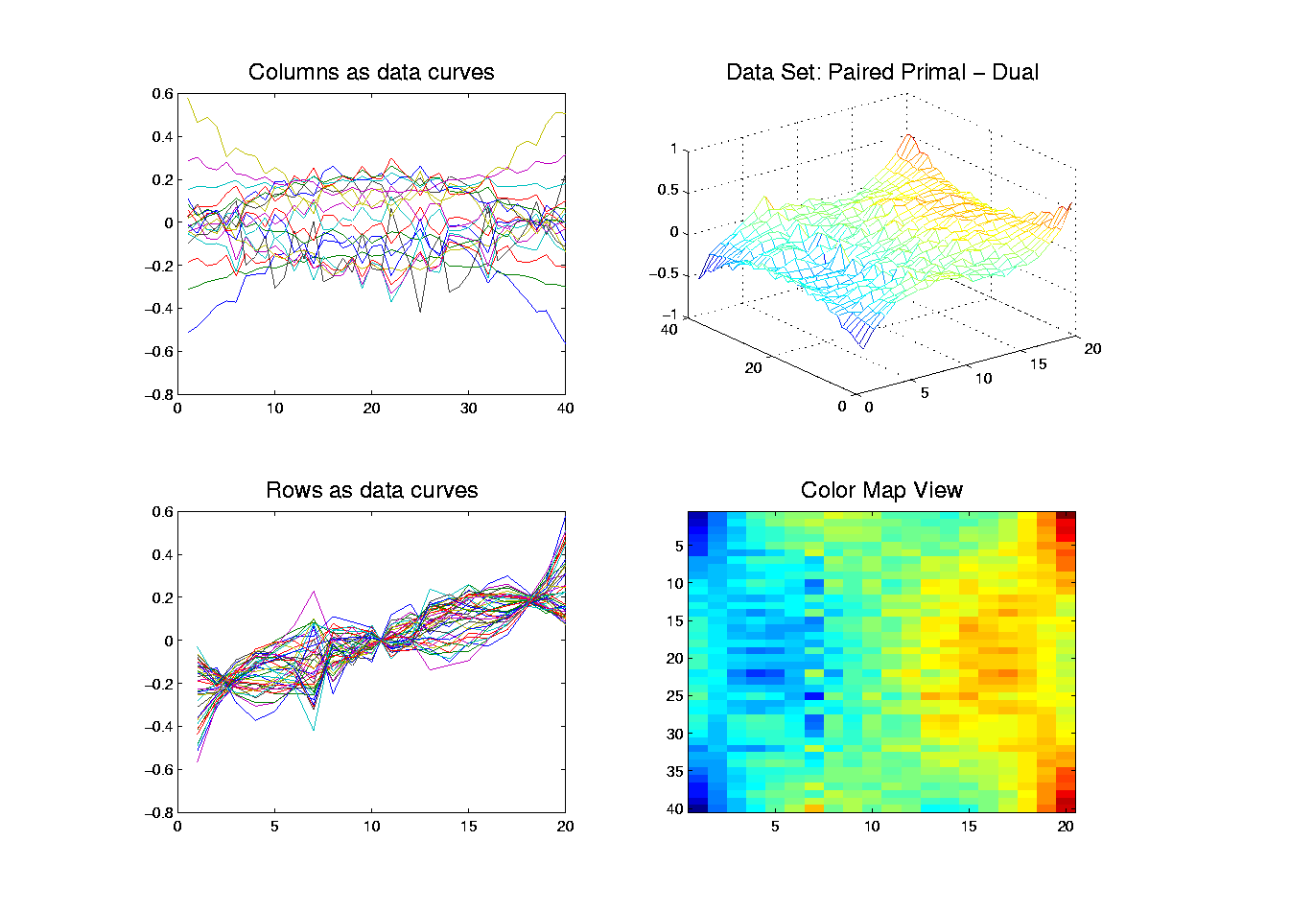
Primal - Dual PCA
Toy Example 5: Mystery #2
What is
Structure?
Find From
Decomposition?
Notes:
26

Slide 27
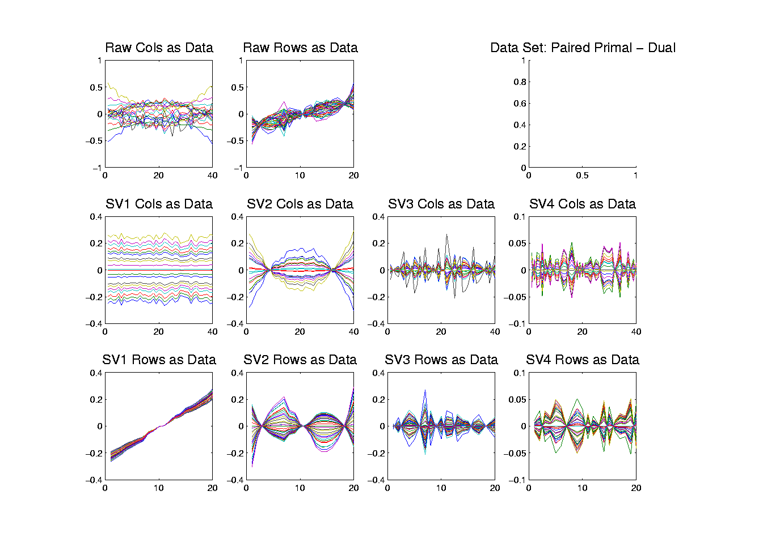
Primal - Dual PCA
Toy Example 5: SVD – Curves View
Const. x Linear
Notes:
27

Slide 28
Primal - Dual PCA
Toy Example 5: SVD – Curves View
Const. x Linear
Parab. x Cubic
Notes:
28

Slide 29
Primal - Dual PCA
Toy Example 5: SVD – Curves View
Const. x Linear
Parab. x Cubic
Gaussian
Noise
Notes:
29

Slide 30
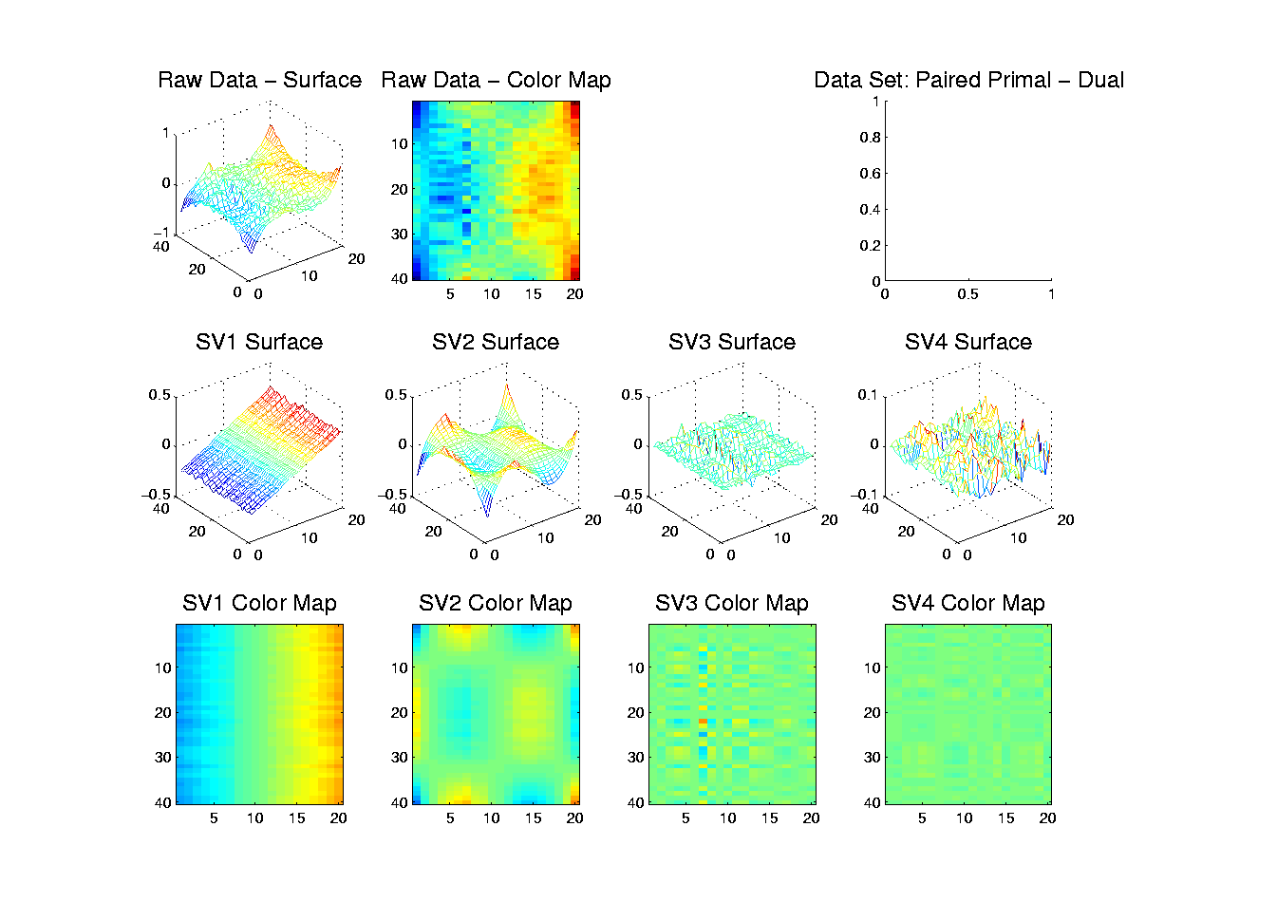
Primal - Dual PCA
Toy Example 5: SVD – Matrix-Image
Const. x Linear
Parab. x Cubic
Gaussian
Noise
Notes:
30

Slide 31
Primal - Dual PCA
Toy Example 5: Mystery #2
Structure: Primal - Dual
Constant Linear
Parabola Cubic
Gaussian Gaussian
Gaussian Gaussian
Visible via either curves, or matrices…
Notes:
31

Slide 32
Primal - Dual PCA
Is SVD (i.e. No Mean Centering)
Always “Better”?
Notes:
32

Slide 33
Primal - Dual PCA
Is SVD (i.e. No Mean Centering)
Always “Better”?
What does “Better” Mean???
Notes:
33

Slide 34
Primal - Dual PCA
Is SVD (i.e. No Mean Centering)
Always “Better”?
What does “Better” Mean???
A Definition:
Provides Most Useful Insights into Data
Others???
Notes:
34

Slide 35
Primal - Dual PCA
Toy Example Where SVD is Less Informative:
Simple Two Dimensional
Notes:
35

Slide 36
Primal - Dual PCA
Toy Example Where SVD is Less Informative:
Simple Two Dimensional
Key is Subtraction of Mean is Bad
I.e. Mean Dir’n Different From PC Dir’ns
And Mean Less Informative
Notes:
36

Slide 37
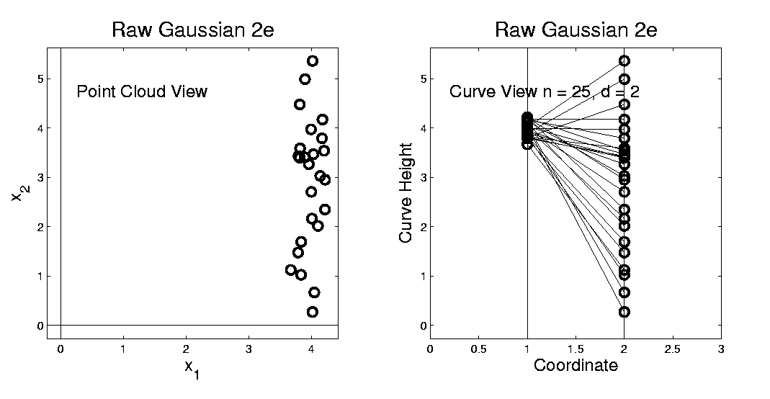
Primal - Dual PCA
Toy Example where SVD is Less Informative:
Raw Data
Notes:
37

Slide 38
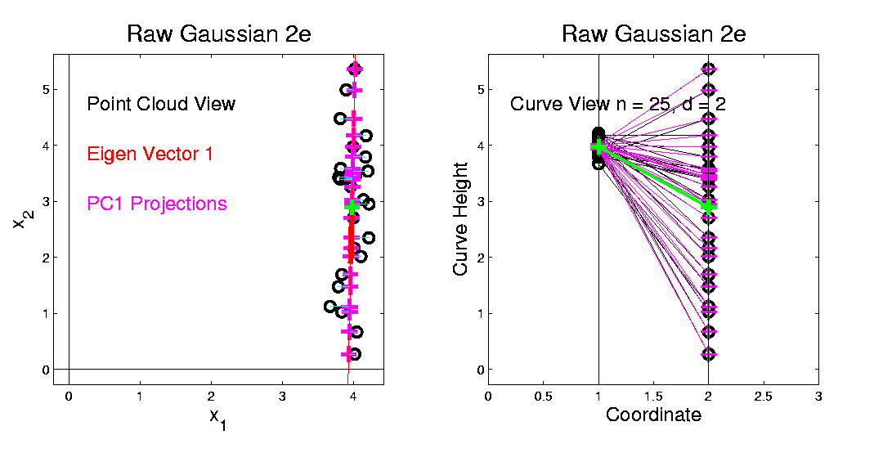
Primal - Dual PCA
PC1 Mode of Variation (Centered at Mean):
Notes:
38

Slide 39
Primal - Dual PCA
PC1 Mode of Variation (Centered at Mean):
Yields Useful (1-d) Mode of Variation
Notes:
39

Slide 40
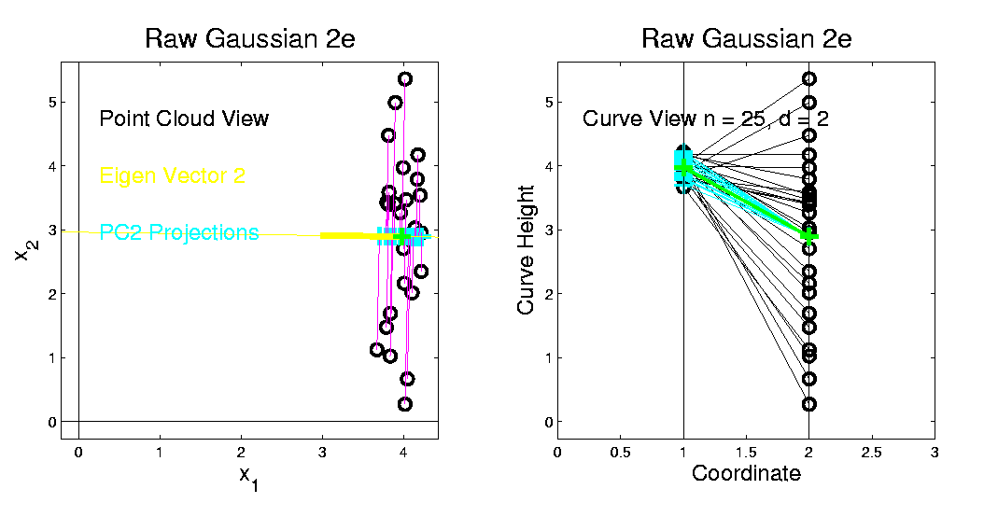
Primal - Dual PCA
PC2 Mode of Variation (Centered at Mean):
Informative Second Mode of Variation
Notes:
40

Slide 41
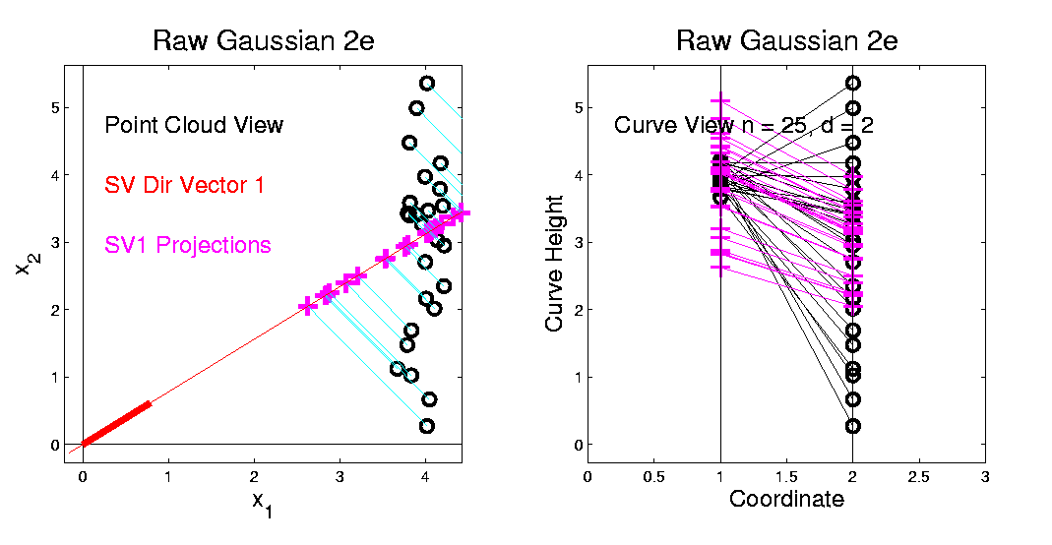
Primal - Dual PCA
SV1 mode of variation (centered at 0):
Notes:
41

Slide 42
Primal - Dual PCA
SV1 mode of variation (centered at 0):
Unintuitive major mode of variation
Notes:
42

Slide 43
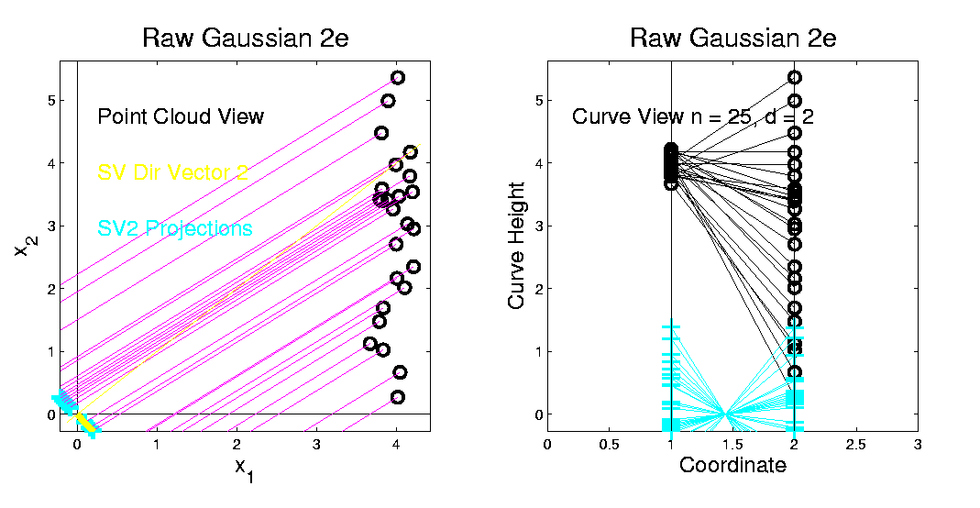
Primal - Dual PCA
SV2 mode of variation (centered at 0):
Unintuitive second mode of variation
Notes:
43

Slide 44
Primal - Dual PCA
Summary of SVD:
Does Give a Decomposition
I.e. Sum of 2 Pieces Gives Data
Notes:
44

Slide 45
Primal - Dual PCA
Summary of SVD:
Does Give a Decomposition
I.e. Sum of 2 Pieces Gives Data
But Not Good Insights
Since Center Point of Analysis Far From Center Point of Data
Notes:
45

Slide 46
Primal - Dual PCA
Summary of SVD:
Does Give a Decomposition
I.e. Sum of 2 Pieces Gives Data
But Not Good Insights
Since Center Point of Analysis Far From Center Point of Data
So Mean Strongly Influences the Impression of Variation
Notes:
46

Slide 47
Primal - Dual PCA
Bottom Line on:
Primal PCA vs. SVD vs. Dual PCA
Notes:
47

Slide 48
Primal - Dual PCA
Bottom Line on:
Primal PCA vs. SVD vs. Dual PCA
These are Not Comparable:
Each has Situations Where it is Best
And Where it is Worst
Notes:
48

Slide 49
Primal - Dual PCA
Bottom Line on:
Primal PCA vs. SVD vs. Dual PCA
These are Not Comparable:
Each has Situations Where it is Best
And Where it is Worst
Generally Should Consider All
Notes:
49

Slide 50
Primal - Dual PCA
Bottom Line on:
Primal PCA vs. SVD vs. Dual PCA
These are Not Comparable:
Each has Situations Where it is Best
And Where it is Worst
Generally Should Consider All
And Choose on Basis of Insights
Interesting Reference: Zhang, et al (2007)
Notes:
50

Slide 51

HDLSS Asymptotics
Modern Mathematical Statistics:
Based on asymptotic analysis
Notes:
51

Slide 52
HDLSS Asymptotics
Modern Mathematical Statistics:
Based on asymptotic analysis
I.e. Uses limiting operations
Almost always
Notes:
52

Slide 53
HDLSS Asymptotics
Modern Mathematical Statistics:
Based on asymptotic analysis
I.e. Uses limiting operations
Almost always
Workhorse Method for Much Insight:
Laws of Large Numbers (Consistency)
Central Limit Theorems (Quantify Errors)
Notes:
53

Slide 54
HDLSS Asymptotics
Modern Mathematical Statistics:
Based on asymptotic analysis
I.e. Uses limiting operations
Almost always
Occasional misconceptions
Notes:
54

Slide 55
HDLSS Asymptotics
Modern Mathematical Statistics:
Based on asymptotic analysis
I.e. Uses limiting operations
Almost always
Occasional misconceptions:
  Indicates behavior for large samples
  Thus only makes sense for “large” samples
Notes:
55

Slide 56
HDLSS Asymptotics
Modern Mathematical Statistics:
Based on asymptotic analysis
I.e. Uses limiting operations
Almost always
Occasional misconceptions:
  Indicates behavior for large samples
  Thus only makes sense for “large” samples
  Models phenomenon of “increasing data”
Notes:
56

Slide 57
HDLSS Asymptotics
Modern Mathematical Statistics:
Based on asymptotic analysis
I.e. Uses limiting operations
Almost always
Occasional misconceptions:
  Indicates behavior for large samples
  Thus only makes sense for “large” samples
  Models phenomenon of “increasing data”
  So other flavors are useless???
Notes:
57

Slide 58
HDLSS Asymptotics
Modern Mathematical Statistics:
Based on asymptotic analysis
Notes:
58

Slide 59
HDLSS Asymptotics
Modern Mathematical Statistics:
Based on asymptotic analysis
Real Reasons:
  Approximation provides insights
Notes:
59

Slide 60
HDLSS Asymptotics
Modern Mathematical Statistics:
Based on asymptotic analysis
Real Reasons:
  Approximation provides insights
  Can find simple underlying structure
  In complex situations
Notes:
60

Slide 61
HDLSS Asymptotics
Modern Mathematical Statistics:
Based on asymptotic analysis
Real Reasons:
  Approximation provides insights
  Can find simple underlying structure
  In complex situations
Thus various flavors are fine:
Notes:
61

Slide 62
HDLSS Asymptotics
Modern Mathematical Statistics:
Based on asymptotic analysis
Real Reasons:
  Approximation provides insights
  Can find simple underlying structure
  In complex situations
Thus various flavors are fine:
Even desirable! (find additional insights)
Notes:
62

Slide 63
HDLSS Asymptotics
Personal Observations:
HDLSS world is…

Slide 64
HDLSS Asymptotics
Personal Observations:
HDLSS world is…
Surprising (many times!)
[Think I’ve got it, and then …]

Slide 65
HDLSS Asymptotics
Personal Observations:
HDLSS world is…
Surprising (many times!)
[Think I’ve got it, and then …]
Mathematically Beautiful (?)

Slide 66
HDLSS Asymptotics
Personal Observations:
HDLSS world is…
Surprising (many times!)
[Think I’ve got it, and then …]
Mathematically Beautiful (?)
Practically Relevant

Slide 67
HDLSS Asymptotics: Simple Paradoxes
Study Ideas From:
Hall, Marron and Neeman (2005)

Slide 68
HDLSS Asymptotics: Simple Paradoxes
For dim’al Standard Normal dist’n:

Slide 69
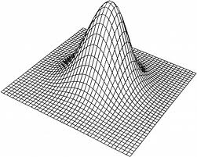
HDLSS Asymptotics: Simple Paradoxes
For dim’al Standard Normal dist’n:
Where are Data?
Near Peak of Density?
Thanks to: psycnet.apa.org

Slide 70
HDLSS Asymptotics: Simple Paradoxes
For dim’al Standard Normal dist’n:
Euclidean Distance to Origin (as )
(measure how close to peak)

Slide 71
HDLSS Asymptotics: Simple Paradoxes
For dim’al Standard Normal dist’n:
Euclidean Distance to Origin (as ):

Slide 72
HDLSS Asymptotics: Simple Paradoxes
For dim’al Standard Normal dist’n:
Euclidean Distance to Origin (as ):

Slide 73
HDLSS Asymptotics: Simple Paradoxes
As ,
Data lie roughly on surface of sphere,
with radius
Notes:
73

Slide 74
HDLSS Asymptotics: Simple Paradoxes
As ,
Data lie roughly on surface of sphere,
with radius
- Yet origin is point of highest density???
Notes:
74

Slide 75
HDLSS Asymptotics: Simple Paradoxes
As ,
Data lie roughly on surface of sphere,
with radius
- Yet origin is point of highest density???
- Paradox resolved by:
density w. r. t. Lebesgue Measure
Notes:
75

Slide 76
HDLSS Asymptotics: Simple Paradoxes
- Paradox resolved by:
density w. r. t. Lebesgue Measure
Notes:
76

Slide 77

HDLSS Asymptotics: Simple Paradoxes
- Paradox resolved by:
density w. r. t. Lebesgue Measure
Consider Volume of Unit Sphere in $ℝ^{d}$
Notes:
77

Slide 78
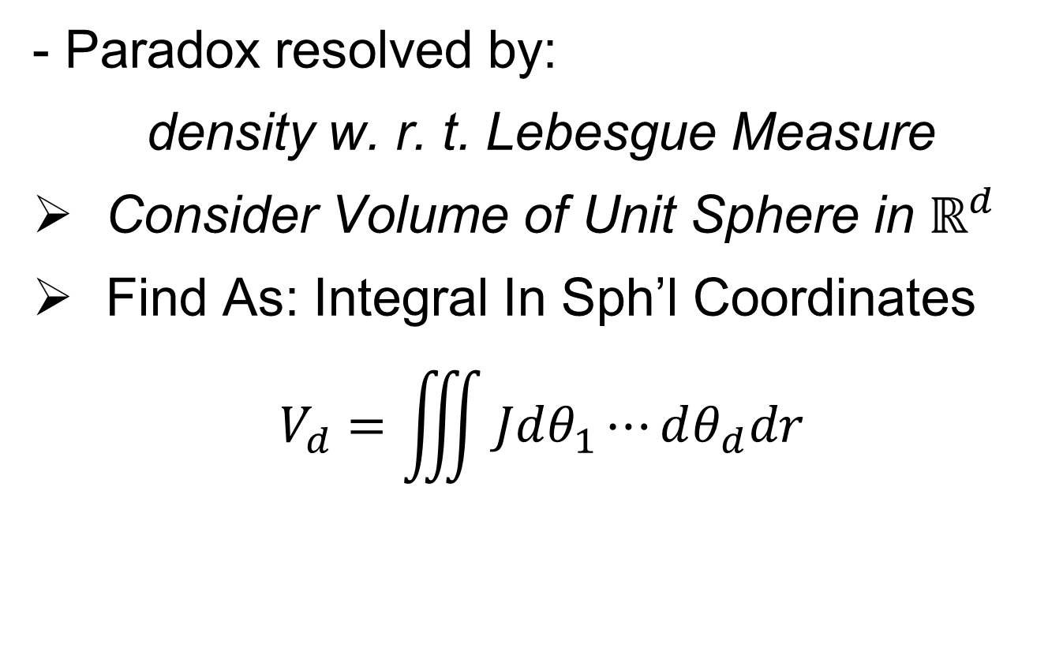
HDLSS Asymptotics: Simple Paradoxes
- Paradox resolved by:
density w. r. t. Lebesgue Measure
Consider Volume of Unit Sphere in $ℝ^{d}$
Find As: Integral In Sph’l Coordinates
$$V_{d}=\iiint{Jdθ_{1}⋯dθ_{d}dr}$$
Notes:
78

Slide 79
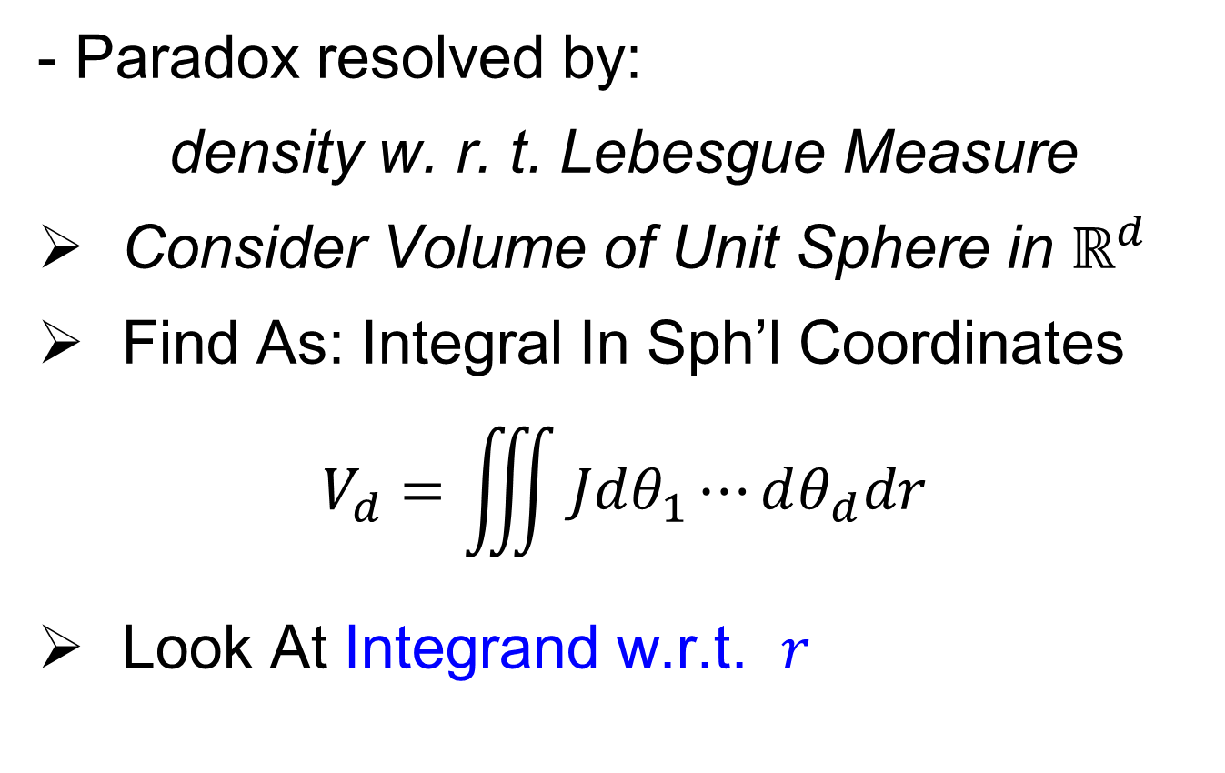
HDLSS Asymptotics: Simple Paradoxes
- Paradox resolved by:
density w. r. t. Lebesgue Measure
Consider Volume of Unit Sphere in $ℝ^{d}$
Find As: Integral In Sph’l Coordinates
$$V_{d}=\iiint{Jdθ_{1}⋯dθ_{d}dr}$$
Look At Integrand w.r.t. $r$
Notes:
79

Slide 80
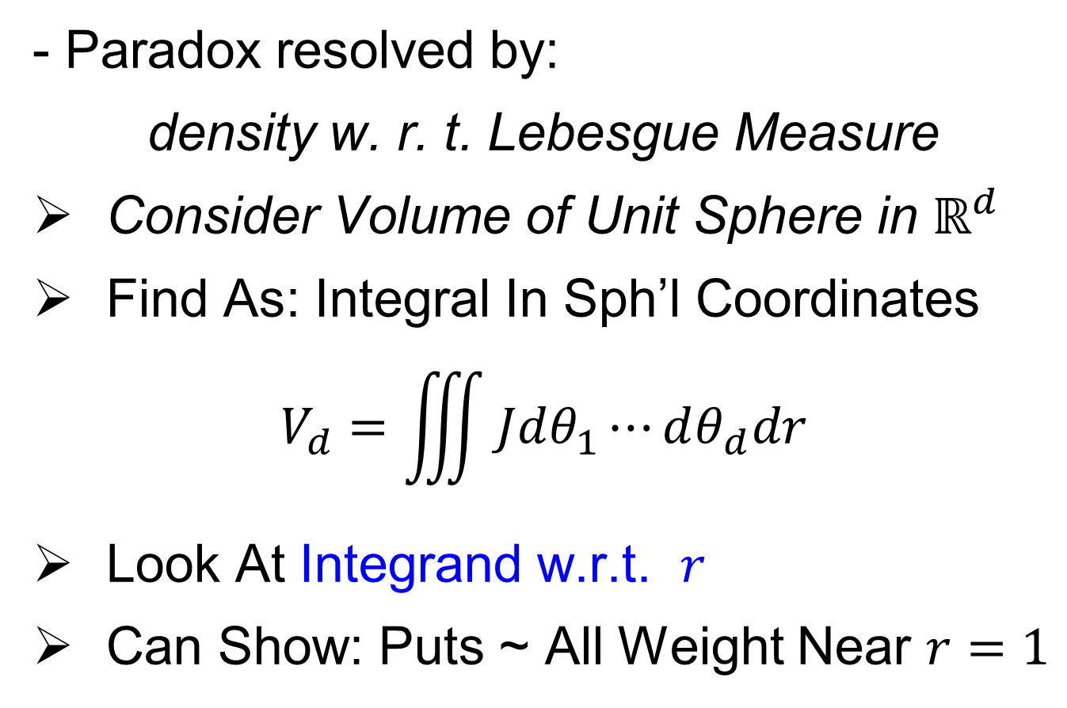
HDLSS Asymptotics: Simple Paradoxes
- Paradox resolved by:
density w. r. t. Lebesgue Measure
Consider Volume of Unit Sphere in $ℝ^{d}$
Find As: Integral In Sph’l Coordinates
$$V_{d}=\iiint{Jdθ_{1}⋯dθ_{d}dr}$$
Look At Integrand w.r.t. $r$
Can Show: Puts ~ All Weight Near $r=1$
Notes:
80

Slide 81
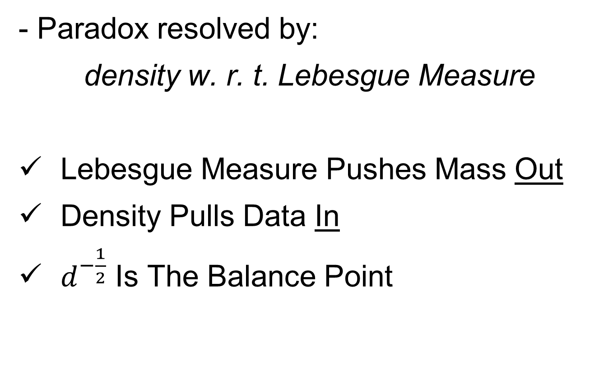
HDLSS Asymptotics: Simple Paradoxes
- Paradox resolved by:
density w. r. t. Lebesgue Measure
Lebesgue Measure Pushes Mass Out
Density Pulls Data In
$d^{−\frac{1}{2}}$ Is The Balance Point
Notes:
81

Slide 82
HDLSS Asymptotics: Simple Paradoxes
As ,
Important Philosophical Consequence
Notes:
82

Slide 83

HDLSS Asymptotics: Simple Paradoxes
As ,
Important Philosophical Consequence:
$∄$“Average People”
Notes:
83

Slide 84
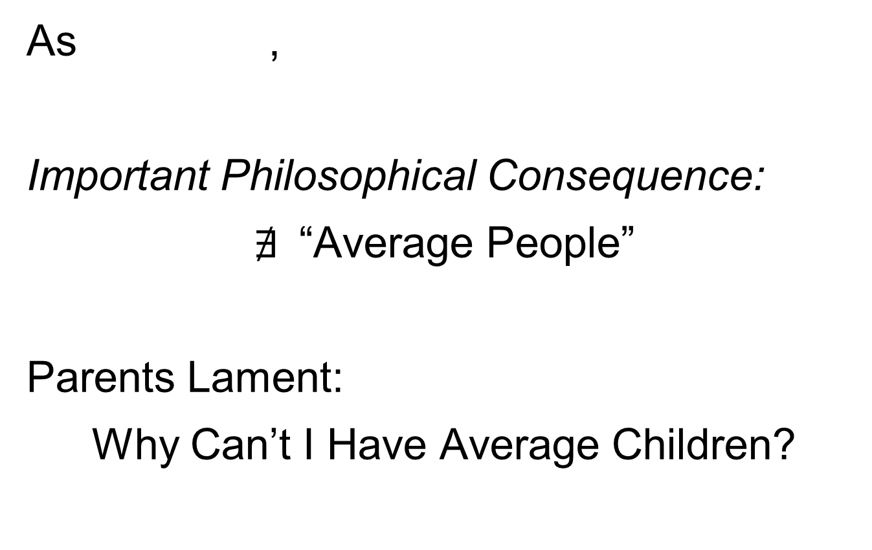
HDLSS Asymptotics: Simple Paradoxes
As ,
Important Philosophical Consequence:
$∄$“Average People”
Parents Lament:
Why Can’t I Have Average Children?
Notes:
84

Slide 85
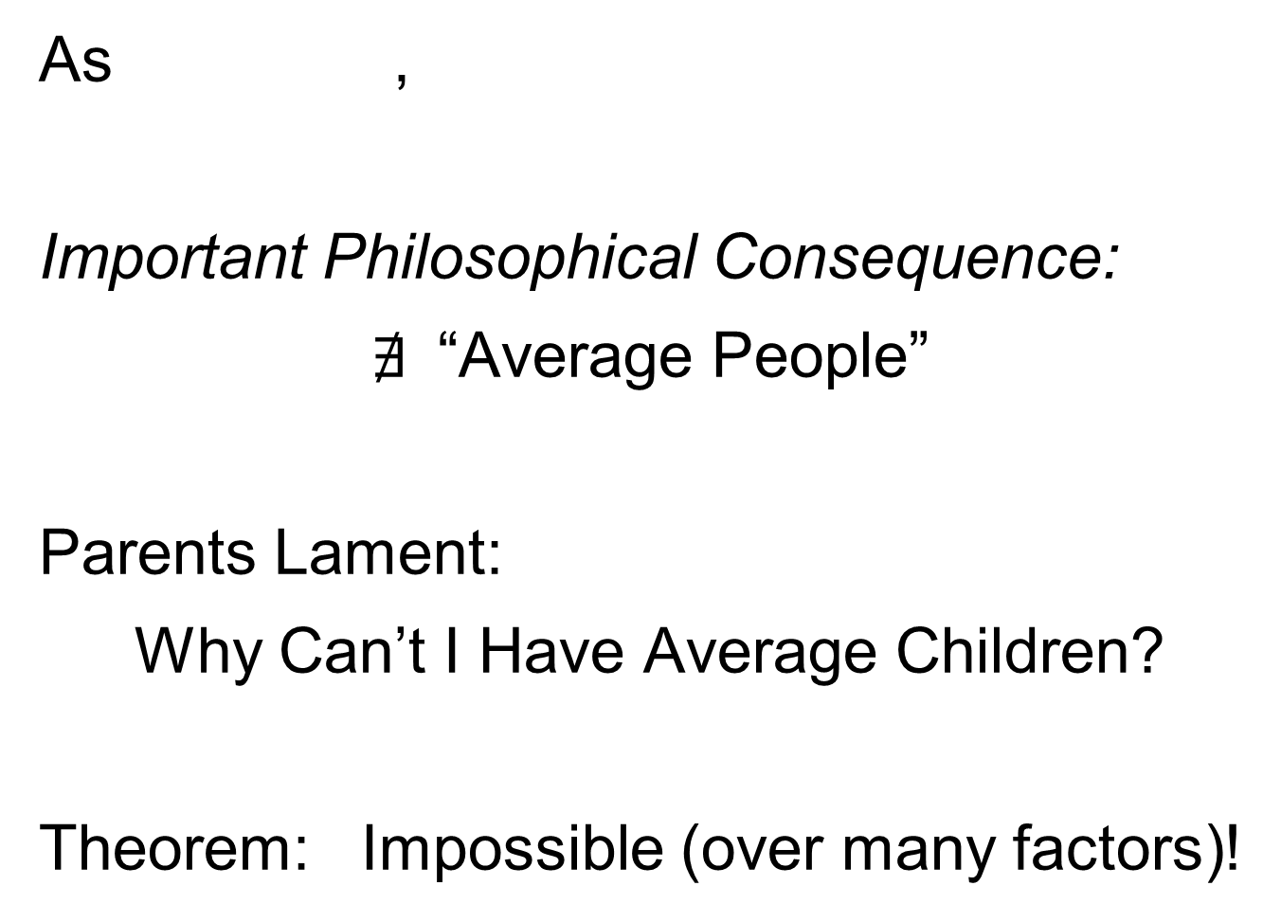
HDLSS Asymptotics: Simple Paradoxes
As ,
Important Philosophical Consequence:
$∄$“Average People”
Parents Lament:
Why Can’t I Have Average Children?
Theorem: Impossible (over many factors)!
Notes:
85

Slide 86
HDLSS Asymptotics: Simple Paradoxes
For dim’al Standard Normal dist’n:
indep. of
Euclidean Dist. Between and

Slide 87
HDLSS Asymptotics: Simple Paradoxes
For dim’al Standard Normal dist’n:
indep. of
Euclidean Dist. Between and
(as ):
Distance tends to non-random constant:

Slide 88
HDLSS Asymptotics: Simple Paradoxes
Distance tends to non-random constant:
Factor , since
Notes:
88

Slide 89
HDLSS Asymptotics: Simple Paradoxes
Distance tends to non-random constant:
Factor , since
Can extend to
Notes:
89

Slide 90
HDLSS Asymptotics: Simple Paradoxes
Distance tends to non-random constant:
Factor , since
Can extend to
Where do they all go???
(we can only perceive 3 dim’ns)
Notes:
90

Slide 91
HDLSS Asymptotics: Simple Paradoxes
Ever Wonder Why?
(we can only perceive 3 dim’ns)
Notes:
91

Slide 92
HDLSS Asymptotics: Simple Paradoxes
Ever Wonder Why?
Perceptual System from Ancestors
They Needed to Find Food
Food Exists in 3-d World
(we can only perceive 3 dim’ns)
Notes:
92

Slide 93
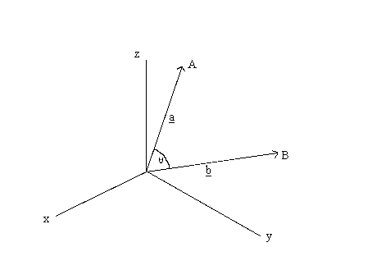


HDLSS Asymptotics: Simple Paradoxes
For dim’al Standard Normal dist’n:
indep. of
High dim’al Angles (as )
As Vectors From Origin
Thanks to: members.tripod.com
$$Z_{1}$$
$$Z_{2}$$

Slide 94
HDLSS Asymptotics: Simple Paradoxes
For dim’al Standard Normal dist’n:
indep. of
High dim’al Angles (as ):

Slide 95
HDLSS Asymptotics: Simple Paradoxes
For dim’al Standard Normal dist’n:
indep. of
High dim’al Angles (as ):
- Everything is orthogonal???

Slide 96
HDLSS Asymptotics: Simple Paradoxes
For dim’al Standard Normal dist’n:
indep. of
High dim’al Angles (as ):
- Everything is orthogonal???
- Where do they all go???
(again our perceptual limitations)

Slide 97
HDLSS Asymptotics: Simple Paradoxes
For dim’al Standard Normal dist’n:
indep. of
High dim’al Angles (as ):
- Everything is orthogonal???
- Where do they all go???
(again our perceptual limitations)
- Again 1st order structure is non-random

Slide 98
HDLSS Asy’s: Geometrical Represent’n
Assume , let
Study Subspace Generated by Data
Hall, Marron & Neeman (2005)

Slide 99
HDLSS Asy’s: Geometrical Represent’n
Assume , let
Study Subspace Generated by Data
Hyperplane through 0,
of dimension
Hall, Marron & Neeman (2005)

Slide 100
HDLSS Asy’s: Geometrical Represent’n
Assume , let
Study Subspace Generated by Data
Hyperplane through 0,
of dimension
Points are “nearly equidistant to 0”,
& dist
Hall, Marron & Neeman (2005)

Slide 101
HDLSS Asy’s: Geometrical Represent’n
Assume , let
Study Subspace Generated by Data
Hyperplane through 0,
of dimension
Points are “nearly equidistant to 0”,
& dist
Within plane, can
“rotate towards Unit Simplex”
Hall, Marron & Neeman (2005)

Slide 102
HDLSS Asy’s: Geometrical Represent’n
Assume , let
Study Subspace Generated by Data
Hyperplane through 0,
of dimension
Points are “nearly equidistant to 0”,
& dist
Within plane, can
“rotate towards Unit Simplex”
All Gaussian data sets are:
“near Unit Simplex Vertices”!!!
(Modulo Rotation)
Hall, Marron & Neeman (2005)

Slide 103
HDLSS Asy’s: Geometrical Represent’n
Assume , let
Study Subspace Generated by Data
Hyperplane through 0,
of dimension
Points are “nearly equidistant to 0”,
& dist
Within plane, can
“rotate towards Unit Simplex”
All Gaussian data sets are:
“near Unit Simplex Vertices”!!!
“Randomness” appears
only in rotation of simplex
Hall, Marron & Neeman (2005)

Slide 104
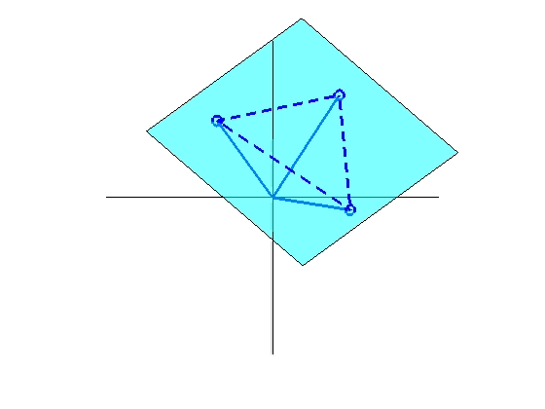
HDLSS Asy’s: Geometrical Represent’n
Assume , let
Study Hyperplane Generated by Data
dimensional hyperplane

Slide 105
HDLSS Asy’s: Geometrical Represent’n
Assume , let
Study Hyperplane Generated by Data
dimensional hyperplane
Points are pairwise equidistant, dist

Slide 106
HDLSS Asy’s: Geometrical Represent’n
Assume , let
Study Hyperplane Generated by Data
dimensional hyperplane
Points are pairwise equidistant, dist
Points lie at vertices of:
“regular hedron”

Slide 107
HDLSS Asy’s: Geometrical Represent’n
Assume , let
Study Hyperplane Generated by Data
dimensional hyperplane
Points are pairwise equidistant, dist
Points lie at vertices of:
“regular hedron”
Again “randomness in data” is only in rotation

Slide 108
HDLSS Asy’s: Geometrical Represent’n
Assume , let
Study Hyperplane Generated by Data
dimensional hyperplane
Points are pairwise equidistant, dist
Points lie at vertices of:
“regular hedron”
Again “randomness in data” is only in rotation
Surprisingly rigid structure in random data?

Slide 109
HDLSS Asy’s: Geometrical Represen’tion
Simulation View: study “rigidity after rotation”
Simple 3 point data sets
In dimensions d = 2, 20, 200, 20000

Slide 110
HDLSS Asy’s: Geometrical Represen’tion
Simulation View: study “rigidity after rotation”
Simple 3 point data sets
In dimensions d = 2, 20, 200, 20000
Generate hyperplane of dimension 2

Slide 111
HDLSS Asy’s: Geometrical Represen’tion
Simulation View: study “rigidity after rotation”
Simple 3 point data sets
In dimensions d = 2, 20, 200, 20000
Generate hyperplane of dimension 2
Rotate that to plane of screen

Slide 112
HDLSS Asy’s: Geometrical Represen’tion
Simulation View: study “rigidity after rotation”
Simple 3 point data sets
In dimensions d = 2, 20, 200, 20000
Generate hyperplane of dimension 2
Rotate that to plane of screen
Rotate within plane, to make “comparable”

Slide 113
HDLSS Asy’s: Geometrical Represen’tion
Simulation View: study “rigidity after rotation”
Simple 3 point data sets
In dimensions d = 2, 20, 200, 20000
Generate hyperplane of dimension 2
Rotate that to plane of screen
Rotate within plane, to make “comparable”
Repeat 10 times, use different colors

Slide 114
HDLSS Asy’s: Geometrical Represen’tion
Simulation View: Shows “Rigidity after Rotation”

Slide 115
HDLSS Asy’s: Geometrical Represen’tion
Now Recall HDLSS Simulation Results,
Comparing DWD, SVM & Others, from 9/18/12

Slide 116
HDLSS Discrim’n Simulations
Main idea:
Comparison of
SVM (Support Vector Machine)
DWD (Distance Weighted Discrimination)
MD (Mean Difference, a.k.a. Centroid)
Linear versions, across dimensions
Notes:
116

Slide 117
HDLSS Discrim’n Simulations
Overall Approach:
Study different known phenomena
  Spherical Gaussians
  Outliers
  Polynomial Embedding
Common Sample Sizes
But wide range of dimensions

Slide 118
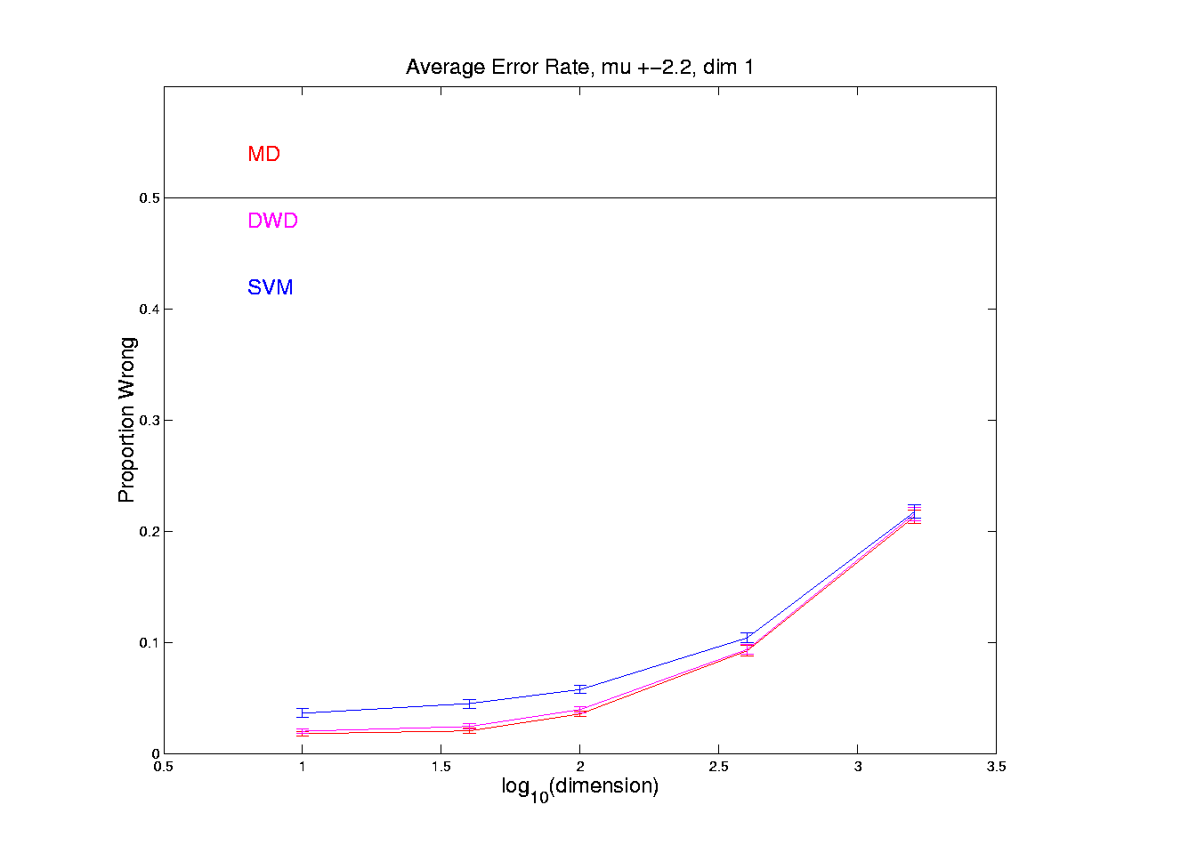
HDLSS Discrim’n Simulations
Spherical Gaussians:
Notes:
DWD1figEBig.ps

Slide 119
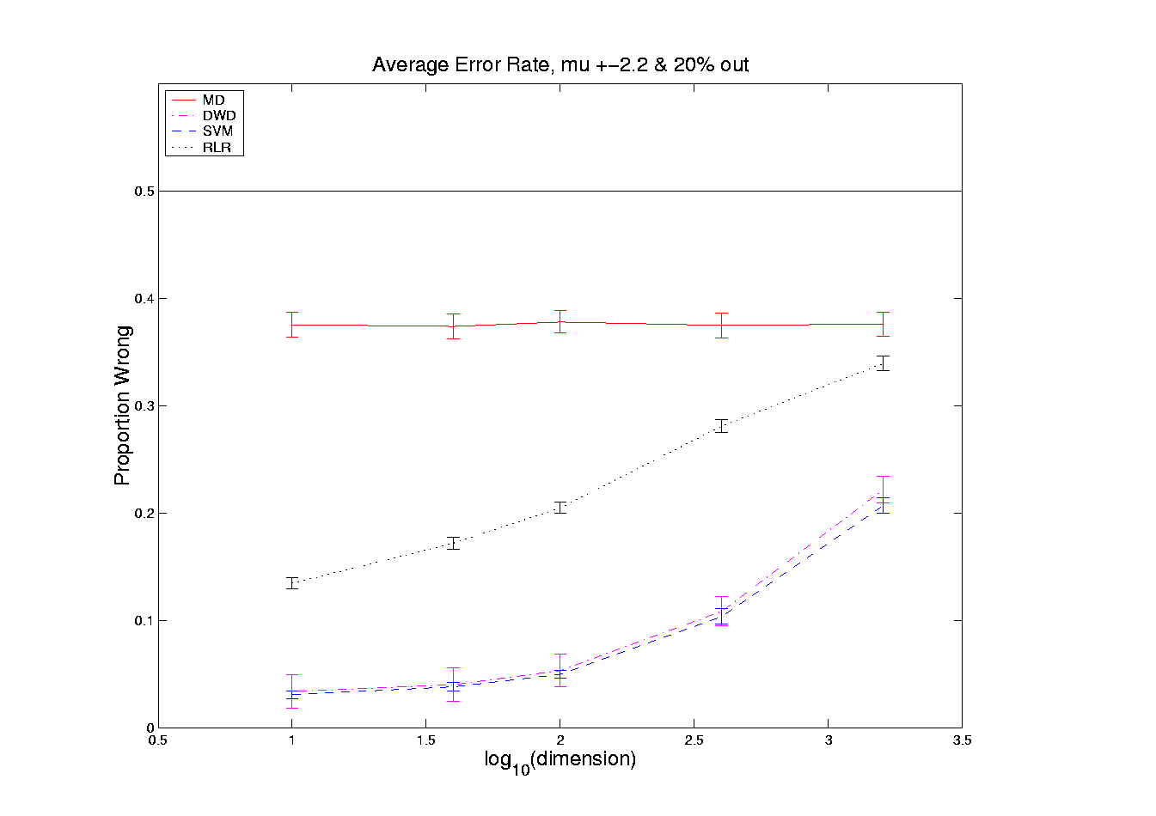
HDLSS Discrim’n Simulations
Outlier Mixture:
Notes:
DWD1figFBig.ps

Slide 120
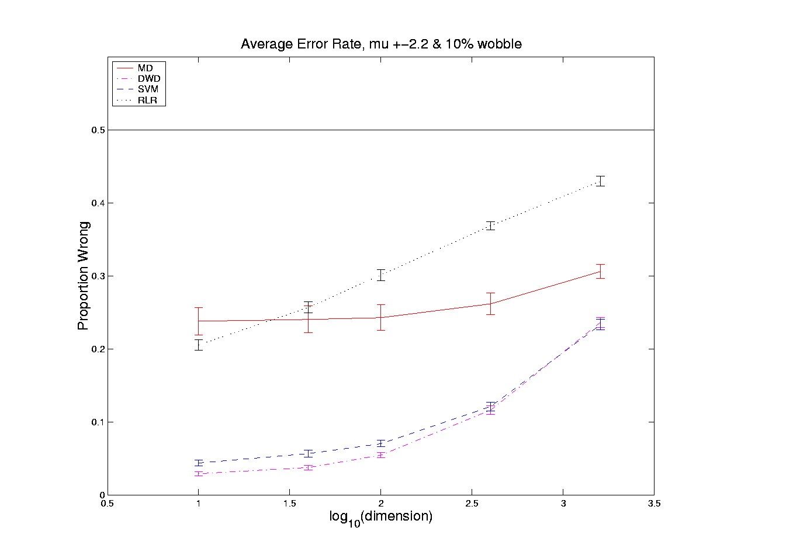
HDLSS Discrim’n Simulations
Wobble Mixture:
Notes:
DWD1figGBig.ps

Slide 121
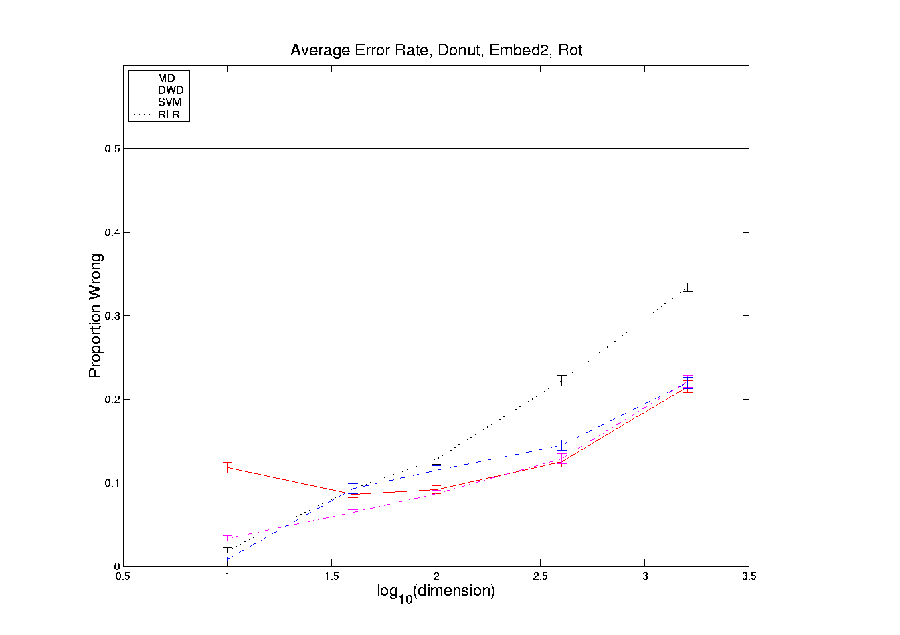
HDLSS Discrim’n Simulations
Nested Spheres:
Notes:
DWD1figHBig.ps

Slide 122
HDLSS Discrim’n Simulations
…
Interesting Phenomenon:
All methods come together
in very high dimensions???

Slide 123
HDLSS Discrim’n Simulations
Can we say more about:
All methods come together
in very high dimensions???
Mathematical Statistical Question:
Mathematics behind this???
(Use Geometric Representation)
Notes:
123

Slide 124
HDLSS Asy’s: Geometrical Represen’tion
Explanation of Observed (Simulation) Behavior:
“everything similar for very high d ”

Slide 125
HDLSS Asy’s: Geometrical Represen’tion
Explanation of Observed (Simulation) Behavior:
“everything similar for very high d ”
2 popn’s are 2 simplices (i.e. regular n-hedrons)

Slide 126
HDLSS Asy’s: Geometrical Represen’tion
Explanation of Observed (Simulation) Behavior:
“everything similar for very high d ”
2 popn’s are 2 simplices (i.e. regular n-hedrons)
All are same distance from the other class

Slide 127
HDLSS Asy’s: Geometrical Represen’tion
Explanation of Observed (Simulation) Behavior:
“everything similar for very high d ”
2 popn’s are 2 simplices (i.e. regular n-hedrons)
All are same distance from the other class
i.e. everything is a support vector
i.e. all sensible directions show “data piling”

Slide 128
HDLSS Asy’s: Geometrical Represen’tion
Explanation of Observed (Simulation) Behavior:
“everything similar for very high d ”
2 popn’s are 2 simplices (i.e. regular n-hedrons)
All are same distance from the other class
i.e. everything is a support vector
i.e. all sensible directions show “data piling”
so “sensible methods are all nearly the same”

Slide 129
HDLSS Asy’s: Geometrical Represen’tion
Straightforward Generalizations:
non-Gaussian data: only need moments

Slide 130
HDLSS Asy’s: Geometrical Represen’tion
Straightforward Generalizations:
non-Gaussian data: only need moments
non-independent: use “mixing conditions”

Slide 131
HDLSS Asy’s: Geometrical Represen’tion
Straightforward Generalizations:
non-Gaussian data: only need moments
non-independent: use “mixing conditions”
Mild Eigenvalue condition on Theoretical Cov.
(Ahn, Marron, Muller & Chi, 2007)

Slide 132
HDLSS Asy’s: Geometrical Represen’tion
Straightforward Generalizations:
non-Gaussian data: only need moments
non-independent: use “mixing conditions”
Mild Eigenvalue condition on Theoretical Cov.
(Ahn, Marron, Muller & Chi, 2007)
All based on simple “Laws of Large Numbers”

Slide 133
2nd Paper on HDLSS Asymptotics
Ahn, Marron, Muller & Chi (2007)
  Assume 2nd Moments
  Assume no eigenvalues too large

Slide 134
2nd Paper on HDLSS Asymptotics
Ahn, Marron, Muller & Chi (2007)
  Assume 2nd Moments
  Assume no eigenvalues too large in sense:
For assume i.e.

Slide 135
2nd Paper on HDLSS Asymptotics
Ahn, Marron, Muller & Chi (2007)
  Assume 2nd Moments
  Assume no eigenvalues too large in sense:
For assume i.e.
(min possible)
(much weaker than previous mixing conditions…)

Slide 136
2nd Paper on HDLSS Asymptotics
Background:
In classical multivariate analysis, the statistic
Is called the “epsilon statistic”

Slide 137
2nd Paper on HDLSS Asymptotics
Background:
In classical multivariate analysis, the statistic
Is called the “epsilon statistic”
And is used to test “sphericity” of dist’n,
i.e. “are all cov’nce eigenvalues the same?”

Slide 138
2nd Paper on HDLSS Asymptotics
Can show: epsilon statistic:
Satisfies:

Slide 139
2nd Paper on HDLSS Asymptotics
Can show: epsilon statistic:
Satisfies:
For spherical Normal,

Slide 140
2nd Paper on HDLSS Asymptotics
Can show: epsilon statistic:
Satisfies:
For spherical Normal,
Single extreme eigenvalue gives

Slide 141
2nd Paper on HDLSS Asymptotics
Can show: epsilon statistic:
Satisfies:
For spherical Normal,
Single extreme eigenvalue gives
So assumption is very mild
Much weaker than mixing conditions

Slide 142
2nd Paper on HDLSS Asymptotics
Ahn, Marron, Muller & Chi (2007)
  Assume 2nd Moments
  Assume no eigenvalues too large, :
Then

Slide 143
2nd Paper on HDLSS Asymptotics
Ahn, Marron, Muller & Chi (2007)
  Assume 2nd Moments
  Assume no eigenvalues too large, :
Then
Not so strong as before:

Slide 144
2nd Paper on HDLSS Asymptotics
Can we improve on:
?

Slide 145
2nd Paper on HDLSS Asymptotics
Can we improve on:
?
John Kent example: Normal scale mixture

Slide 146
2nd Paper on HDLSS Asymptotics
Can we improve on:
?
John Kent example: Normal scale mixture
Won’t get:

Slide 147
2nd Paper on HDLSS Asymptotics
Notes on Kent’s Normal Scale Mixture
Data Vectors are indep’dent of each other

Slide 148
2nd Paper on HDLSS Asymptotics
Notes on Kent’s Normal Scale Mixture
Data Vectors are indep’dent of each other
But entries of each have strong depend’ce

Slide 149
2nd Paper on HDLSS Asymptotics
Notes on Kent’s Normal Scale Mixture
Data Vectors are indep’dent of each other
But entries of each have strong depend’ce
However, can show entries have cov = 0!

Slide 150
2nd Paper on HDLSS Asymptotics
Notes on Kent’s Normal Scale Mixture
Data Vectors are indep’dent of each other
But entries of each have strong depend’ce
However, can show entries have cov = 0!
Recall statistical folklore:
Covariance = 0 Independence

Slide 151
0 Covariance is not independence
Simple Example

Slide 152
0 Covariance is not independence
Simple Example:
Random Variables and
Make both Gaussian
(Note: Not Using Multivariate Gaussian)

Slide 153
0 Covariance is not independence
Simple Example:
Random Variables and
Make both Gaussian
With strong dependence
Yet 0 covariance
Given , define

Slide 154
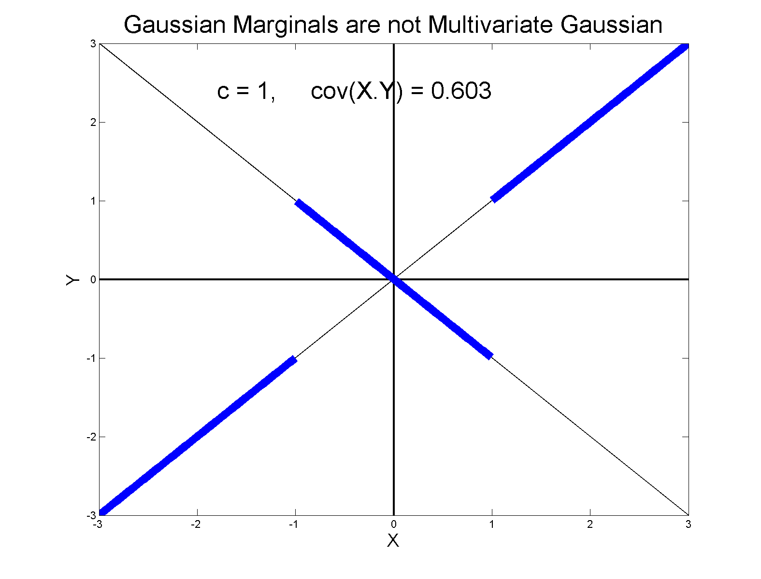
0 Covariance is not independence
Simple Example:

Slide 155
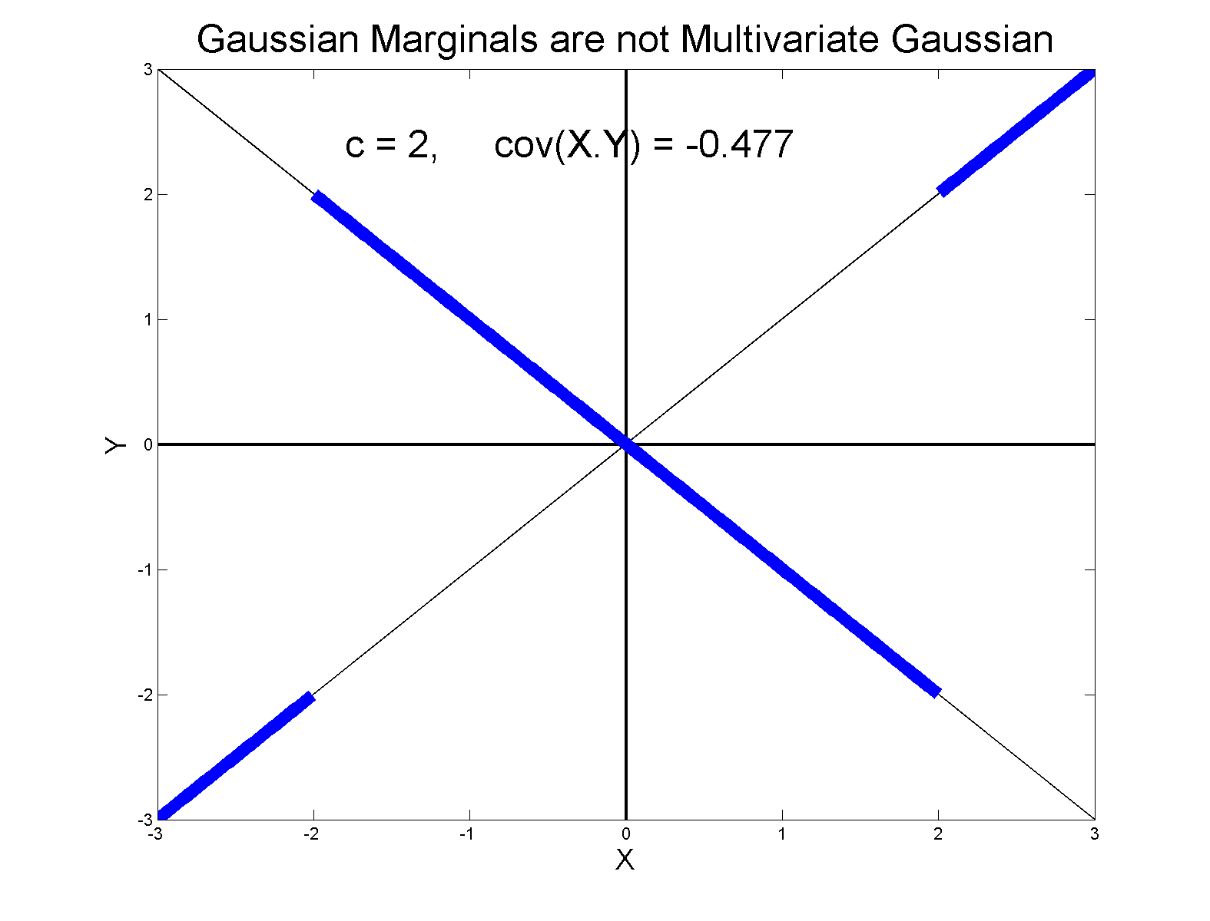
0 Covariance is not independence
Simple Example:

Slide 156
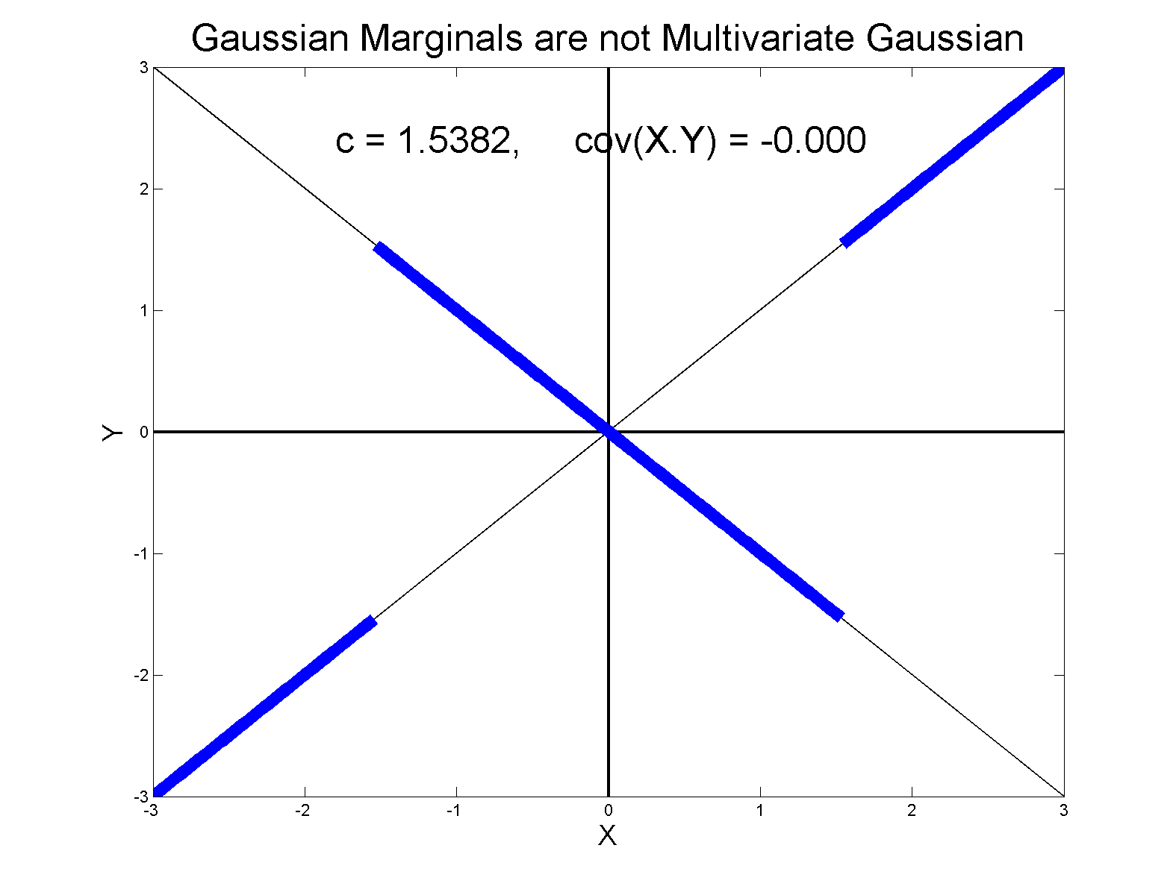
0 Covariance is not independence
Simple Example, c to make cov(X,Y) = 0

Slide 157
0 Covariance is not independence
Simple Example:
Distribution is degenerate
Supported on diagonal lines

Slide 158
0 Covariance is not independence
Simple Example:
Distribution is degenerate
Supported on diagonal lines
Not abs. cont. w.r.t. 2-d Lebesgue meas.

Slide 159
0 Covariance is not independence
Simple Example:
Distribution is degenerate
Supported on diagonal lines
Not abs. cont. w.r.t. 2-d Lebesgue meas.
For small , have
For large , have

Slide 160
0 Covariance is not independence
Simple Example:
Distribution is degenerate
Supported on diagonal lines
Not abs. cont. w.r.t. 2-d Lebesgue meas.
For small , have
For large , have
By continuity, with

Slide 161
0 Covariance is not independence
Result:
Joint distribution of and :
  Has Gaussian marginals
  Has

Slide 162
0 Covariance is not independence
Result:
Joint distribution of and :
  Has Gaussian marginals
  Has
  Yet strong dependence of and
  Thus not multivariate Gaussian

Slide 163
0 Covariance is not independence
Result:
Joint distribution of and :
  Has Gaussian marginals
  Has
  Yet strong dependence of and
  Thus not multivariate Gaussian
Shows Multivariate Gaussian means more
than Gaussian Marginals

