Slide 1
Statistics – O. R. 881 Object Oriented Data Analysis
Steve Marron
Dept. of Statistics and Operations Research
University of North Carolina

Slide 2
Current Sections in Textbook
Today:
Sections 11.3, 11.4
Next Class:
Section 11.4, 11.5

Slide 3
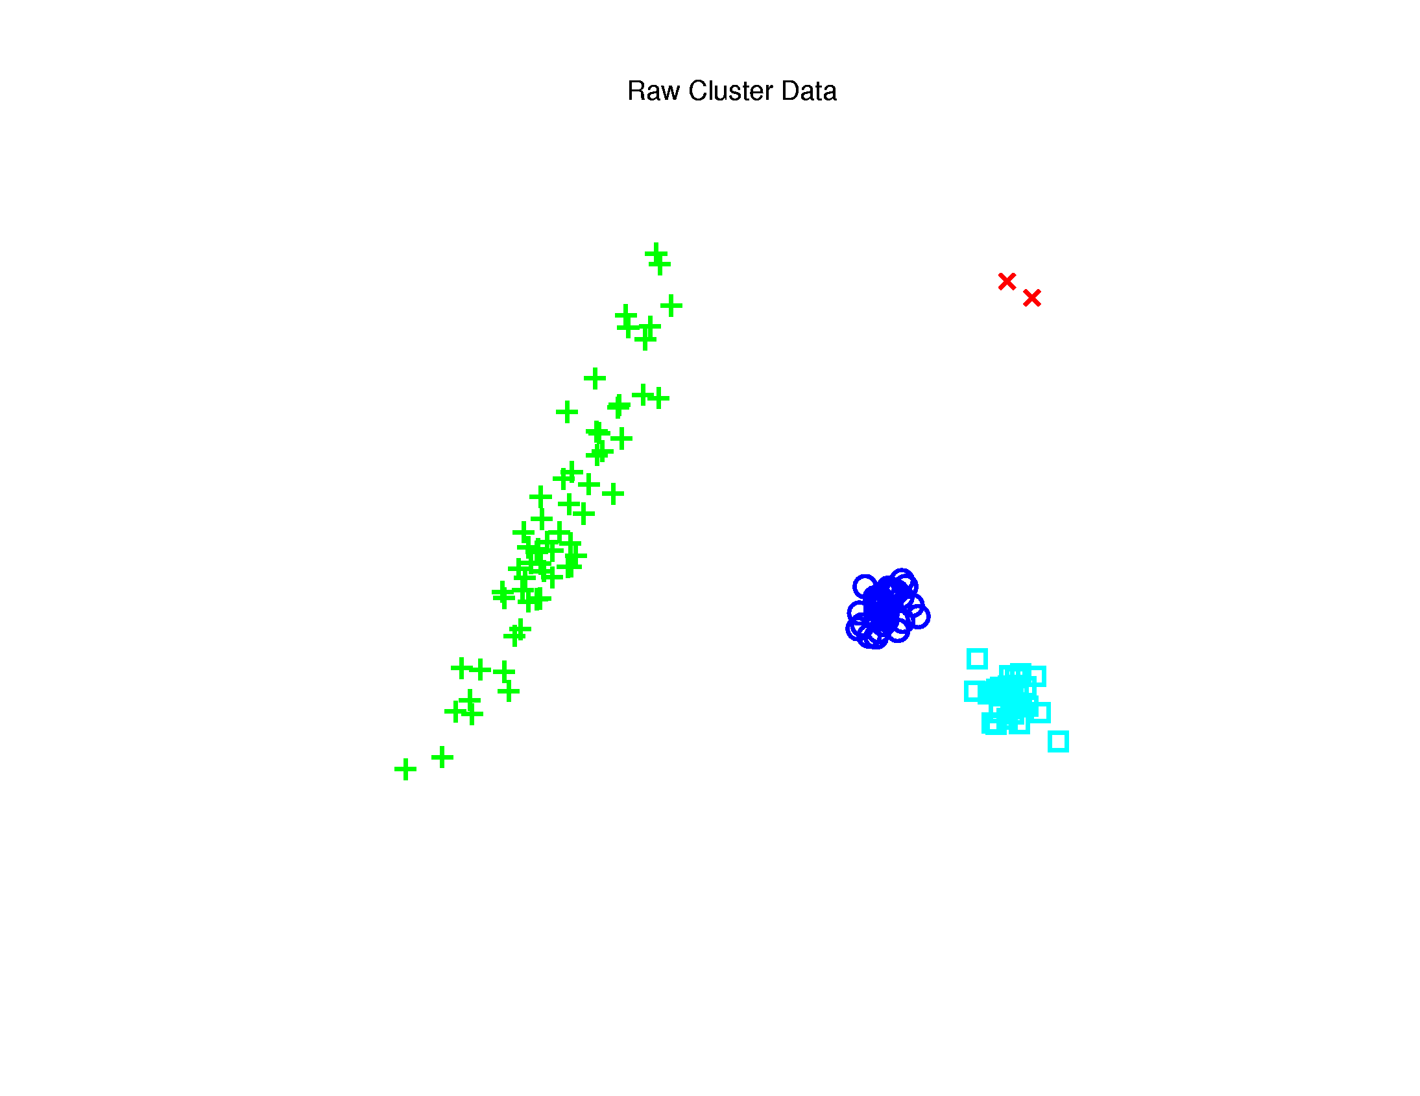
Last Class: Kernel PCA
Toy $ℝ^{2}$ Example: Raw Data
Long Stretched
Cluster
Round Clusters
Outliers?
Small Cluster?

Slide 4
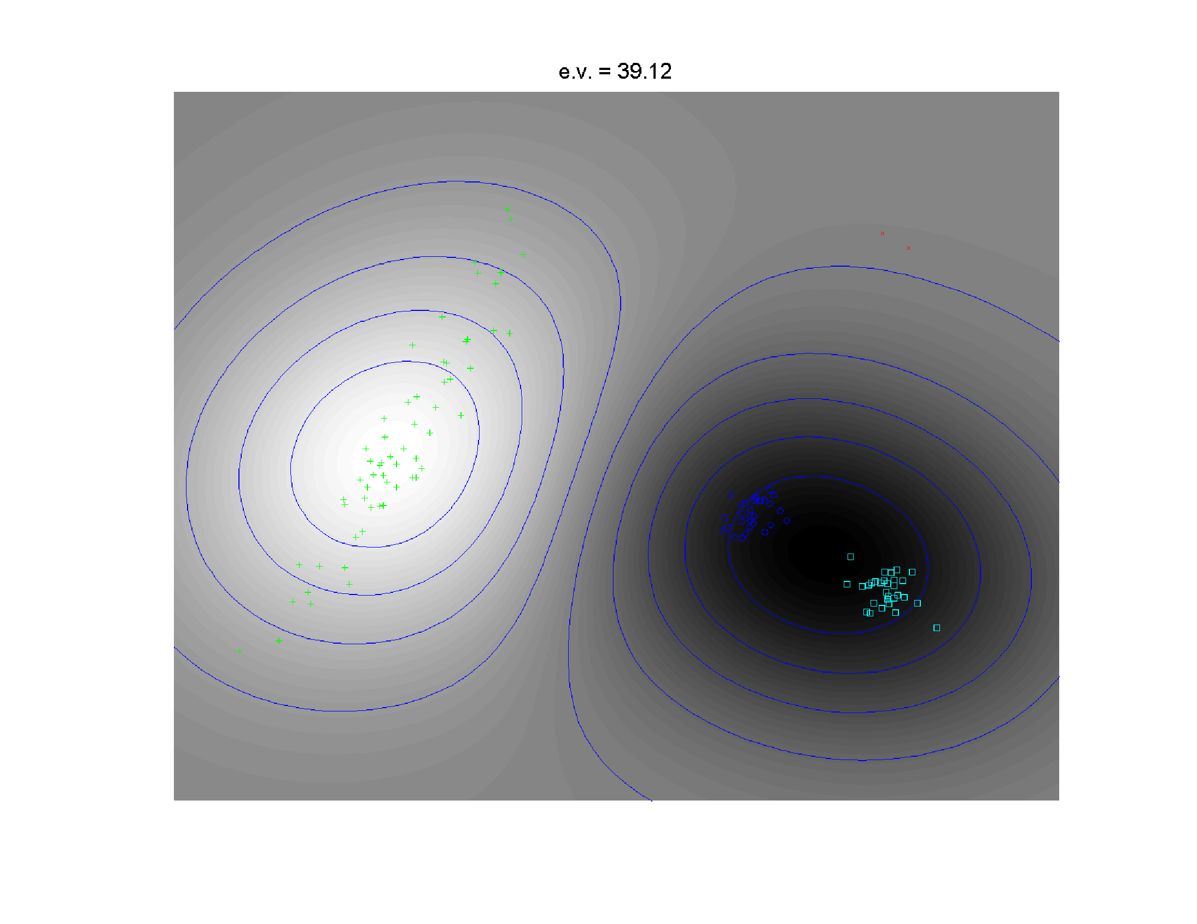
Last Class: Kernel PCA
1st Component
Finds Coarse
Scale Green
vs. Blues

Slide 5
Last Class: t-SNE Visualizat’n
Main Idea:
Data
Kernel Space
MDS Type Representers
Induces Kernel
PCA Type Locality
Gaussian Kernel
Transformation
Cauchy Kernel
Transformation
Pushes Away
Farther Points
Optimization: Make
Close As Possible
Recall Multi Dimensional
Scaling = Auto-Encoder

Slide 6
Last Class: t-SNE Visualizat’n
Same Toy $ℝ^{2}$ Example
4(?) Quite
Diverse
Clusters

Slide 7
Last Class: t-SNE Visualizat’n
Perplexity = 30 (Default)
Keeps Local
Structure
But Global
Rearangement
And Outlier
Cluster is Split

Slide 8
Last Class: Supp. Vec. Mach.
Motivation:
Find a linear method that “works well”
for embedded data
Note: Embedded data are
very non-Gaussian
Suggests value of
really new approach

Slide 9
Last Class: SVMs, Tuning Par.
Toy Example: $d=50$, Sph’l Gaussian data
For Large Values of C
Lots of Data Piling
Large Angle to Optimal
Thus Less Generalizable
(For This Data Set)
But Big
Margin
Called Hard Margin SVM

Slide 10
Last Class: SVMs, Tuning Par.
Toy Example: $d=50$, Sph’l Gaussian data
For Small Values of C
No Apparent Data Piling
Smaller Angle to Optimal
So More Generalizable
Yet Smaller
Margin $\frac{1}{\left\|w\right\|}$
Connection to MD?
Add MD Axis to Plot

Slide 11
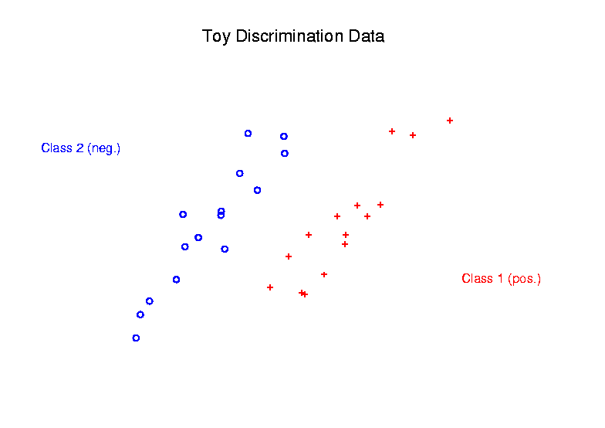
Last Class: SVMs
Graphical View, using Toy Example:

Slide 12
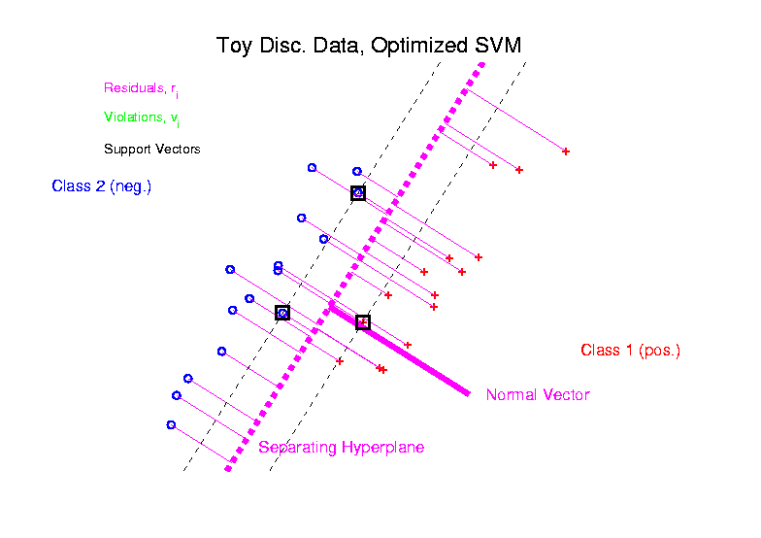
Last Class: SVM
Graphical View, using Toy Example:

Slide 13
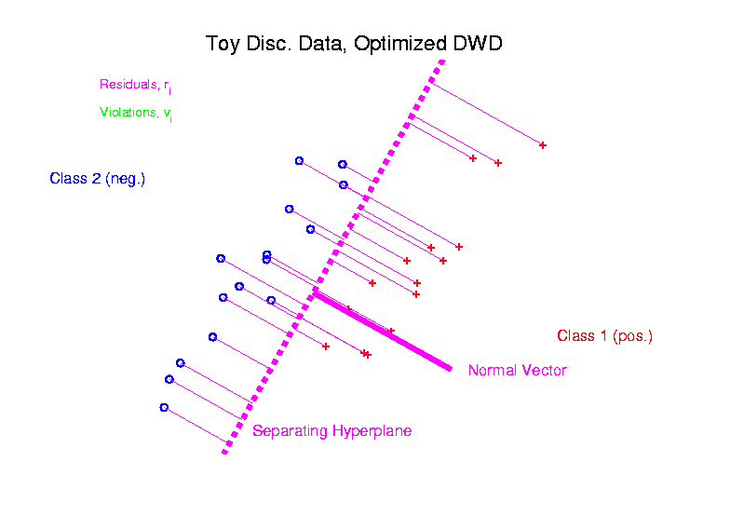
Last Class: DWD
Graphical View, using Toy Example:

Slide 14
Last Class: Dist. W’ted Disc.
Toy e.g.: Hard Margin SVM Direction
- Bigger Gap
- Smaller Angle
- Better
Gen’ability
- Feels support
vectors too
strongly???
- Ugly subpops?
- Improvement?
Similarly Feels Small
Scale Noise Artifacts

Slide 15
Last Class: Dist. W’ted Disc.
Toy e.g.: Distance Weighted Discrimination
- Addresses
these issues
- Smaller Angle
- Better
Gen’ability
- Nice subpops
- Replaces
min dist. by
avg. dist.

Slide 16
Last Class: Dist. W’ted Disc.
Based on Optimization Problem:
For “Residuals”:

Slide 17
Distance Weighted Discrim’n
Based on Optimization Problem:
More precisely:
Work in appropriate penalty for violations
Optimization Method:
Second Order Cone Programming
“Still convex” gen’n of quad’c program’g
Allows fast greedy solution
Can use available fast software
(SDP3, Michael Todd, et al)

Slide 18
Distance Weighted Discrim’n
References for more on DWD:
Main paper:
Marron, Todd and Ahn (2007)
Links to more papers:
Ahn (2006)
R Implementation of DWD:
CRAN (2014)
SDPT3 Software:
Toh et al (1999)
Sparse DWD: Wang & Zou (2016)
Notes:
18

Slide 19
Distance Weighted Discrim’n
References for more on DWD:
Faster Version:
Lam et al. (2018)
Robust (Against Heterogeneity) Version:
Wang & Zou (2016)
Approach: three-block
semiproximal alternating
direction method of
multipliers
May Discuss
More Later
Notes:
19

Slide 20
Distance Weighted Discrim’n
2-d Visualization:
$\min_{w,b}{\sum_{i=1}^{n}{\frac{1}{r_{i}^{q}}}}$
Pushes Plane
Away From
Data
All Points
Have Some
Influence
(not just support vectors)

Slide 21
Distance Weighted Discrim’n
Caution:
Early DWD Versions Assumed $n_{+}=n_{−}$
(Balanced Sampling)
Improved Version:
Qiao et al. (2010)
Also Includes Arbitrary Class Priors
If Not, Cutoff $β$ Is Wrong,
Can Give Poor Results
Notes:
21

Slide 22
Distance Weighted Discrim’n
Current Choice of Tuning Parameter $C$:
“Large Value Works Well”
“Hard Margin” Analog Handles Variation Well
Don’t Need Cross-Validation as with SVM
(So DWD much more efficient)

Slide 23
Distance Weighted Discrim’n
Interesting Open Problem:
Analyze DWD from Viewpoint of:
Carmichael and Marron (2021)

Slide 24
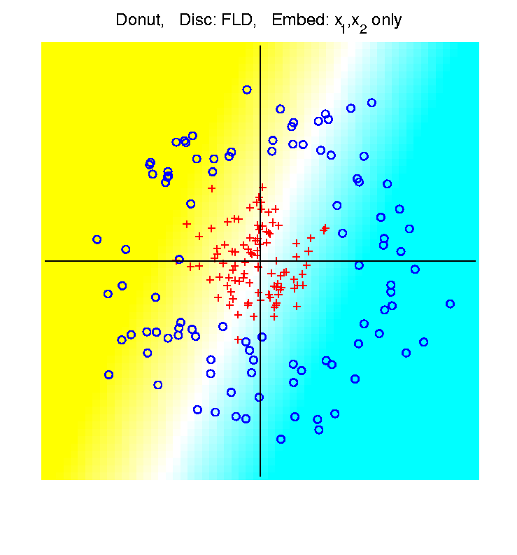
Recall: High $d$ Asymptotics & Kernels
Recall
Flexibility
From
Kernel
Embedding
Idea

Slide 25
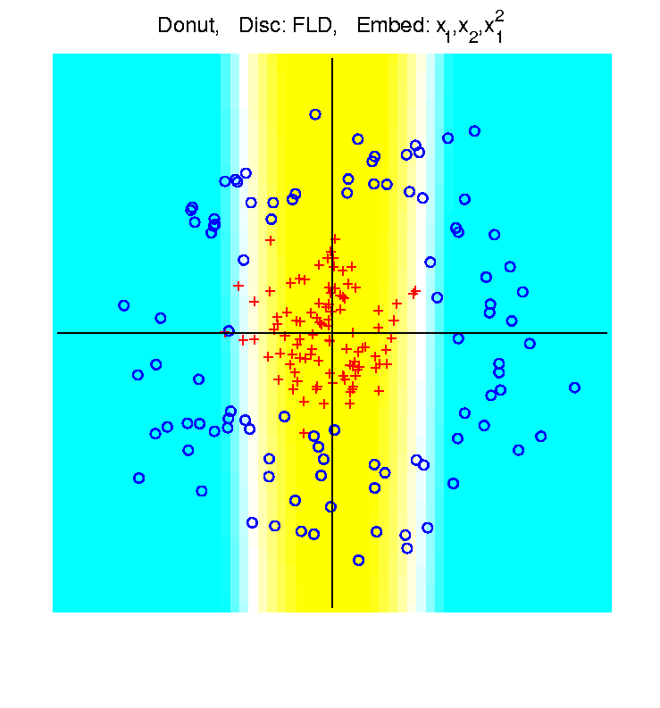
Recall: High $d$ Asymptotics & Kernels
Recall
Flexibility
From
Kernel
Embedding
Idea

Slide 26
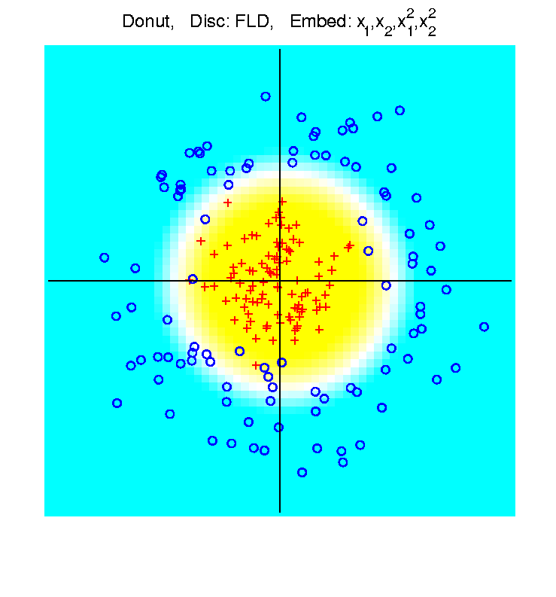
Recall: High $d$ Asymptotics & Kernels
Recall
Flexibility
From
Kernel
Embedding
Idea

Slide 27
Recall: High $d$ Asymptotics & Kernels
Interesting Question:
Behavior in Very High Dimensions?
Answer: El Karoui (2010)
In Random Matrix Limit, $n\sim d→∞$
Kernel Embedded Classifiers ~
~ Linear Classifiers

Slide 28
Recall: High $d$ Asymptotics & Kernels
In Random Matrix Limit, $n\sim d→∞$
Kernel Embedded Classifiers ~
~ Linear Classifiers
Intuitively Sensible?
High Dimensional Space is Very Big
Recall HDLSS Geometric Represent’n
Linear Methods: “Enough Room to Work”

Slide 29
Recall: High $d$ Asymptotics & Kernels
Interesting Question:
Behavior in Very High Dimensions?
Implications for DWD:
Recall Main Advantage is for High d
So Not Clear Embedding Helps
Thus Not Yet Implemented in DWD

Slide 30
HDLSS Discrim’n Simulations
Main idea:
Comparison of
SVM (Hard Margin Version)
DWD (Distance Weighted Discrimination)
MD (Mean Difference, a.k.a. Centroid)
Linear versions, across dimensions
Notes:
30

Slide 31
HDLSS Discrim’n Simulations
Overall Approach:
Study different known phenomena
Spherical Gaussians
Outliers
Polynomial Embedding
Common Sample Sizes
$$n_{+}=n_{−}=25$$
But wide range of dimensions
$$d=10, 40, 100, 400, 1600$$

Slide 32
HDLSS Discrim’n Simulations
Criterion for Comparison:
Based on 100 Simulated Experiments
Each had $n_{+}=n_{−}=25$ Training Data
Assessed with $200$ Test Data Points
Recorded Misclassification Proportion

Slide 33
HDLSS Discrim’n Simulations
Spherical Gaussians:
Notes:
DWD1figEBig.ps

Slide 34
HDLSS Discrim’n Simulations
Spherical Gaussians:
Same setup as before
Means shifted in dim 1 only, $μ_{1}=±2.2$
All methods pretty good
Harder problem for higher dimension
SVM noticeably worse
MD best (Likelihood method)
DWD very close to MD
Methods converge for higher dimension??

Slide 35
HDLSS Discrim’n Simulations
Outlier Mixture:
Notes:
DWD1figFBig.ps

Slide 36
HDLSS Discrim’n Simulations
Outlier Mixture:
80% dim. 1 $μ_{1}=±2.2$, other dims 0
20% dim. 1 ±100, dim. 2 ±500, others 0
MD is a disaster, driven by outliers
SVM & DWD are both very robust
SVM is best
DWD very close to SVM (insig’t difference)
Methods converge for higher dimension??
Ignore RLR (a mistake)

Slide 37
HDLSS Discrim’n Simulations
Wobble Mixture:
Notes:
DWD1figGBig.ps

Slide 38
HDLSS Discrim’n Simulations
Wobble Mixture:
80% dim. 1 $μ_{1}=±2.2$, other dims 0
20% dim. 1 ±0.1, rand dim ±100, others 0
MD still very bad, driven by outliers
SVM & DWD are both very robust
SVM loses (affected by margin push)
DWD slightly better (by w’ted influence)
Methods converge for higher dimension??
Ignore RLR (a mistake)

Slide 39
HDLSS Discrim’n Simulations
Nested Spheres:
Notes:
DWD1figHBig.ps

Slide 40
HDLSS Discrim’n Simulations
Nested Spheres:
1st d/2 dim’s, Gaussian with var 1 or C
2nd d/2 dim’s, the squares of the 1st dim’s
(as for 2nd degree polynomial embedding)
Each method best somewhere
MD best in highest d (data non-Gaussian)
Methods not comparable (realistic)
Methods converge for higher dimension??
HDLSS space is a strange place
Ignore RLR (a mistake)

Slide 41
HDLSS Discrim’n Simulations
Conclusions:
Everything (sensible) is best sometimes
DWD often very near best
MD weak beyond Gaussian
Caution about simulations (and examples):
Very easy to cherry pick best ones
Good practice in Machine Learning
“Ignore method proposed, but read
paper for useful comparison of others”
Every Dog Has his Day

Slide 42
HDLSS Discrim’n Simulations
Caution: There are additional players
E.g. Regularized Logistic Regression
looks also very competitive
Interesting Phenomenon:
All methods come together
in very high dimensions???

Slide 43
HDLSS Discrim’n Simulations
Can we say more about:
All methods come together
in very high dimensions???
Mathematical Statistical Question:
Mathematics behind this???
Notes:
43

Slide 44
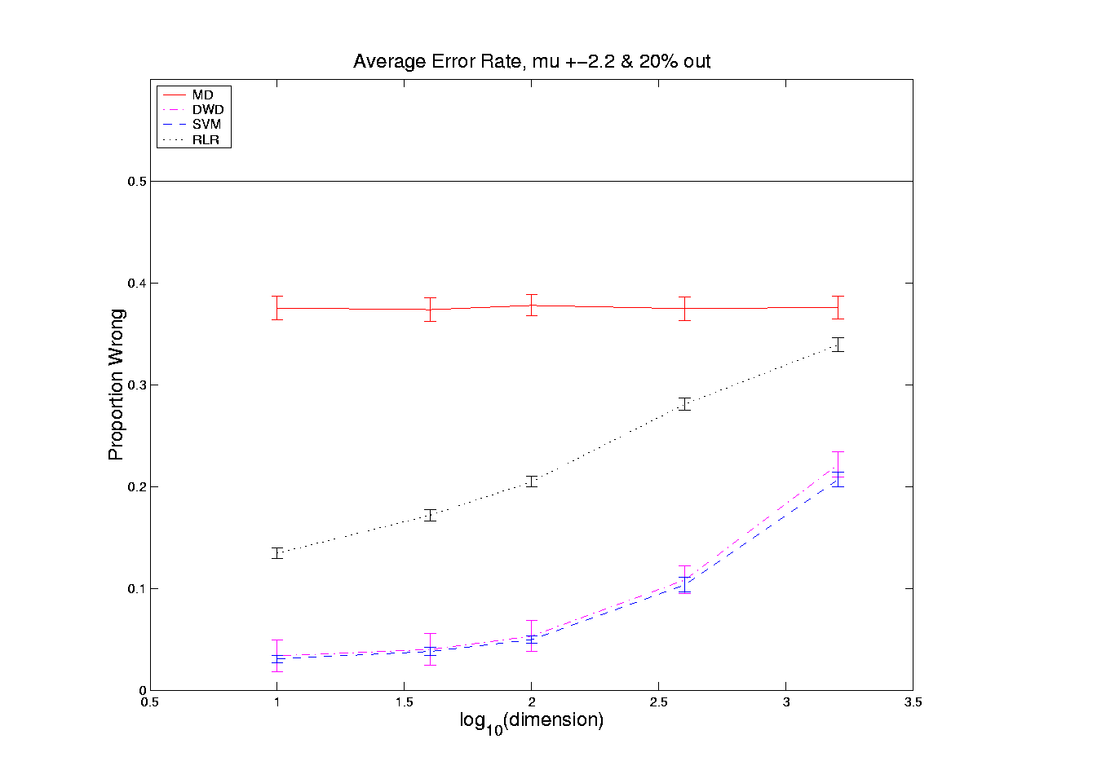
HDLSS Asymptotics in Classification
Recall in Simulations,
Methods Came Together, for High $d$

Slide 45
HDLSS Asymptotics in Classification
Explanation of Observed (Simulation) Behavior:
“everything similar for very high d ”
2 popn’s are 2 simplices (i.e. regular n-hedrons)
All are same distance from the other class
i.e. everything is a support vector
i.e. all sensible directions show “data piling”
so “sensible methods are all nearly the same”

Slide 46
HDLSS Asymptotics in Classification
Further Consequences of Geometric Represen’tion
1. DWD more stable than SVM
(based on deeper limiting distributions)
(reflects intuitive idea feeling sampling variation)
(something like mean vs. median)
Hall, Marron, Neeman (2005)
2. 1-NN rule inefficiency is quantified.
Hall, Marron, Neeman (2005)
3. Inefficiency of DWD for uneven sample size
(motivates weighted version)
Qiao, et al (2010)

Slide 47
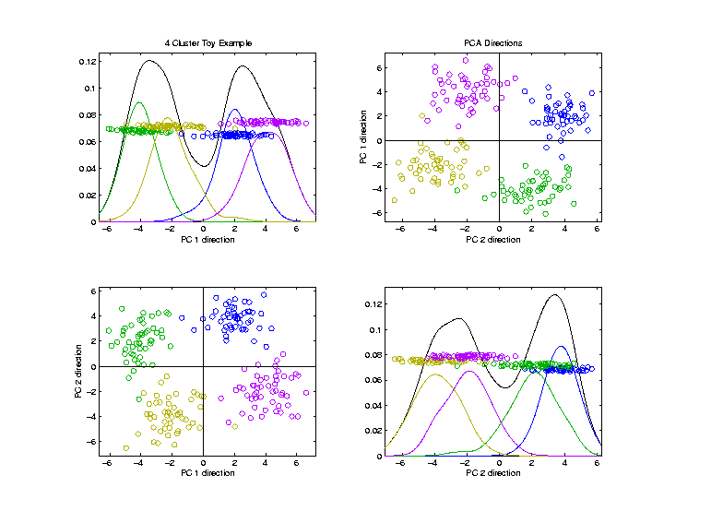
Visualization by DWD, SVM, MD
Toy Example:
4 Clusters,
Symmetric
Gaussians,
$d=200$

Slide 48
Visualization by DWD, SVM, MD
Toy Example:
Train DWD
On These
2 Classes

Slide 49
Visualization by DWD, SVM, MD
Toy Example:
Train SVM & MD
On These
2 Classes

Slide 50
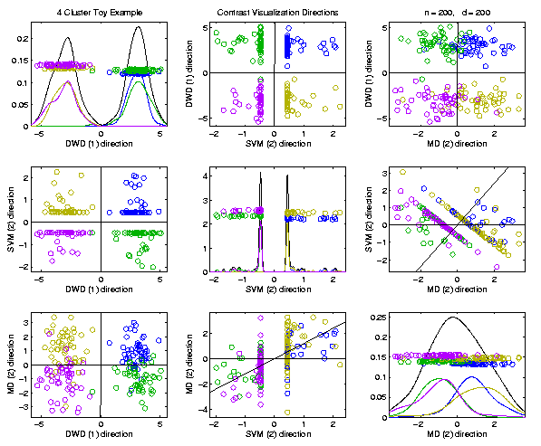
Visualization by DWD, SVM, MD
Toy Example:
Use Those
Directions
In Scatterplot
Matrix View
SVM Data Piling Leaves Lines in Plots

Slide 51
Visualization by DWD, SVM, MD
Toy Example:
MD Has
Strong
Overlap
200 Dim’al Noise
Impacts Means
DWD Gives Superior Visualization
Optimization Less Sensitive to 200 Dim’al Noise

Slide 52
Batch and Source Adjustment
Important Application
of
Distance Weighted Discrimination

Slide 53
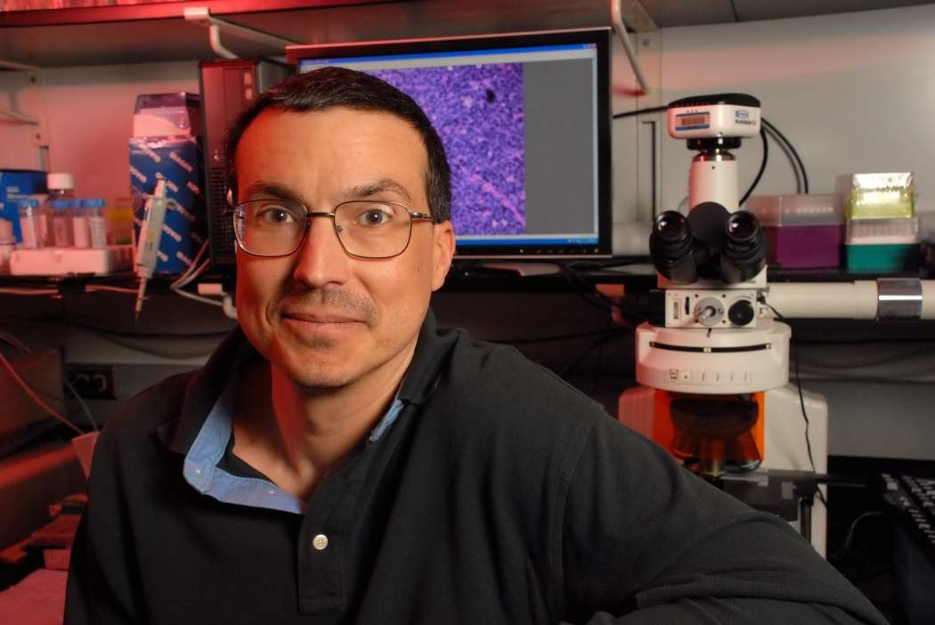
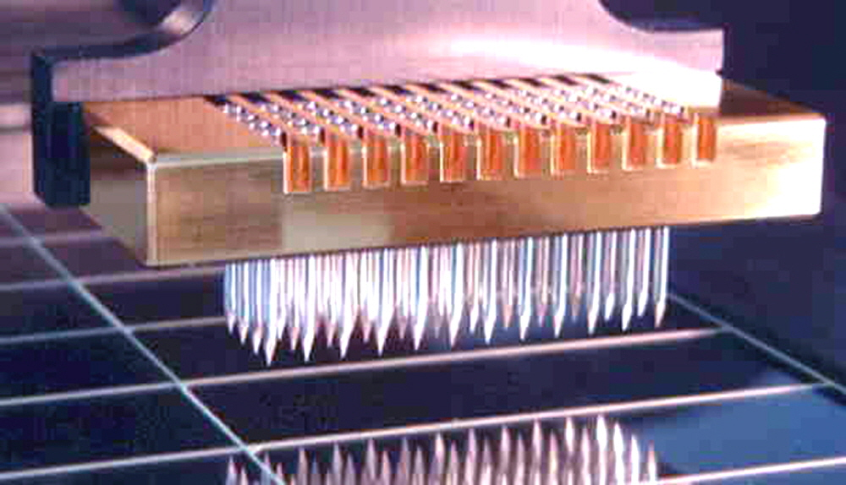
Batch and Source Adjustment
For Stanford Breast Cancer Data
From Perou et al (2000)
Microarray for Measuring Gene Expression
Old Style: Arrays Printed in Lab

Slide 54
Batch and Source Adjustment
For Stanford Breast Cancer Data
From Perou et al (2000)
Analysis in Benito et al (2004)
Adjust for Source Effects
Different sources of mRNA
Adjust for Batch Effects
Arrays fabricated at different times

Slide 55
Idea Behind Adjustment
Early Approach: Alter et al (2000)
Squash Out PC1 direction
Eliminates variation in that direction

Slide 56
DWD: Why not PC1?
PC 1 Direction feels variation, not classes
Also eliminates (important?) within class variation

Slide 57
DWD: Why not PC1?
Direction driven by classes
“Sliding” maintains (important?) within class variation

Slide 58
E. g. even worse for PCA
PC1 direction is worst possible

Slide 59
But easy for DWD
Since DWD uses class label information

Slide 60
Batch and Source Adjustment
Try Out Real Data:
Stanford Breast Cancer Data
From Perou et al (2000)
$d=1753$ “Intrinsic” Genes
$n=107$ Breast Cancer Patients
Discovered With Clustering: Subtypes

Slide 61
Source Batch Adj: Raw Breast Cancer data
See Some
Clusters?

Slide 62
Source Batch Adj: Source Colors
Color By Ink Used
to Print Chips
Bad News, Since
This Dominates PC1
Squishing PC1
Not So Good
Since PC2
Also Involved
Yet Want to Find
Cancer Subtypes

Slide 63
Source Batch Adj: Batch Colors
Color By
Fabrication
Batch
This
Dominates
PC4
Is There
Any Biology
In This Data?

Slide 64
Source Batch Adj: Biological Class Colors
Color By
Cancer
Subtypes
Important Biology
Appears in PCs 2 & 3
Strongly Motivates
Adjustment of Data

Slide 65
Source Batch Adj: Biological Class Col. & Symbols
Follow Subtypes
Using Symbols

Slide 66
Source Batch Adj: Biological Class Symbols
Switch Off
Subtype
Colors

Slide 67
Source Batch Adj: Source Colors
Return to
Source
Colors

Slide 68
Source Batch Adj: PC 1-3 & DWD direction
Replace PC4
By DWD
Direction
Note Much Farther
Apart Than in PC1

Slide 69
Source Batch Adj: DWD Source Adjustment
Slide Data
In DWD
Direction
Note How Subtypes
Come Together
Until Means
Are the Same

Slide 70
Source Batch Adj: Source Adj’d, PCA view
Return PC4

Slide 71
Source Batch Adj: Source Adj’d, Class Colored
Subtype Colors
Shows Very
Successful
Adjustment

Slide 72
Source Batch Adj: Source Adj’d, Batch Colored
Next Consider
Batch Colors

Slide 73
Source Batch Adj: Source Adj’d, 5 PCs
Don’t Want to Replace PC4
With DWD, Since Will Miss
Effect of Adjustment,
So Add PC5 (to Replace)

Slide 74
Source Batch Adj: S. Adj’d, Batch 1,2 vs. 3 DWD
Replace PC5 With DWD Trained
on Blue vs. (Green & Red)

Slide 75
Source Batch Adj: S. & B1,2 vs. 3 Adjusted
Slide Data
In DWD
Direction
Good Impact
On PC4

Slide 76
Source Batch Adj: S. & B1,2 vs. 3 Adj’d, 5 PCs
Return to PC5

Slide 77
Source Batch Adj: S. & B Adj’d, B1 vs. 2 DWD
DWD Trained on
(Green & Blue) vs. Red

Slide 78
Source Batch Adj: S. & B Adj’d, B1 vs. 2 Adj’d
Slide Data
In DWD
Direction

Slide 79
Source Batch Adj: S. & B Adj’d, 5 PC view
Return
To PC5

Slide 80
Source Batch Adj: S. & B Adj’d, 4 PC view
Go Back To
4 PCs View

Slide 81
Source Batch Adj: S. & B Adj’d, Class Colors
Return Subtype Colors
Note Subtypes Distinguished,
i.e. Successful Adjustment
After adjusting, These Are
No Longer PC Directions

Slide 82
Source Batch Adj: S. & B Adj’d, Adj’d PCA
Recompute PC Axes
PC1 & 2 Now About Biology

Slide 83
DWD does not solve all problems
Only handles means, not differing variation
Alternative: Shabalin et al (2008)

Slide 84
Interesting Benchmark Data Set
NCI 60 Cell Lines
Interesting benchmark, since same cells
Data Web available:
http://discover.nci.nih.gov/datasetsNature2000.jsp
Both cDNA and Affymetrix Platforms
Different from Breast Cancer Data
Which had no common samples
See Liu et al. (2009)

Slide 85
Interesting Benchmark Data Set
NCI 60 Cell Lines
Interesting benchmark, since same cells
Previously Studied, (1/18/2024)
Illustrating Limitations of PCA Views
Used DWD Dir’ns to Focus on Types

Slide 86
NCI 60: Can we find classes Using PCA view?
Notes:
86

Slide 87
NCI 60: Views using DWD Dir’ns (focus on biology)
Now
Study
Where
This
Data
Came
From
Notes:
87

Slide 88
Recall DWD Appl’n: Visualization
Recall PCA limitations
DWD uses class info
Hence can “better separate known classes”
Did this for pairs of classes
(DWD just on those, ignore others)
Carefully choose pairs in NCI 60 data
Showed Effectiveness of DWD Visualization

Slide 89
Recall DWD Appl’n: Visualization
Now Study Provenance of NCI 60 Data
Gene Expression Experiment
Same Samples On 2 Microarray Platforms
Affymetrix (Boston)
CDNA (Stanford, Chuck Perou)
Which is “Better”?
Measuring the “Same” thing?
Can Put on Same Scale?
Benito, et al. (2004)
60 Cancer
Cell Lines

Slide 90
NCI 60: Raw Data, Platform Colored
Common Samples
Connected by
Dashed Lines
Huge Platform
Differences
Fortunately
Systematic

Slide 91
NCI 60: Raw Data
Use Common Colors

Slide 92
NCI 60: Raw Data, Before DWD Adjustment
Slide Points Down
Along Diagonal
(to make space)
Color Blue
For “Before”

Slide 93
NCI 60: Before & After DWD adjustment
Add On Red
Points for
“After” DWD
Show Blue → Red
Difference as
Black Lines

Slide 94
NCI 60: Before & After, new scales
Rescale Axes to
Focus on Red Only

Slide 95
NCI 60: After DWD
Turn Off
All But Red

Slide 96
NCI 60: DWD adjusted data
Slide Down to Middle

Slide 97
NCI 60: Before Column Mean Adjustment
Slide Further Down
To Become “Before”
For Next Step

Slide 98
NCI 60: Before & After Column Mean Adjustment
Impacts Variation
In PC1 Direction
Subtract Trait Means
(i.e. Means of Columns)

Slide 99
NCI 60: Before & After Col. Mean Adj., Rescaled
Rescale Axes to
Focus on Red Only

Slide 100
NCI 60: After DWD & Column Mean Adj.
Turn Off
All But Red

Slide 101
NCI 60: DWD & Column Mean Adjusted
Slide Down to Middle

Slide 102
NCI 60: Before Column Stand. Dev. Adjustment
Slide Further Down
To Become “Before”
For Next Step

Slide 103
NCI 60: Before and After Column S.D. Adjustment
Standardize Columns
(Divide Columns by SD)
Reduces Blue Variation Everywhere

Slide 104
NCI 60: Before and After Col. S.D. Adj., Rescaled
Rescale Axes to
Focus on Red Only

Slide 105
NCI 60: After Column Stand. Dev. adjustment
Turn Off
All But Red

Slide 106
NCI 60: Fully Adjusted Data
Slide Down to Middle

Slide 107
NCI 60: Fully Adjusted Data, Platform Colored
Return Original Colors
Next Study Clusters
Using “Brushing”

Slide 108
NCI 60: Fully Adjusted Data, Melanoma Cluster
BREAST.MDAMB435
BREAST.MDN
MELAN.MALME3M
MELAN.SKMEL2
MELAN.SKMEL5
MELAN.SKMEL28
MELAN.M14
MELAN.UACC62
MELAN.UACC257
Known Mislabellings

Slide 109
NCI 60: Fully Adjusted Data, Leukemia Cluster
LEUK.CCRFCEM
LEUK.K562
LEUK.MOLT4
LEUK.HL60
LEUK.RPMI8266
LEUK.SR

Slide 110
Why not adjust using SVM?
Major Problem: Proj’d Distrib’al Shape
Triangular Dist’ns (opposite skewed)
Does not allow sensible rigid shift

Slide 111
Why not adjust using SVM?
Nicely Fixed by DWD
Projected Dist’ns near Gaussian
Sensible to shift

Slide 112
Why not adjust by means?
DWD is complicated: value added?
Because it is “cool”
Recall Improves SVM for HDLSS
Good Empirical Success
Routinely Used in Perou Lab
Many Comparisons Done
Similar Lessons from Wistar
Proven Statistical Power

Slide 113
Why not adjust by means?
But Why Not PAM (~Mean Difference)?
Simpler is Better
Why not means, i.e. point cloud centerpoints?
Elegant Answer: Liu et al (2009)

Slide 114
Why not adjust by means?
But Why Not PAM (~Mean Difference)?
Simpler is Better
Why not means, i.e. point cloud centerpoints?
Drawback to PAM:
Poor Handling of Unbalanced Biological Subtypes
DWD more Resistant to Unbalance

Slide 115
Why not adjust by means?
Toy Example:
Gaussian Clusters
Two batches (denoted: + o)
Two subtypes (red and blue)
Goal: bring together
+ ←→ o and also + ←→ o
Challenge: unequal biological ratios within batches

Slide 116
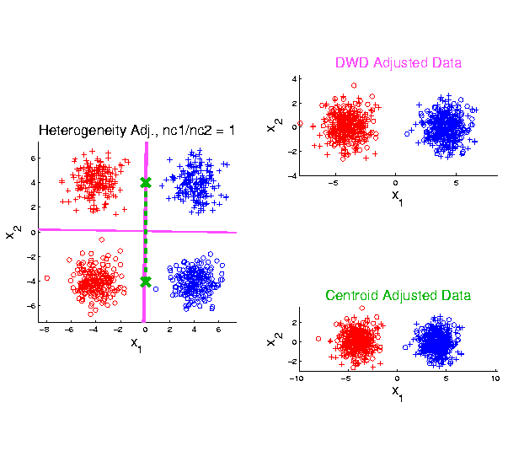
Twiddle ratios of subtypes
2-d Toy
Example
Balanced
Mixture
Adjusted Along
DWD Direction
Adjusted Along
MD Direction

Slide 117
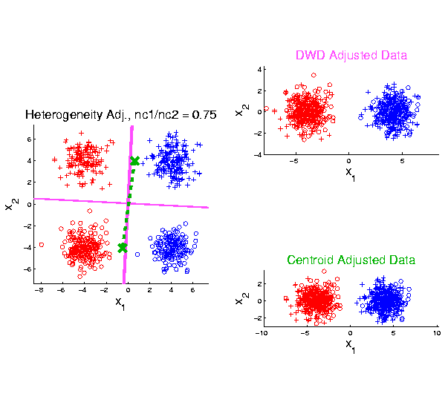
Twiddle ratios of subtypes
2-d Toy
Example
Unbalanced
Mixture
(Through
“decimation”)

Slide 118
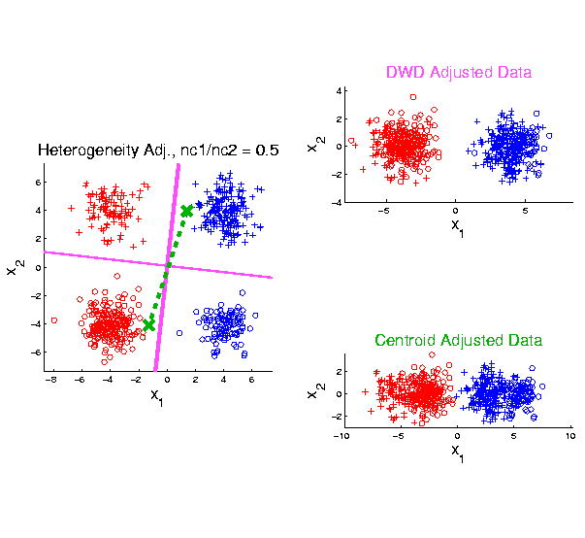
Twiddle ratios of subtypes
2-d Toy
Example
Unbalanced
Mixture
(Diminishing
Discriminatory
Power)

Slide 119
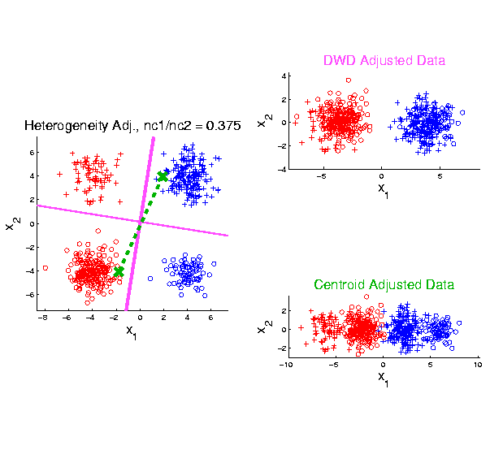
Twiddle ratios of subtypes
2-d Toy
Example
Unbalanced
Mixture

Slide 120
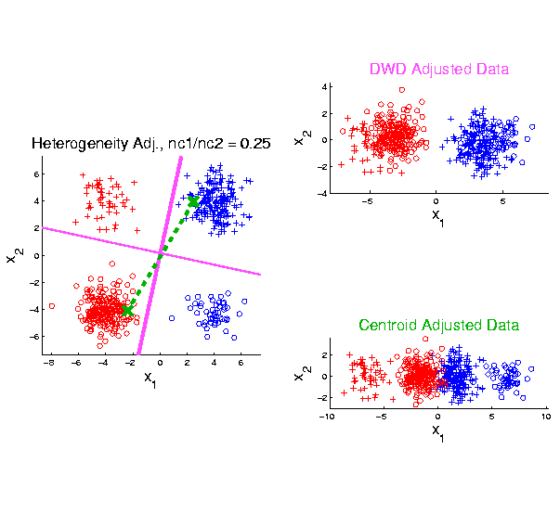
Twiddle ratios of subtypes
2-d Toy
Example
Unbalanced
Mixture

Slide 121
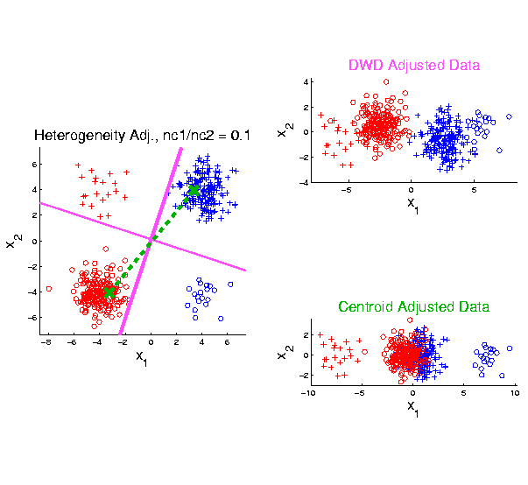
Twiddle ratios of subtypes
2-d Toy
Example
Unbalanced
Mixture
Note: Losing
Distinction
To Be Studied

Slide 122
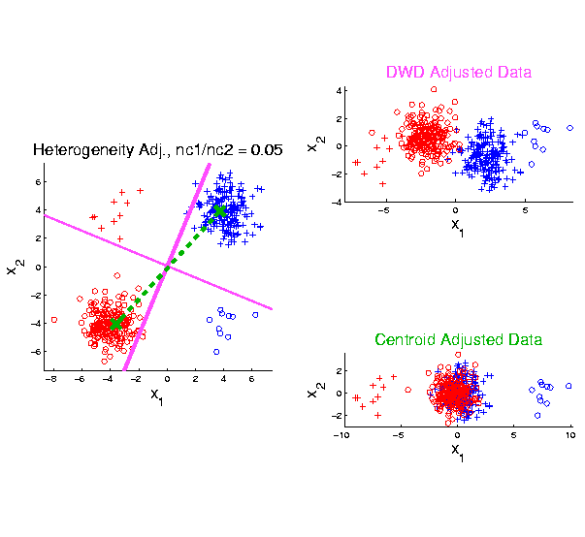
Twiddle ratios of subtypes
2-d Toy
Example
Unbalanced
Mixture

Slide 123
Why not adjust by means?
DWD robust against non-proportional subtypes…
Mathematical Statistical Question:
Are there mathematics behind this?
Notes:
123

Slide 124
Participant Presentation
1:35 Charles Zhao
???
Next Class: Yu Chen

