Slide 1
Statistics – O. R. 881 Object Oriented Data Analysis
Steve Marron
Dept. of Statistics and Operations Research
University of North Carolina

Slide 2
Current Sections in Textbook
Today:
Sections 16.1, 16.2
Next Class:
Sections 11.1, 11.2

Slide 3
Last Class: Scatterplot Smoo.
E.g. Bralower Fossils – local linear smooths
Goldilocks Smoothing
Parameter Selection
Undersmoothed, Feels Sampling Variation
Oversmoothed,
Misses Important
Structure
Is This Valley Real?
About Right? Seems Good Balance?
Nicely Follows
Deep Valley

Slide 4
Last Class: SiZer Background
Fun Scale Space Views (Incomes Data)
Surface View

Slide 5
Last Class: SiZer Background
Basic idea: a bump is characterized by:
an increase
followed by a decrease
Generalization:
Many features of interest captured
by sign of the slope of the smooth
Foundation of SiZer:
Statistical inference on slopes,
over scale space

Slide 6
Last Class: SiZer Background
SiZer analysis of British Incomes data:

Slide 7
Last Class: SiZer Overview
Would you like to try smoothing & SiZer?
Marron Software Website as Before
In “Smoothing” Directory:
kdeSM.m
nprSM.m
sizerSM.m
Recall: “>> help sizerSM” for usage

Slide 8
Last Class Q-Q plots
Consider Testbed of 4 Toy Examples:
non-Gaussian!
non-Gaussian(?)
Gaussian
Gaussian?
(Will use these names several times)

Slide 9
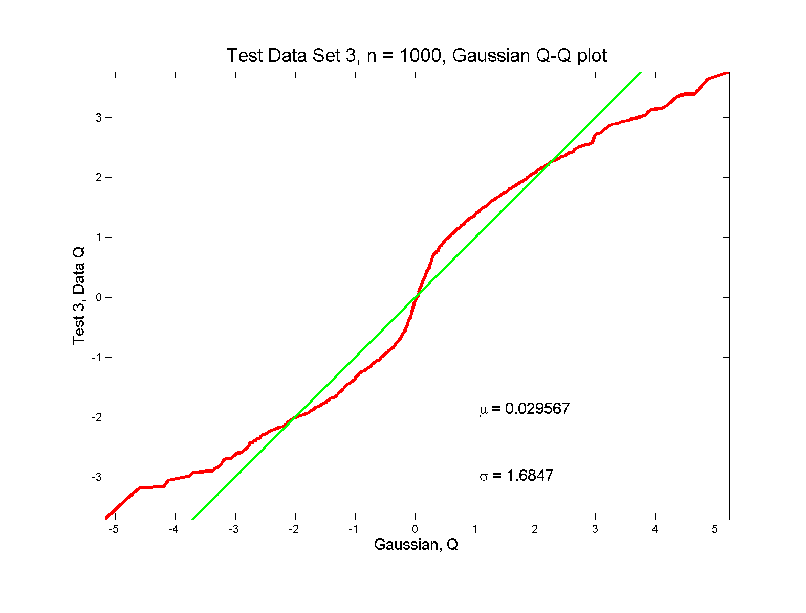
Q-Q plots
non-Gaussian! departures from line?
Bimodal Example From Above
Quantiles Grow
Slowly at Modes
Quantiles Grow
Fast at Valley

Slide 10
Q-Q plots
non-Gaussian! departures from line?
Seems different from line?
2 modes turn into wiggles?
Less strong feature
Been proposed to study modality

Slide 11
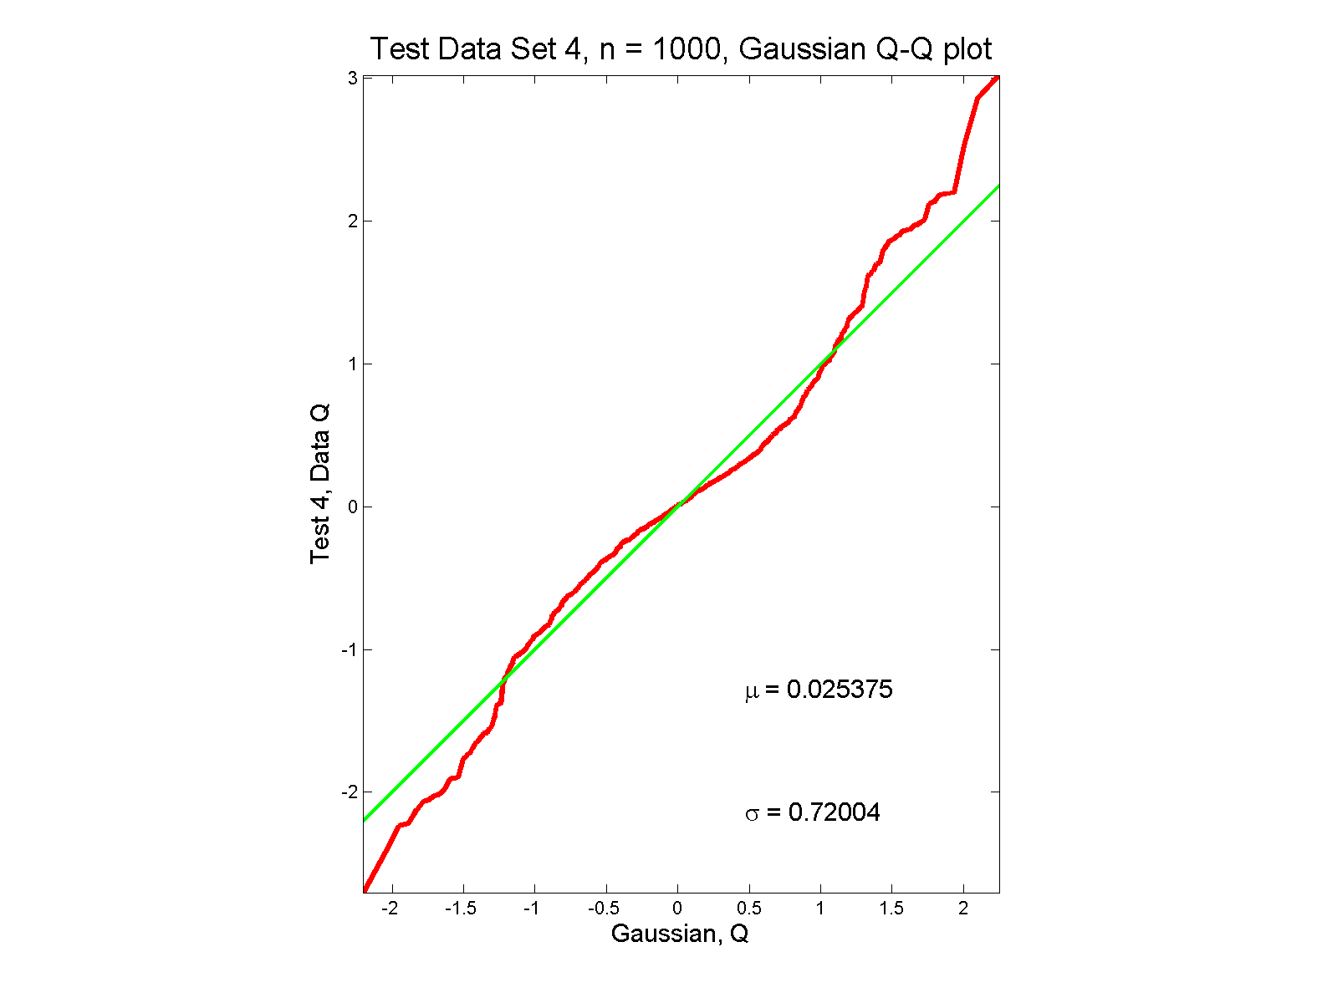
Q-Q plots
non-Gaussian (?) departures from line?

Slide 12
Q-Q plots
non-Gaussian (?) departures from line?
Seems different from line?
Harder to say this time?
What is signal & what is noise?
Need to understand sampling variation

Slide 13
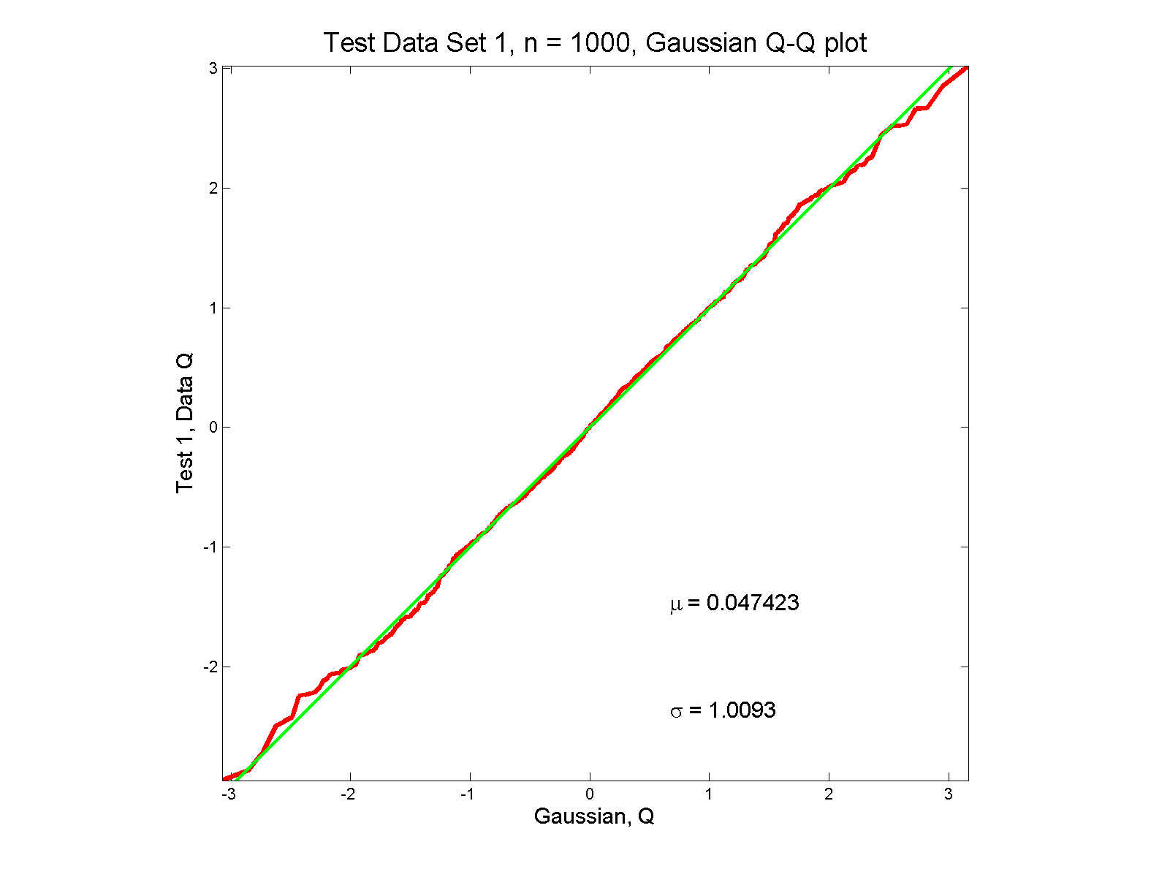
Q-Q plots
Gaussian: Departures from line?

Slide 14
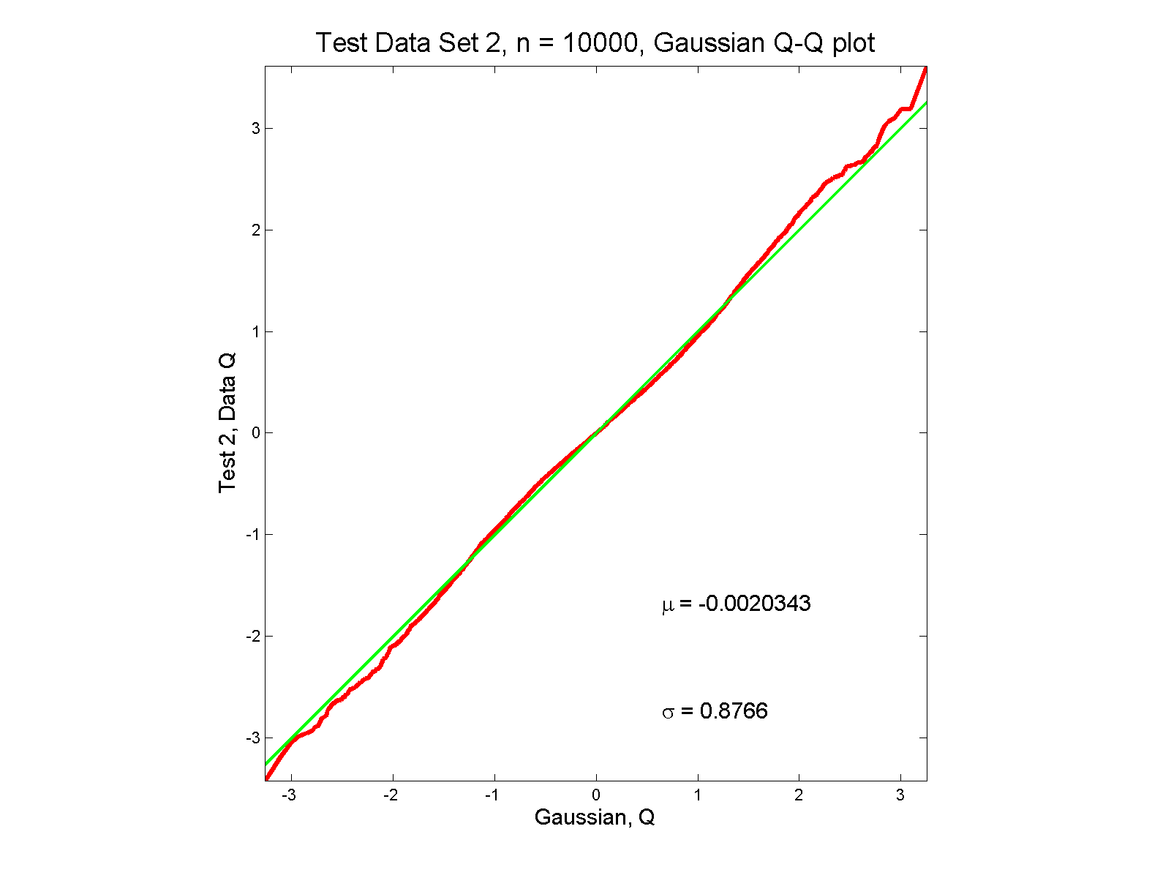
Q-Q plots
Gaussian? Departures from line?
Keep $n=10,000$
In Mind Here

Slide 15
Q-Q plots
Gaussian? departures from line?
Looks much like?
Wiggles all random variation?
But there are n = 10,000 data points…
How to assess signal & noise?
Need to understand sampling variation

Slide 16
Q-Q plots
Need to understand sampling variation
Approach: Q-Q envelope plot
Simulate from Theoretical Dist’n
Samples of same size
About 100 samples gives
“good visual impression”
Overlay resulting 100 QQ-curves
To visually convey natural sampling variation

Slide 17
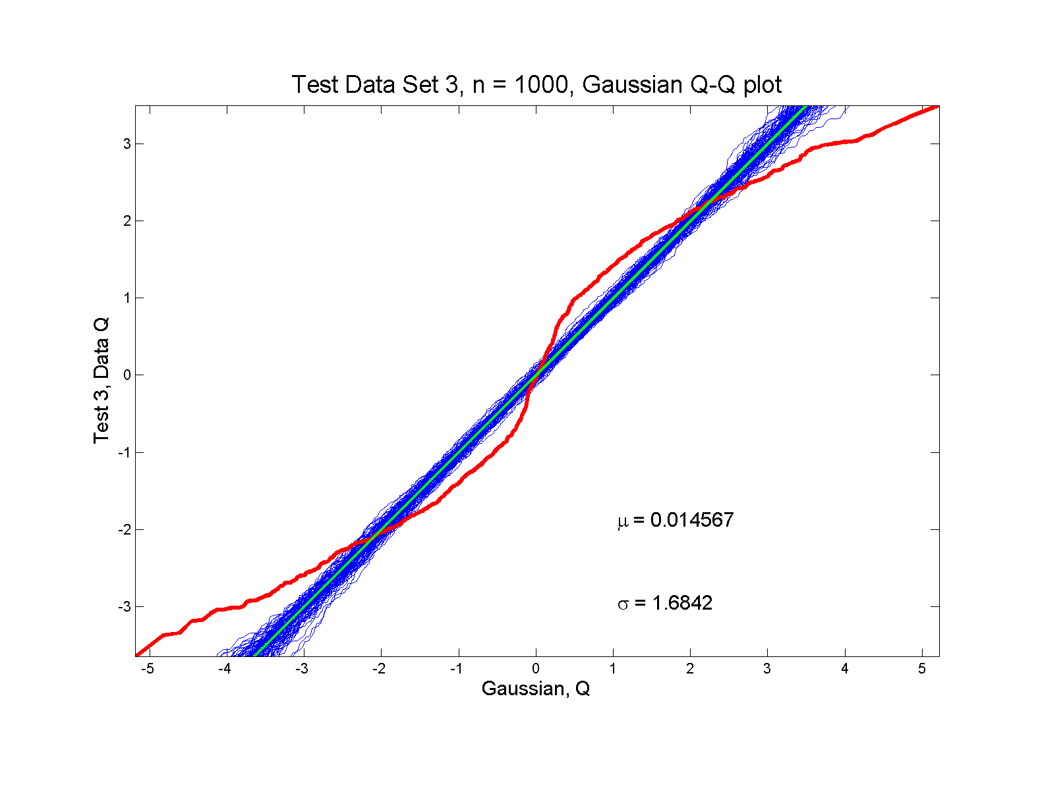
Q-Q Envelope plots
non-Gaussian! departures from line?

Slide 18
Q-Q Envelope plots
non-Gaussian! departures from line?
Envelope Plot shows:
Departures are significant
Clear these data are not Gaussian
Q-Q plot gives clear indication

Slide 19
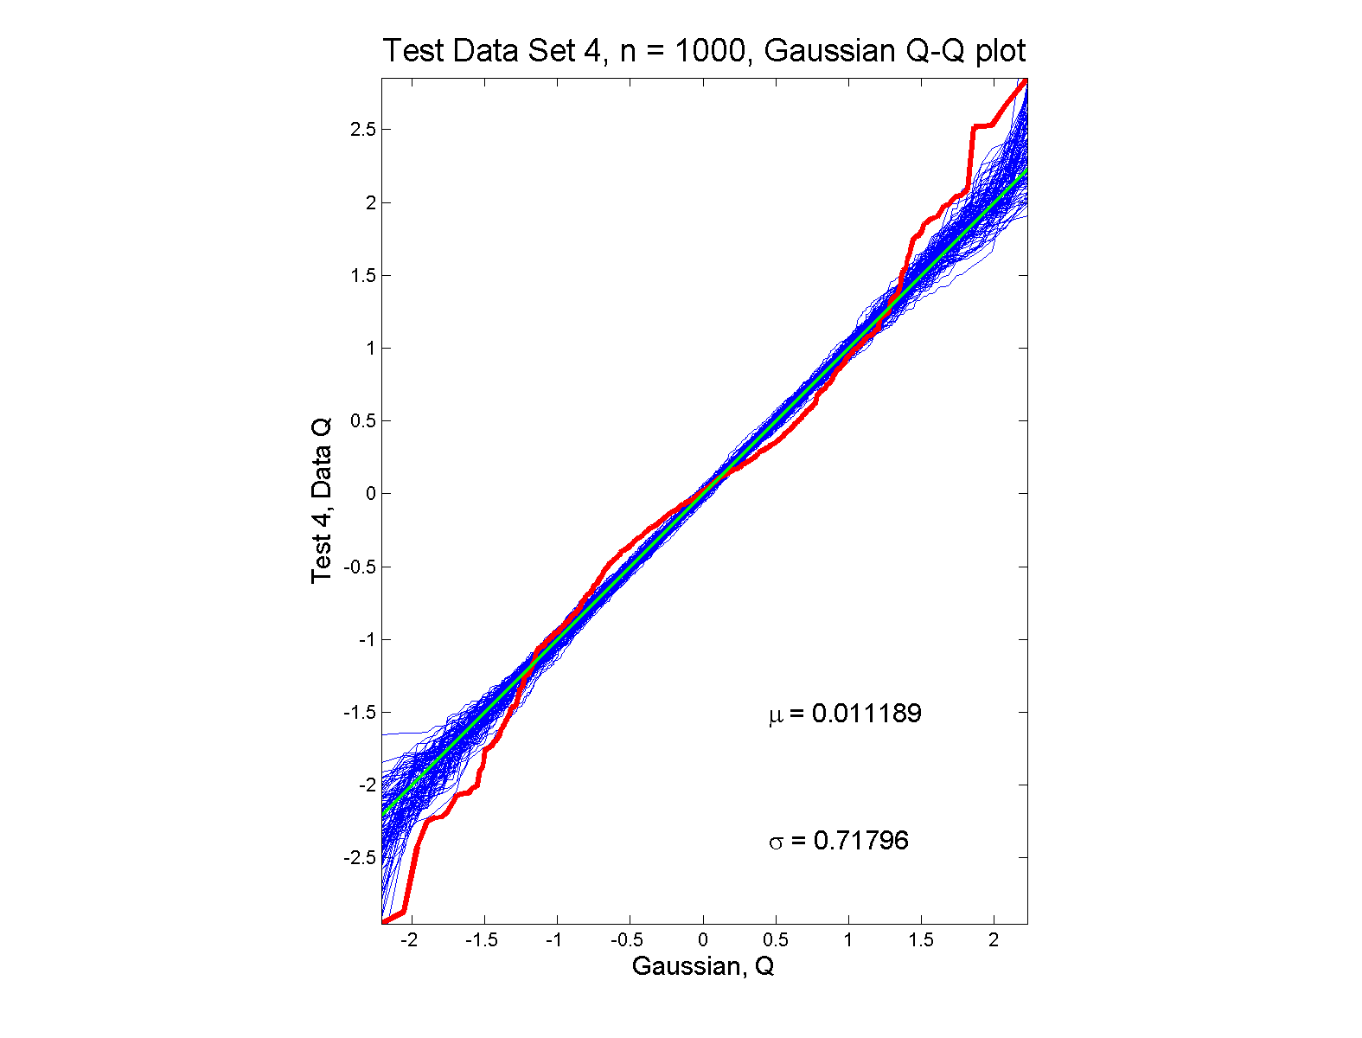
Q-Q Envelope plots
non-Gaussian (?) departures from line?

Slide 20
Q-Q Envelope plots
non-Gaussian (?) departures from line?
Envelope Plot shows:
Departures are significant
Clear these data are not Gaussian
Recall not so clear from e.g. histogram
Q-Q plot gives clear indication
Envelope plot reflects sampling variation

Slide 21
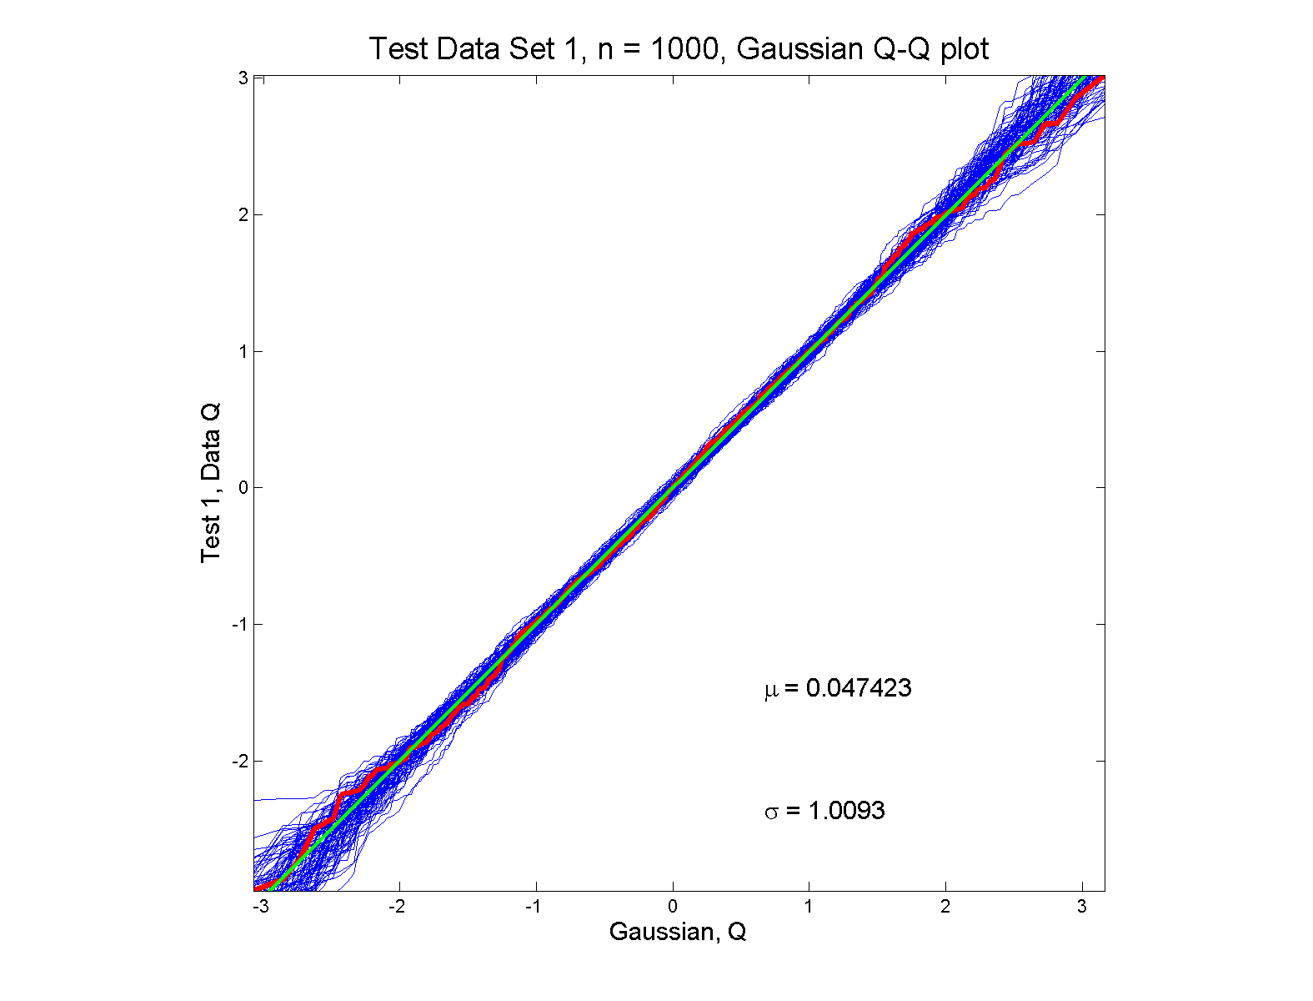
Q-Q Envelope plots
Gaussian: Stays Within Envelope
As Expected,
Since This Is
Null Hypothesis

Slide 22
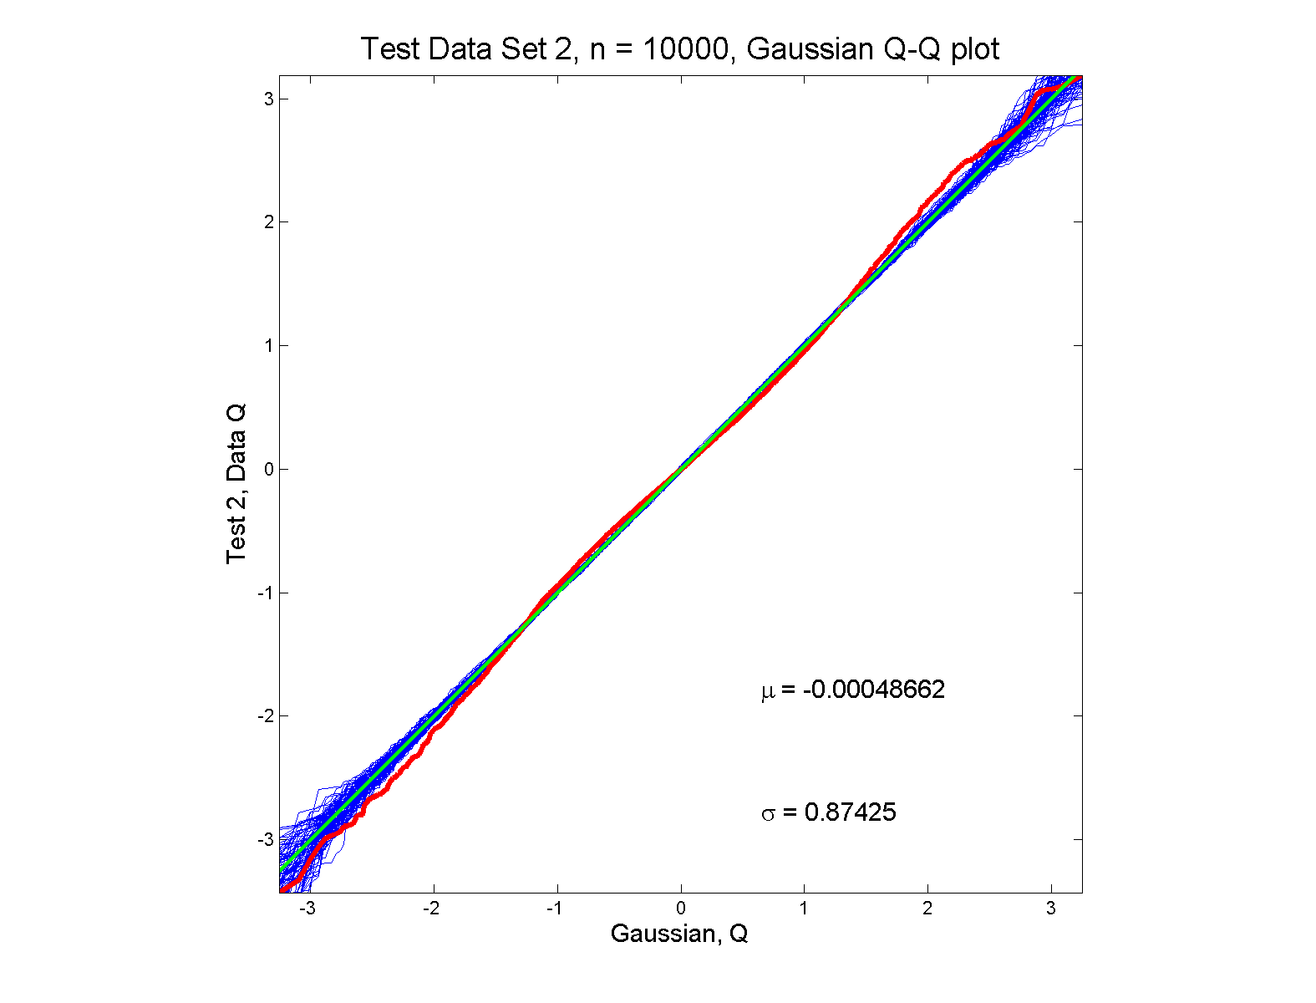
Q-Q Envelope plots
Gaussian? departures from line?

Slide 23
Q-Q Envelope plots
Gaussian? departures from line?
Harder to see
But clearly there
Conclude non-Gaussian
Really needed n = 10,000 data points…
(why bigger sample size was used)
Envelope plot reflects sampling variation
I.e. Is Much Narrower

Slide 24
Q-Q Envelope plots
What were these distributions?
Non-Gaussian!
0.5 N(-1.5,0.75²) + 0.5 N(1.5,0.75²)
Non-Gaussian (?)
0.4 N(0,1) + 0.3 N(0,0.5²) + 0.3 N(0,0.25²)
Gaussian
Gaussian?
0.7 N(0,1) + 0.3 N(0,0.5²)

Slide 25
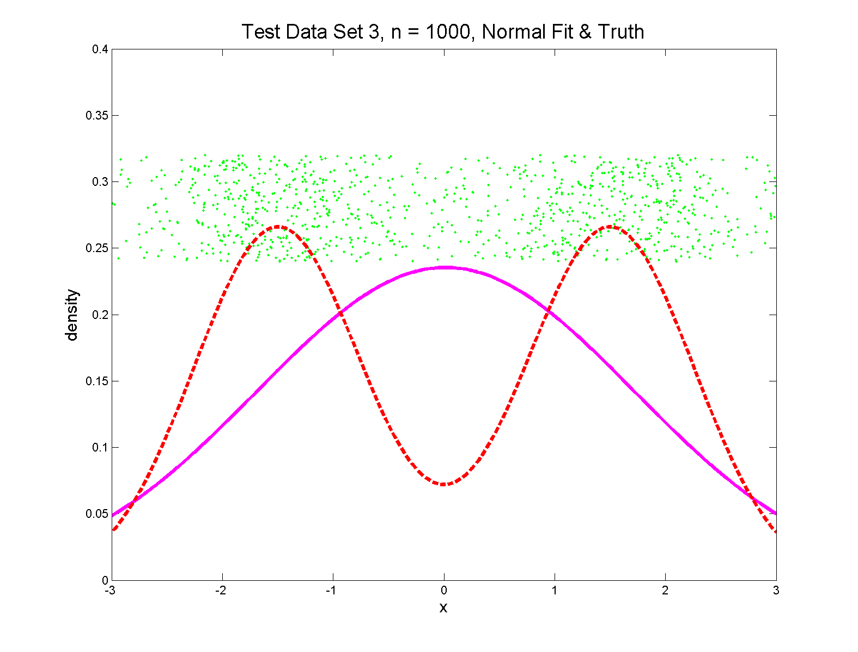
Q-Q Envelope plots
Non-Gaussian! .5 N(-1.5,0.75²) + 0.5 N(1.5,0.75²)
True Density
Fit $N\left(\hat{μ},σ^{2}\right)$ Density

Slide 26
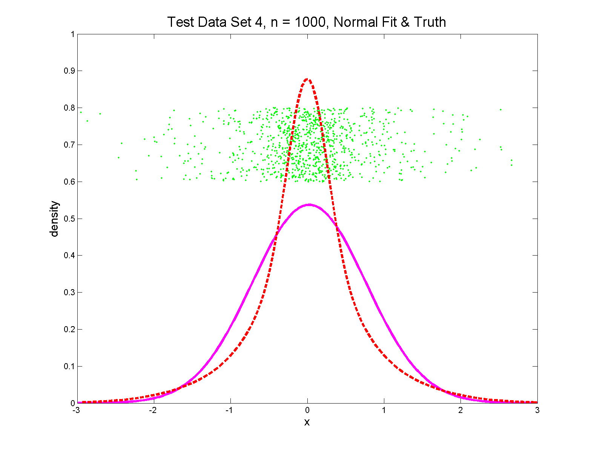
Q-Q Envelope plots
Non-Gaussian (?) 0.4 N(0,1) + 0.3 N(0,0.5²) + 0.3 N(0,0.25²)
Strong Kurtosis
Now Visible

Slide 27
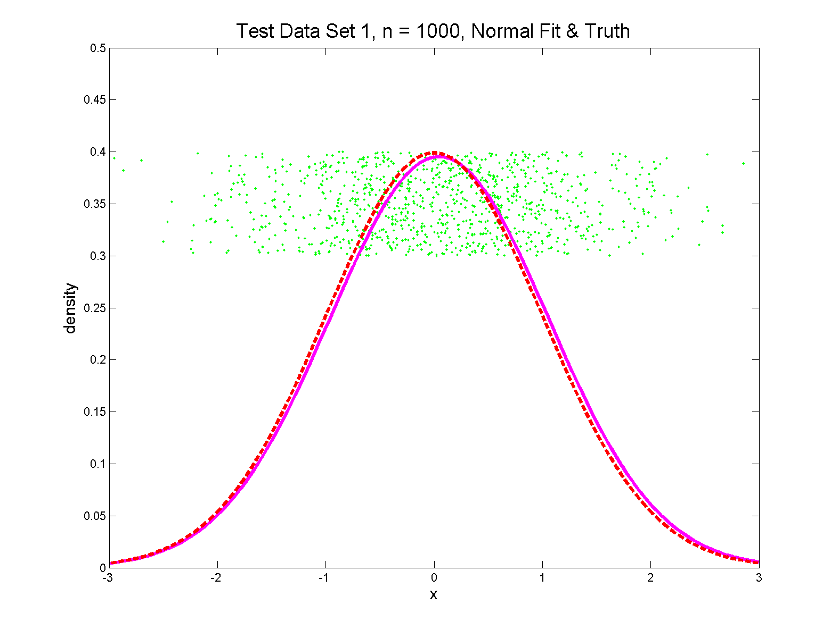
Q-Q Envelope plots
Gaussian

Slide 28
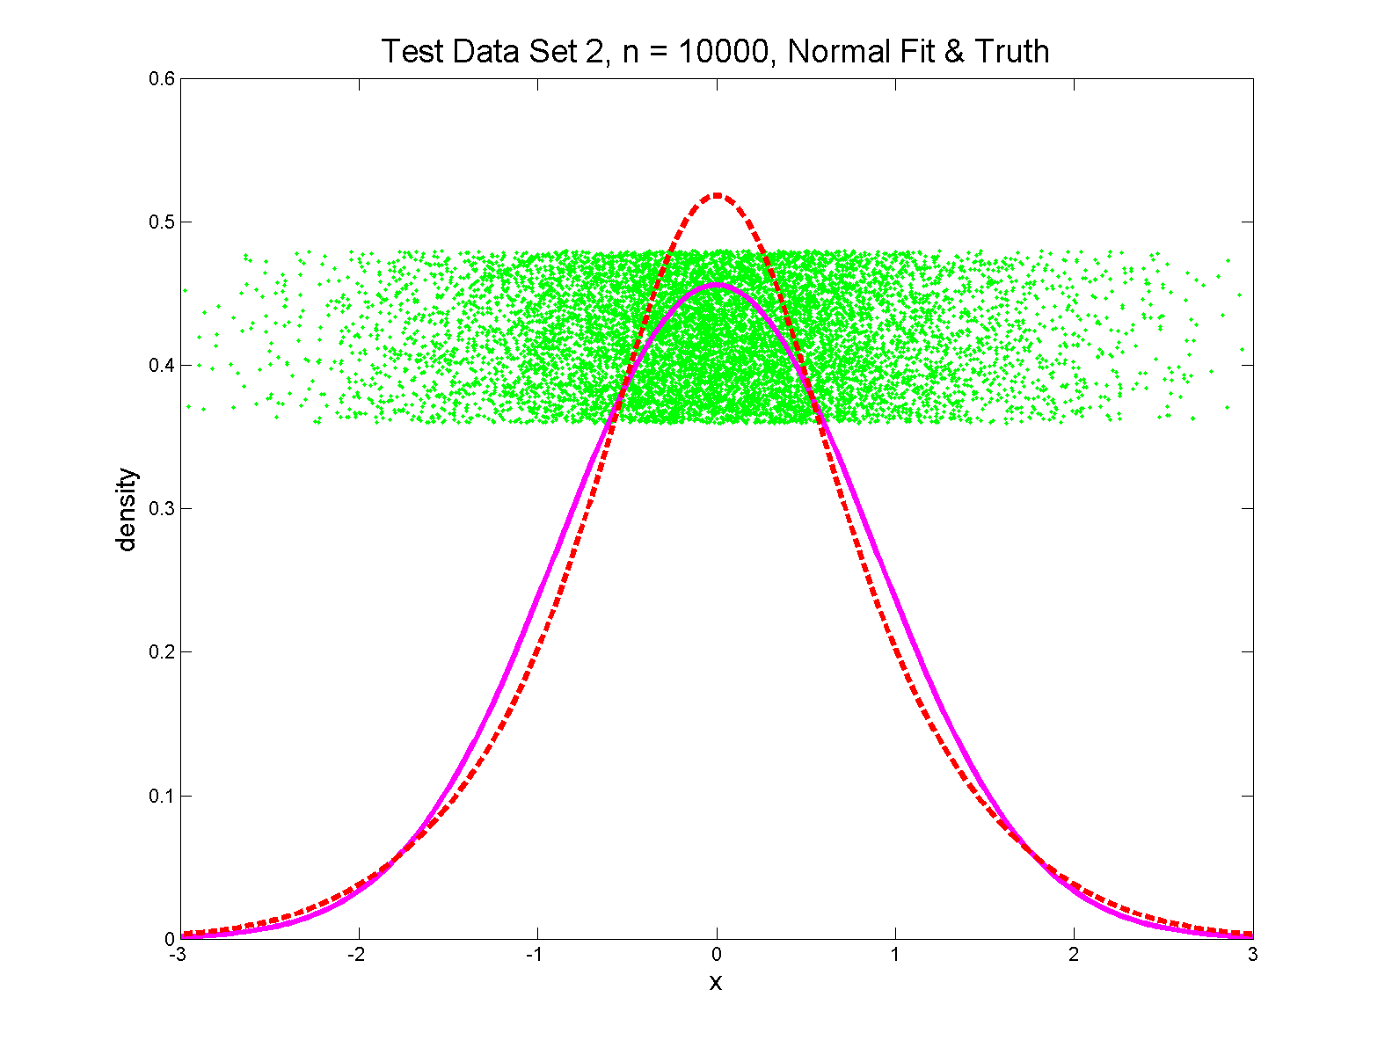
Q-Q Envelope plots
Gaussian? 0.7 N(0,1) + 0.3 N(0,0.5²)
Less Kurtosis
But Present

Slide 29
Q-Q Envelope Plots
Marron’s Matlab Software:
qqLM.m
In General Directory

Slide 30
Q-Q Envelope Plots
Marron’s Matlab Software:
qqLM.m
In General Directory

Slide 31
Q-Q plots
Variations on Q-Q Plots:
For $N\left(μ,σ^{2}\right)$ theoretical distribution:
$$p=P\left\{X≤q\right\}=Φ\left(\frac{q−μ}{σ}\right)$$
Solving for $q$ gives
$$q=μ+σΦ^{−1}\left(p\right)=μ+σz$$
Where $z$ is the Standard Normal Quantile

Slide 32
Q-Q plots
Variations on Q-Q Plots:
Solving for $q$ gives
$$q=μ+σΦ^{−1}\left(p\right)=μ+σz$$
So Q-Q plot against Standard Normal
is linear
With slope $σ$ and intercept $μ$

Slide 33
Q-Q plots
Variations on Q-Q Plots:
Can replace Gaussian with other dist’ns
Can compare 2 theoretical distn’s
Can compare 2 empirical distn’s
Could also Vary P-P plots = ROC curves

Slide 34
Outliers in PCA
Deep Toy Example:

Slide 35
Outliers in PCA
Deep Toy Example:
Why is green curve an outlier?
Never leaves range of other data
But Euclidean distance to others very large
relative to other distances
Also major difference in terms of shape
And even smoothness
Important lesson:
$∃$ many directions in $ℝ^{d}$

Slide 36
Outliers in PCA
Much like
earlier
Parabolas
Example
But with
1 “outlier”
thrown in

Slide 37
Outliers in PCA
PCA for
Deeper
Toy E.g.
Data:

Slide 38
Outliers in PCA
Deeper Toy Example:
At first glance, mean and PC1 look similar to no outlier version
PC2 clearly driven completely by outlier
PC2 scores plot (on right) gives clear outlier diagnostic
Outlier does not appear in other directions
Previous PC2, now appears as PC3
Power (scree plot) now “spread farther”

Slide 39
Outliers in PCA
Closer Look at Deeper Toy Example:
Mean “influenced” a little, by the outlier
Appearance of “corners” at every other coordinate
PC1 substantially “influenced” by the outlier
Clear “wiggles”

Slide 40
Outliers in PCA
What can (should?) be done about outliers?
Context 1: Outliers are important aspects of the population
They need to be highlighted in the analysis
Although could separate into subpopulations
Context 2: Outliers are “bad data”, of no interest
recording errors? Other mistakes?
Then should avoid distorted view of PCA

Slide 41
Outliers in PCA
Two Differing Goals for Outliers:
Avoid Major Influence on Analysis
Find Interesting Data Points
(e.g. In-liers)
Wilkinson (2017)

Slide 42
Outliers in PCA
Two Differing Goals for Outliers:
Avoid Major Influence on Analysis
Find Interesting Data Points
FDA Version: Mean & Shape Outliers
Dai & Genton (2016, 2017)

Slide 43
Outliers in PCA
Standard Statistical Approaches to Dealing with Influential Outliers:
Outlier Deletion:
Kick out “bad data”
Robust Statistical methods:
Work with full data set,
but downweight “bad data”
Reduce influence, instead of “deleting”
(Think Median)

Slide 44
Outliers in PCA
Alternate approach:
Robust Statistical Methods
Recall main idea:
Downweight (instead of delete) outliers
$∃$ a large literature. Good intro’s
(from different viewpoints) are:
Huber (2011)
Hampel, et al (2011)
Staudte & Sheather (2011)
Clarke (2018)

Slide 45
Outliers in PCA
Simple robustness concept: breakdown point
how much of data “moved to ”
will “destroy estimate”?
Usual mean has breakdown 0
Median has breakdown ½ (best possible)
Conclude:
Median much more robust than mean
Median uses all data
Median gets good breakdown from
“equal vote”

Slide 46
Outliers in PCA
Mean has
breakdown 0
Single
Outlier
Pulls Mean
Outside
range
of data

Slide 47
Outliers in PCA
Controversy:
Is median’s “equal vote” scheme good or bad?
Huber:
Outliers contain some information,
So should only control “influence”
(e.g. median)
Hampel, et. al.:
Outliers contain no useful information
Should be assigned weight 0
(not done by median)
Using “proper robust method”
(not simply deleted)

Slide 48
Outliers in PCA
Robustness Controversy (cont.):
Both are “right” (depending on context)
Source of major (unfortunately bitter) debate!

Slide 49
Robust PCA
What is multivariate median?
There are several!
(“median” generalizes in different ways)
Coordinate-wise median
Often worst
Not rotation invariant
(2-d data uniform on “L”)
$$\left(\begin{matrix}median\left(X_{i,1}\right) \\ ⋮ \\ median\left(X_{d,1}\right)\end{matrix}\right)$$

Slide 50
Robust PCA
Coordinate-wise median
Not rotation invariant
Thus poor notion of “center”

Slide 51
Robust PCA
Coordinate-wise median
Can lie on convex hull of data
Thus poor notion of “center”

Slide 52
Robust PCA
What is multivariate median?
There are several!
(“median” generalizes in different ways)
Coordinate-wise median
Often worst
Not rotation invariant
(2-d data uniform on “L”)
Can lie on convex hull of data
(same example)
Thus can be poor notion of “center”
$$\left(\begin{matrix}median\left(X_{i,1}\right) \\ ⋮ \\ median\left(X_{d,1}\right)\end{matrix}\right)$$

Slide 53
Robust PCA
What is multivariate median (cont.)?
ii. Simplicial depth (a. k. a. “data depth”):
Liu (1990)
“Paint Thickness” of $d+1$ dim “simplices” with corners at data
Nice idea
Good invariance properties
Slow to compute

Slide 54
Robust PCA
What is multivariate median (cont.)?
iii. Huber’s $L^{p}$ M-estimate:
Given data $X_{1},⋯,X_{n}∈ℝ^{d}$,
Estimate “center of population” by
$$\hat{θ}={argmin}_{θ}\sum_{i=1}^{n}{{\left\|X_{i}−θ\right\|}_{2}^{p}}$$
Where ${\left\|∙\right\|}_{2}$ is the usual Euclidean norm
Here: use only $p=1$
(minimal impact by outliers)

Slide 55
Robust PCA
Huber’s $L^{p}$ M-estimate (cont):
Estimate “center of population” by
$$\hat{θ}={argmin}_{θ}\sum_{i=1}^{n}{{\left\|X_{i}−θ\right\|}_{2}^{p}}$$
Case $p=2$:
Can show $\hat{θ}=\overline{X}$ (sample mean)
(also called “Fréchet Mean”, …)
Again Here: use only $p=1$
(minimal impact by outliers)

Slide 56
Robust PCA
$L^{1}$ M-estimate (cont.):
A view of minimizer: Study solution of
$$\underline{0}=\left(\begin{matrix}⋮ \\ \frac{∂}{∂θ_{j}}\sum_{i=1}^{n}{{\left\|X_{i}−θ\right\|}_{2}} \\ ⋮\end{matrix}\right)=$$
$$=\sum_{i=1}^{n}{\frac{X_{i}−θ}{{\left\|X_{i}−θ\right\|}_{2}}}$$

Slide 57
Robust PCA
$L^{1}$ M-estimate (cont.):
A view of minimizer: Study solution of
$$\underline{0}=\sum_{i=1}^{n}{\frac{X_{i}−θ}{{\left\|X_{i}−θ\right\|}_{2}}}$$
A useful viewpoint is based on:
$P_{Sph(θ,1)}$ = “Proj’n of data onto sphere
centered at $θ$ with radius $1$”
And representation: $P_{Sph(θ,1)}X_{i}=θ+\frac{X_{i}−θ}{{\left\|X_{i}−θ\right\|}_{2}}$

Slide 58
Robust PCA
$L^{1}$ M-estimate (cont.):
Thus the solution of
$$0=\sum_{i=1}^{n}{\frac{X_{i}−θ}{{\left\|X_{i}−θ\right\|}_{2}}}=\sum_{i=1}^{n}{\left(P_{Sph(θ,1)}X_{i}−θ\right)}$$
is the solution of:
$$0=avg\left\{P_{Sph(θ,1)}X_{i}−θ:i=1,⋯,n\right\}$$
So $\hat{θ}$ is location where projected data are centered at $\hat{θ}$
“Slide sphere around until mean (of projected data) is at center”

Slide 59
Robust PCA
$L^{1}$ M-estimate (cont.):
Data are
+ signs

Slide 60
Robust PCA
M-estimate (cont.):
Data are
+ signs
Sample Mean, $\overline{X}$
outside “hot dog”
of data

Slide 61
Robust PCA
M-estimate (cont.):
Candidate
Sphere Center, $θ$

Slide 62
Robust PCA
M-estimate (cont.):
Candidate
Sphere Center, $θ$
Projections
Of Data

Slide 63
Robust PCA
M-estimate (cont.):
Candidate
Sphere Center, $θ$
Projections
Of Data
Mean of
Projections

Slide 64
Robust PCA
M-estimate (cont.):
“Slide sphere
around until
mean (of
projected data)
is at center”

Slide 65
Robust PCA
M-estimate (cont.):
Additional literature:
Called “geometric median” (long before Huber) by: Haldane (1948)
Shown unique for $d>1$ by: Milasevic and Ducharme (1987)
Useful iterative algorithm: Gower (1974)
(see also Sec. 3.2 of Huber (2011)).

Slide 66
Robust PCA
Now have robust measure of “center”,
how about
“spread”?
I.e. how
can we
do robust
PCA?

Slide 67
Robust PCA
Now have robust measure of “center”,
how about
“spread”?
Parabs e.g.
from above
With an
“outlier” (???)
Added in

Slide 68
Robust PCA
Now have robust measure of “center”,
how about
“spread”?
Small Impact on Mean

Slide 69
Robust PCA
Now have robust measure of “center”,
how about
“spread”?
Small Impact on Mean
More on PC1 Dir’n

Slide 70
Robust PCA
Now have robust measure of “center”,
how about
“spread”?
Small Impact on Mean
More on PC1 Dir’n
Dominates Residuals
Thus PC2 Dir’n
& PC2 scores

Slide 71
Robust PCA
Now have robust measure of “center”,
how about
“spread”?
Small Impact on Mean
More on PC1 Dir’n
Dominates Residuals
Thus PC2 Dir’n
& PC2 scores
Tilt now in PC3
Viualization is very
Useful diagnostic

Slide 72
Robust PCA
Now have robust measure of “center”,
how about
“spread”?
How
can we
do robust
PCA?

Slide 73
Robust PCA
Approaches to Robust PCA:
Robust Estimation of Covariance Matrix
Projection Pursuit
Spherical PCA

Slide 74
Robust PCA
Robust PCA 1: Robust Estimation of Covariance Matrix
A. Component-wise Robust Covariances:
Major problem:
Hard to get non-negative definiteness
Minimum Volume Ellipsoid:
Rousseeuw & Leroy (2005)
Requires $n>d$ (in available software)
Needed for simple definition of affine invariant

Slide 75
Robust PCA
Robust PCA 2: Projection Pursuit
Idea: focus on
“finding direction of greatest variability”
Reference: Li and Chen (1985)
Problems:
Robust estimates of “spread” are nonlinear
Results in many local optima

Slide 76
Robust PCA
Robust PCA 2: Projection Pursuit (cont.)
Problems:
Results in many local optima
Makes search problem very challenging
Especially in very high dimensions
Most examples have $d=4,5$
Guoying Li:
“I’ve heard of $d=20$,
but 60 seems too big”

Slide 77
Robust PCA
Robust PCA 3:
Spherical
PCA
Locantore et al (1999)
“Hot Dog” of Data
Based on Projection
On Sphere Idea
from M-estimation
Projects to “Ice Caps”
Projection Data To
Centered Sphere

Slide 78
Robust PCA
Robust PCA 3: Spherical PCA
Idea: use “projection to sphere” idea from M-estimation
In particular project data to centered sphere
“Hot Dog” of data becomes “Ice Caps”
Easily found by PCA (on proj’d data)
Outliers pulled in to reduce influence
Radius of sphere unimportant
Notes:
78

Slide 79
Robust PCA
Robust PCA 3: Spherical PCA
Independent Derivation & Alternate Name:
PCA of Spatial Signs
(think: multivariate extension of “sign test”)
Simple Nonparametric Approach To:
test $H_{0}:μ=0$ using #(+) & #(-)
(in one dimension)
Notes:
79

Slide 80
Robust PCA
Robust PCA 3: Spherical PCA
Independent Derivation & Alternate Name:
PCA of Spatial Signs
Spatial Signs Are
Angles in Polar
Coordinates
Notes:
80

Slide 81
Robust PCA
Robust PCA 3: Spherical PCA
Independent Derivation & Alternate Name:
PCA of Spatial Signs
1st Paper:
Möttönen & Oja (1995)
Complete Description:
Oja (2010)
Notes:
81

Slide 82
Robust PCA
Spatial Signs
Interesting Variation:
Spatial Ranks
Idea: Keep
Track of “Depth”
Via Ranks of Radii
Notes:
82

Slide 83
Robust PCA
Spatial Signs and Ranks
Interesting Decomposition of Variation
(Useful to do PCA of Each)
Parallel to “Amplitude & Phase Variation”
Notes:
83

Slide 84
Robust PCA
Spherical PCA for Toy Example:
Curve Data
With an
Outlier
First recall
Conventional
PCA
Strongly
Impacted
By Outlier
Notes:
84

Slide 85
Robust PCA
Mean Looks
Smoother
Spherical PCA for Toy Example:
Now do
Spherical
PCA
Better result?
PC1 Nearly Flat
Lines are Eigenvalues on Sphere
Circles Show Original Variances
PC2 is Tilt (NOT Outlier)
Outlier Demoted to PC3
Notes:
85

Slide 86
Robust PCA
Spherical PCA for Toy Example:
Check out
Later
Components
Notes:
86

Slide 87
Cornea Data
Cornea Data:
Raw Data
Decompose
Into
Modes of
Variation?

Slide 88
Cornea Data
Data Representation - Zernike Basis
Descriptor Space is Vector Space of Zernike Coefficients
So Perform PCA There, For Modes of Var’n
Works In Polar Coordinates
Tensor Product of Fourier (Angles) &
Special Jacobi (Radii) Bases
Challenge: Elliminate
Singularity at Origin
Born & Wolf (1980), Schwiegerling, et al. (1995)

Slide 89
PCA of Cornea Data
PC1 Movie:

Slide 90
PCA of Cornea Data
PC1 (First Mode) Summary:
Mean (1st image): mild vert’l astigmatism
known pop’n structure called “with the rule”
Main dir’n: “more curved” & “less curved”
Corresponds to first optometric measure
(89% of variat’n, in Mean Resid. SS sense)
Also: “stronger astig’m” & “no astig’m”
Found corr’n between astig’m and curv’re
Scores (cyan): Apparent Gaussian dist’n

Slide 91
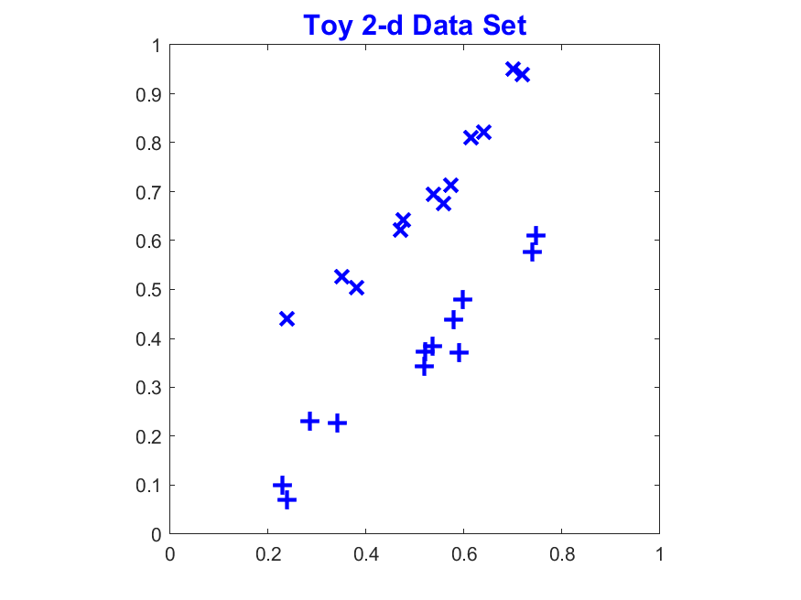
Visualization Aside
Approaches to Visualize Modes of Variation
(Recall 1-d Set in Object Space)
Showing Variation
Notes:
91

Slide 92
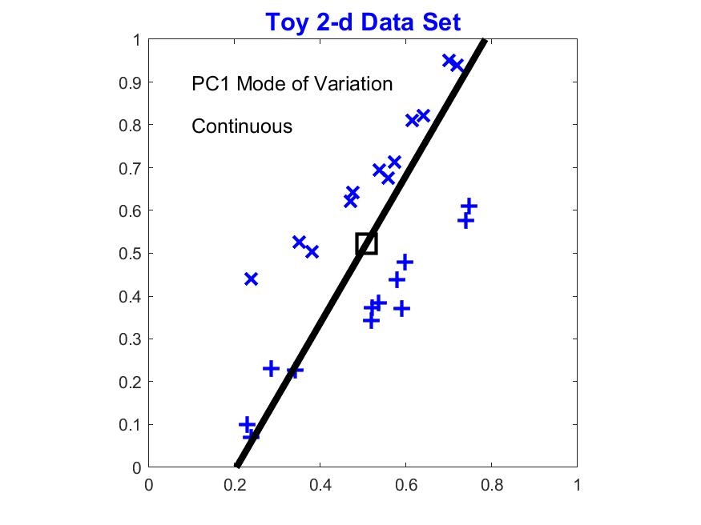
Visualization Aside
Approaches to Visualize Modes of Variation
(Recall 1-d Set in Object Space)
Entire Line
Notes:
92

Slide 93
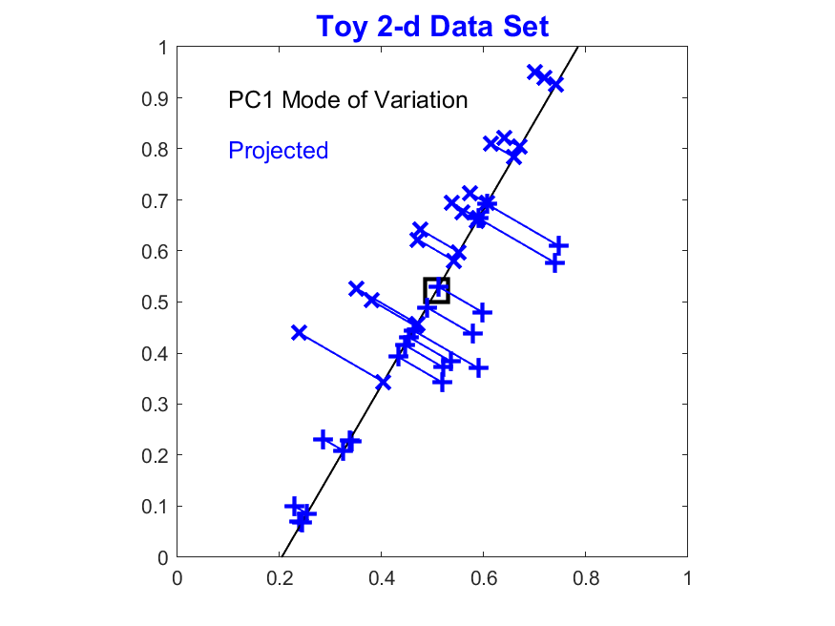
Visualization Aside
Approaches to Visualize Modes of Variation
(Recall 1-d Set in Object Space)
Entire Line
Projections
Notes:
93

Slide 94
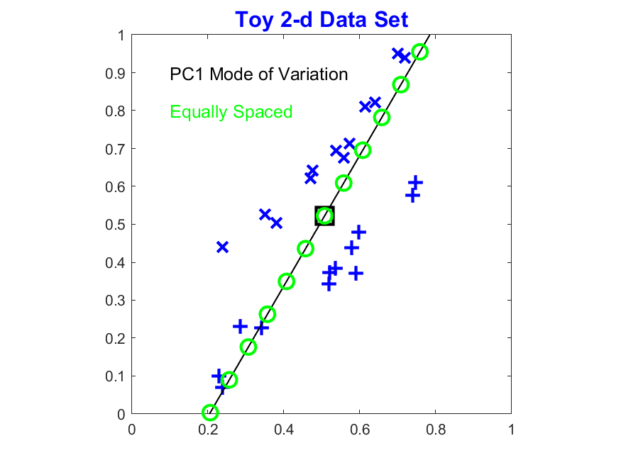
Visualization Aside
Approaches to Visualize Modes of Variation
(Recall 1-d Set in Object Space)
Entire Line
Projections
Equally Spaced
Choice Depends on Context
Notes:
94

Slide 95
Participant Presentation
1:35 Ameer Qaqish
Gaussian Processes
Next Class: Grace Smith

