Slide 1
Statistics – O. R. 881
Object Oriented Data Analysis
Steve Marron
Dept. of Statistics and Operations Research
University of North Carolina

Slide 2
Current Sections in Textbook
Today:
Section 17.2, 14.2
Next Class:
Sections 14.2, 14.1

Slide 3
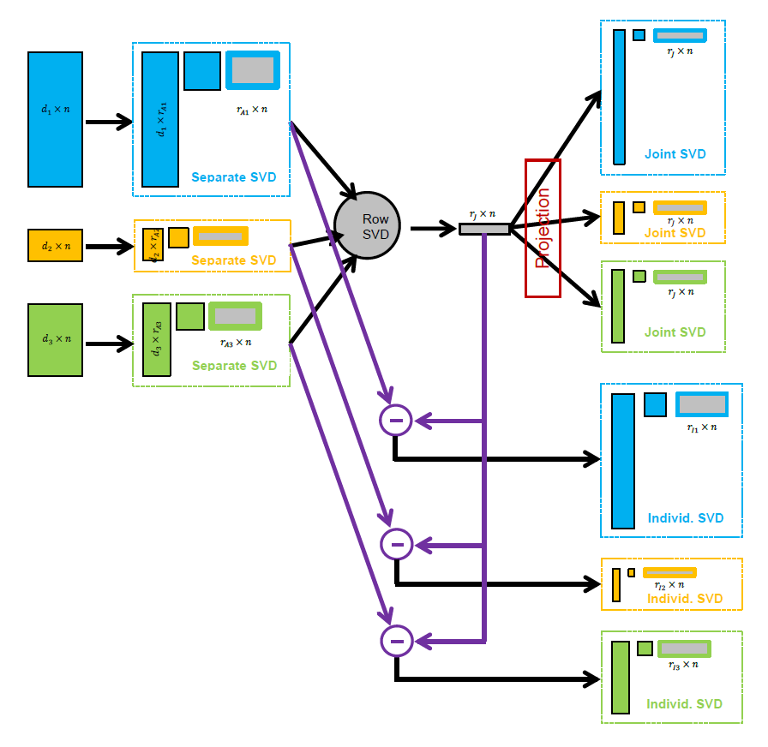
Last Class: AJIVE Algorithm
Overview

Slide 4
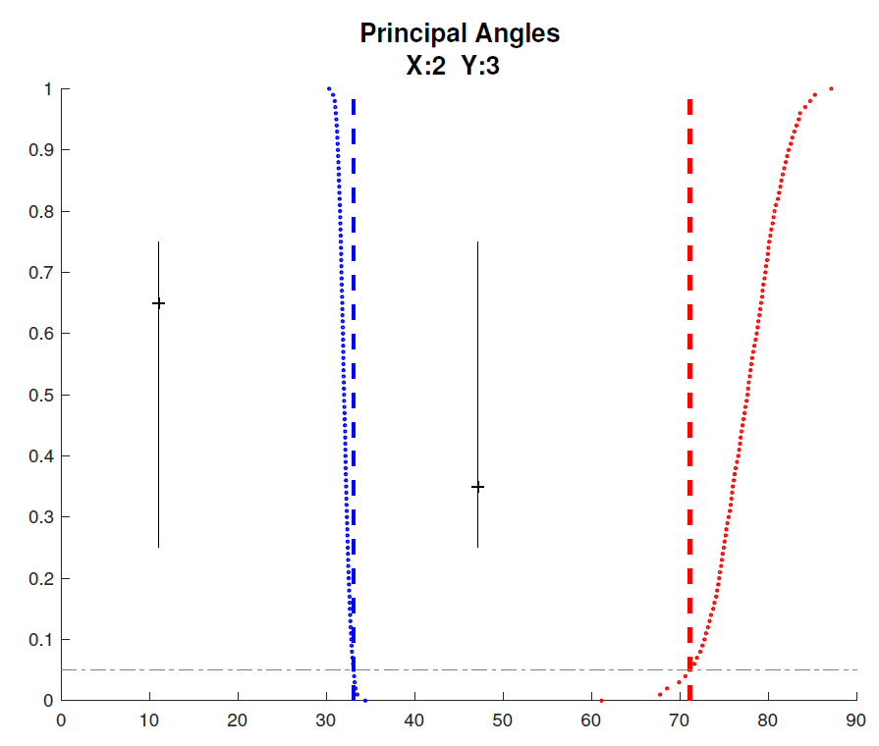

Last Class: Revisit Toy Example
Well Chosen Initial Ranks, $r_{A1}=2$, $r_{A2}=3$
Diagnostic Plot:
1st Principal Angle
(Joint + noise)
Conclude
Neither Is
Random
Conclude
Larger
Not Joint
2nd Principal Angle
(Small Indiv. + )
Random Subspaces
Distribution & Quantile
Wedin Bound Estimates
Distribution & Quantile

Slide 5
Last Class: AJIVE Cancer Data
Analysis Goal:
Understand How Images & Genomics
Work Together
Work Separately
Approach: AJIVE
Clinical Diagnostic Standard
Deep Insight &
New Treatments
As of Jan. 2020: ~70
Drugs Approved for
Breast Cancer Therapy

Slide 6
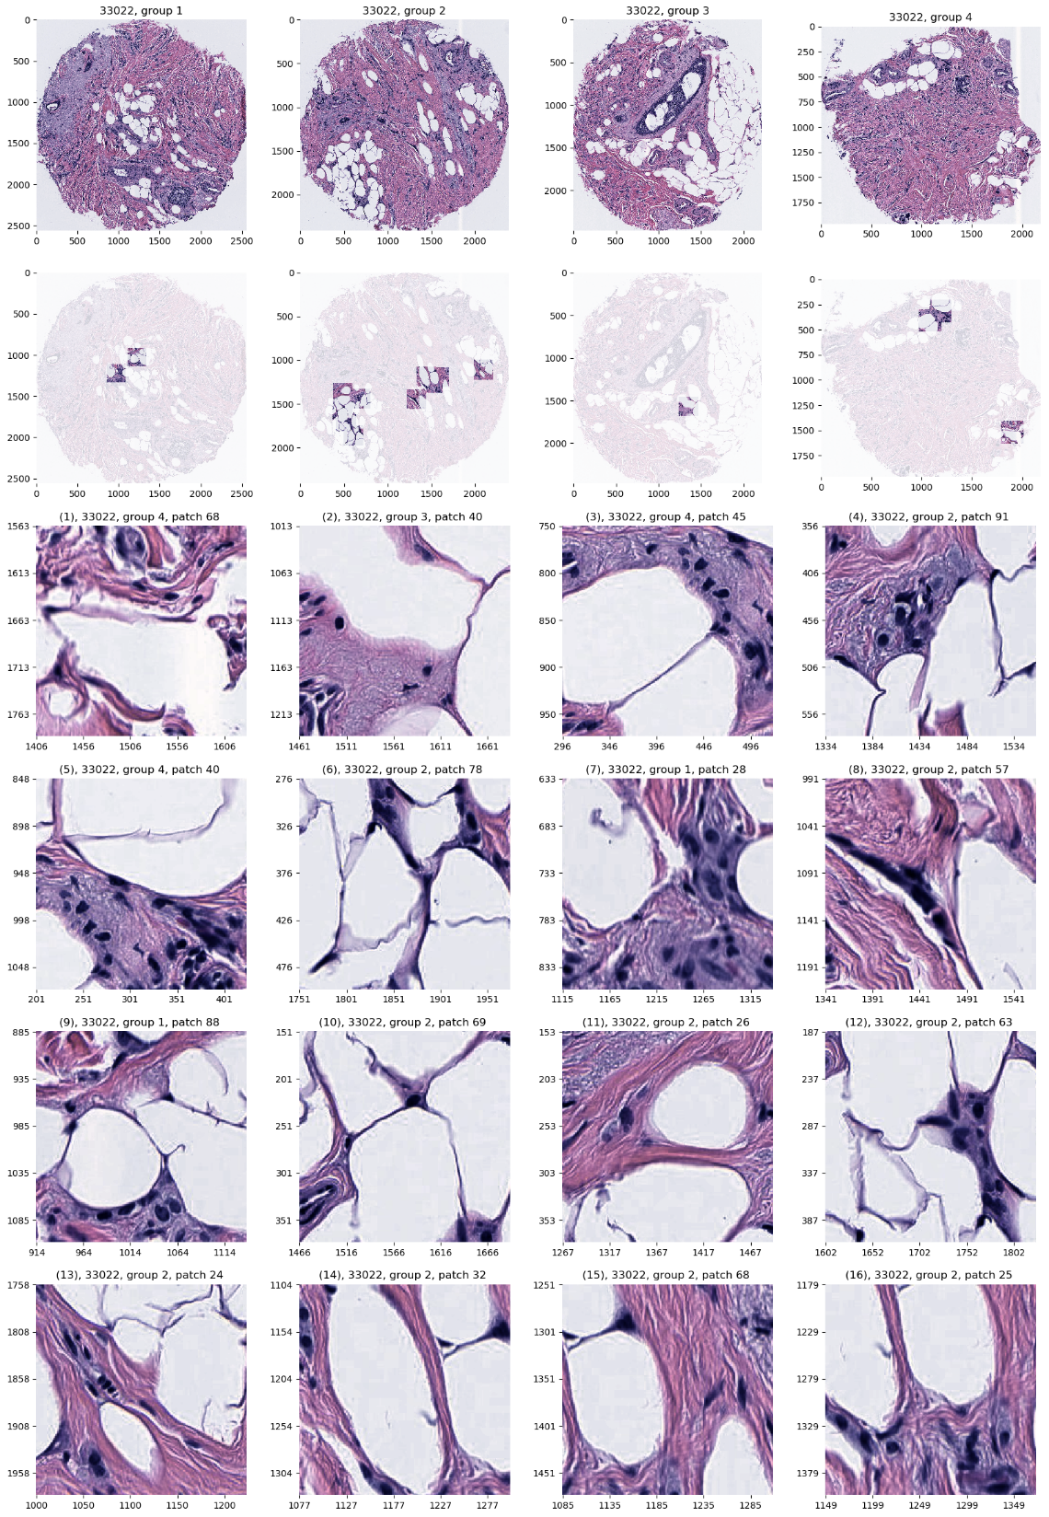
Last Class: AJIVE Cancer Data
JIVE: Common Normalized Scores 1
Look at Extremes
Negative End
Top Person
Top 16 Patches
Fat Cells & Stroma

Slide 7
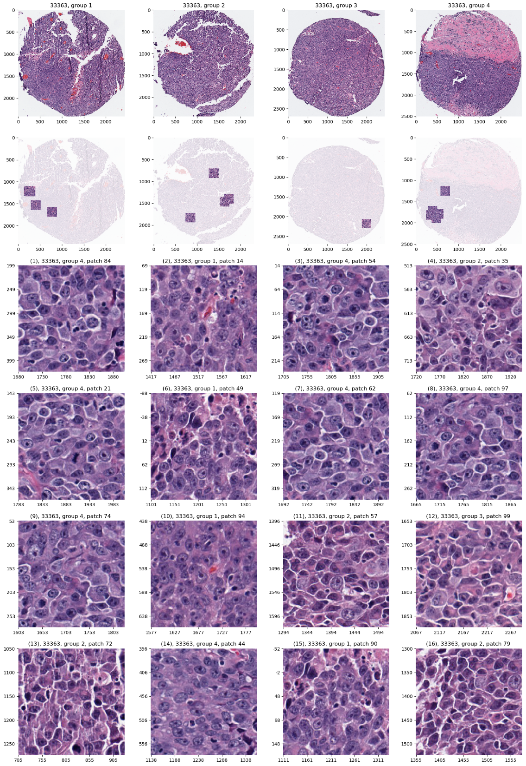
AJIVE Analysis of Cancer Data
JIVE: Common Normalized Scores 1
Look at Extremes
Positive End
Top Person
Top 16 Patches
Highly “Cellular”
Markedly Atypical Cells

Slide 8
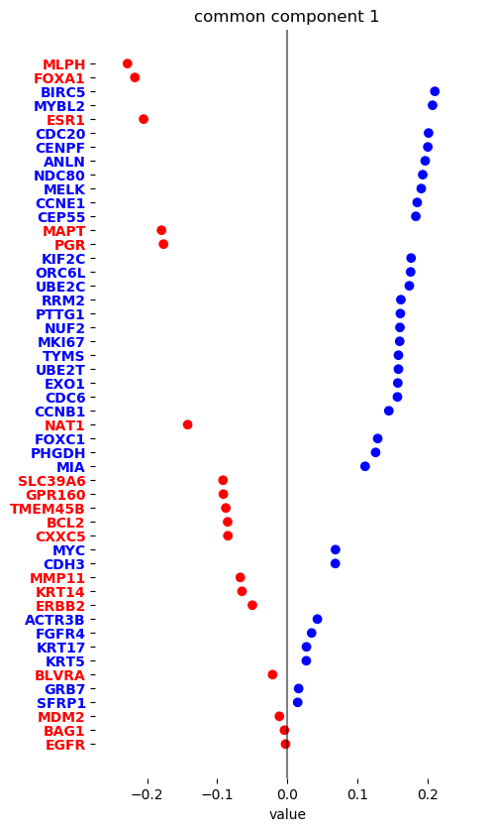
Last Class: AJIVE Cancer Data
JIVE: Gene Expression
Common Normalized
Loadings 1
Very Consistent w/ Image
“High Proliferation” Genes
“Low Prolif.” – Lum A Genes

Slide 9
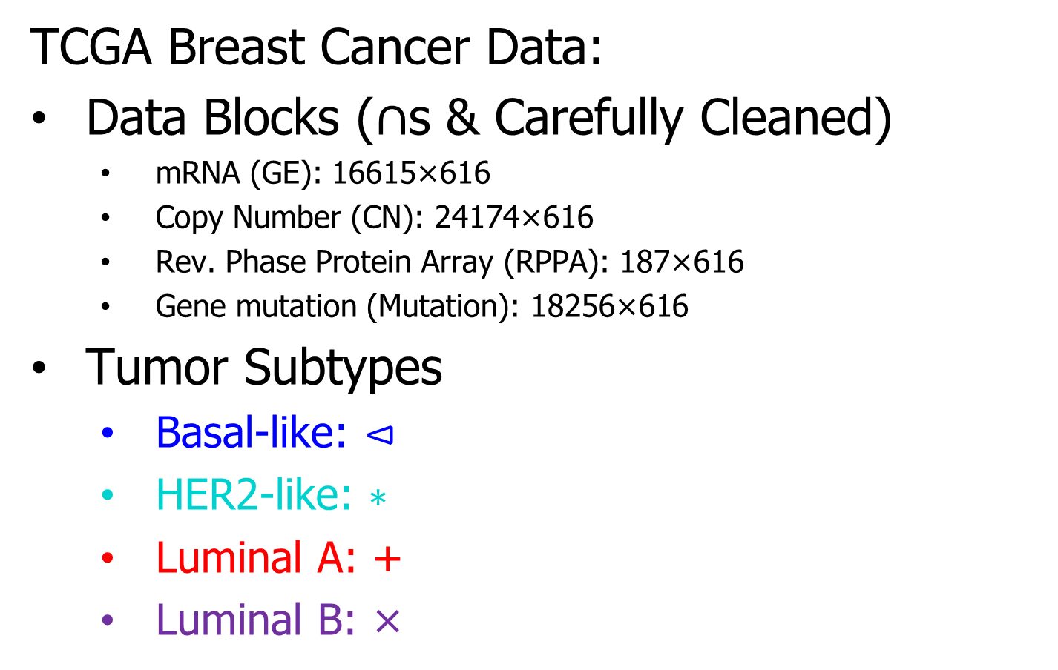
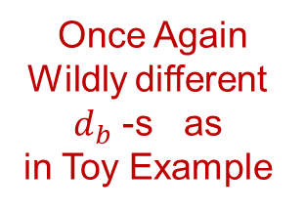
Last Class: Genomics by AJIVE
TCGA Breast Cancer Data:
Data Blocks ($∩$s & Carefully Cleaned)
  mRNA (GE): 16615×616
  Copy Number (CN): 24174×616
  Rev. Phase Protein Array (RPPA): 187×616
  Gene mutation (Mutation): 18256×616
Tumor Subtypes
  Basal-like: ⊲
  HER2-like: ∗
  Luminal A: +
  Luminal B: ×
Once Again
Wildly different
$d_{b}$ -s as
in Toy Example

Slide 10
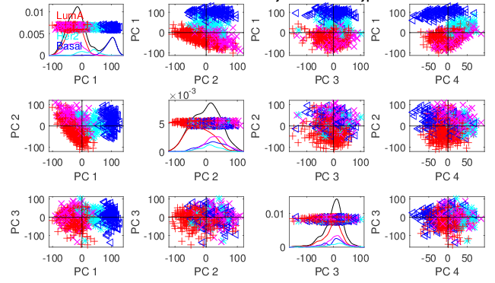
Last Class: Genomics by AJIVE
Separate PCA on Gene Expression (GE)
PC1 Flags
Basals
PC2 Flags
LumAs

Slide 11
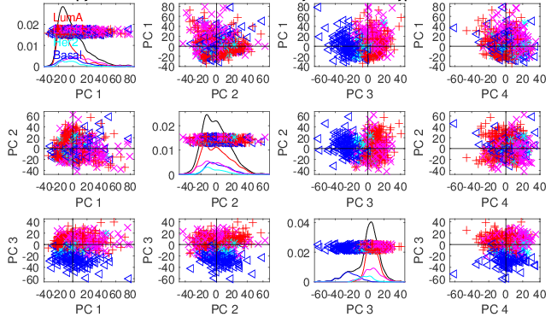
Last Class: Genomics by AJIVE
Separate PCA on Copy Number (CN)
Other
Effects
+Subtypes

Slide 12
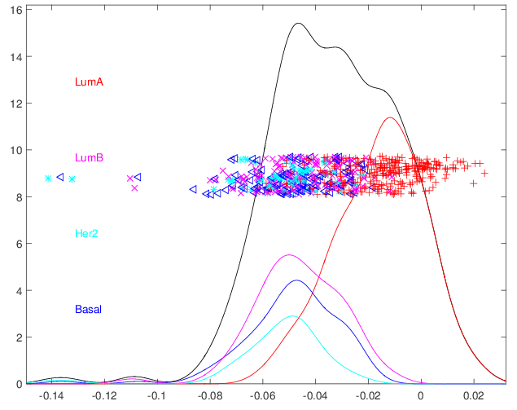
Last Class: Genomics by AJIVE
4-way Joint Scores (CNS)
Flags LumAs
Effect Driven
By All 4
Factors
Together
Interesting Point: Mutation Plays Role Here

Slide 13
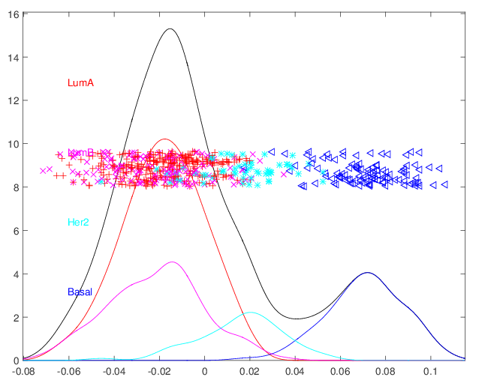
Last Class: Genomics by AJIVE
Joint JIVE PC1 for GE-CN-RPPA (CNS)
Great Separation
of Basals
Some Separation
of Her2s
LumAs & LumBs
Combined
All More Distinct
Than Raw Data

Slide 14
Last Class: Genomics by AJIVE
JIVE on GE – CN, Test of Basals vs. Others
Summarize Z-scores
Joint JIVE
>> Separate
JIVE Data
Combo Helps!

Slide 15
Last Class: Genomics by AJIVE
JIVE on GE – CN, Test of Basals vs. Others
Summarize Z-scores
GE has info
Not in CN
But not CN

Slide 16
Last Class: DIVAS
Improvements Over AJIVE:
3 Block JIVE Analysis
≈ +

Slide 17
Last Class: DIVAS
Improvements Over AJIVE:
Partially Shared Blocks in DIVAS Analysis
≈ + + + +

Slide 18
Last Class: DIVAS
Improvements Over AJIVE:
Partially Shared Blocks
Improved Initial Rank Choice
Inference Via Random Direction Bounds
Iterative Search Algorithm
Give Better and More Precise Inference

Slide 19
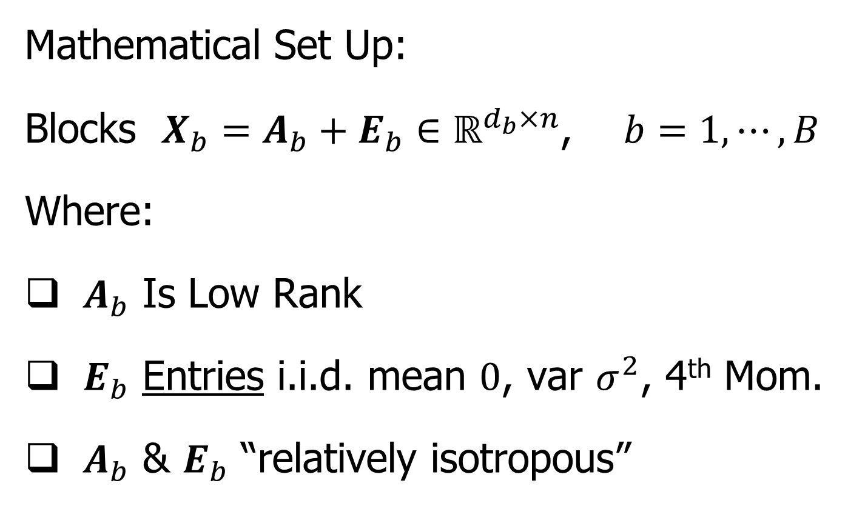
DIVAS
Mathematical Set Up:
Blocks $X_{b}=A_{b}+E_{b}∈ℝ^{d_{b}×n}$, $b=1,⋯,B$
Where:
$A_{b}$ Is Low Rank
$E_{b}$ Entries i.i.d. mean $0$, var $σ^{2}$, 4th Mom.
$A_{b}$ & $E_{b}$ “relatively isotropous”
Invariant with
Respect to
Direction
(Weaker than Gaussian)

Slide 20
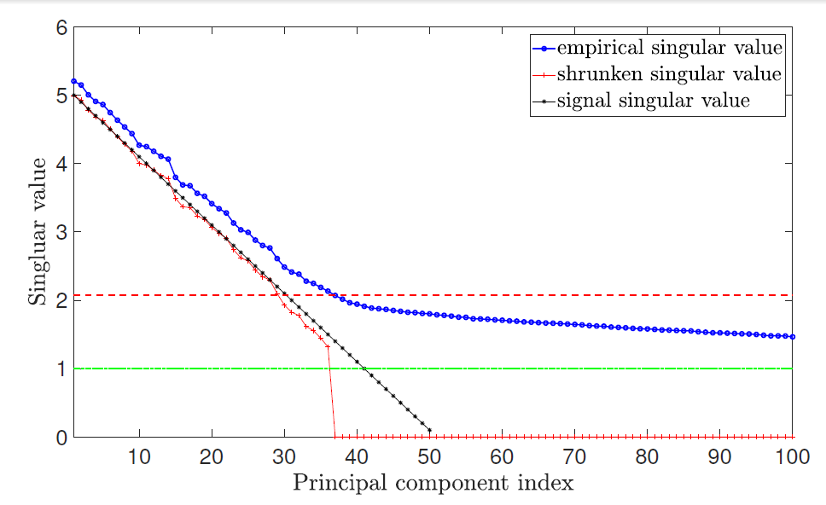

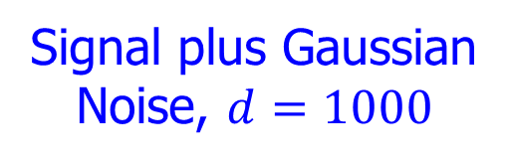

DIVAS
Improved (over AJIVE) Initial Rank Choice
Conventional Scree Plot
(square root scale)
Underlying
Low Rank
Signal, $A_{b}$
Signal plus Gaussian
Noise, $d=1000$
$N\left(0,1\right)$ Noise
Impossible
To Recover

Slide 21

DIVAS
Improved (over AJIVE) Initial Rank Choice
Does Not Look Additive,
Since on Singular Value
(Not Energy) Scale
Conventional Scree Plot
(square root scale)
Signal plus Gaussian
Noise, $d=1000$
Bigger than $σ=1$, Since First $100$ In Sort

Slide 22


DIVAS
Improved (over AJIVE) Initial Rank Choice
Estimate Singular Values of Signal $A_{b}$
Appropriately
Shrinks Big Ones
Shabalin
Nobel (2013)
Shrinkage
Zeroes Out
Small Values
${\hat{σ}}^{2}$ Based on Median
Of Marcenko-Pasteur
Will Cover Soon

Slide 23
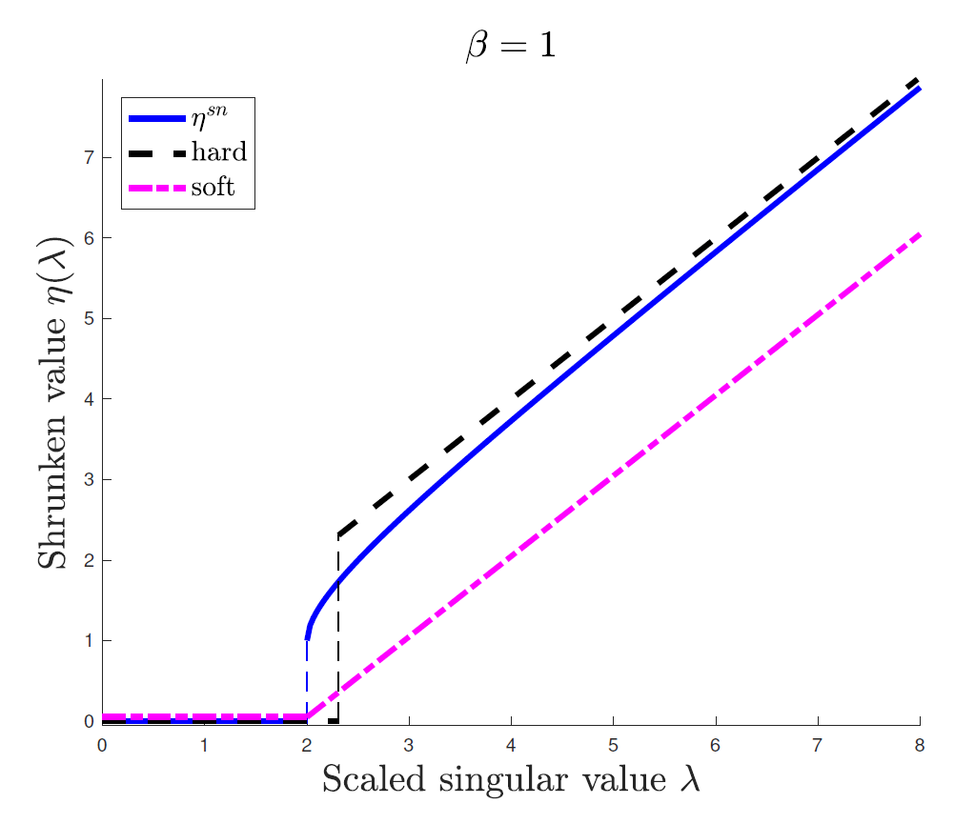
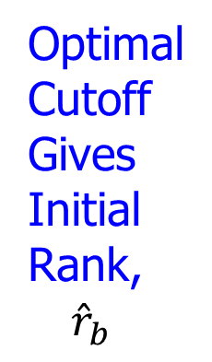
DIVAS
Shabalin Nobel Shrinkage (For Denoising)
Optimized
For
Marcenko
Pasteur
Optimal
Cutoff
Gives
Initial
Rank,
${\hat{r}}_{b}$

Slide 24
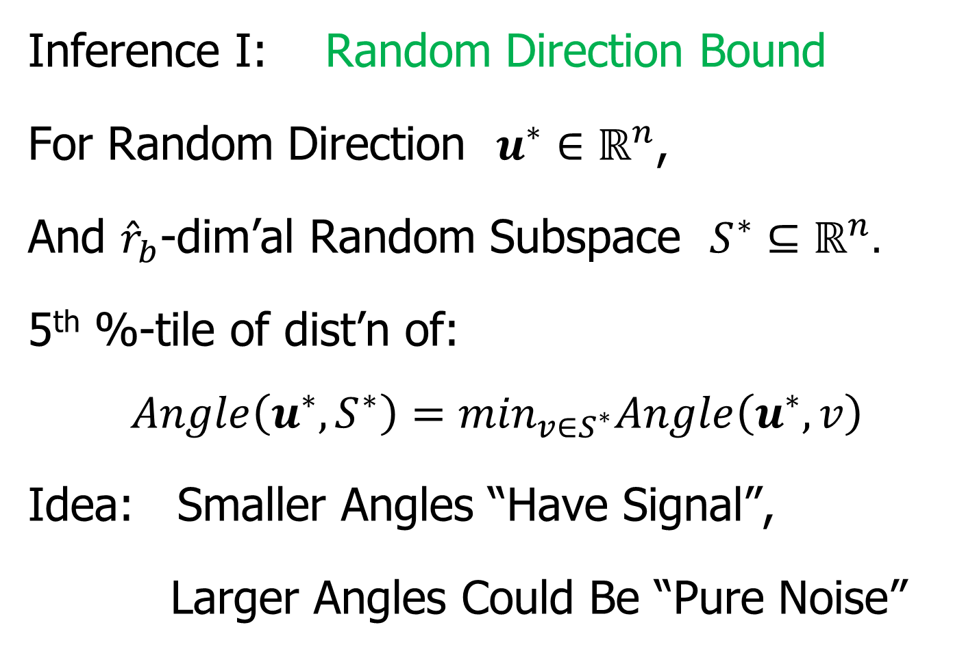
DIVAS
Inference I: Random Direction Bound
For Random Direction $u^{∗}∈ℝ^{n}$,
And ${\hat{r}}_{b}$-dim’al Random Subspace $S^{∗}⊆ℝ^{n}.$
5th %-tile of dist’n of:
$$Angle\left(u^{∗},S^{∗}\right)=\min_{v∈S^{∗}}Angle\left(u^{∗},v\right)$$
Idea: Smaller Angles “Have Signal”,
Larger Angles Could Be “Pure Noise”

Slide 25
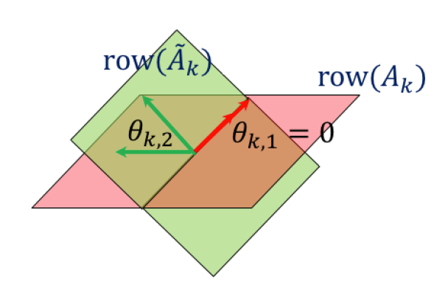

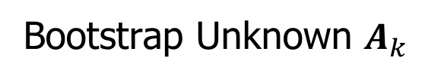
DIVAS
Inference II: Bootstrap Principal Angles
Goal: Relationship Between Subspaces
Signal $row\left(A_{b}\right)$ & Estimated $row\left({\tilde{A}}_{b}\right)$
Useful Summary:
Principal Angle Analysis
Bootstrap Unknown $A_{k}$

Slide 26
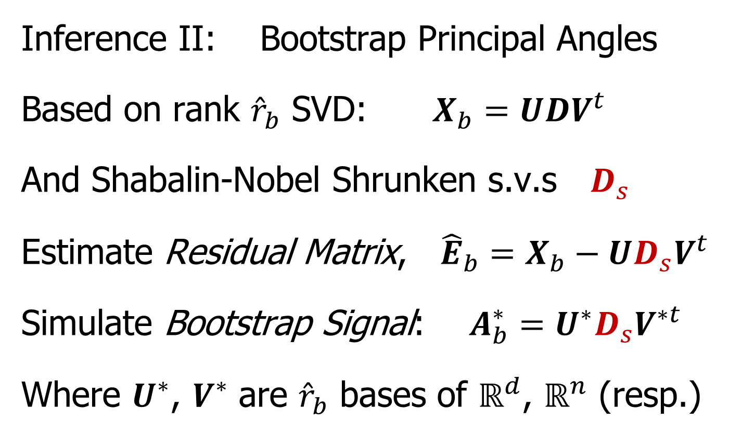
DIVAS
Inference II: Bootstrap Principal Angles
Based on rank ${\hat{r}}_{b}$ SVD: $X_{b}=UDV^{t}$
And Shabalin-Nobel Shrunken s.v.s $D_{s}$
Estimate Residual Matrix, ${\hat{E}}_{b}=X_{b}−UD_{s}V^{t}$
Simulate Bootstrap Signal: $A_{b}^{∗}=U^{∗}D_{s}V^{∗t}$
Where $U^{∗}$, $V^{∗}$ are ${\hat{r}}_{b}$ bases of $ℝ^{d}$, $ℝ^{n}$ (resp.)
Think Random Rotations

Slide 27
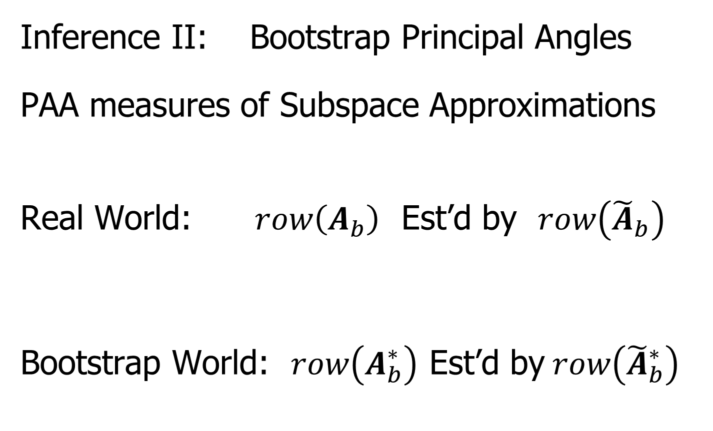
DIVAS
Inference II: Bootstrap Principal Angles
PAA measures of Subspace Approximations
Real World: $row\left(A_{b}\right)$ Est’d by $row\left({\tilde{A}}_{b}\right)$
Bootstrap World: $row\left(A_{b}^{∗}\right)$ Est’d by$row\left({\tilde{A}}_{b}^{∗}\right)$
“Relative Isotropy” Makes This Work
≈

Slide 28
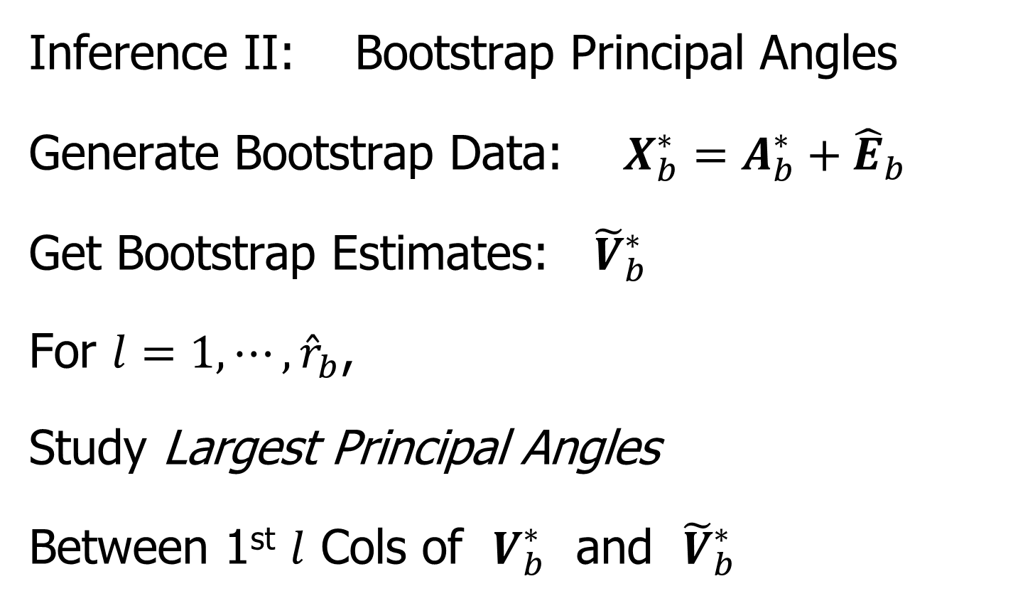
DIVAS
Inference II: Bootstrap Principal Angles
Generate Bootstrap Data: $X_{b}^{∗}=A_{b}^{∗}+{\hat{E}}_{b}$
Get Bootstrap Estimates: ${\tilde{V}}_{b}^{∗}$
For $l=1,⋯,{\hat{r}}_{b}$,
Study Largest Principal Angles
Between 1st $l$ Cols of $V_{b}^{∗}$ and ${\tilde{V}}_{b}^{∗}$

Slide 29
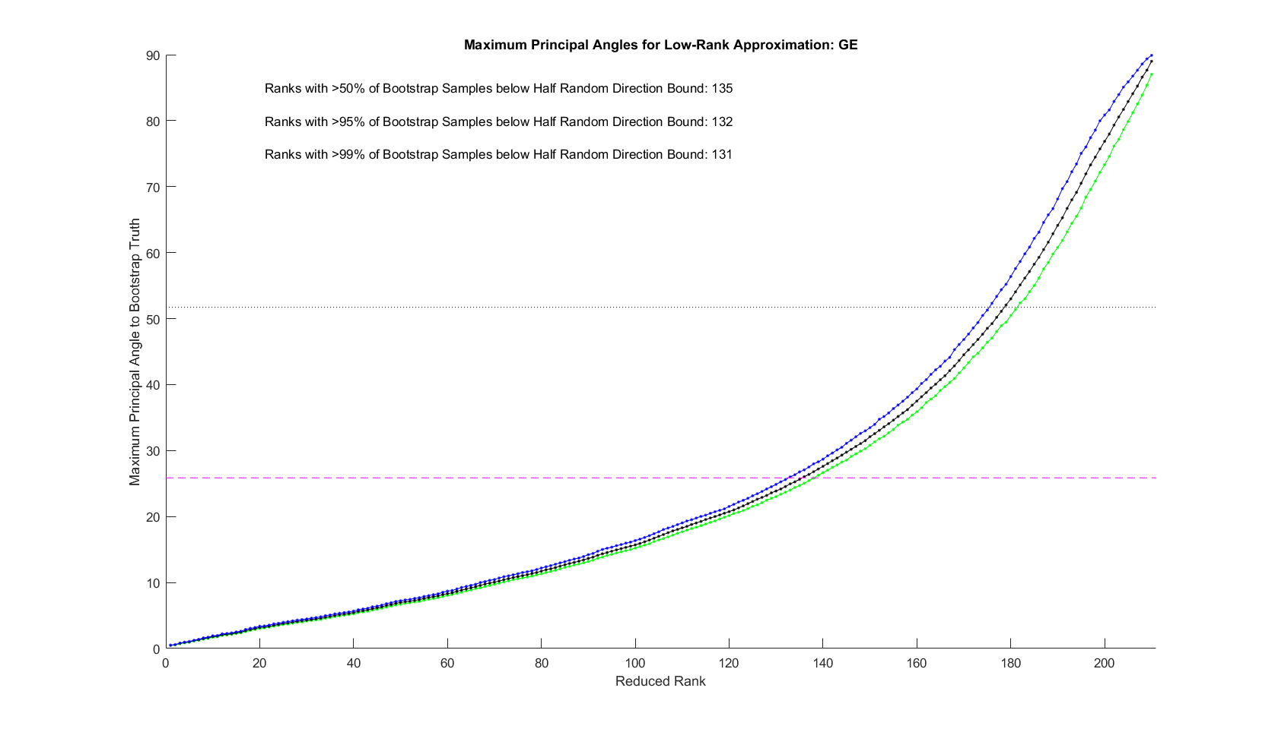
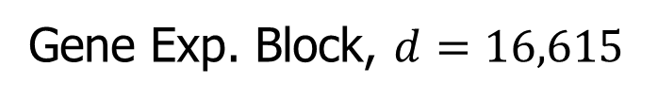

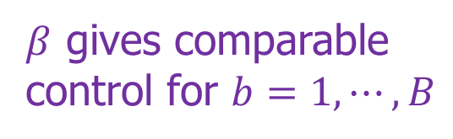
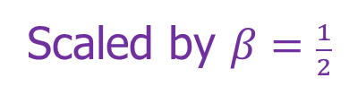
DIVAS
Initial Rank Selection (Bootstrap Inference):
Random Direction Bound
Scaled by $β=\frac{1}{2}$
$β$ gives comparable
control for $b=1,⋯,B$
Determines ${\tilde{r}}_{b}$
Gene Exp. Block, $d=16,615$

Slide 30
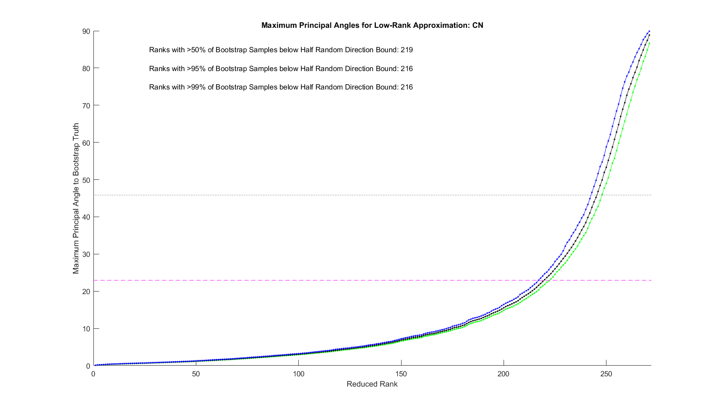
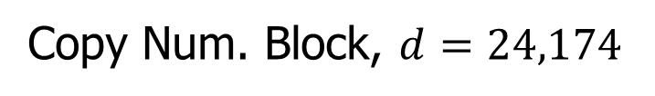
DIVAS
Initial Rank Selection (Bootstrap Inference):
Copy Num. Block, $d=24,174$

Slide 31
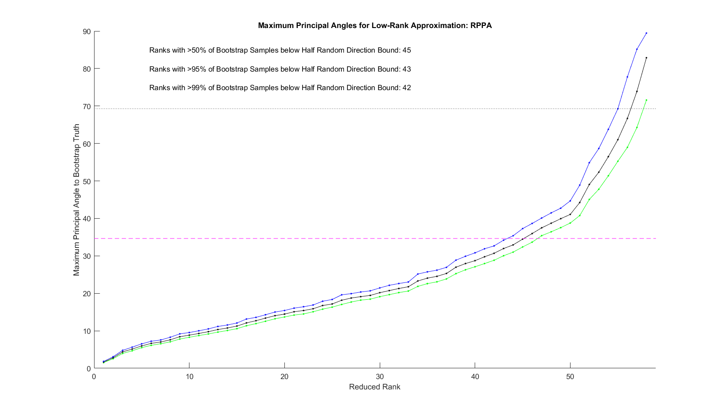
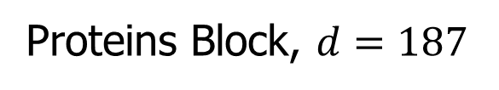
DIVAS
Initial Rank Selection (Bootstrap Inference):
Proteins Block, $d=187$

Slide 32
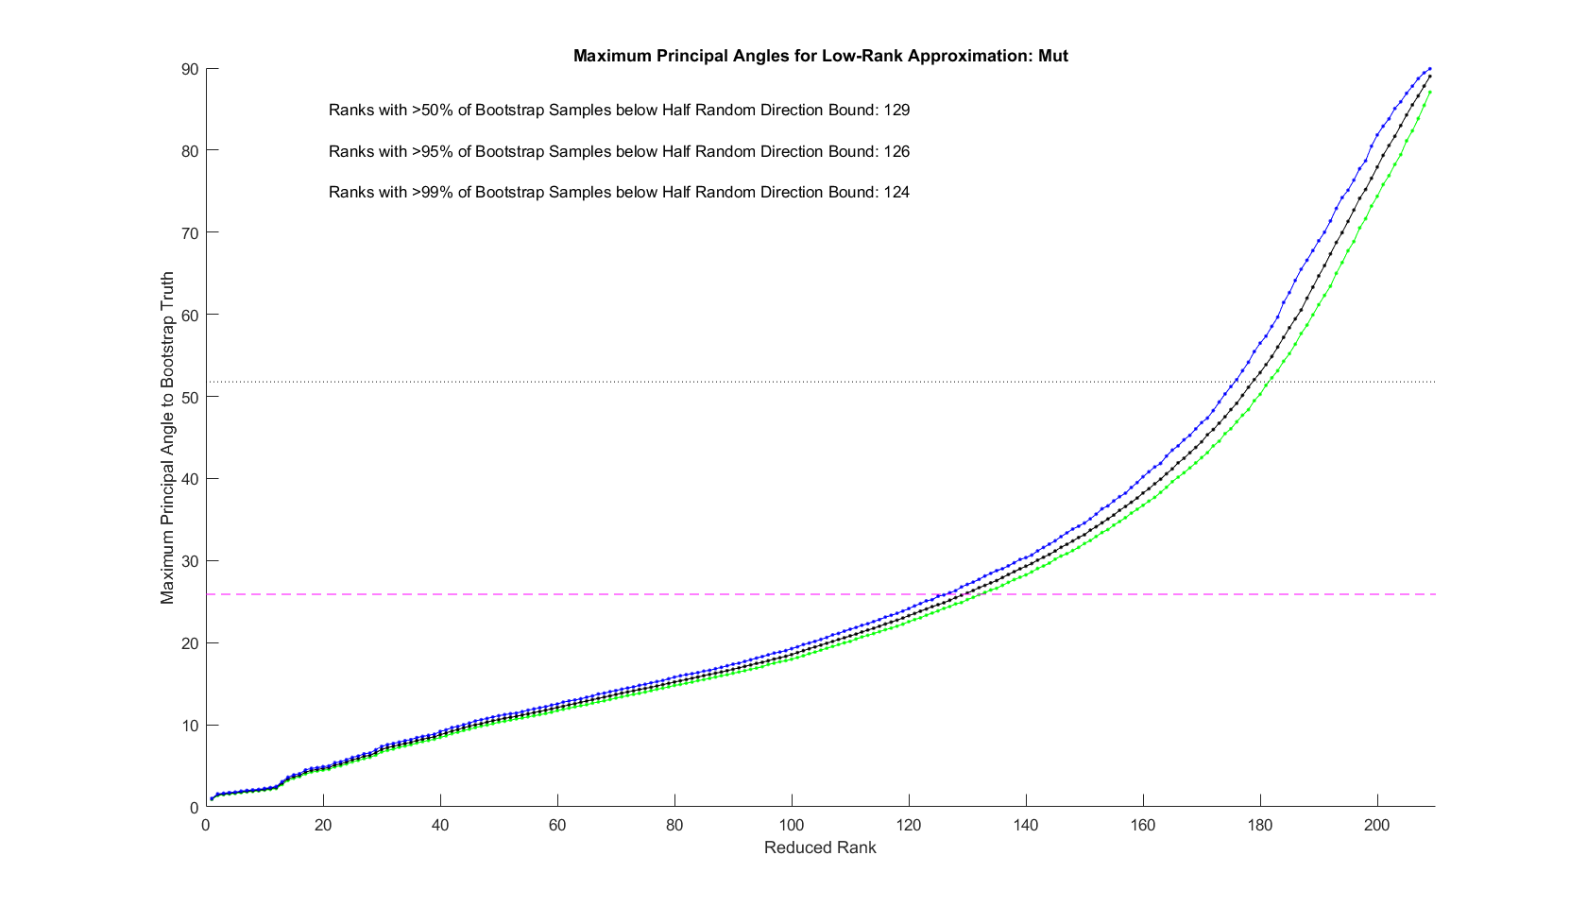
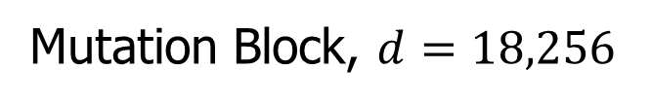
DIVAS
Initial Rank Selection (Bootstrap Inference):
Mutation Block, $d=18,256$

Slide 33
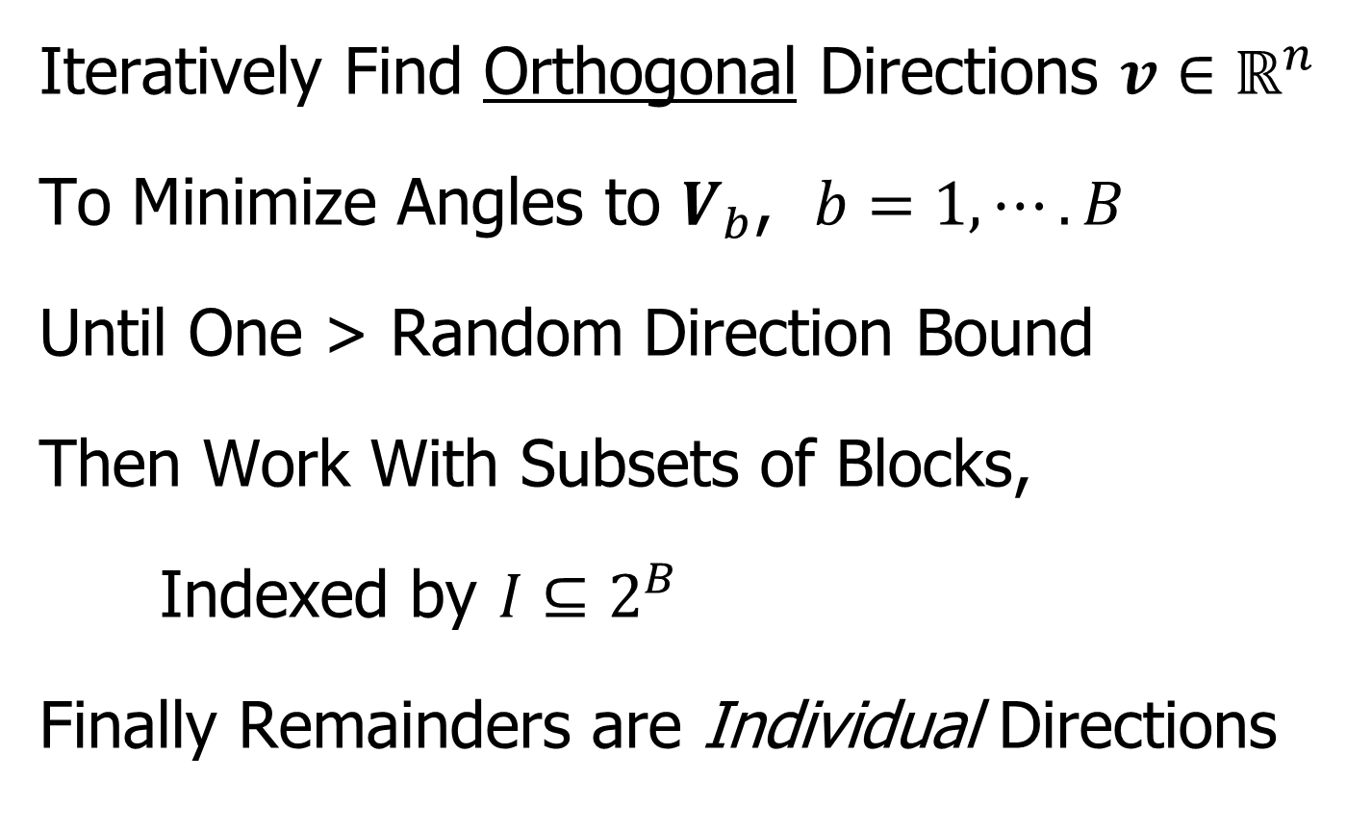
DIVAS
Iteratively Find Orthogonal Directions $v∈ℝ^{n}$
To Minimize Angles to $V_{b}$, $b=1,⋯.B$
Until One > Random Direction Bound
Then Work With Subsets of Blocks,
Indexed by $I⊆2^{B}$
Finally Remainders are Individual Directions

Slide 34
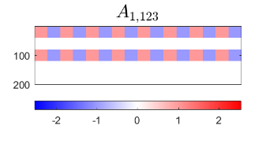
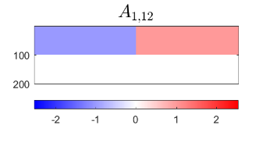
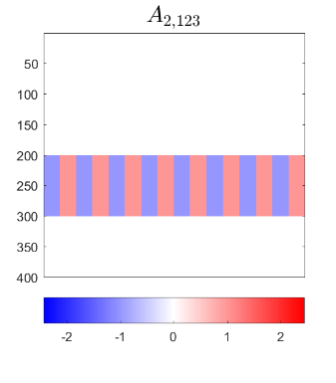
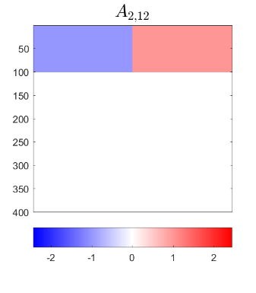
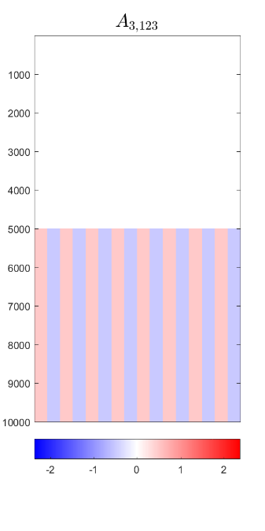
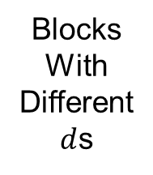
DIVAS – 3 Block Toy Example
1-2 Joint Comp, Rank 1
1-2 Scores
Orthogonal to
1-2-3 Scores
Blocks
With
Different
$d$s
1-2-3 Joint Component, Rank 1

Slide 35
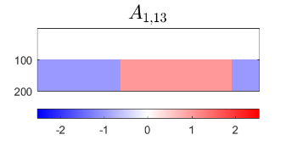
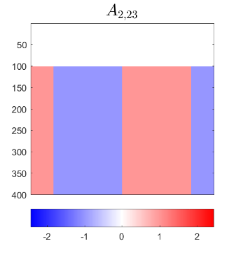
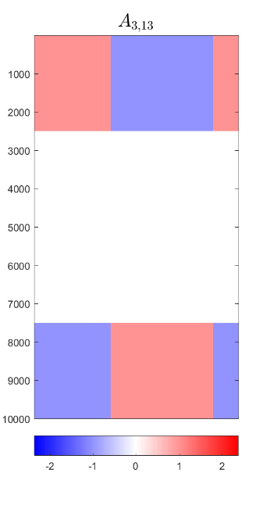
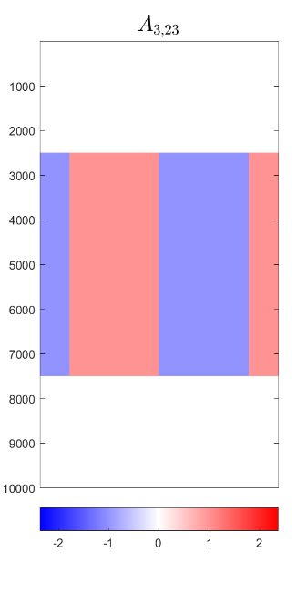


DIVAS – 3 Block Toy Example
1-3 Comps.
2-3 Comps.
Both $⊥$ to Joint
And All three ${60}^{°}$ Apart

Slide 36
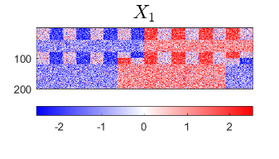
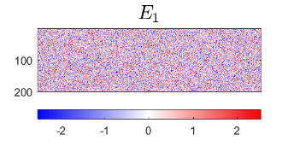
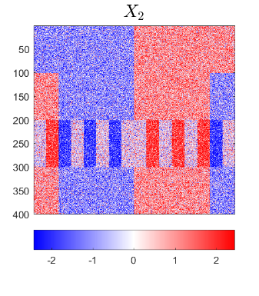
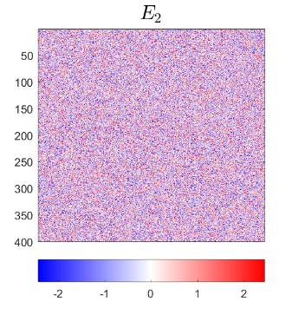


DIVAS – 3 Block Toy Example
Input to DIVAS: Sum of ALL
IID Gaussian Noise

Slide 37









DIVAS – 3 Block Toy Example
$$X_{1}$$
$$A_{1}$$
$$E_{1}$$
$$X_{2}$$
$$A_{2}$$
$$E_{2}$$
$$X_{3}$$
$$A_{3}$$
$$E_{3}$$

Slide 38










DIVAS – 3 Block Toy Example
Deeper Look at Estimation of 1st Block, i.e. $A_{1}$
Target
DIVAS
AJIVE
Large Angles $≈$ Worse Estimation
2.76°
5.01°
1.71°
4.23°
7.89°
7.14°

Slide 39








DIVAS – 3 Block Toy Example
Deeper Look at Estimation of 2nd Block
Target
DIVAS
AJIVE
DIVAS
Again
Gives
Better
Estimation
2.76°
5.00°
2.11°
4.23°
5.79°
3.76°

Slide 40



DIVAS – 3 Block Toy Example
Deeper 3rd Block - Target

Slide 41



DIVAS – 3 Block Toy Example
Deeper 3rd Block - DIVAS
2.76°
1.71°
2.11°

Slide 42


DIVAS – 3 Block Toy Example
Deeper 3rd Block - AJIVE
4.23°
1.43°
2.47°

Slide 43
DIVAS on TCGA Data
Breast Cancer
Gene Expression (GE) [16615 x 616]
Copy Number (CN) [24174 x 616]
Protein Exp. (RPPA) [187 x 616]
Mutation Status (MU) [18256 x 616]

Slide 44

DIVAS on TCGA Data
Color Coded Share Types
Statistical Significance Summary

Slide 45

DIVAS on TCGA Data
6 CN$→$GE$→$Protein Modes
Statistical Significance Summary
Single 4-way mode, as in AJIVE Analysis
Little Systematic
Mutation Variation

Slide 46


DIVAS on TCGA Data
GE or CN$→$ Proteins
Statistical Significance Summary
Major CN$→$GE Variation
No Pairwise Mut Variation
Many Modes of
Individual Var’n

Slide 47
DIVAS on TCGA Data
Statistical Significance Summary
Final Rank
Filtered Rank
Maximal Rank

Slide 48
DIVAS on TCGA Data
Statistical Significance Summary
Number of Cases
Involved in Direction
Can Reveal Modes Driven by Outliers

Slide 49

DIVAS Modes of Variation from TCGA
TCGA Breast Cancer Data:
Data Blocks ($∩$s & Carefully Cleaned)
  mRNA (GE): 16615×616
  Copy Number (CN): 24174×616
  Rev. Phase Protein Array (RPPA): 187×616
  Gene mutation (Mutation): 18256×616
Tumor Subtypes
  Basal-like: ⊲
  HER2-like: ∗
  Luminal A: +
  Luminal B: ×

Slide 50

DIVAS Modes of Variation from TCGA
Gene Exp. PCA Modes of Variation (Scores)
Strong Basal Separation
Other Differences
Not So Apparent
Lum B & HER2 Separation

Slide 51


DIVAS Modes of Variation from TCGA
Gene Exp. PCA Modes of Varia’n (Loadings)
PAM 50 Genes

Slide 52


DIVAS Modes of Variation from TCGA
Gene Exp. PCA Modes of Varia’n (Loadings)

Slide 53

DIVAS Modes of Variation from TCGA
DIVAS 4-way & 3-Way Modes (Scores)
Luminals vs. Others
Basals vs. HER2s
HER2s vs. Lum Bs

Slide 54


DIVAS Modes of Variation from TCGA
DIVAS 4-way & 3-Way Modes (GE Loadings)
More PAM 50 Genes

Slide 55
DIVAS on Mortality Data
Data Blocks:
Swiss Males
Spanish Males
Swiss Females
Spanish Females
Expected Differences:
Record Keeping, War
Expected Commonalities:
Overall Improvement,
Pandemic, Automobiles
Explore Gender Issues

Slide 56

DIVAS on Mortality Data
DIVAS Result:
6 Two-way Spanish
Male – Female Modes
2 Four-way Modes
1 Three-way Mode

Slide 57

DIVAS on Mortality Data
Double Mean Centering,
i.e. Flat Mode Removed
Note: Age Rounding in Spain
Show Overall Improvement,
Four-Way Modes
Pandemic & Automotive Effects

Slide 58

DIVAS on Mortality Data
Three-Way Mode
AIDS Epidemic?

Slide 59

DIVAS on Mortality Data
Civil War
Record Keeping
Two-Way Modes (Spanish Males & Females)

Slide 60

HDLSS Asymptotics
Text: Sec. 14.2
Recall Various “Mysteries” about
High Dimension Low Sample Size Data
Natural Separation of $N_{1000}\left(0,I\right)$ Data
Strange behavior in HDLSS Classificat’n
GWAS Failure of Spherical PCA
Next Investigate Mathematics Of These
Notes:
60

Slide 61

HDLSS Asymptotics
Modern Mathematical Statistics:
Based on asymptotic analysis
Notes:
61

Slide 62

HDLSS Asymptotics
Modern Mathematical Statistics:
Based on asymptotic analysis
I.e. Uses limiting operations
Very often $\lim_{n→∞}{}$
Workhorse Method for Much Insight:
Laws of Large Numbers (Consistency)
Central Limit Theorems
(Quantify Errors, Basis of Inference)
Notes:
62

Slide 63

HDLSS Asymptotics
Modern Mathematical Statistics:
Based on asymptotic analysis
I.e. Uses limiting operations
Very often $\lim_{n→∞}{}$
Occasional misconceptions:
  Indicates behavior for large samples
  Thus only makes sense for “large” samples
  Models phenomenon of “increasing data”
  So other flavors are useless???
Sometimes Ask
Junior Researchers
Why They Do
Asymptotics
Notes:
63

Slide 64
HDLSS Asymptotics
Modern Mathematical Statistics:
Based on asymptotic analysis
Real Reasons:
  Approximation provides insights
  Can find simple underlying structure
  In complex situations
Thus various flavors are fine:
$$\lim_{n→∞}{} \lim_{d→∞}{} \lim_{n,d→∞}{} \lim_{σ→0}{}$$
Even desirable! (find additional insights)
Notes:
64

Slide 65
HDLSS Asymptotics
Personal Observations:
HDLSS world is…
Surprising (many times!)
[Think I’ve got it, and then …]
Mathematically Beautiful (?)
Doing Mathematics Is Essential
Practically Relevant
Only Way To Understand
When Intuition Fails!

Slide 66


HDLSS Asymptotics: Simple Paradoxes
For $d$ dimensional Standard Normal dist’n:
$$\tilde{z}=\left(\begin{matrix}{\tilde{z}}_{1} \\ ⋮ \\ {\tilde{z}}_{d}\end{matrix}\right)\sim N_{d}\left(0,I_{d}\right)$$
Where are the Data?
Near Peak of Density?
Thanks to: psycnet.apa.org
Recall tilde for random,
Bold for vectors & matrices

Slide 67

HDLSS Asymptotics: Simple Paradoxes
For $d$ dimensional Standard Normal dist’n:
$$\tilde{z}=\left(\begin{matrix}{\tilde{z}}_{1} \\ ⋮ \\ {\tilde{z}}_{d}\end{matrix}\right)\sim N_{d}\left(0,I_{d}\right)$$
Euclidean Distance to Origin (as $d→∞$)
(measure how close to peak)

Slide 68


HDLSS Asymptotics: Simple Paradoxes
For $d$ dimensional Standard Normal dist’n:
$$\tilde{z}=\left(\begin{matrix}{\tilde{z}}_{1} \\ ⋮ \\ {\tilde{z}}_{d}\end{matrix}\right)\sim N_{d}\left(0,I_{d}\right)$$
Euclidean Distance to Origin (as $d→∞$)
$\left\|\tilde{z}\right\|=\sqrt{\sum_{i=1}^{d}{{{\tilde{z}}_{i}}^{2}}}\sim \sqrt{χ_{d}^{2}}$
Recall $Eχ_{d}^{2}=d$,
$var\left(χ_{d}^{2}\right)=2d$

Slide 69

HDLSS Asymptotics: Simple Paradoxes
For $d$ dimensional Standard Normal dist’n:
$$\tilde{z}=\left(\begin{matrix}{\tilde{z}}_{1} \\ ⋮ \\ {\tilde{z}}_{d}\end{matrix}\right)\sim N_{d}\left(0,I_{d}\right)$$
Euclidean Distance to Origin (as $d→∞$)
$\left\|\tilde{z}\right\|=\sqrt{\sum_{i=1}^{d}{{{\tilde{z}}_{i}}^{2}}}\sim \sqrt{χ_{d}^{2}}$
$\left\|\tilde{z}\right\|=\sqrt{d+O_{p}\left(d^{1/2}\right)}=\sqrt{d}+O_{p}\left(1\right)$
Taylor Expansion,
i.e. “Delta Method”

Slide 70

HDLSS Asymptotics: Simple Paradoxes
As $d→∞$,
$$\left\|\tilde{z}\right\|=\sqrt{d}+O_{p}\left(1\right)$$
Data lie roughly on surface of sphere,
with radius $\sqrt{d}$
- Yet origin is point of highest density???
- Paradox resolved by:
density w. r. t. Lebesgue Measure
Notes:
70

Slide 71

HDLSS Asymptotics: Simple Paradoxes
- Paradox resolved by:
density w. r. t. Lebesgue Measure
Consider Volume of Unit Sphere in $ℝ^{d}$
Find As: Integral In Sph’l Coordinates
$$V_{d}=\iiint{Jdθ_{1}⋯dθ_{d}dr}$$
Notes:
71

Slide 72
HDLSS Asymptotics: Simple Paradoxes
- Paradox resolved by:
density w. r. t. Lebesgue Measure
Consider Volume of Unit Sphere in $ℝ^{d}$
Find As: Integral In Sph’l Coordinates
$$V_{d}=\iiint{Jdθ_{1}⋯dθ_{d}dr}$$
Look At Integrand w.r.t. $r$
Can Show: Puts ~ All Weight Near $r=1$
Notes:
72

Slide 73

HDLSS Asymptotics: Simple Paradoxes
- Paradox resolved by:
density w. r. t. Lebesgue Measure
Lebesgue Measure Pushes Mass Out
Density Pulls Data In
$\sqrt{d}$ Is The Balance Point
Notes:
73

Slide 74

HDLSS Asymptotics: Simple Paradoxes
As $d→∞$, $\left\|\tilde{z}\right\|=\sqrt{d}+O_{p}\left(1\right)$
Important Philosophical Consequence:
$∄$“Average People”
Parents Lament:
Why Can’t I Have Average Children?
Theorem: Impossible (over many factors)!
Notes:
74

Slide 75

HDLSS Asymptotics: Simple Paradoxes
Distance tends to non-random constant:
For $Z_{1}$ & $Z_{2}$ independent
$$\left\|{\tilde{z}}_{1}−{\tilde{z}}_{2}\right\|=\sqrt{2d}+O_{p}\left(1\right)$$
Factor $\sqrt{2}$, since
$sd\left({\tilde{x}}_{1}−{\tilde{x}}_{2}\right)=\sqrt{{sd\left({\tilde{x}}_{1}\right)}^{2}+{sd\left({\tilde{x}}_{2}\right)}^{2}}$
Can extend to independent ${\tilde{z}}_{1},⋯{\tilde{z}}_{n}$
All points are equidistant
(We can only perceive 3 dimensions)
Notes:
75

Slide 76
HDLSS Asymptotics: Simple Paradoxes
Recall Reason Why
Perceptual System from Ancestors
They Needed to Find Food
Food Exists in 3-d World
(We can only perceive 3 dimensions)
Notes:
76

Slide 77


HDLSS Asymptotics: Simple Paradoxes
For $d$ dim’al Standard Normal dist’n:
${\tilde{z}}_{1}$ indep. of ${\tilde{z}}_{2}\sim N_{d}\left(0,I_{d}\right)$
High dim’al Angles (as $d→∞$):
As vectors from the Origin
$\left(\cos^{−1}\left({{\underline{u}}_{1}}^{t}{\underline{u}}_{2}\right)\right)$
Thanks to: members.tripod.com

Slide 78





HDLSS Asymptotics: Simple Paradoxes
For $d$ dim’al Standard Normal dist’n:
${\tilde{z}}_{1}$ indep. of ${\tilde{z}}_{2}\sim N_{d}\left(0,I_{d}\right)$
High dim’al Angles (as $d→∞$):
$$Angle\left({\underline{Z}}_{1},{\underline{Z}}_{2}\right)={90}^{°}+O_{p}\left(d^{−1/2}\right)$$
- Everything is orthogonal???
$\sqrt{2d}$
Note Pythagorean Theorem:
$\sqrt{d}$
${90}^{°}$
$\sqrt{d}$

Slide 79

HDLSS Asy’s: Geometrical Represent’n
Assume ${\tilde{z}}_{1},⋯{\tilde{z}}_{n}\sim N_{d}\left(0,I_{d}\right)$, let $d→∞$
Study Subspace Generated by Data
Hall, Marron & Neeman (2005)

Slide 80

HDLSS Asy’s: Geometrical Represent’n
Assume ${\tilde{z}}_{1},⋯{\tilde{z}}_{n}\sim N_{d}\left(0,I_{d}\right)$, let $d→∞$
Study Subspace Generated by Data
Hyperplane through $0$,
of dimension $n$
Hall, Marron & Neeman (2005)

Slide 81

HDLSS Asy’s: Geometrical Represent’n
Assume ${\tilde{z}}_{1},⋯{\tilde{z}}_{n}\sim N_{d}\left(0,I_{d}\right)$, let $d→∞$
Study Subspace Generated by Data
Hyperplane through $0$,
of dimension $n$
Points are “nearly equidistant to $0$”,
& dist $\sqrt{d}$
Hall, Marron & Neeman (2005)

Slide 82

HDLSS Asy’s: Geometrical Represent’n
Assume ${\tilde{z}}_{1},⋯{\tilde{z}}_{n}\sim N_{d}\left(0,I_{d}\right)$, let $d→∞$
Study Subspace Generated by Data
Hyperplane through $0$,
of dimension $n$
Points are “nearly equidistant to $0$”,
& dist $\sqrt{d}$
Within plane, can
“rotate towards $\sqrt{d} ×$ Unit Simplex”
Hall, Marron & Neeman (2005)

Slide 83
Participant Presentation
1:35 Enes Kelestemur:
Drug Discovery
Next Class: Shiying Li

