Slide 1
Statistics – O. R. 881 Object Oriented Data Analysis
Steve Marron
Dept. of Statistics and Operations Research
University of North Carolina

Slide 2
Current Sections in Textbook
Today:
Sections 5.3, 6.1
Next Class:
Sections 6.3, 17.1

Slide 3
Participant Presentations
Online Participants:
Please Send
An Email.
Including Auditors
Please Sign Up:
Name
Email (Onyen is fine, or …)
Are You ENRolled?
Dept. & Advisor (Lab?)
Tentative Title (“????” Is OK)
When:
Next Week, Early, Oct., Nov., Late

Slide 4
Last Class: Data Visualization
For a Matrix of Data:
$${\left(\begin{matrix}x_{11} & ⋯ & x_{1n} \\ ⋮ & ⋱ & ⋮ \\ x_{d1} & ⋯ & x_{dn}\end{matrix}\right)}_{d×n}$$
Three Useful (& Important) Visualizations
Curve Objects
Relationships Between Objects
Marginal Distributions (1-d each “variable”)

Slide 5
Last Class: Marg. Dist. Plots
Ideas:
For Each Variable (i.e. Trait)
Study 1-d Distributions
Simultaneous Views:
Jitter Plots
Smooth Histograms (Kernel Density Est’s)

Slide 6
Last Class: Marg. Dist. Plots
View:
4 x 4 Grid
Since Comfortable Number
Lose Detail for More
For $d>16$:
Choose Representative Subset
(Since often too many to look at all)
Text, Sec. 5.1

Slide 7
Last Class: Marg. Dist. Plots
Representative Subset of Variables:
Sort Variables on a Data Summary
E.g Mean, S.D., Skewness, Median, …
Usually Take Nearly Equally Spaced Grid
Sometimes Specify Variables
E.g. All Largest (or Smallest) Summaries

Slide 8
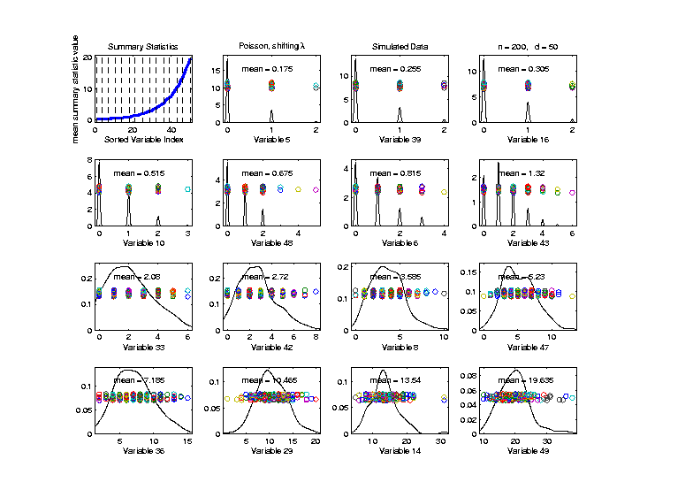
Last Class: Marg. Dist. Plots
Toy Example: $n=200$, $d=50$,
i.i.d. Poisson, with parameters $λ=0.2,⋯,20$
Sort Variables
On Sample
Mean
Summary
Plot with
Equal
Spacing

Slide 9
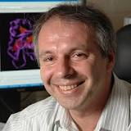
Last Class: Marg. Dist. Plot
Drug Discovery Data
$n = 262$, Chemical Compounds
$d = 2489$, Chemical “Descriptors”
Discrete Response:
0 – blue o, 1 – red +
(Thanks to Alex Tropsha Lab)

Slide 10
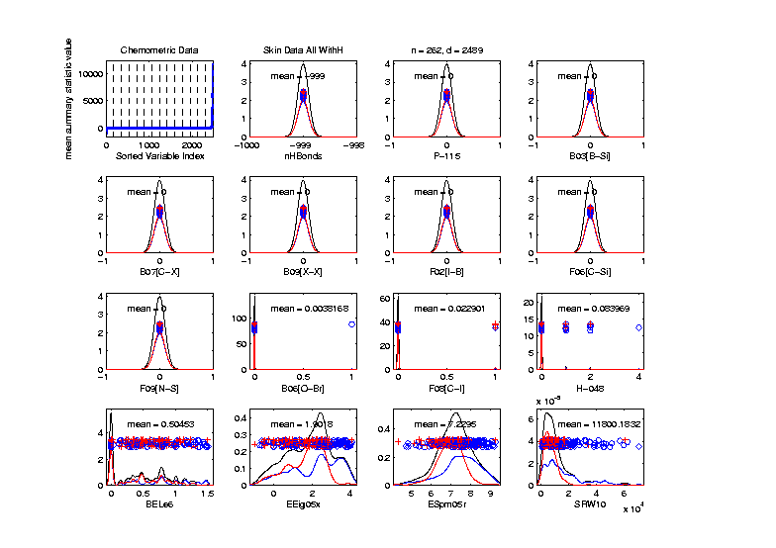
Last Class: Marg. Dist. Plot
Drug Discovery – Sort on Means
Note: Many
With No
Variation???

Slide 11
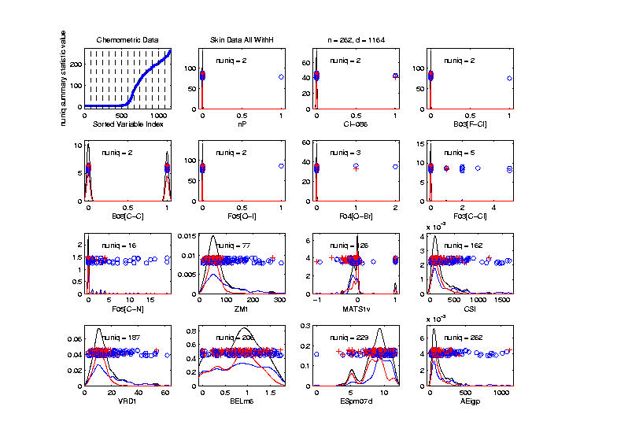
Last Class: Marg. Dist. Plot
Drug Discovery - Sort On Number Unique
Shows
Many
Binary
Few Truly
Continuous

Slide 12
Last Class: Marg. Dist. Plot
Common Practice:
Delete “Mostly 0” Variables (little information)
More Careful Look, Borysov et al (2016)
These Can Contain Useful Info
(Especially When So Many)
Not Clear What This Means!
Defined as “$≥95\% 0$s”

Slide 13
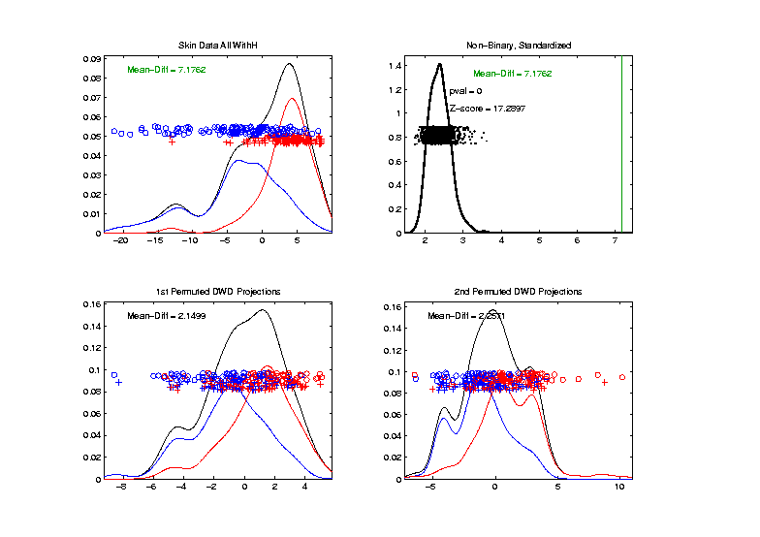
Last Class: Drug Discovery Data
DiProPerm test of Blue vs. Red
Non-Binary – Standardized
Z = 17.3
Stronger
Reflects
More Info
In Data

Slide 14
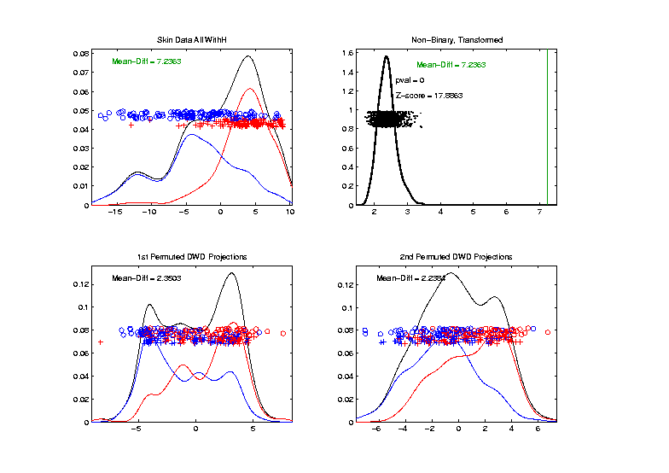
Last Class: Drug Discovery Data
Introduced
Very Soon
DiProPerm test of Blue vs. Red
Non-Binary – Shifted Log Transforms
Z = 17.9
Slightly
Stronger

Slide 15
Last Class: Limitation of PCA
Strongly Feels Scaling of Each Variable
Consequence:
May want to standardize each variable
(i.e. subtract $\overline{X}$, divide by $s$)
Also called Whitening
Equivalent Approach:
Base PCA on Correlation Matrix
Called Correlation PCA
Instead of Usual
Covariance Matrix

Slide 16
Last Class: Correlation PCA
Why use correlation matrix?
Makes features “unit free”
e.g. Height, Weight, Age, $, …
Are “directions in point cloud” meaningful or useful?
Will unimportant directions dominate?

Slide 17
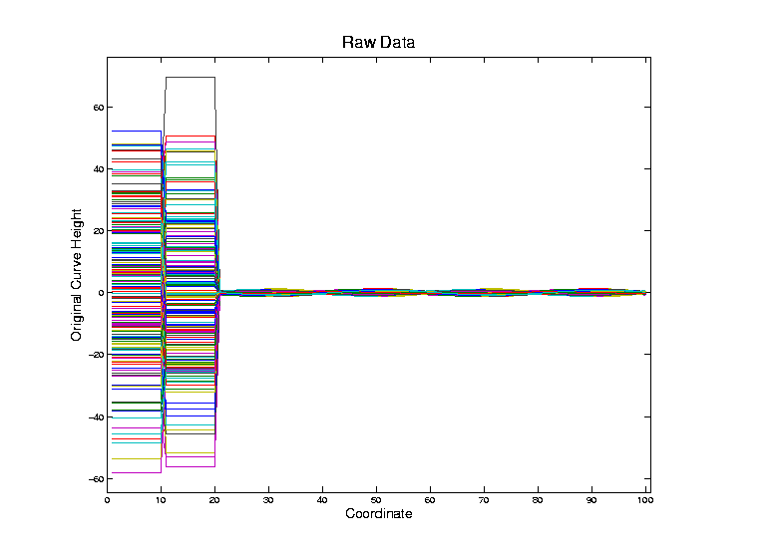
Last Class: Correlation PCA
Toy Example Contrasting Cov. vs. Corr.

Slide 18
Last Class: Correlation PCA
Toy Example Contrasting Cov. vs. Corr.
Big Var’n
Part

Slide 19
Last Class: Correlation PCA
Toy Example Contrasting Cov. vs. Corr.
Big Var’n
Part
Small
Var’n
Part

Slide 20
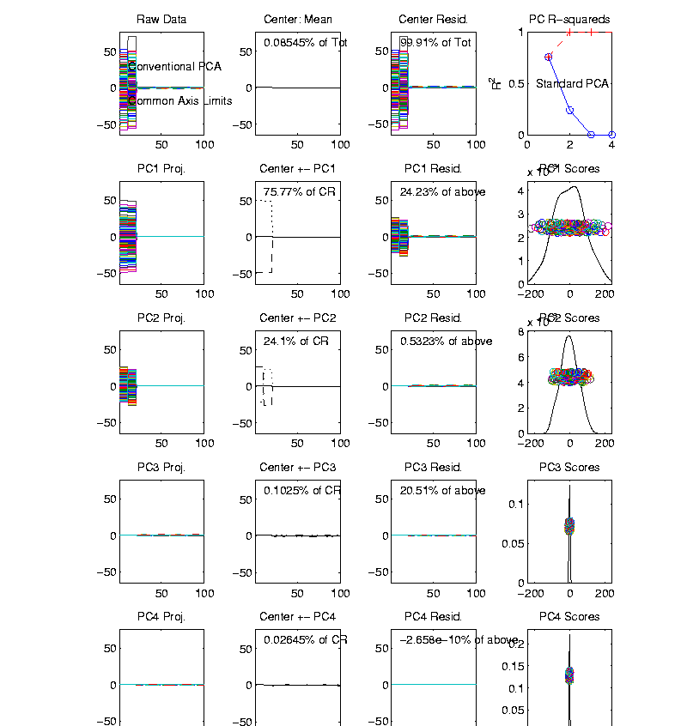
Last Class: Correlation PCA
Toy Example Contrasting Cov. vs. Corr.
1st Comp:
Nearly Flat
2nd Comp:
Contrast
3rd & 4th:
Very Small

Slide 21
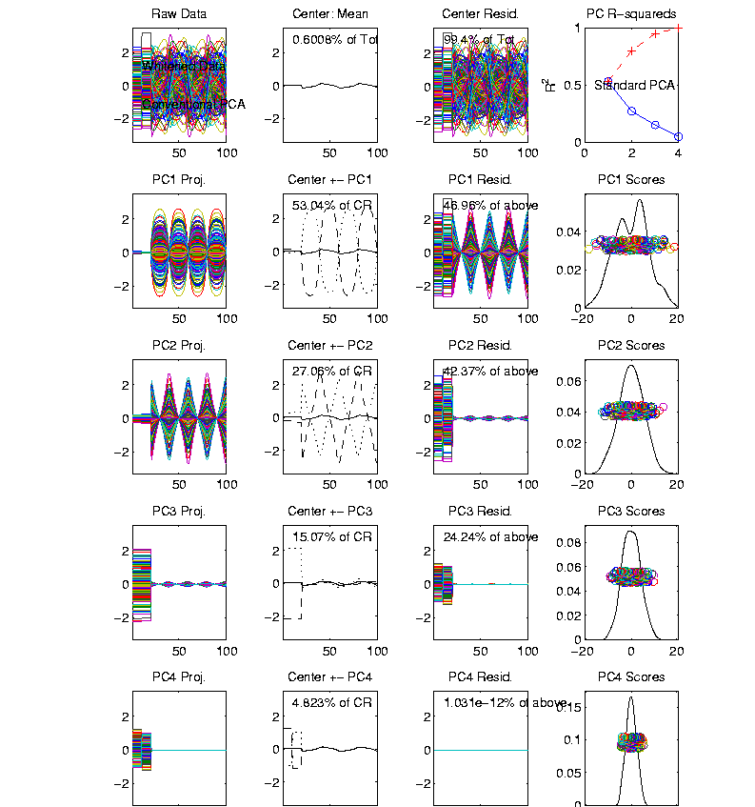
Last Class: Correlation PCA
Toy Example Contrasting Cov. vs. Corr.
Correlation
“Whitened”
Version
All Much
Different
Which Is
“Right” ???

Slide 22
Last Class: Correlation PCA
Personal Thoughts on Correlation PCA:
Can be very useful
(especially with noncommensurate units)
Not always, can hide important structure

Slide 23
Transformations
Text: Sec. 5.3
Useful Method for Data Analysis
Apply to Marginal Distributions
(i.e. to Individual Variables)
Idea: Put Data on Right Scale
Common Example:
Data Orders of Magnitude Different
Log₁₀ Puts Data on More Analyzable Scale
Recall Log for
Mortality and
RNAseq Data

Slide 24
Transformations
Famous Family:
Box – Cox Transformations
Box & Cox (1964)
Given a parameter $λ∈ℝ$,
$$x ↦ \frac{x^{λ}−1}{λ}$$

Slide 25
Transformations
Box – Cox Transformations
Why this strange form? Instead of just
$$x ↦x^{λ}$$
Reason: Nicer Behavior as $λ→0$,
$$\lim_{λ→0}{\frac{x^{λ}−1}{λ}}=\ln{x}$$

Slide 26
Homework 3
Verify that, for $x>0$, and $λ∈ℝ$,
$$\lim_{λ→0}{\frac{x^{λ}−1}{λ}}=\ln{x}$$
Turn in .pdf Answer on Canvas, Either
Word Processed or Write & Photo
Due: Feb. 8,
11:00AM

Slide 27
Transformations
Box – Cox Transformations
(vs. $x$)
(graphics from http://onlinestatbook.com/2/transformations/box-cox.html)

Slide 28
Transformations
Box – Cox Transformations
(vs. $x$)
(vs. $\ln{x}$)
(graphics from http://onlinestatbook.com/2/transformations/box-cox.html)

Slide 29
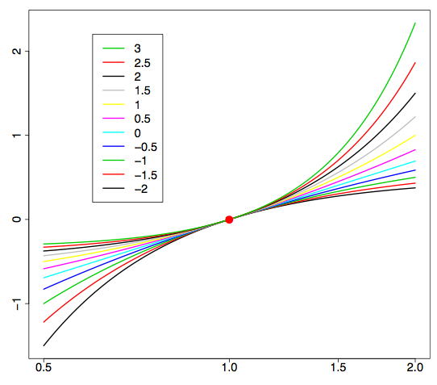
Transformations
Box – Cox Transformations (vs. $\ln{x}$)
(graphics from http://onlinestatbook.com/2/transformations/box-cox.html)
Lots of Flexibility
to Address Either
Positive or Negative
Skewness

Slide 30
Transformations
Another useful family:
Shifted Log Transformations
Given a parameter $δ∈ℝ$,
$$x ↦ \log\left(x+δ\right)$$
(Will use more below)

Slide 31
Transformations
Example: Melanoma Data Analysis
Miedema, et al (2012)

Slide 32
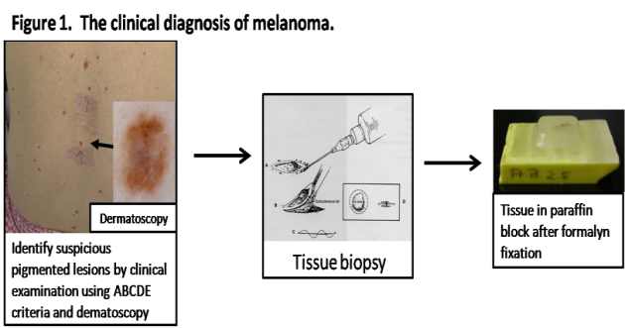
Introduction
Background
Clinical diagnosis

Slide 33
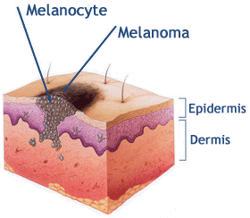
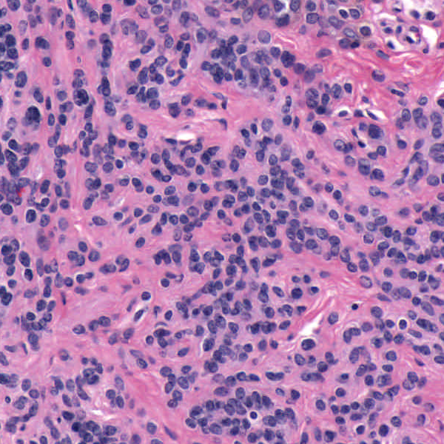
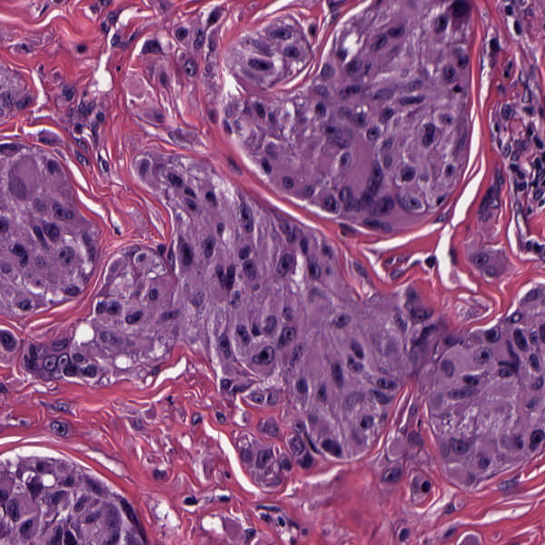
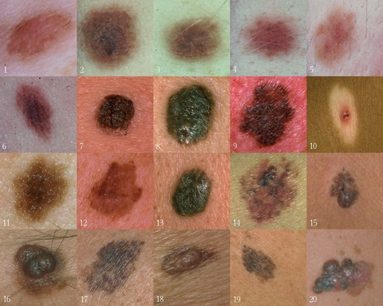
Background
Goal
Image Analysis of Histology Slides
Image: www.melanoma.ca
Benign
Melanoma
1 in 75 North Americans will develop a
malignant melanoma in their lifetime.
Initial goal: Automatically segment nuclei.
Challenge: Dense packing of nuclei.
Ultimately: Cancer grading and patient survival.
Image: melanoma.blogsome.com

Slide 34
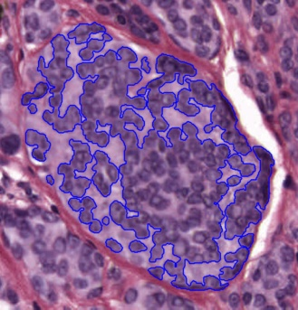
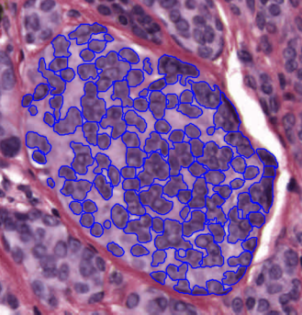
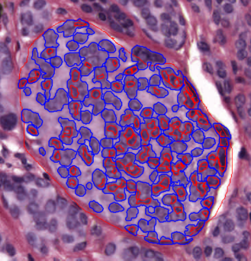
Segmentation
Cell Nuclei from Histology
Cutting Cell Clusters
Without subdivision
With subdivision
Our segmentation
Commercial seg.
Not perfect, but improved over standard algorithm (rq. validation).

Slide 35
Feature Extraction
Features from Cell Nuclei
Feature Extraction
Extract various features based on color and morphology
Example “high-level” concepts:
Stain intensity
Nuclear area
Density of nuclei
Regularity of nuclear shape
Called “Hand Crafted Features”
Currently Obsolete: Replaced by Deep Learning Features
But Transformation Point (of this) Still Applies

Slide 36
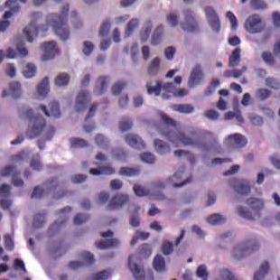
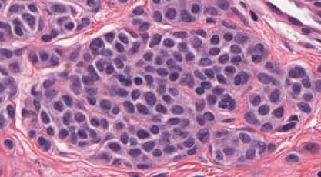
Feature Extraction
Features from Cell Nuclei
Original Image
Conventional Nevus
Superficial Spreading Melanoma

Slide 37
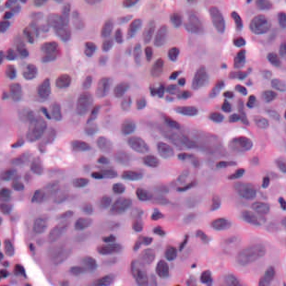
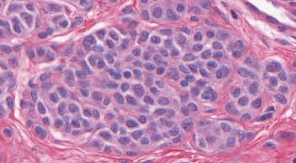
Feature Extraction
Features from Cell Nuclei
Restained Image
1. Color Normalization,
Addresses Different Staining & Fading
Conventional Nevus
Superficial Spreading Melanoma

Slide 38
Feature Extraction
Features from Cell Nuclei
Masked Region
2. Focus on “Region of Interest”
Conventional Nevus
Conventional Nevus
Superficial Spreading Melanoma
Superficial Spreading Melanoma
Masks generated by pathologist

Slide 39
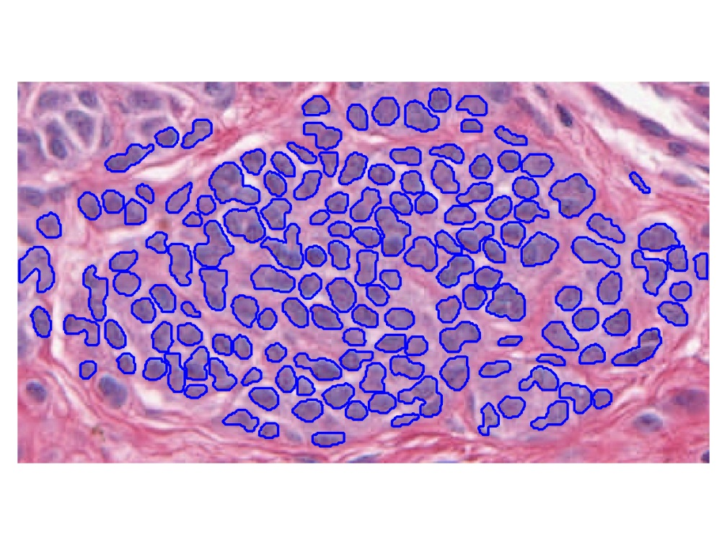
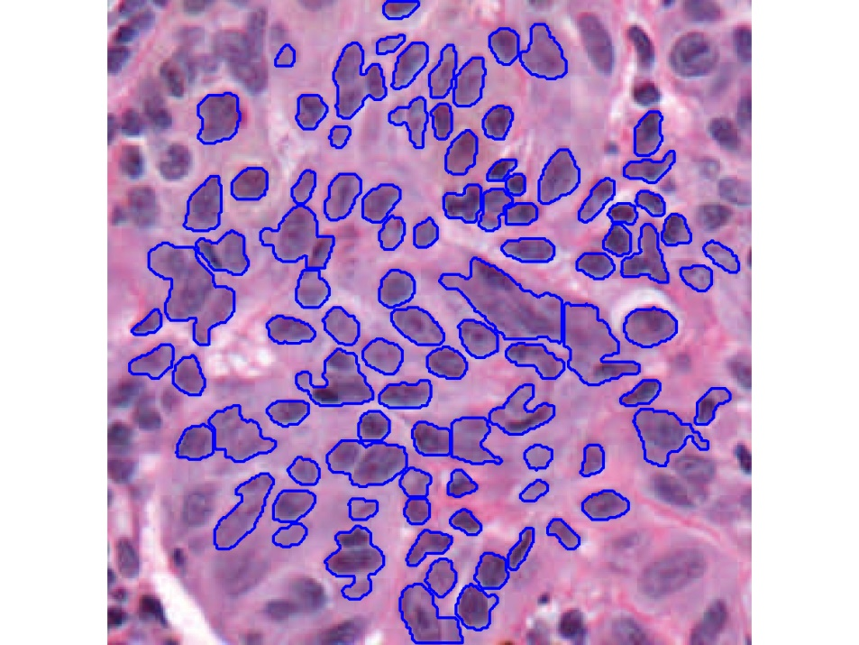
Feature Extraction
Features from Cell Nuclei
Segmented Nuclei
3. Nuclei “Segmentation”
Find “Boundaries”
Conventional Nevus
Superficial Spreading Melanoma

Slide 40
Feature Extraction
Features from Cell Nuclei
Labeled Nuclei
4. Highlight Nuclei
Conventional Nevus
Superficial Spreading Melanoma

Slide 41
Feature Extraction
Features from Cell Nuclei
Nuclear Regions
5. Expand to Generate Cell Regions
Conventional Nevus
Superficial Spreading Melanoma
Generated by growing nuclei out from boundary
Used for various color and density features:
Region Stain 2, Region Area Ratio, etc.

Slide 42
Feature Extraction
Features from Cell Nuclei
Delaunay Triangulation
6. Delauney Triangulation Quantifies Relations
Conventional Nevus
Superficial Spreading Melanoma
Triangulation of nuclear centers
Used for various density features:
Mean Delaunay, Max. Delaunay, etc.

Slide 43
Transformations
Statistical Challenge:
Some Features Spread Over Several Orders of Magnitude
Few Big Values Can Dominate Analysis

Slide 44
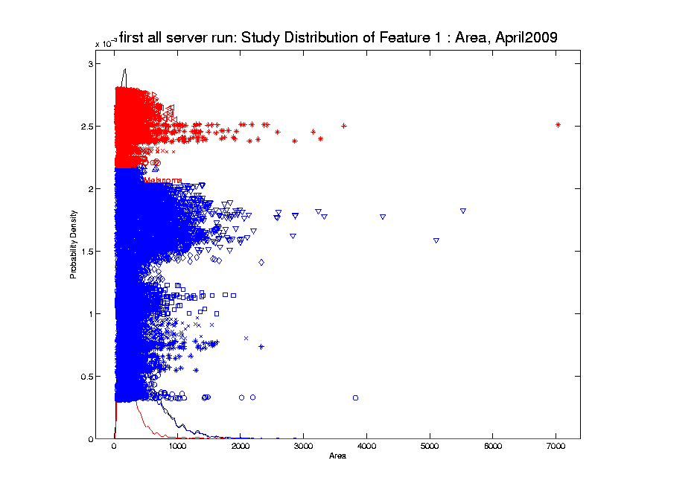
Transformations
Few Large Values Can Dominate Analysis

Slide 45
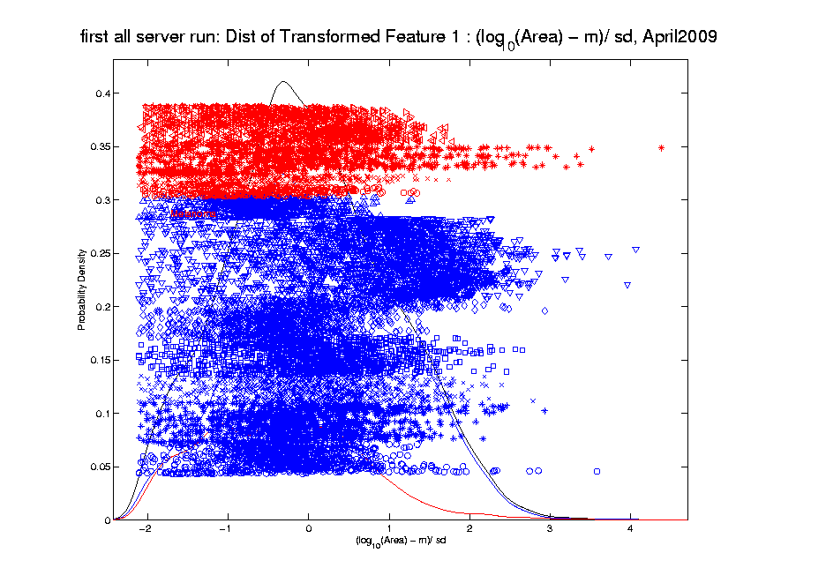
Transformations
Log Scale Gives All More Appropriate Weight
Note:
Orders
Of
Magnitude
Log₁₀ most
Interpretable

Slide 46
Transformations
Note That Order Matters:
Log Transform First
Standardize ($∙−\overline{X}$ / $s$) Second
Since Mean, $\overline{X}$, and Standard Deviation, $s$
Hard to Interpret for Skewed Data
Most Sensible for ~ Gaussian Data

Slide 47
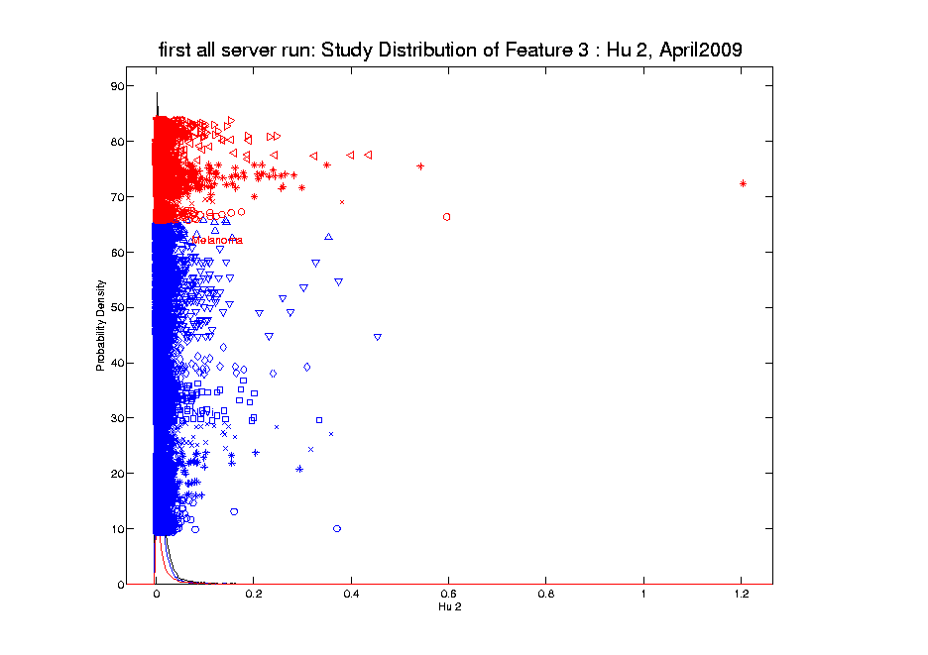
Transformations
Another Feature with Large Values
Problem
For This
Feature:
0 Values
(no log)

Slide 48
Transformations
Another Feature with Large Values
Approach:
Shifted
Log:
$$log\left(∙+δ\right)$$
Need to
Tune

Slide 49
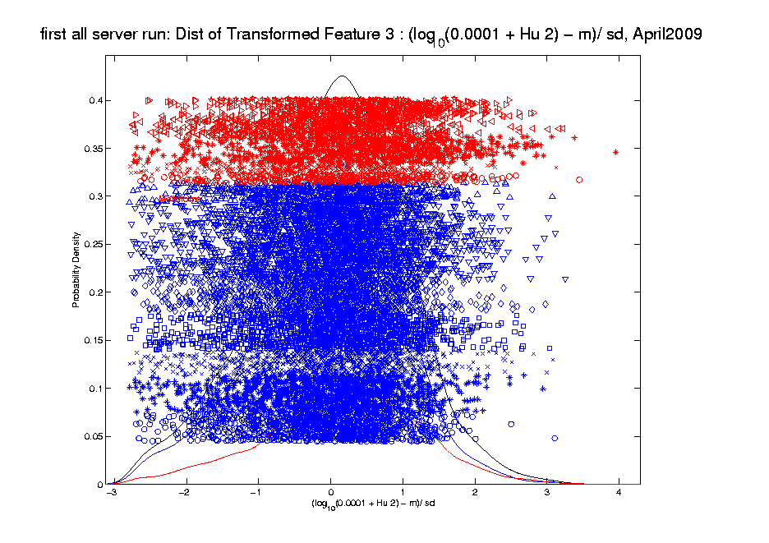
Transformations
Much Nicer Distribution

Slide 50
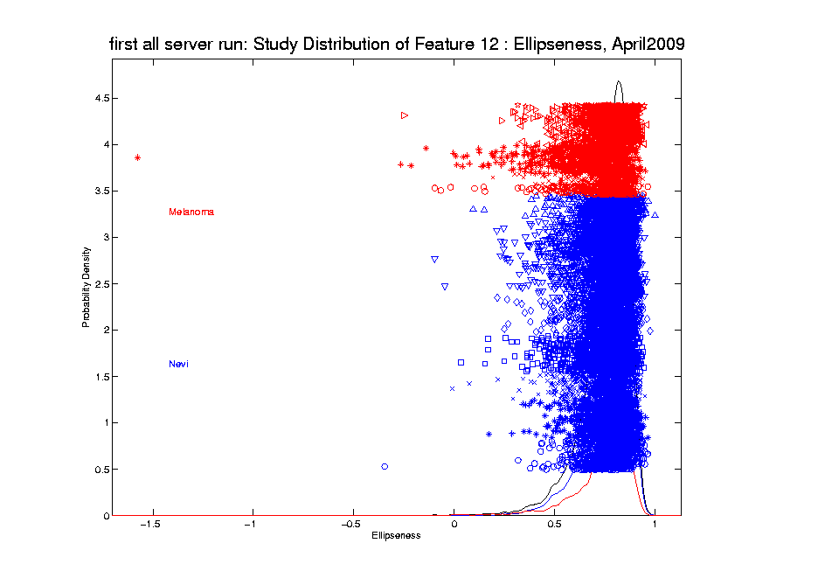
Transformations
Different Direction (Negative) of Skewness

Slide 51
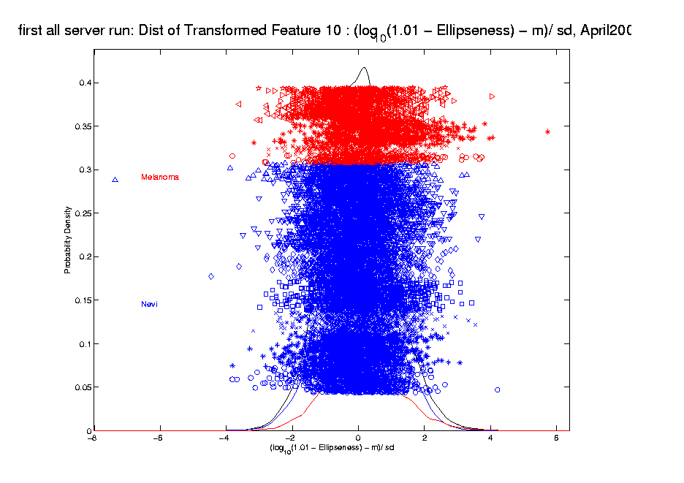
Transformations
Use Log Difference Transformation

Slide 52
Transformations
Major Challenge:
Hard to Visually Choose
Transformation of Many Variables
Motivates Automatic Transformation
Approach: Feng et al (2016)
Notes:
For a high dimensional data set, automation is important!
The parameterizations of the shift parameter strongly depend on knowledge of the data e.g. data range, data distribution, so user intervention is usually required. However, modern high-output data sets usually have a very large number of variables, i.e. features, so there is a strong need to automate the selection of shift parameter
What is the challenge here?
First challenge comes from tuning the shift parameter value
variables may range from different magnitude
It depends on the data magnitude (to make valid log function)
You have different optimal shift parameter value for different variables given a target
How to handle positive and negative skewness at same time
2. Address outliers which are also quite different from variable to variable

Slide 53
Automatic Transformations
Approach: Shifted log transform
Challenges Addressed:
Tune the shift parameter for each variable
$\log\left(∙+δ\right)$: Independent of data magnitude
Handle both positive and negative skewness
Address influential data points
Text: Sec. 5.3
Notes:
For a high dimensional data set, automation is important!
The parameterizations of the shift parameter strongly depend on knowledge of the data e.g. data range, data distribution, so user intervention is usually required. However, modern high-output data sets usually have a very large number of variables, i.e. features, so there is a strong need to automate the selection of shift parameter
What is the challenge here?
First challenge comes from tuning the shift parameter value
variables may range from different magnitude
It depends on the data magnitude (to make valid log function)
You have different optimal shift parameter value for different variables given a target
How to handle positive and negative skewness at same time
2. Address outliers which are also quite different from variable to variable

Slide 54
Automatic Transformations
Outline
A new parameterized transformation function
Appropriate reparametrization of $\log\left(∙+δ\right)$
Standardization and Winsorization
Selection of $δ$
Notes:
Based on these challenges we propose an automatic transformation scheme
The new scheme consists of three parts
1. A new parametrized family of transformation functions
This re-parametrization facilitate the automation by making the selection of shift tuning parameter independent of data magnitude.
Beside, it put transformation function for handling both positive and negative skewness in the same family
2. A robust way for standardization and also an option for winsorizing the influential points (winsorization means that given a vector of data values and a threshold, when the absolute data values are larger than the threshold, you will pull these values back to the threshold)
3. The parameter value selection
How to use an algorithm for optimal value

Slide 55
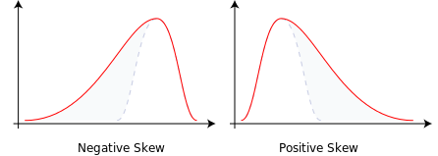
Automatic Transformations
Form of Transformation Function
Based on 1-d data set: $x_{1}, ⋯,x_{n}$
For positive skewness want: $\log\left(x_{i}\right)$
For negative skewness want: $−\log\left(−x_{i}\right)$
Preserves Order of Data
But Need Valid Inputs!
i.e. $\log{x}$ needs $x>0$
Handle with Shift $η$
Notes:
We start with the new re-parametrized function and we will start from the very basic
Deal both positive and negative skewness + maintain the order of data values
Given a feature vector in the data set, we need to first calculate its skewness
Based on the sign of the skewness we will have different log transformation (applying convex transformation function will increase the skewness and concave will decrease)
For negative one, we add negative sign to keep the same order of the data values

Slide 56
Automatic Transformations
Transformation Function
Modified log transforms
Positive skewness
$log⁡(x_{i}−min\left(x_{1}, ⋯,x_{n}\right)+η$)
Negative skewness
$−log⁡(\max\left(x_{1}, ⋯,x_{n}\right)− x_{i}+η$)
These are $≥0$
So Shift $η>0$ Controls Distortion by log
Notes:
One big concern is that logarithm functions require positive inputs
Therefore it is important to modify the functions for both positive and negative cases to be valid for any element value.
Substract the minimal value and add a positive shift parameter
use max value to minus each data value and add with a positive shift parameter

Slide 57
Automatic Transformations
Transformation Function
Modified log transforms
Positive skewness
$log⁡(x_{i}−min\left(x_{1}, ⋯,x_{n}\right)+η$)
Negative skewness
$−log⁡(\max\left(x_{1}, ⋯,x_{n}\right)− x_{i}+η$)
Note: For $g\left(t\right)=\log{t}$, $g^{′′}\left(t\right)=\frac{−1}{t^{2}}≈0$ for Large $t$
So Transformation $≈$ Linear for Large $η$
Notes:
One big concern is that logarithm functions require positive inputs
Therefore it is important to modify the functions for both positive and negative cases to be valid for any element value.
Substract the minimal value and add a positive shift parameter
use max value to minus each data value and add with a positive shift parameter

Slide 58
Automatic Transformations
Reparametrization (Nicer Format):
Based on Range of Data, $R=\max_{i}{x_{i}}−\min_{i}{x_{i}}$
For Positive Skewness: $β=\frac{R}{η}$
For Negative Skewness: $β=\frac{−R}{η}$
This Gives $β∈\left(−∞,+∞\right)$
Where Sign Determines Skewness Type
Notes:
Thus, we further parametrize the parameter eta in terms of the multiples of the range
of the feature vectors
This makes the selection of parameter values beta independent of the data magnitude
The beta ranges from negative inf to positive inf
Now we note that the functions for pos and negative are both symmetric around zero
Thus we can take advantage of it and combine them into one family of functions.

Slide 59
Automatic Transformations
Reparametrization (Nicer Format):
Use Shifted Log With: $η=\left|\frac{1}{β}\right|R$
Note: $β∈\left(−∞,+∞\right)$ Gives Transformation:
Nearly Linear for $β≈0$
Strongly Un-Right Skews for Large $β>0$
Strongly Un-Left Skews for $β≪0$
Notes:
Thus, we further parametrize the parameter eta in terms of the multiples of the range
of the feature vectors
This makes the selection of parameter values beta independent of the data magnitude
The beta ranges from negative inf to positive inf
Now we note that the functions for pos and negative are both symmetric around zero
Thus we can take advantage of it and combine them into one family of functions.

Slide 60
Automatic Transformations
Reparametrized Transformation function
Positive skewness
$log⁡(x_{i}−min\left(x_{1}, ⋯,x_{n}\right)+\left|\frac{1}{β}\right|R$)
Negative skewness
$−log⁡(\max\left(x_{1}, ⋯,x_{n}\right)− x_{i}+\left|\frac{1}{β}\right|R$)
Notes:
Thus, we further parametrize the parameter eta in terms of the multiples of the range
of the feature vectors
This makes the selection of parameter values beta independent of the data magnitude
The beta ranges from negative inf to positive inf
Now we note that the functions for pos and negative are both symmetric around zero
Thus we can take advantage of it and combine them into one family of functions.

Slide 61
Automatic Transformations
$$φ_{β}\left(x_{i}\right)=\left\{\begin{aligned}log⁡(x_{i}−min\left(x_{1}, ⋯,x_{n}\right)+\frac{1}{β}R\text{)}, β>0 \\ −log⁡(\max\left(x_{1}, ⋯,x_{n}\right)− x_{i}−\frac{1}{β}R\text{)}\text{, }β<0\end{aligned}\right.$$
Family of transformation functions
Comments
Single family for both positive and negative skewness
Parameter value selection is independent of data magnitude
As $β→0$: transformation + standardization $→$
$→$ standardization only
Notes:
Finally incorporating all the elements we have discussed the new parameterized family of transformation functions
For beta is positive, transformation for positive skewness
For beta is negative, transformation for negative skewness
And the parameter value selection is independent of data magnitude

Slide 62
Automatic Transformations
Standardization
Subtract median (robust center)
Divide by $\sqrt{π/2}$ of the MAD (robust scale)
(Mean Absolute Deviation from the median)
Winsorization
Threshold based on extreme value theory
(see Feng et al (2016) for details)
Notes:
After the shift log transformation, we need to deal with potential influential values by winsorization,
Before that we need a robust standardization ( and I will talk about it later)
To make standardization robust, we will use some robust statistics that is subtracting the median and divide based on the mean absolute deviation from median (not MAD which might be 0)

Slide 63
Automatic Transformations
Select parameter value $β$
Evaluation: Anderson – Darling test statistics
Often Useful Weighting of Tails
Powerful for Important Departures from Normality
Anderson – Darling (1952), Discussion / Comparison: Stephens (1974)
Algorithm: grid search
Search a value minimizing AD test statistics
Can be computed in parallel
Notes:
Here we a process for transformation which is controlled by the parameter beta
The last step is to deicide the optimal value of beta
To do that, we first need a criteria
A-D test stat is used which measures the distance between the empirical distribution function (EDF) of the transformed data and the cumulative distribution function (CDF) of the standard normal.
It give appropriate weight to the tails using a weighted L2 metric. It is more powerful for detecting
Given the evaluation, we adopt the grid search algorithm for minimizing the A-D test stat.
One major reason for using it is due to the simplicity of computing the stat and complexity of optimizing it. Besides, grid search is useful if the number of parameter to optimize is not large. Another advantage is that the computation of A-D test stat is independent with each other and thus is easy to be computed in parallel.

Slide 64
Melanoma Data
Notes:
We applied our automatic transformation on the same melanoma data

Slide 65
Melanoma Data
Much Nicer Distributions
Notes:
We applied our automatic transformation on the same melanoma data

Slide 66
Melanoma Data
Q-Q plot Views (will study in detail later)
(before, after, ${45}^{°}$ line)
Notes:
Use QQ Plot to compare normality

Slide 67
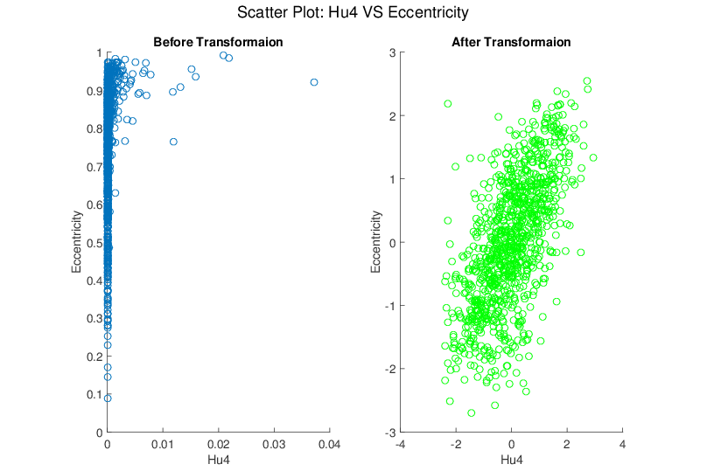
Melanoma Data
Much Nicer Distributions
Notes:
Besides, although the transformation targets at marginal dist
We see improvement of bivariate normality in many real data sets for example here.

Slide 68
Limitations
Not Useful for:
Binary Variables
Symmetric but highly kurtotic distribution
Notes:
No benefit for binary variables.
not useful in modifying a symmetric, but highly kurtotic distribution.

Slide 69
Recall Matlab Software
Again Recall Posted Software for OODA

Slide 70
Automatic Shifted Log Trans.
Matlab Software:
AutoTransQF.m
In General Directory

Slide 71
Revisit Gene Expression
More Cancer
Data
Focus On:
Ovarian &
Uterine Types

Slide 72
Revisit Gene Expression
Ovarian (o) & Uterine (+) Cancer Cases
Raw Data PCA
Zoom In
Proj’ns on Mean
Difference Dir’n
Zoom In

Slide 73
Revisit Gene Expression
Ovarian (o) & Uterine (+) Cancer Cases
Slide
Over
To Look
At Log
Trans.

Slide 74
Revisit Gene Expression
Ovarian (o) & Uterine (+) Cancer Cases
Add In Automatic
Log Transformed PCA
Proj’ns on Mean
Difference Dir’n
Note Much
Better

Slide 75
Revisit Gene Expression
Ovarian (o) & Uterine (+) Cancer Cases
Quantification
Of Better
Separation???

Slide 76
Revisit Gene Expression
Quantify
Separation
Of Groups
Using
ROC Curves

Slide 77
ROC Curve
Text: Fig. 5.16
Challenge:
Measure “Goodness of Separation”
Approach from Signal Detection:
Receiver Operator Characteristic
(ROC) Curve
Developed in WWII, History in
Green and Swets (1966)

Slide 78
ROC Curve
Challenge:
Measure “Goodness of Separation”
Approach from Signal Detection:
Receiver Operator Characteristic
(ROC) Curve
Good Modern Treatment:
DeLong, DeLong & Clarke-Pearson (1988)

Slide 79
ROC Curve
Challenge:
Measure “Goodness of Separation”
Idea: For Range of Cutoffs
Plot:
Prop’n +1’s Smaller than Cutoff
Vs.
Prop’n -1s Smaller than Cutoff

Slide 80
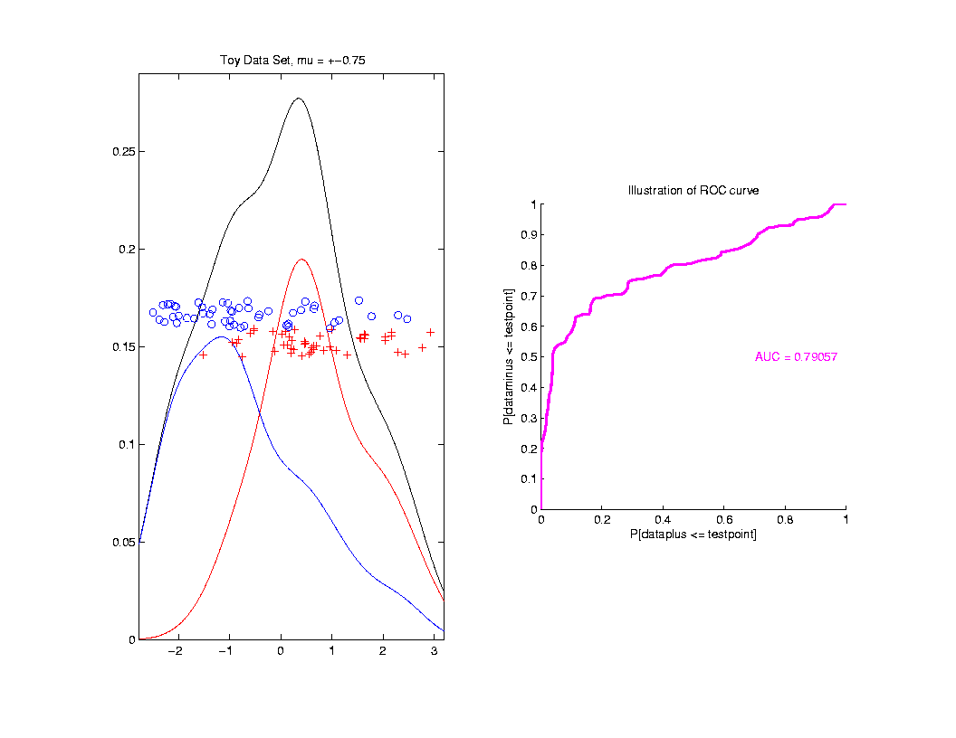
ROC Curve
Aim:
Quantify
“Overlap”
Approach
Consider
Series
Of Cutoffs

Slide 81
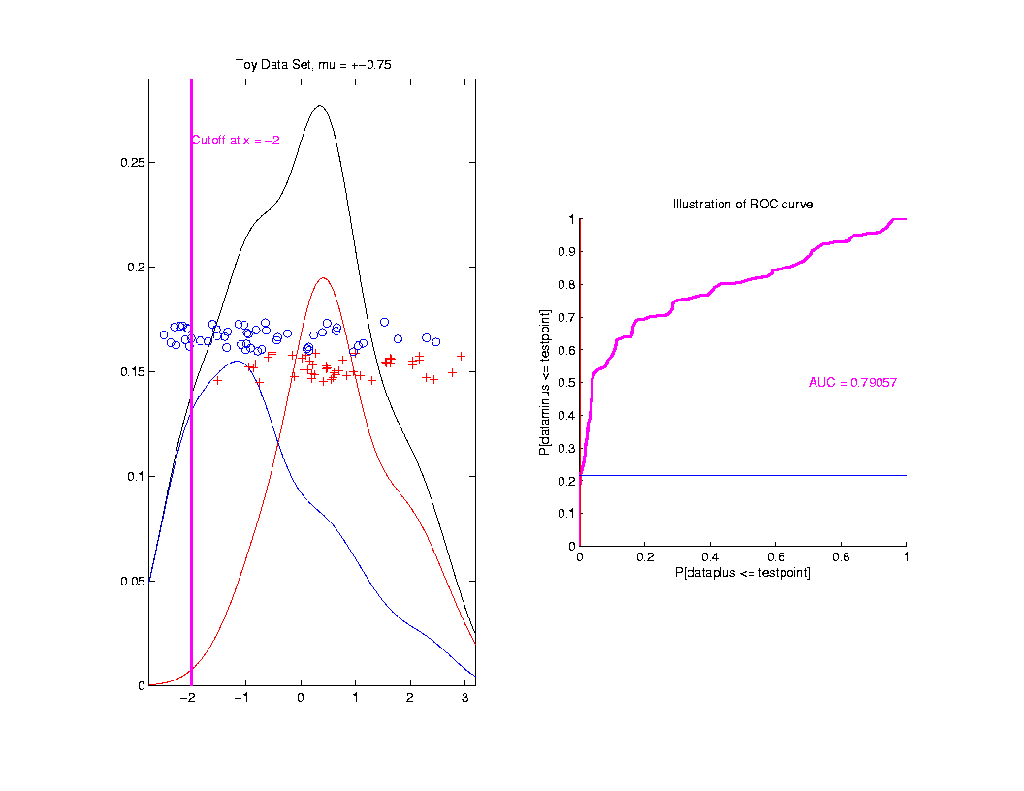
ROC Curve
Approach
Consider
Series
Of Cutoffs

Slide 82
ROC Curve
X-coord
Is Prop’n
Of Reds
Smaller

Slide 83
ROC Curve
X-coord
Is Prop’n
Of Reds
Smaller
Y-coord
Is Prop’n
Of Blues
Smaller

Slide 84
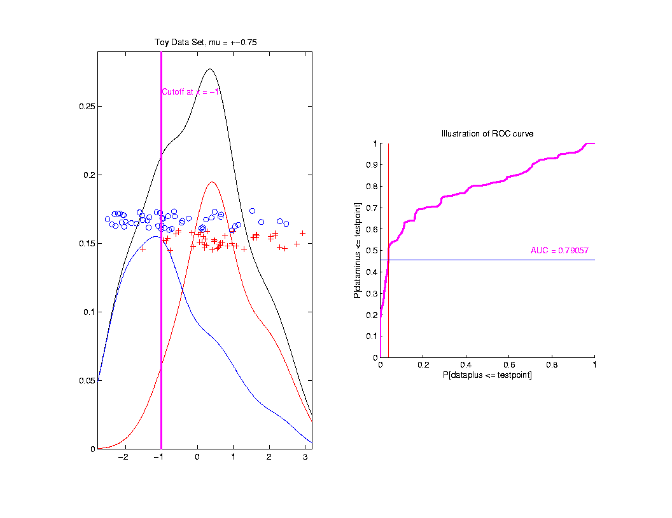
ROC Curve
Slide
Cutoff
To
Trace
Out
Curve

Slide 85
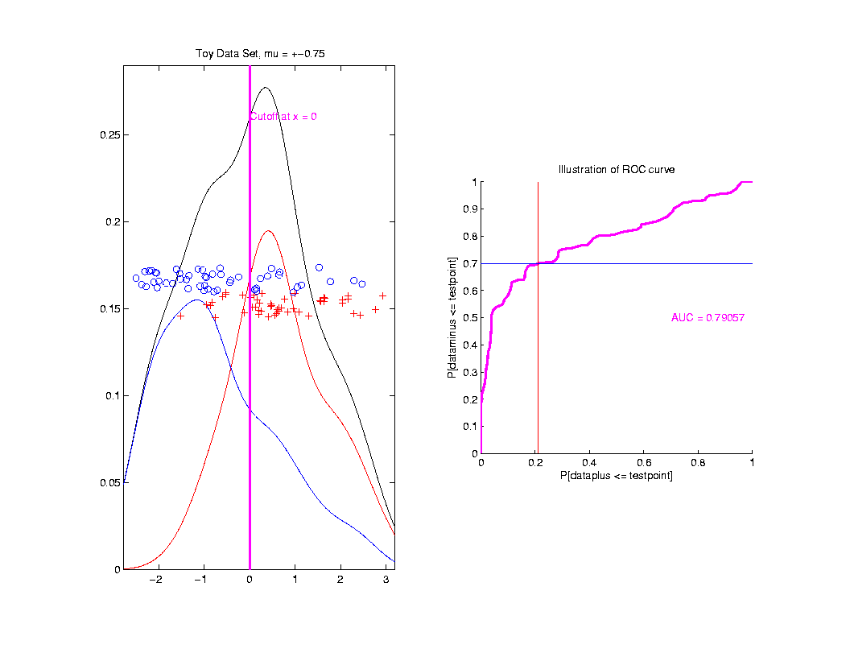
ROC Curve
Slide
Cutoff
To
Trace
Out
Curve

Slide 86
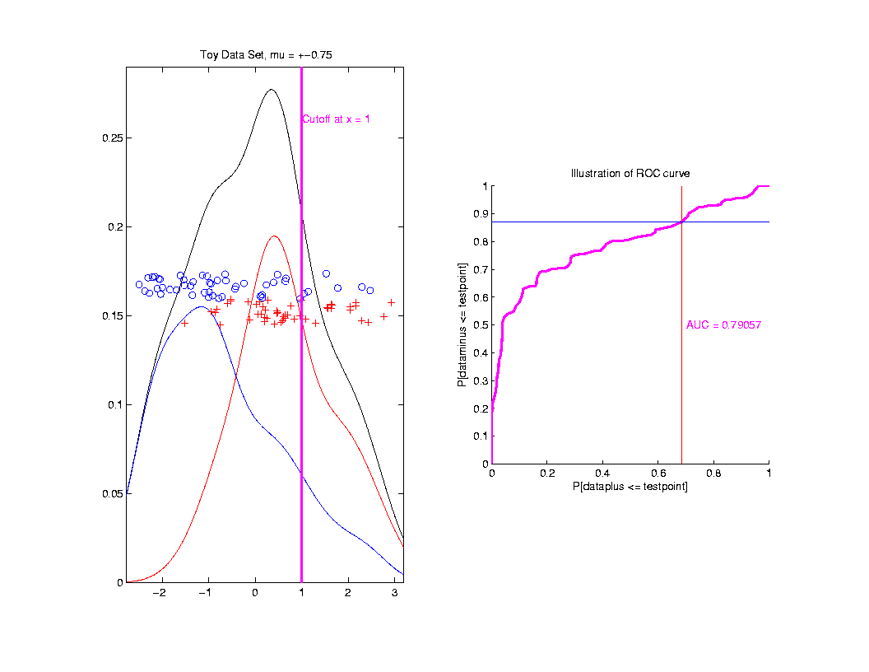
ROC Curve
Slide
Cutoff
To
Trace
Out
Curve

Slide 87
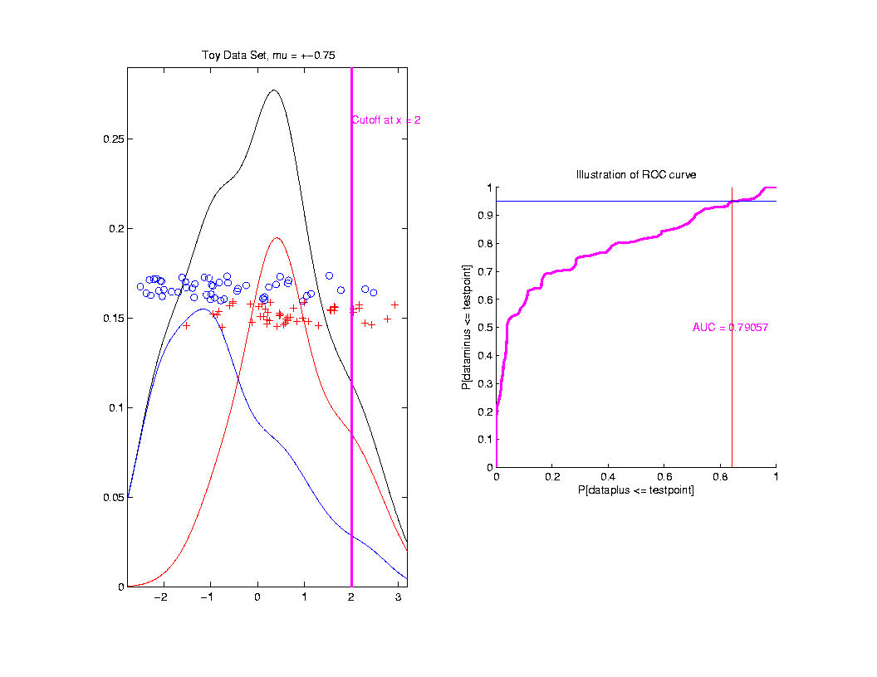
ROC Curve
Slide
Cutoff
To
Trace
Out
Curve

Slide 88
ROC Curve
Better
Separation
Is “More
To Upper
Left”
Useful Summary:
Area Under the Curve

Slide 89
ROC Curve
Alternate Interpretation
Given
Separating
Boundary
Between
Blue & Red
Prop’n
Blues
“Correct”
Prop’n
Reds
“Correct”
Called “True Positive” and “True Negative” Classification Rates
ROC Curve Summarizes Over Cutoffs

Slide 90
ROC Curve
Summarize
& Compare
Using
Area
Under
Curve
(AUC)

Slide 91
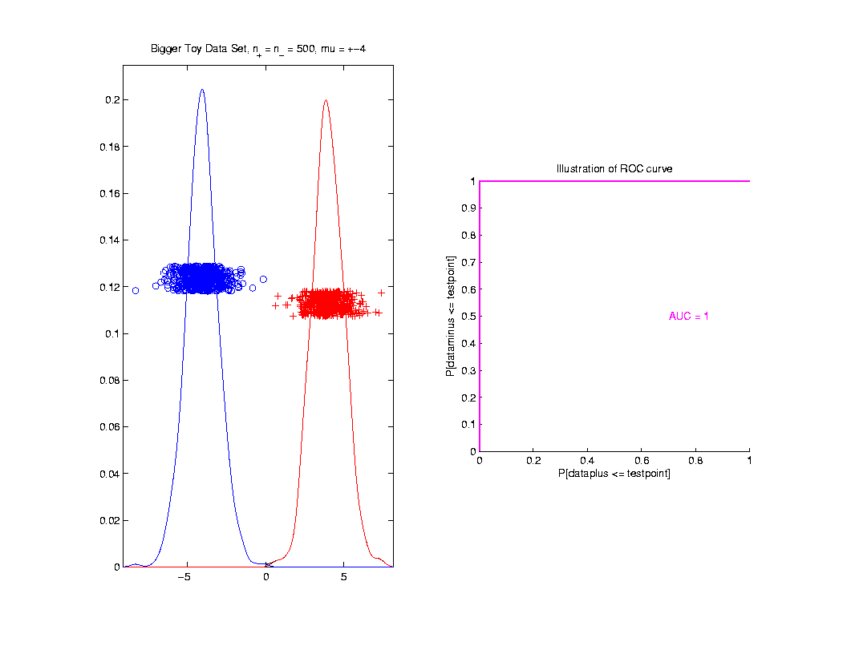
ROC Curve
Toy
Example
Perfect
Separation

Slide 92
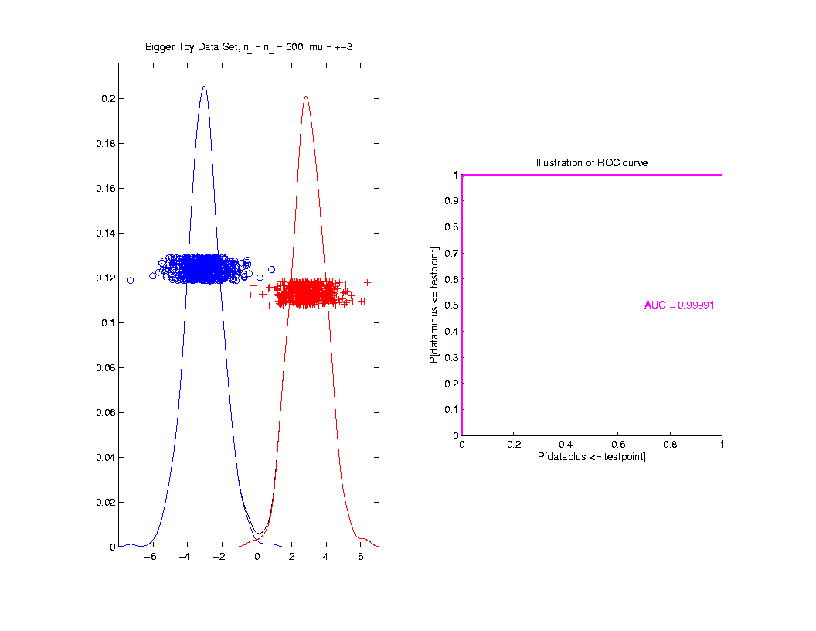
ROC Curve
Toy
Example
Very
Slight
Overlap

Slide 93
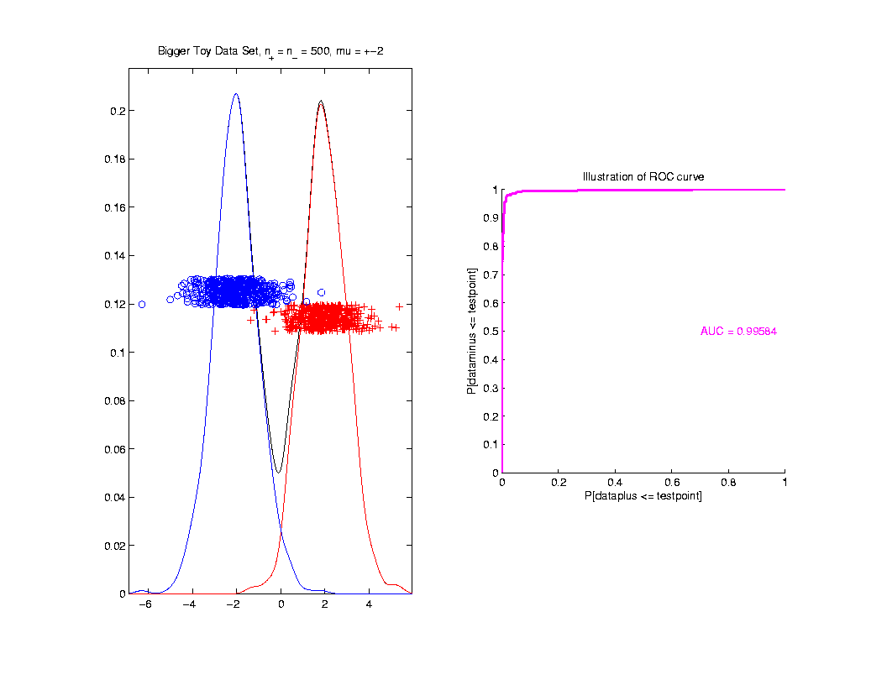
ROC Curve
Toy
Example
Little
More
Overlap

Slide 94
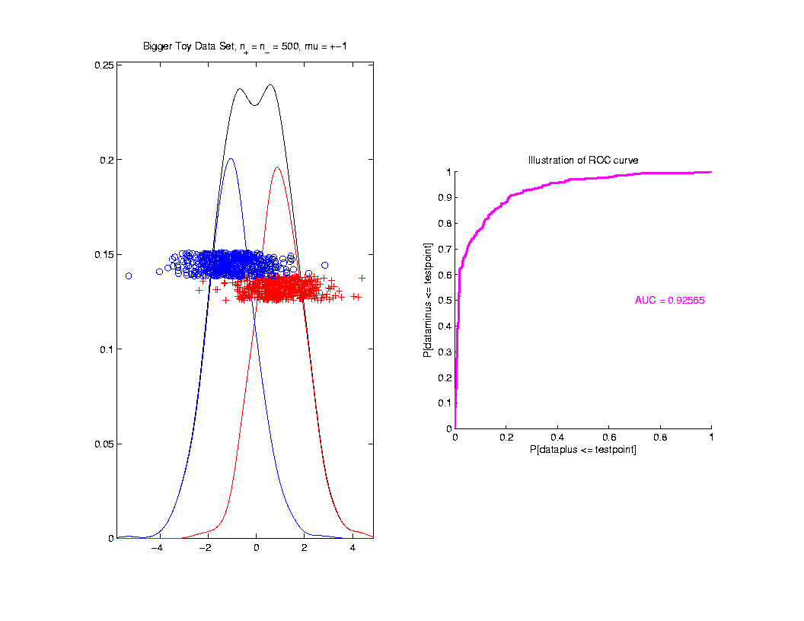
ROC Curve
Toy
Example
More
Overlap

Slide 95
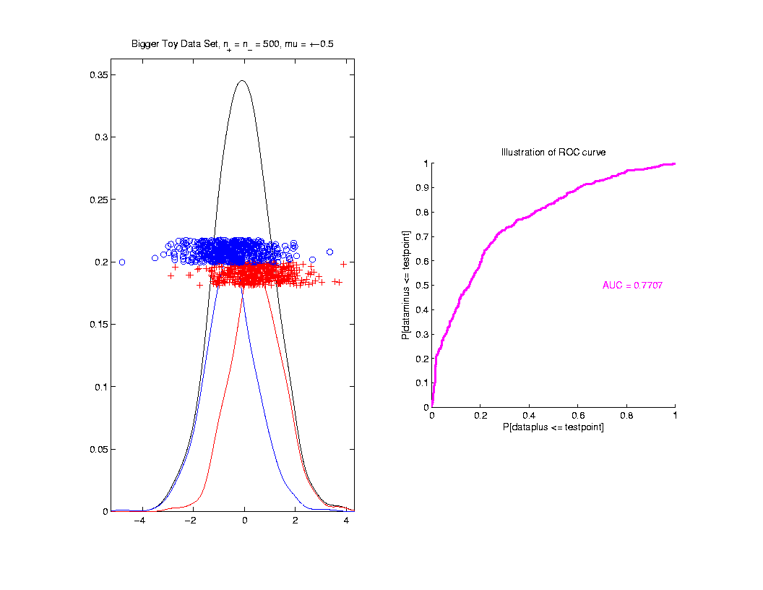
ROC Curve
Toy
Example
Much
More
Overlap

Slide 96
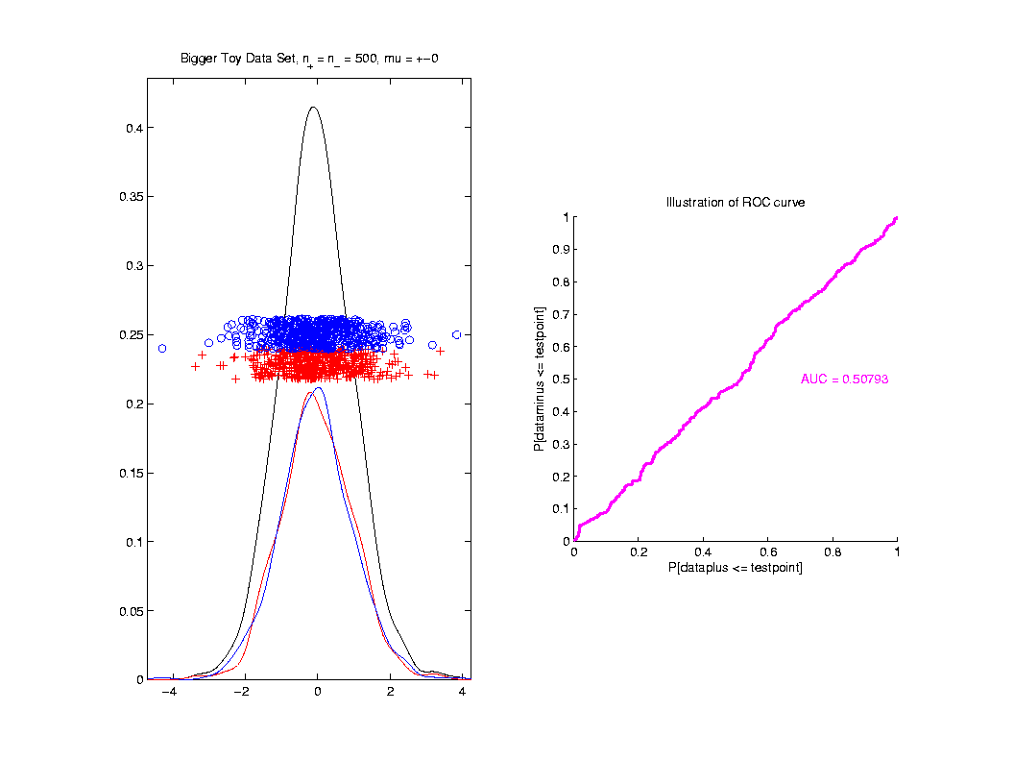
ROC Curve
Toy
Example
Complete
Overlap

Slide 97
ROC Curve
Toy
Example
Complete
Overlap
AUC ≈ 0.5 Reflects “Coin Tossing”

Slide 98
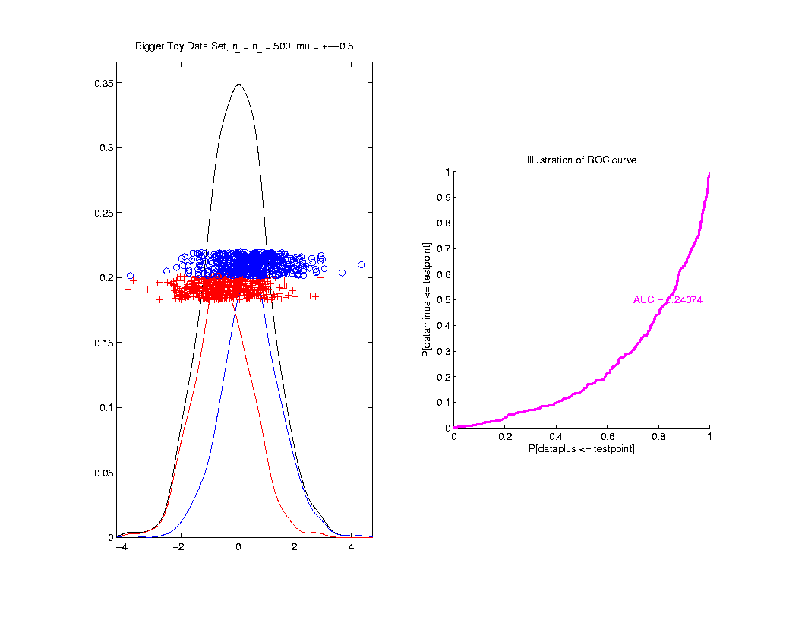
ROC Curve
Toy
Example
Can
Reflect
“Worse
Than Coin
Tossing”

Slide 99
ROC Curve
Interpretation of AUC:
Very Context Dependent
Radiology:
“> 70% has Predictive Usefulness”
Varies Field by Field
Bigger is Better

Slide 100
Revisit Gene Expression
ROC Curve
Much Better
For Log
Transformations

Slide 101
Data Visualization
Overview of Visualization Methods:
Curve Views (Modes of Variation)
Scatterplot Matrices (Shows Relationships)
Marginal Distributions
Heat-Map Views

Slide 102
Heat-Map Views
Main Idea:
Look at Full Data Matrix
As an Image (Rectangular Array of “Pixels”)
Coding Values with Colors (Gray Levels)
Text: Sec. 6.1

Slide 103
Heat-Map Views
Some Principles:
For Nonnegative Data (i. e. all $x_{i,j}≥0$)
Gray Level is Informative (& Not Distracting)
Actually Gray Level Is Also Good For:
“No Pivotal Value (e.g. 0) To HighLight”
Some Advocate a RAINBOW
Gives “Greater Range”???
Borland & Taylor (2007) Disagree
Over Perceptual Interpretation
(What Is Equally Spaced ???)

Slide 104
Heat-Map Views
Some Principles:
Ordering Rows and Columns Really Matters
Clustering Columns Highlights Relationships
Clustering “Knobs”:
Hierarchical with
Euclidean Distance
& Average Linkage

Slide 105
Heat-Map Views
Some Principles:
Ordering Rows and Columns Really Matters
Clustering Columns & Rows is Crucial
Population Structure
Invisible w/ Random Order

Slide 106
Heat-Map Views
Dist’n of Values, with Usual
Jitter Plot + Smooth Histo
Some Principles:
Color Scale is Also Critical
Equal Bin Spacing
Toy Example
Many Small
Values & Few
Large Ones
Results in Very
Poor Contrast

Slide 107
Heat-Map Views
Natural Approach (to Skewed Dist’n):
Log Transformation
Much Better
Scaling, Using
More of the
Color Range
Same Toy Example
Much Better
Contrast, Now
See 4 Peaks

Slide 108
Heat-Map Views
Can Look at Either
Original Or Log View
Natural Approach (to Skewed Dist’n):
Quantile Scaling (= #s in Each Bin)
Same Toy Example
Non-Equally Spaced Bins
Far More
Contrast
Good or Bad?
Peaks Less
Prominent

Slide 109
Heat-Map Views
“Best” Choice of Color Scaling:
Context Dependent
Equally Spaced (Most Interpretable?)
Log Spacing (Can Be Very Useful)
Quantile Spacing (Also Useful)
Should Look At Several & Decide

Slide 110
Heat-Map Views
Important Color Scale Choice:
Endpoints of Color Range
Note Ending Color Used Beyond Range
Color Cutoffs?
When No Pivotal Value (e.g. 0 Not Important)
Recommend Quantiles, e.g. $q_{0.05}$ & $q_{0.95}$
Often Worth
Twiddling These

Slide 111
Heat-Map Views
Color Choice When 0 Needs Highlighting
A Recommendation ($∃$ Many):
Important: Middle White Highlights 0
Shade Indicates Magnitude
Red for <0? (Econ.) for >0? (Climatology)

Slide 112
Heat-Map Views
Color Choice When 0 Needs Highlighting
A Recommendation ($∃$ Many):
Why Not Red-Green??? (Common in Bioinf.)
~10% of European (Ancestry) Males are Red-Green Colorblind
Most Other Choices as Good as This

Slide 113
Heat-Map Views
Caution: Many
Packages Do This!
Color Choice When 0 Needs Highlighting
Endpoints? ($q_{0.05}$ & $q_{0.95}$ Will Re-Center!)
Recommend Using Absolute Quantiles:
$±{\left|q\right|}_{0.10}$
Where ${\left|q\right|}_{α}$ is $α$-th Quantile of $\left|X_{1}\right|,⋯,\left|X_{n}\right|$

Slide 114
Recall Real Data Curve Objects
Lung Cancer Data Example
Genetics (Cancer Research)
RNAseq (Next Gener’n Sequen’g)
Deep look at “gene components”
Gene studied here: CDKN2A
Goal: Study Alternate Splicing
Sample Size, $n = 180$
Dimension, $d = 1709$

Slide 115
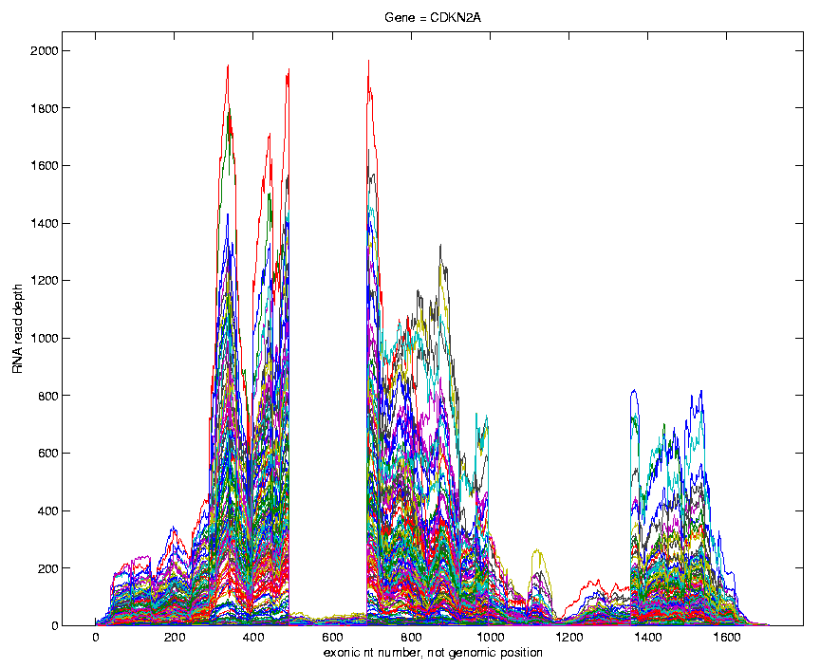
Recall Lung Cancer Curve Objects
Simple
1st
View:
Curve
Overlay
(counts
scale)
Note: Data Set
Structure May
Be Hidden In
Low Areas
I. Object Representation

Slide 116
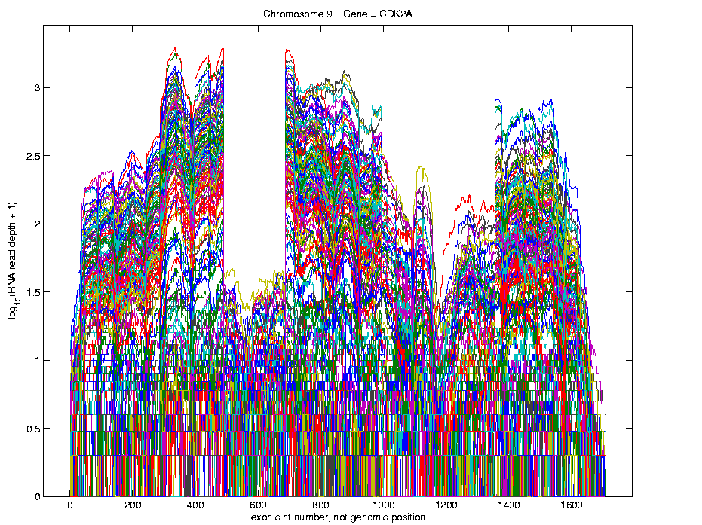
Recall Lung Cancer Curve Objects
Simple
1st
View:
Curve
Overlay
(log
scale)
I. Object Representation

Slide 117
Recall Lung Cancer Curve Objects
Heatmap View of $\log_{10}(∙+1)$ Counts
Interesting
Structure?
Distribution of Colors

Slide 118
Recall Lung Cancer Curve Objects
Better
Sort?
Centered (Rows & Columns) Version
Harder to
Intrepret?
Distribution of Colors

Slide 119
Recall Lung Cancer Curve Objects
A Better Sorting
Interpretation?
Distribution of Colors
Conclude Heatmap Worse
Than Modes of Variation Here

Slide 120
Heat-Map Views
Larger Example: $n=200$, $d=20,000$
Major Issue: Most Computer Displays Have Only a Few Thousand Pixels of Resolution
So Cannot See Full Matrix
Most Displays Compensate With Ad Hoc Rules Designed for Text and Natural Images
Can Miss Important Aspects of the Data

Slide 121
Heat-Map Views
Will See OK
For This Data
Larger Example: $n=200$, $d=20,000$
Simple Approach Here: Study 1st $200$ Rows
Looks Totally Random?
Have Done Both Column
And Row Clustering

Slide 122
Heat-Map Views
Larger Example: $n=200$, $d=20,000$
Revisit With Scatterplot Matrix View
Conclude: Heat
Map Worse
Than Scatterplot
In This Case
Colored 1st 100 & 2nd 100
Clear Cluster Structure
Hidden by Noise in
Heatmap View!
Is This Real (or Artifact)?
$N(−0.04,1)$ & $N(0.04,1)$

Slide 123
Heat-Map Views
For Opposite Answer Consider Another
Data Set ($n=d=50$) with Curve View:
Very Noisy
1st 25 Features
>> 2nd 25
Two Clear
Clusters
Understand Pop’n
Structure???

Slide 124
Heat-Map Views
Data Source is Above Example:
Gives Quicker Impression of Structure
More Natural View Than Curves
2 Clusters
1st Features Larger

Slide 125
Heat-Map Views
One More Point (From This Example):
Than Both Separated
Mean +/- Curves
Easier to Understand

Slide 126
Heat-Map Views
Which Data View Is “Best”???
Heat Maps?
Curves?
Scatterplots?

Slide 127
Heat-Map Views
Which Data View Is “Best”???
Simon Sheather Quote:
“Every Dog Has His Day”

Slide 128
Heat-Map Views
“Every Dog Has His Day”
Idea:
Any Data Analytic Method Somebody Likes Has Some Situations Where It Is “Best”
& Of Course Others Where It Is Poor
(Will See This Again)

Slide 129
Heat-Map Views
Some Overview Papers:
History:
Wilkinson & Friendly (2009)
Criticism of Common Color Choices:
Borland & Taylor (2007)

