Slide 1
Statistics – O. R. 881
Object Oriented Data Analysis
Steve Marron
Dept. of Statistics and Operations Research
University of North Carolina

Slide 2
Last Class: Administrative Info
Details on Course Web Page
https://marron.web.unc.edu/course-home-page-stor-881-object-oriented-data-analysis-spring-2022/
Or access from Canvas page
Or:
  Google: “Marrons teaching material”
  Choose This Course

Slide 3
Administrative Info
Several People are Enrolled for 1 Credit
Really Want This?
Most Want 3 Credits (Full Course)
Option Exists So Some Can Save $$$
Be Sure That Is What You Want…

Slide 4
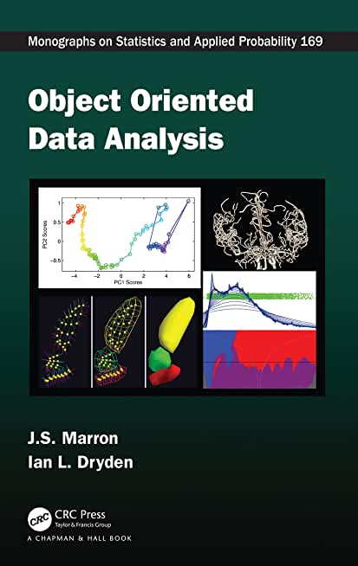

Object Oriented Data Analysis
Textbook:
Object Oriented Data Analysis
Marron and Dryden (2021)

Slide 5
Current Sections in Textbook
Today:
Sections 3.1, 3.3, 4.1
Next Class:
Section 3.3, 4.1, 6.4, 13.1

Slide 6
Last Class: Course Context
Currently Fashionable Topic:
Big Data Science
Many Important Issues.
But More Challenging (& Important?):
Complex Data
( )

Slide 7
Last Class: OODA
What is it?
A Sound-Bite Explanation:
What is the “atom of the statistical analysis”?
1st Course: Numbers
Multivariate Analysis Course : Vectors
Functional Data Analysis: Curves
More generally: Data Objects

Slide 8
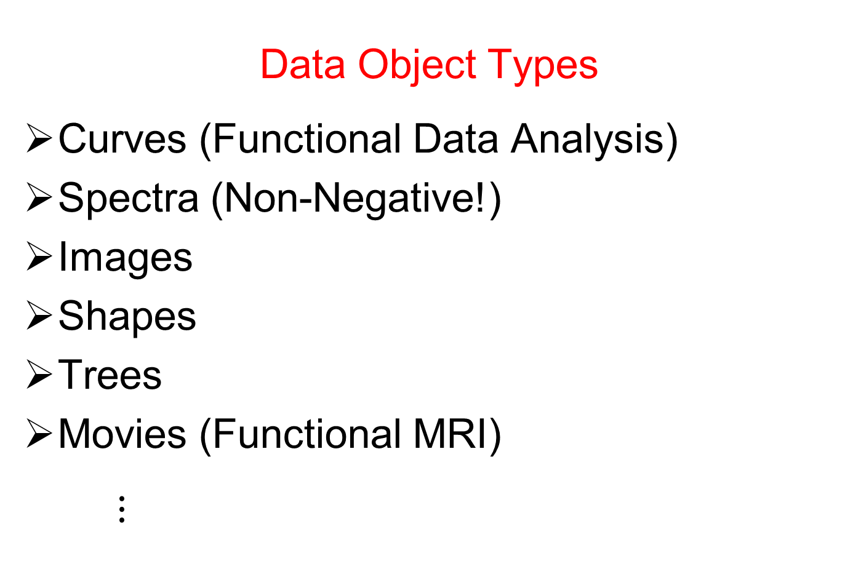
Last Class: OODA
Data Object Types
Curves (Functional Data Analysis)
Spectra (Non-Negative!)
Images
Shapes
Trees
Movies (Functional MRI)
$⋮$

Slide 9
Last Class: OODA
Current Motivation (of OODA terminology):
In Complicated Data Analyses
Fundamental (Non-Obvious) Question Is:
“What Should We Take as Data Objects?”
Key to Focusing Needed Analyses

Slide 10
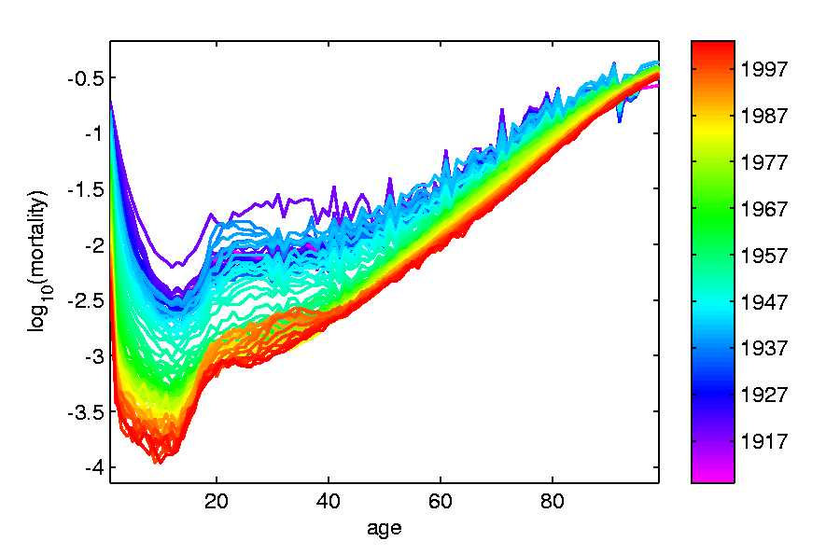
Last Class: Taste of OODA
Spanish Male Mortality Curves
Enhancement: Color by Year
1908
1931
1964
1987
2002

Slide 11
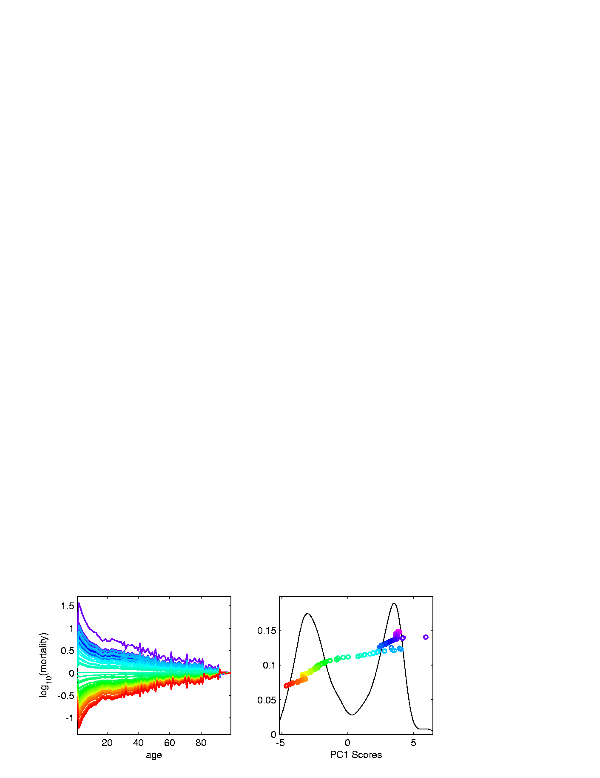
Last Class: Taste of OODA
Spanish Male Mortality Curves
1918 Flu Pandemic
Spanish Civil War
1st Mode of
Variation

Slide 12
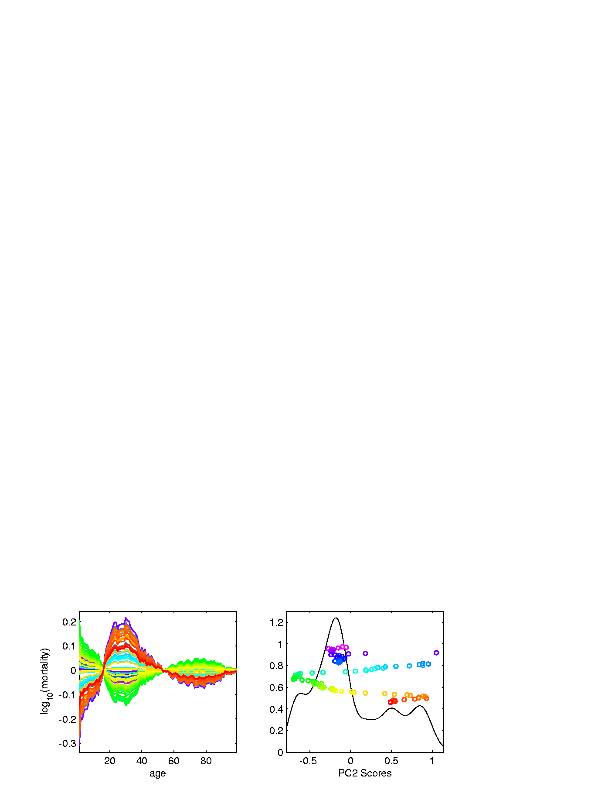
Last Class: Taste of OODA
Spanish Male Mortality Curves
Flu Pandemic, Civil War
2nd Mode of
Variation
Intro of Automobile,
Improved Safety

Slide 13
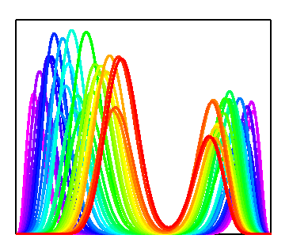
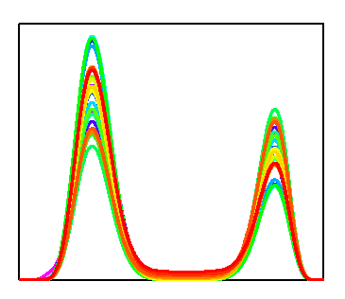

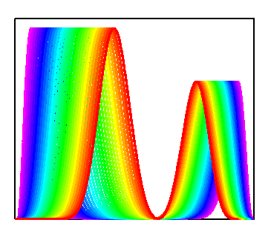
Last Class: Taste of OODA
Phase and Amplitude Curves
Raw
Data
Ampl’de
Varia’n
Interesting
Modes of
Variation!
Phase
Varia’n
Warps

Slide 14
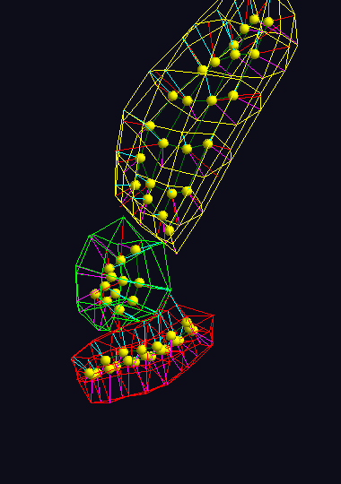
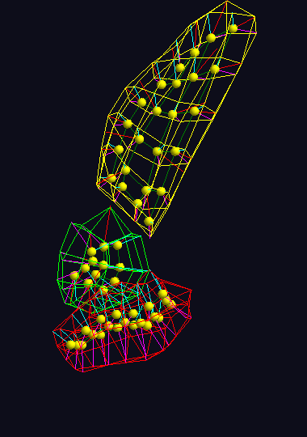
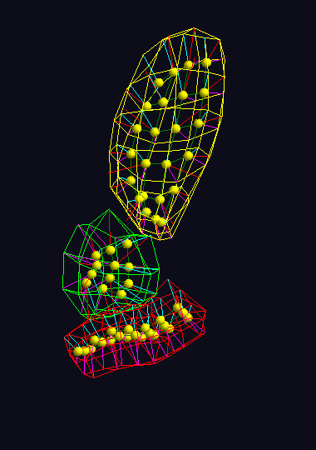



Last Class: Taste of OODA
Note: Different Display of Modes of Variation
Shapes in Image Analysis (3-d)
Analysis of Variation (Princ. Geod. Anal.)
Mode 1: Rectum
Mode 2: Twisting
Mode 3: Bladder
$$μ−2×{PC}_{1}$$
$$μ−2×{PC}_{1}$$
$$μ−2×{PC}_{1}$$

Slide 15
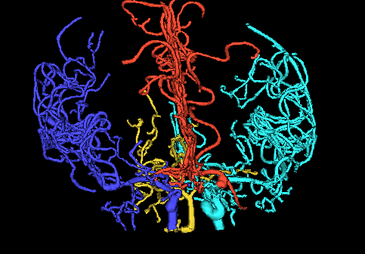
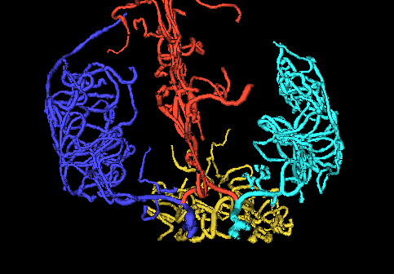
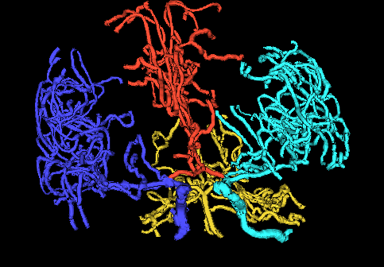
Last Class: Taste of OODA
Tree Structured Data Objects
Brain Artery Data,
Analyze Sample of n=100
Average? Variation About Average???
Modes of Variation???
,
, ... ,

Slide 16
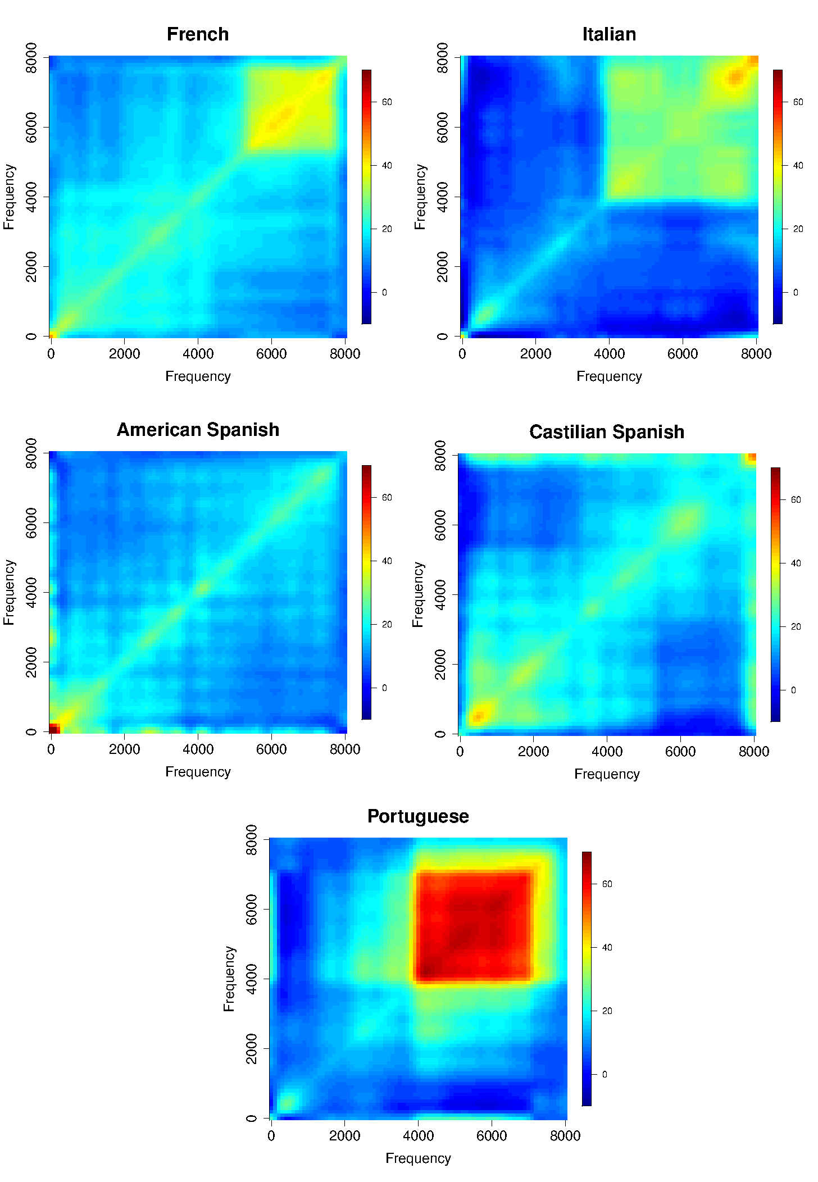
Last Class: Taste of OODA
Sounds
as Data
Objects
Analysis
Of Dialects

Slide 17
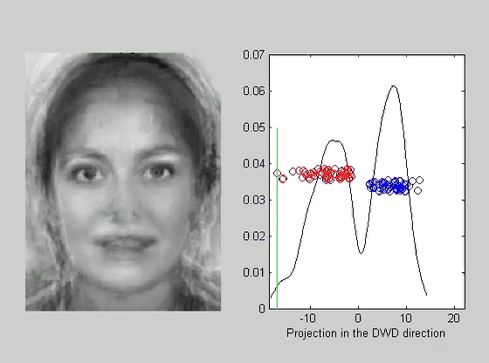
Last Class: Taste of OODA
Faces as Data Objects
Classify
Males vs.
Females

Slide 18
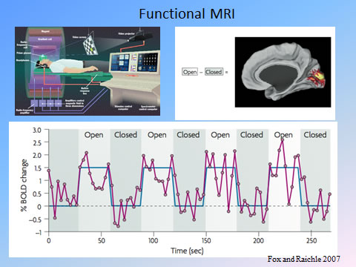
Last Class: Taste of OODA
Functional Magnetic Resonance Imaging
3-d Maps of
Brain Activity
Collected
Over Time
Data Objects?
Heat Map at
One Time?
Time Series at
One Location?

Slide 19
Last Class: OODA
Three Major Phases of OODA:
I. Object Definition
“What are the Data Objects?”
Exploratory Analysis
“What Is Data Structure / Drivers?”
III. Confirmatory Analysis / Validation
Is it Really There (vs. Noise Artifact)?

Slide 20

Last Class: Basics of OODA
Convenient Organizational Structure:
Data Matrix
$$\left[\begin{matrix}x_{11} & ⋯ & x_{1n} \\ ⋮ & ⋱ & ⋮ \\ x_{d1} & ⋯ & x_{dn}\end{matrix}\right]$$
Convention Here:
Columns are Data Objects
(Indexed by $j=1,⋯,n$)

Slide 21

Last Class: Basics of OODA
Convenient Organizational Structure:
Data Matrix
$$\left[\begin{matrix}x_{11} & ⋯ & x_{1n} \\ ⋮ & ⋱ & ⋮ \\ x_{d1} & ⋯ & x_{dn}\end{matrix}\right]$$
Terminology:
Numbers in Rows are called “Traits”
(Indexed by $i=1,⋯,d$)
OODA Continually Evolving
Note: ~Post-Text
Terminology

Slide 22
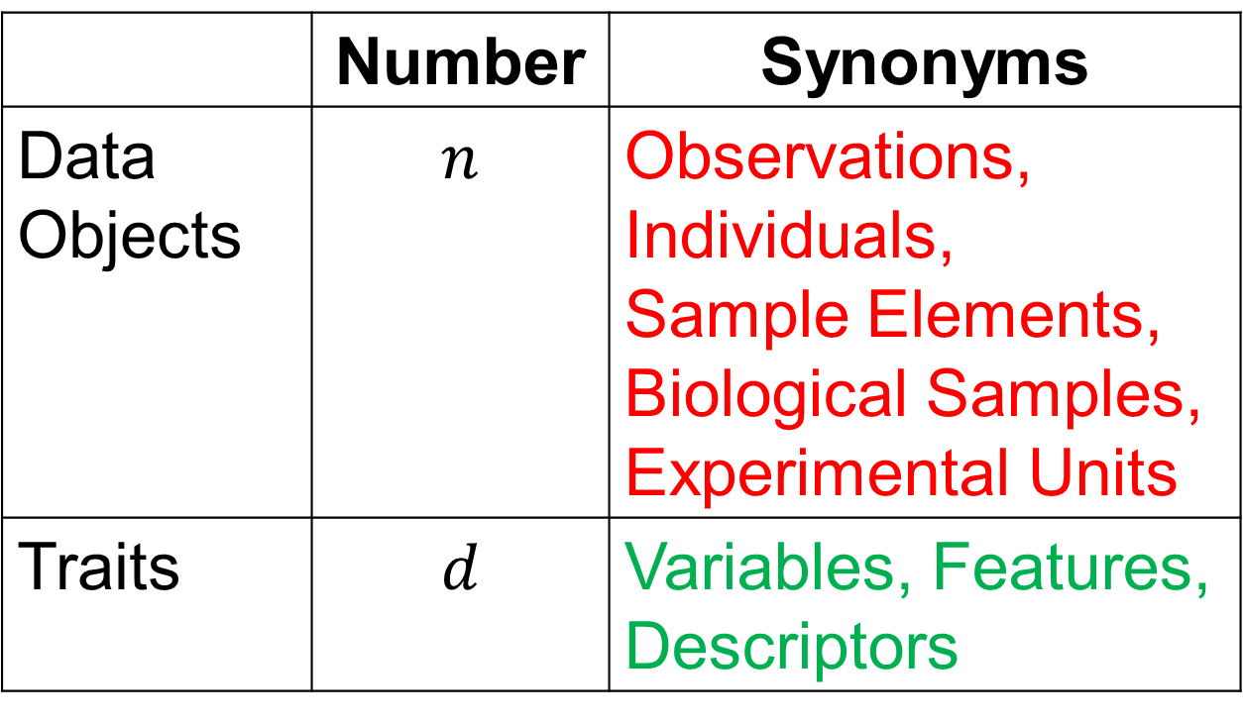
Last Class: Basics of OODA
Common Synonyms:
 | Number | Synonyms
Data Objects | $$n$$ | Observations, Individuals, Sample Elements, Biological Samples, Experimental Units
Traits | $$d$$ | Variables, Features, Descriptors

Slide 23
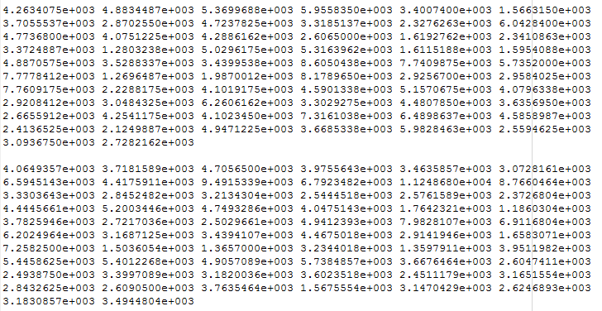
Last Class: Visualization
Terrible Approach: Look at .txt file

Slide 24
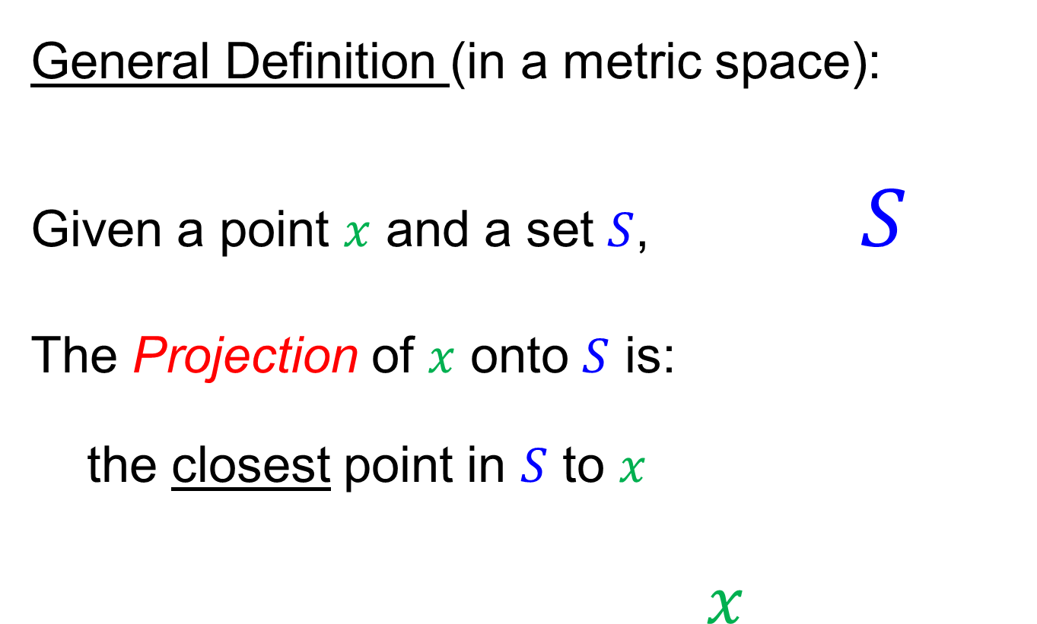
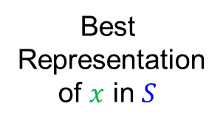
Last Class: Projection
General Definition (in a metric space):
Given a point $x$ and a set $S$, $S$
The Projection of $x$ onto $S$ is:
the closest point in $S$ to $x$
$x$
Best
Representation
of $x$ in $S$

Slide 25
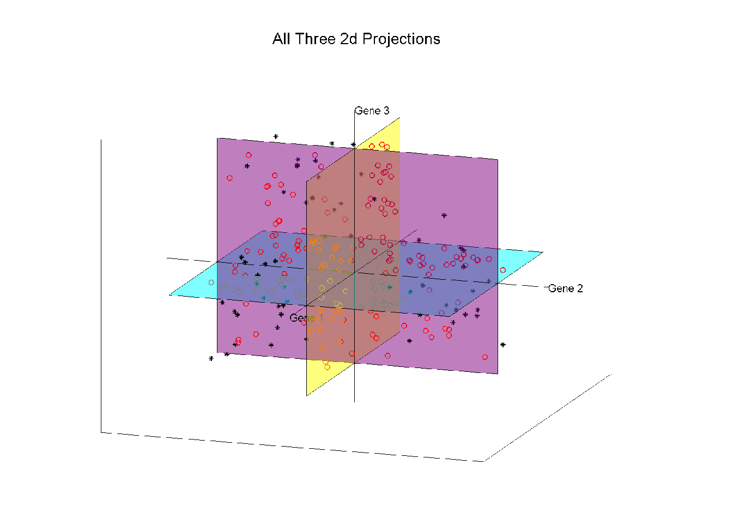
Last Class: Illust’n of Multivar. View:
Think:
Front
Top
Side
Views
Notes:
EgView1p27proj3Dall.ps

Slide 26
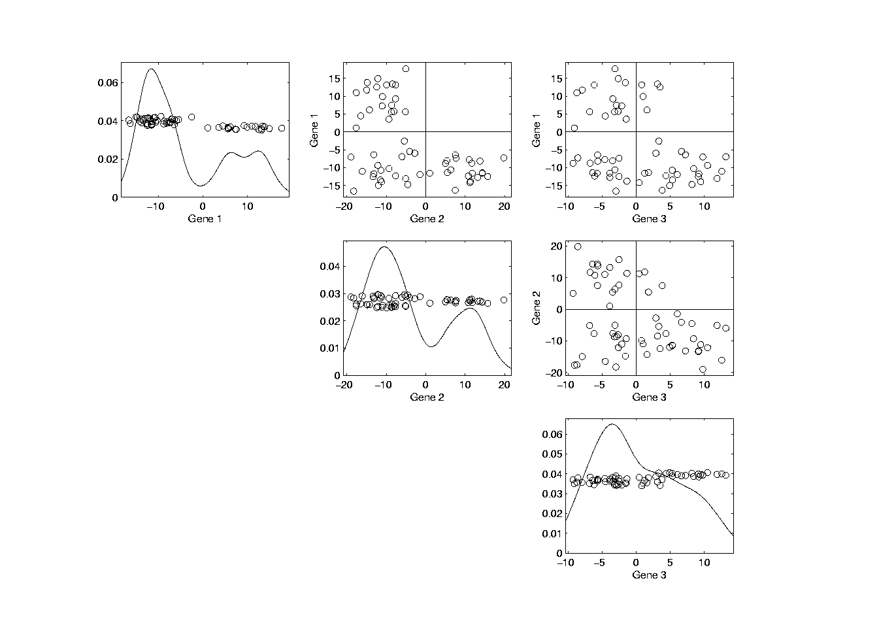
Last Class: Illust’n of Multivar. View
Note Linkage of Axes
Notes:
EgView1p39ScatPlot.ps

Slide 27
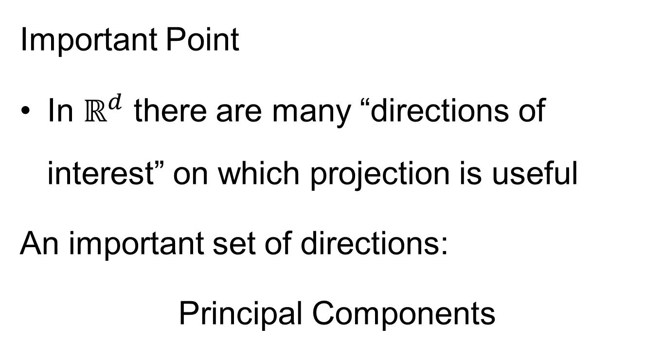
Projection
Important Point
In $ℝ^{d}$ there are many “directions of interest” on which projection is useful
An important set of directions:
Principal Components

Slide 28
Principal Components
Find Directions of:
“Maximal (Projected) Variation”
Compute Sequentially
On Orthogonal Subspaces
Will take careful look at mathematics later
Results in Useful
“Modes of Variation”

Slide 29
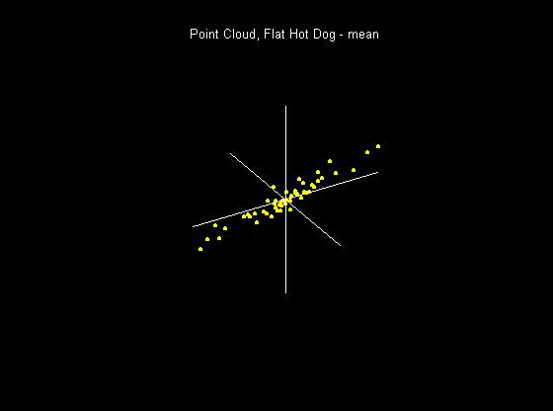
Principal Components
For simple,
3-d toy data,
raw data
view:
(via rotation)
Notes:
29

Slide 30
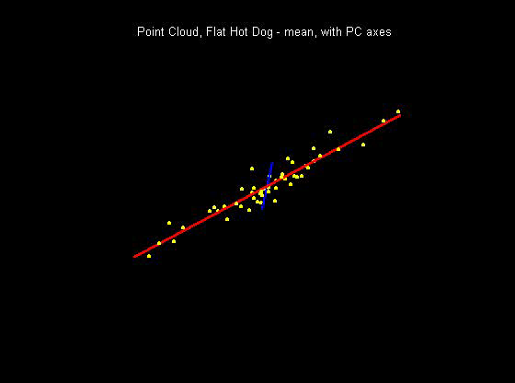
Principal Components
PCA just
gives rotated
coordinate
system:
Notes:
30

Slide 31
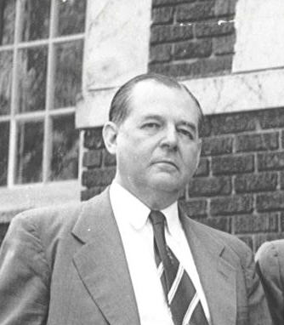
Principal Components
Early References:
Pearson (1901)
Hotelling (1933)
Founder of UNC Statistics Dept.
Notes:
31

Slide 32
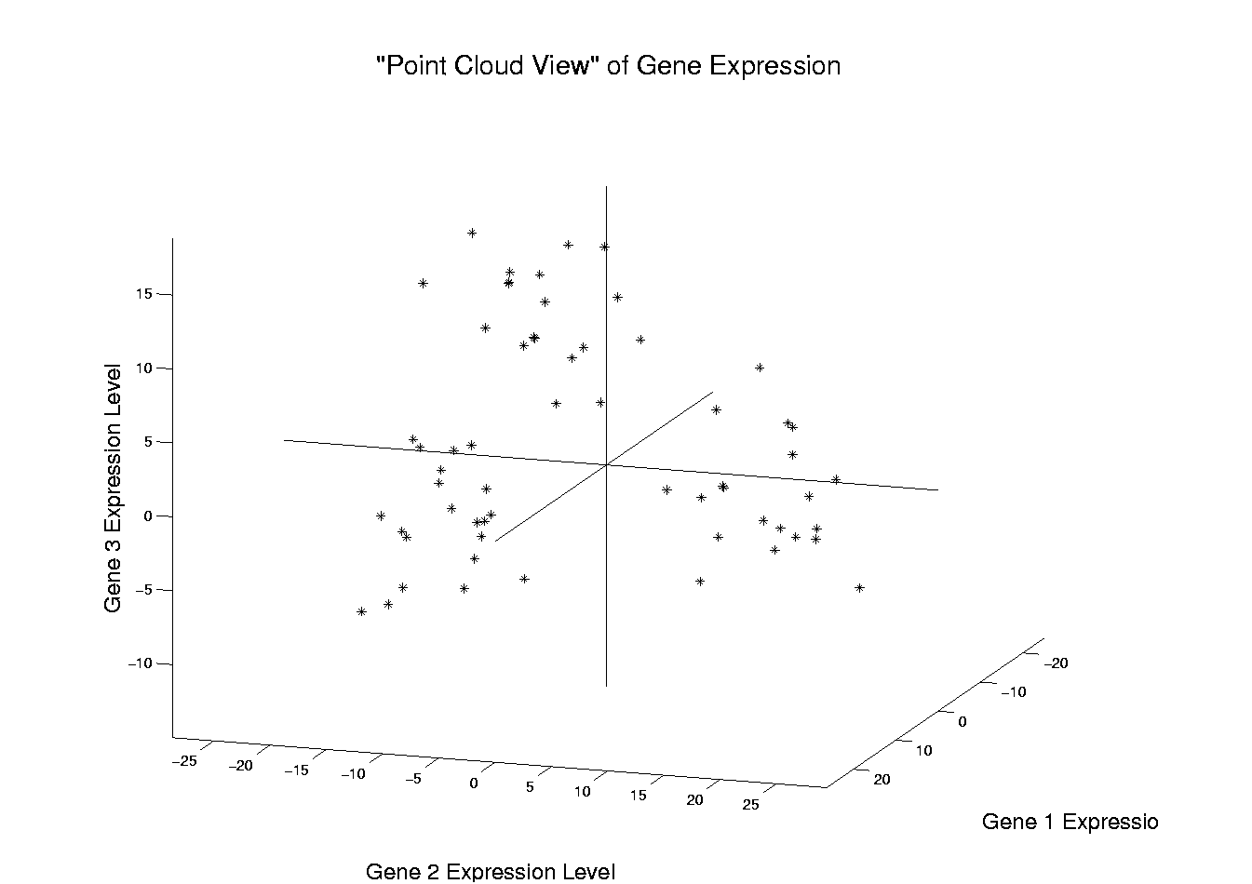
Illust’n of PCA View: Recall Raw Data
Notes:
EgView1p1RawData.ps

Slide 33
Illust’n of PCA View: Recall Trait by Trait Views
Notes:
EgView1p27proj3Dall.ps

Slide 34
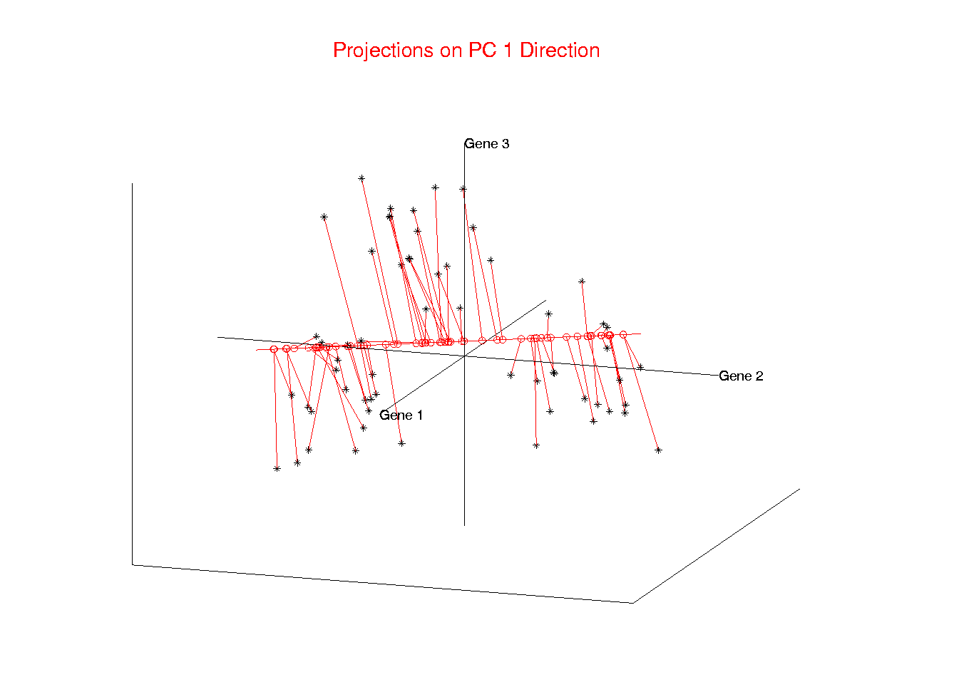
Illust’n of PCA View: PC1 Projections
Note Different Axis
Chosen to
Maximize Spread
Notes:
EgView1p51proj3dPC1.ps

Slide 35
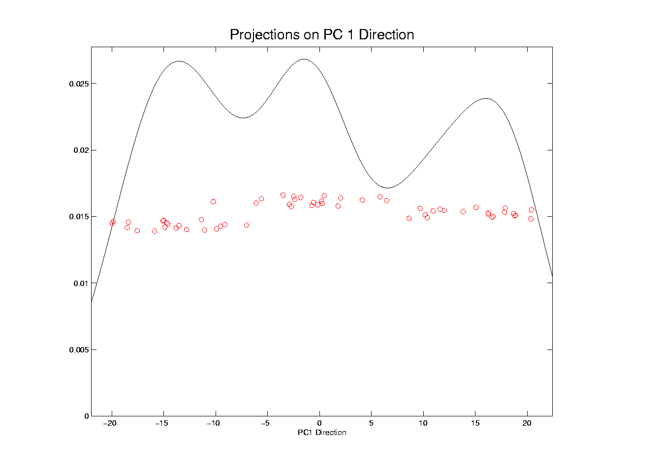
Illust’n of PCA View: PC1 Projections, 1-d View
All 3 Clusters Now Appear
Now See Value of Order in Data Set on Vertical Axis
Notes:
EgView1p61Proj1dPC1.ps

Slide 36
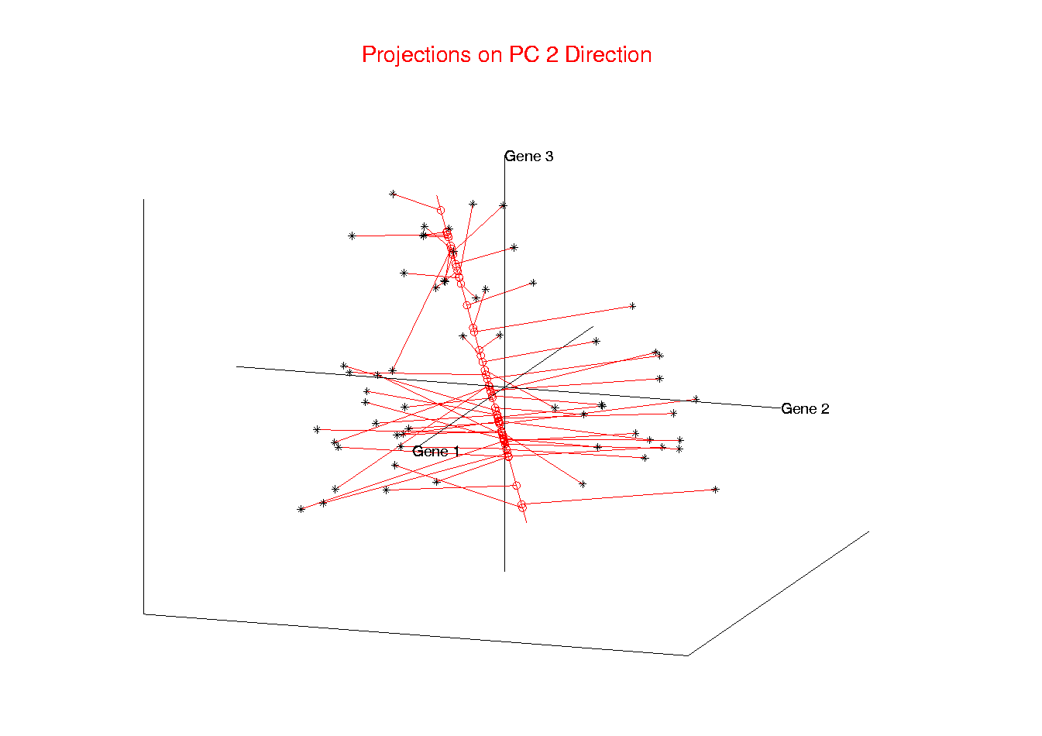
Illust’n of PCA View: PC2 Projections
Max’s Projected Variation Orthogonal to PC1
Notes:
EgView1p52proj3dPC2.ps

Slide 37
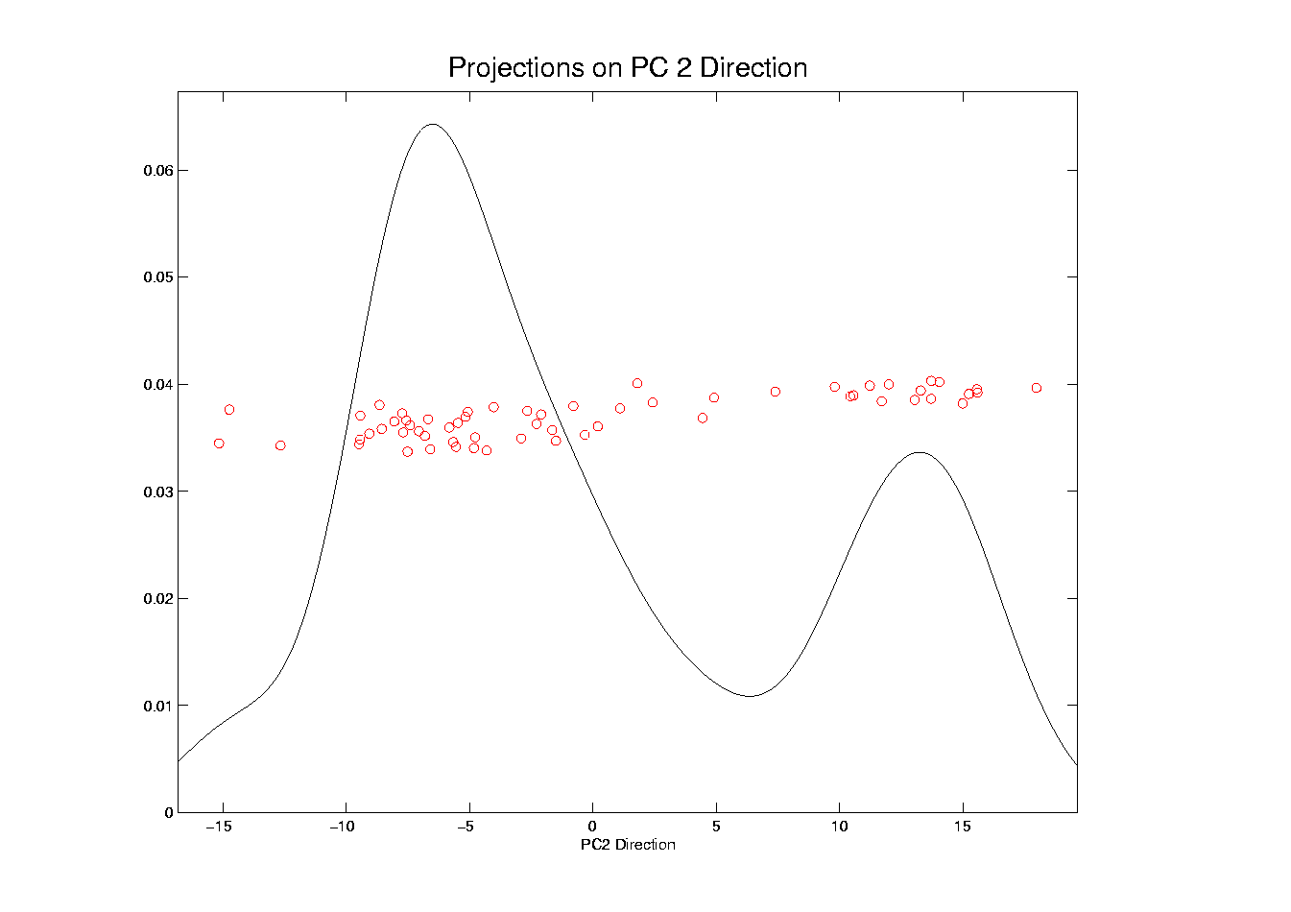
Illust’n of PCA View: PC2 Projections, 1-d View
Separates 1 cluster from others
Notes:
EgView1p62Proj1dPC2.ps

Slide 38
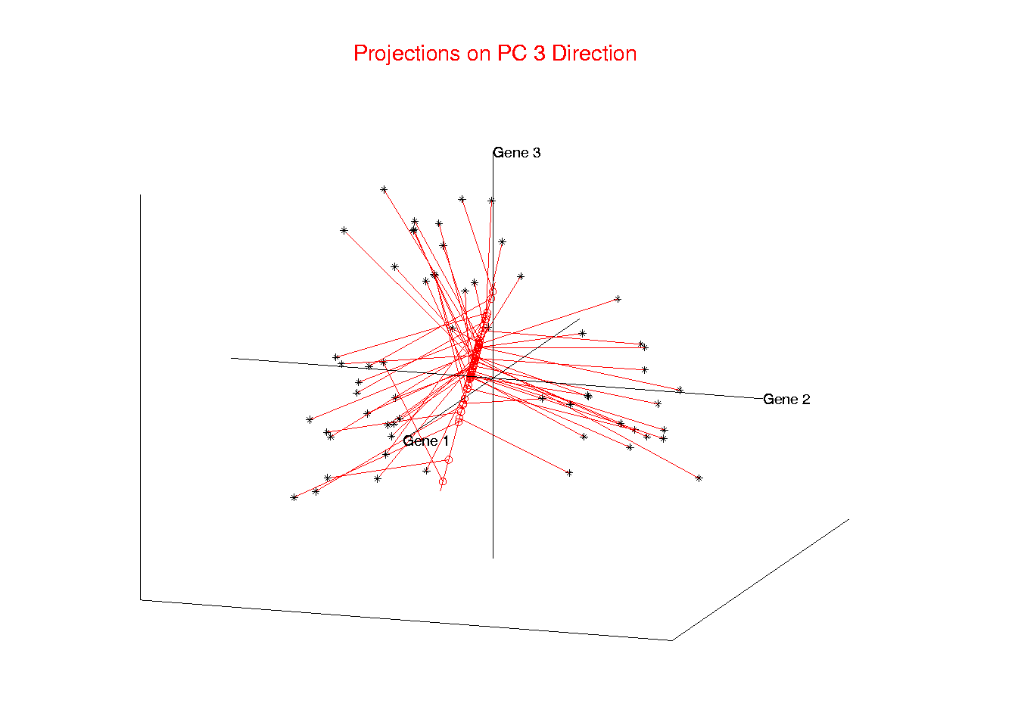
Illust’n of PCA View: PC3 Projections
Notes:
EgView1p53proj3dPC3.ps

Slide 39
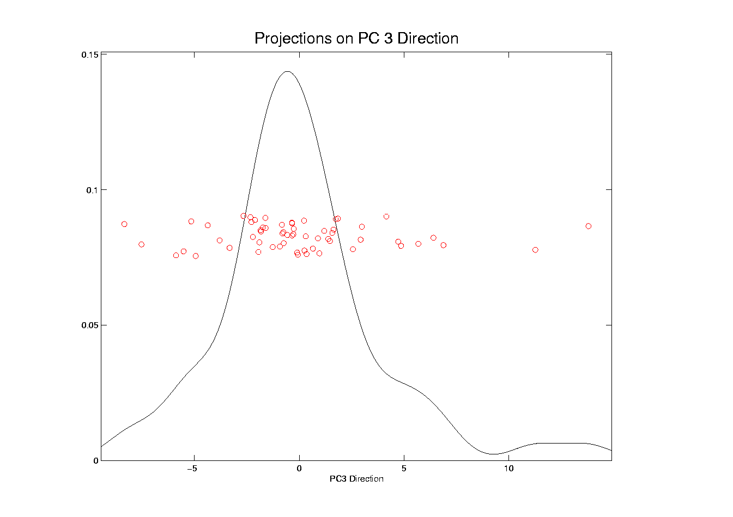
Illust’n of PCA View: PC3 Projections, 1-d View
Don’t See Clusters ???
Notes:
EgView1p63Proj1dPC3.ps

Slide 40
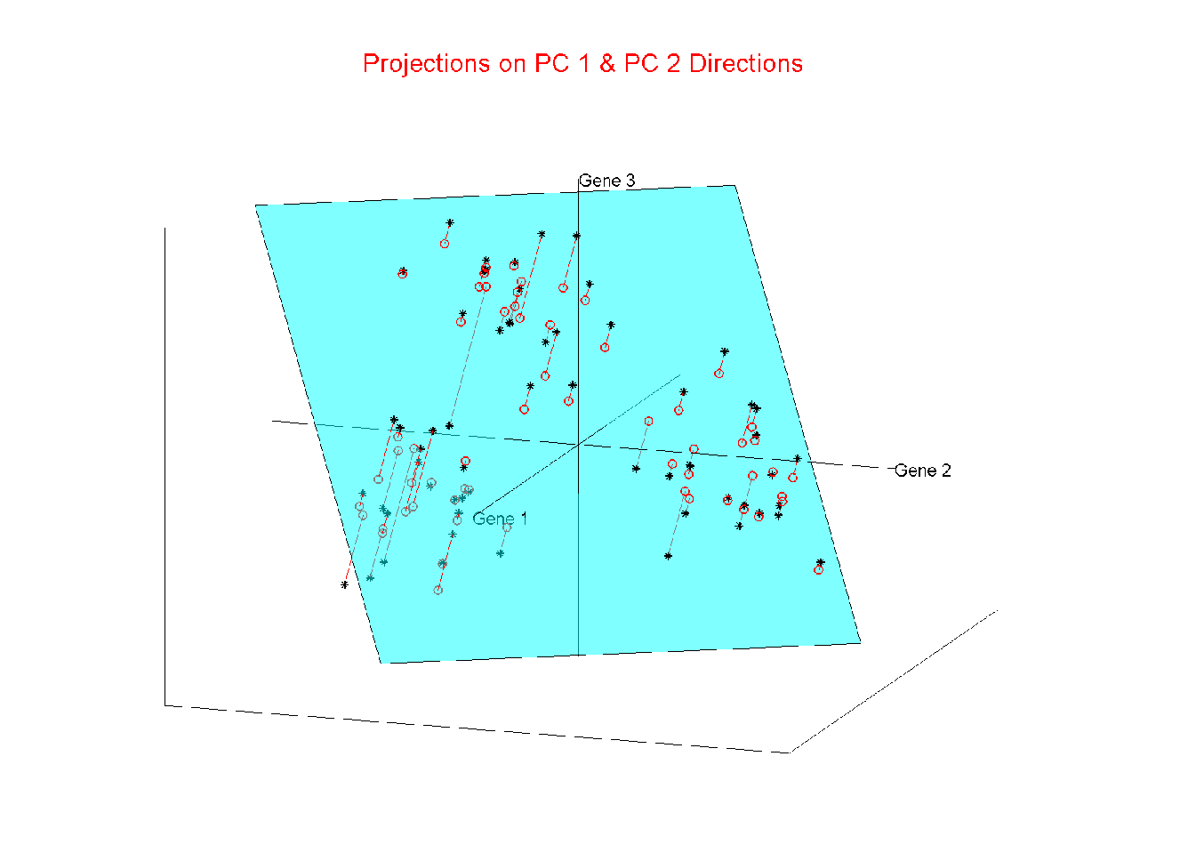
Illust’n of PCA View: Projections on PC1,2 plane
Notes:
EgView1p54proj3dPC12.ps

Slide 41
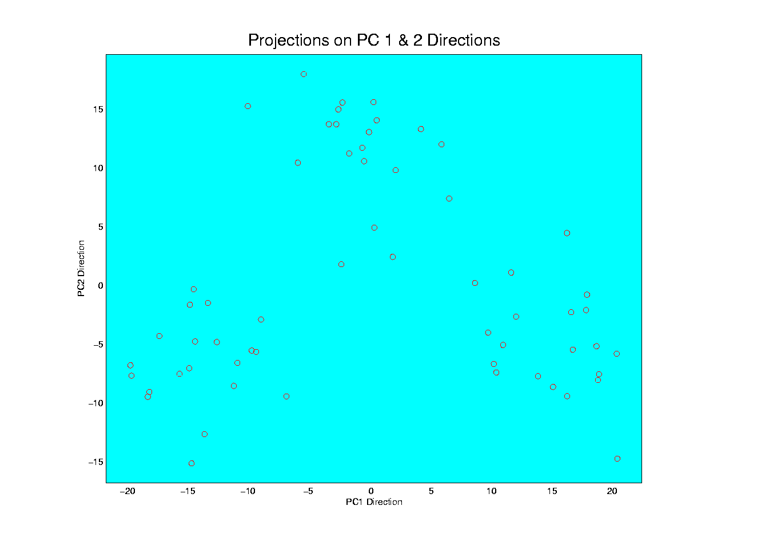
Illust’n of PCA View: PC1 & 2 Proj’n Scatterplot
Very Good Separation of Clusters
Notes:
EgView1p64proj2dPC12.ps

Slide 42
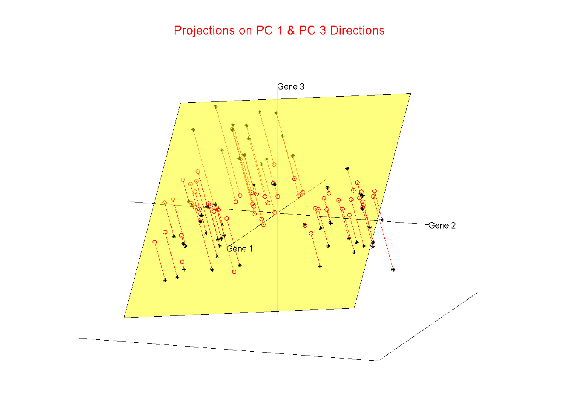
Illust’n of PCA View: Projections on PC1,3 plane
Notes:
EgView1p55proj3dPC13.ps

Slide 43
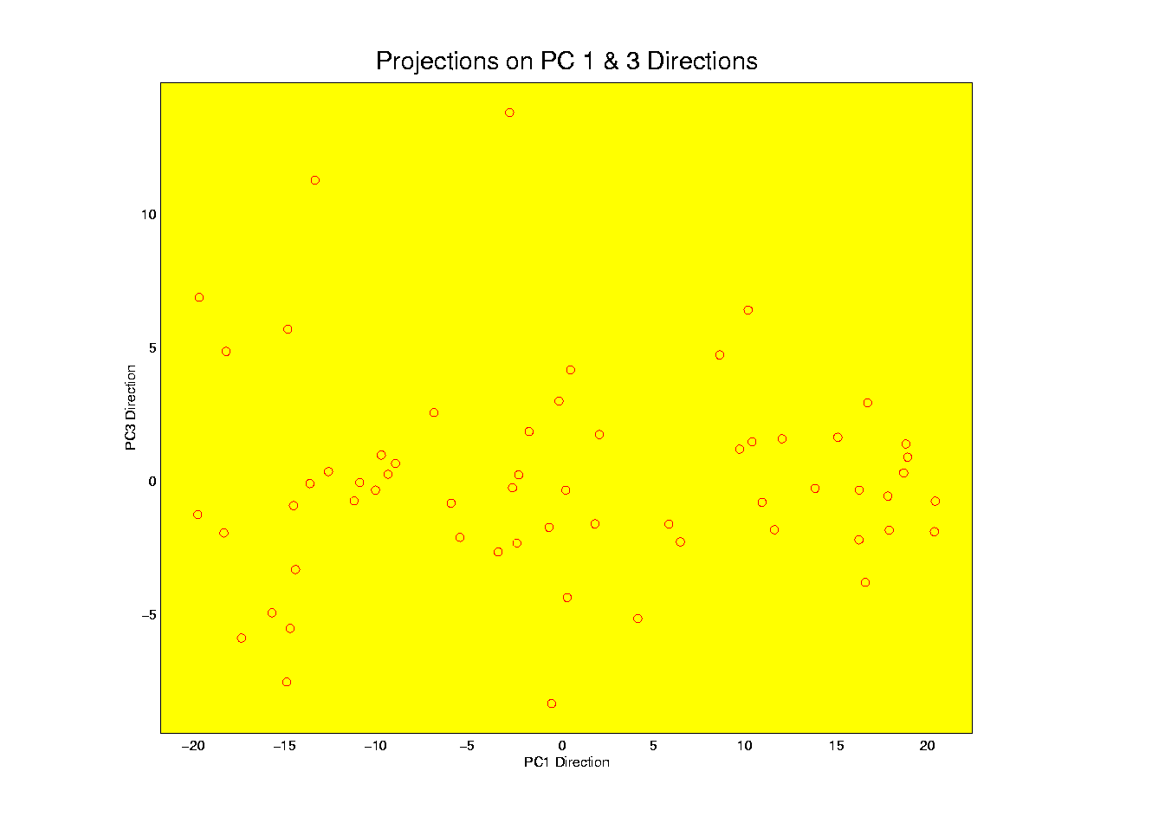
Illust’n of PCA View: PC1 & 3 Proj’n Scatterplot
Notes:
EgView1p65proj2dPC13.ps

Slide 44
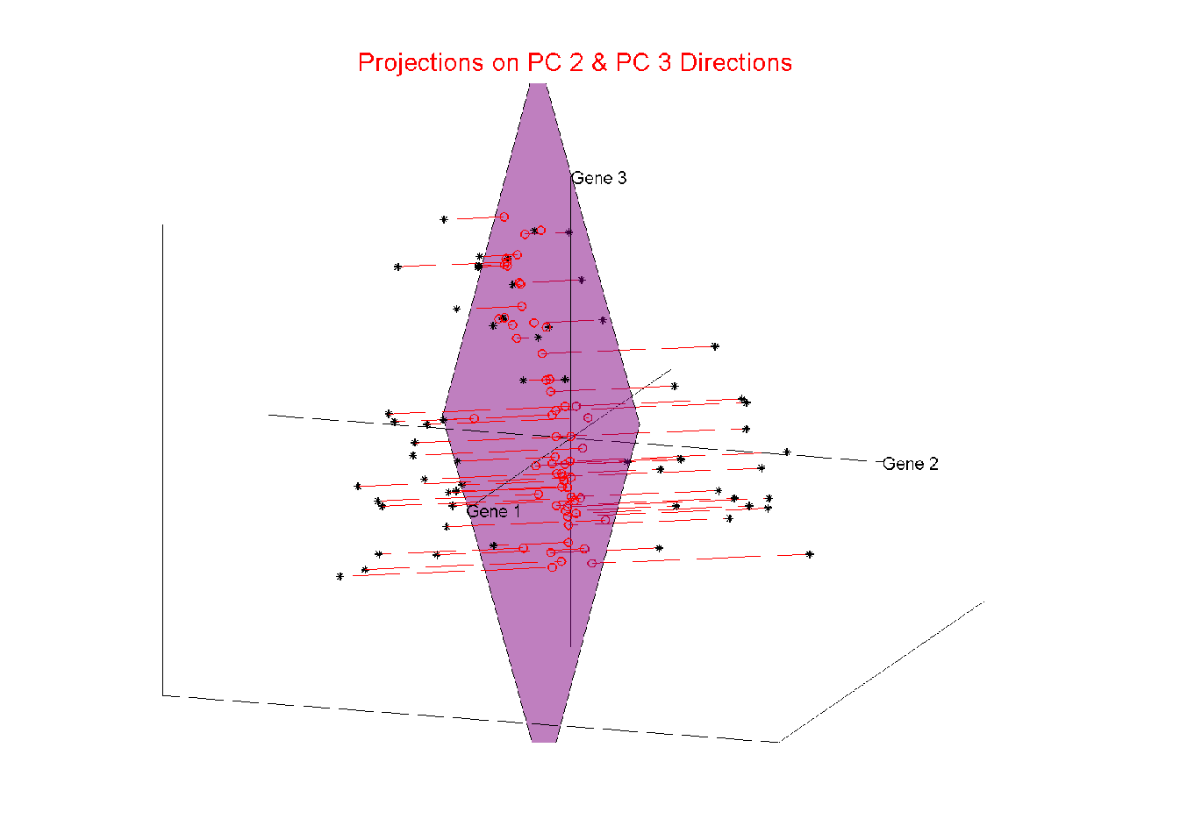
Illust’n of PCA View: Projections on PC2,3 plane
Notes:
EgView1p56proj3dPC23.ps

Slide 45
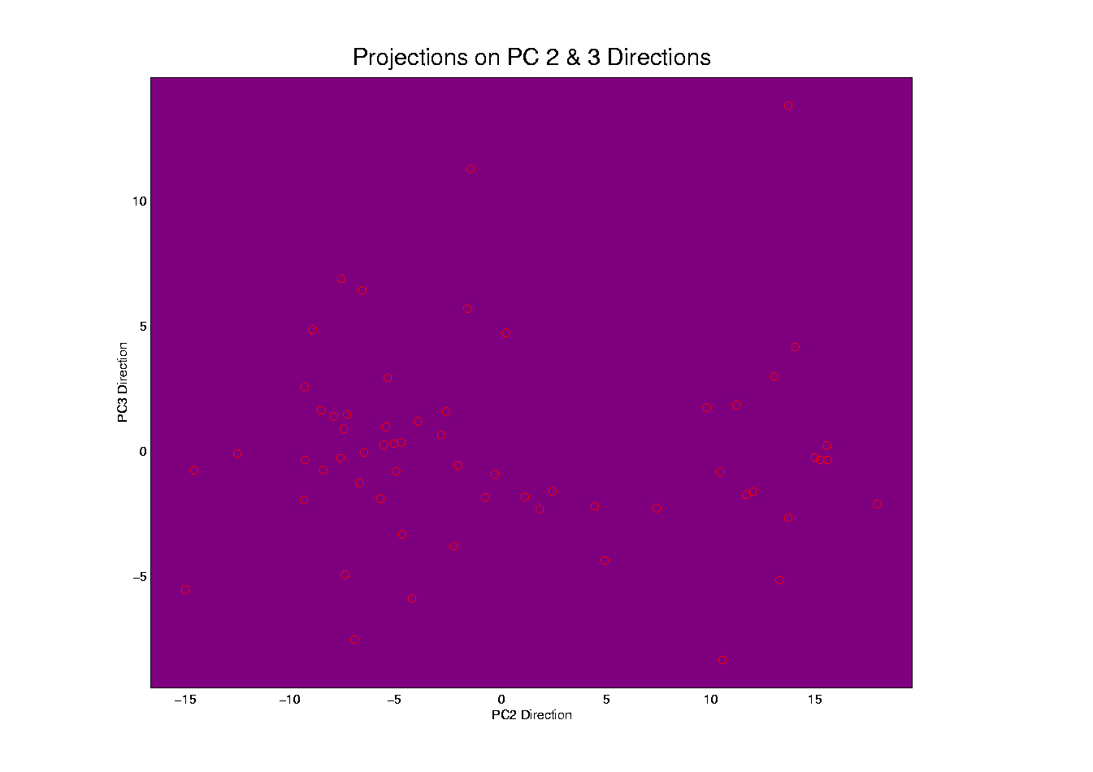
Illust’n of PCA View: PC2 & 3 Proj’n Scatterplot
Notes:
EgView1p66proj2dPC23.ps

Slide 46
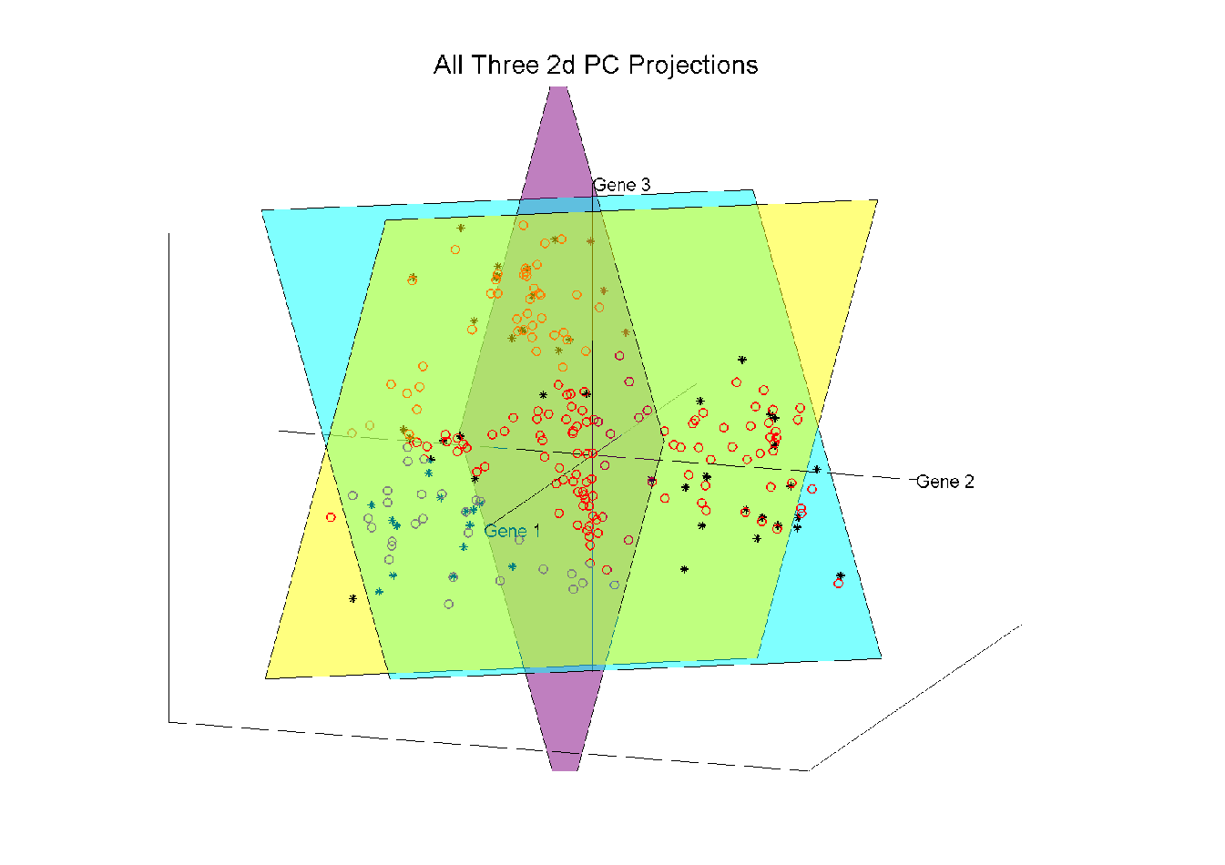
Illust’n of PCA View: All 3 PC Projections
Notes:
EgView1p57proj3dPCall.ps

Slide 47
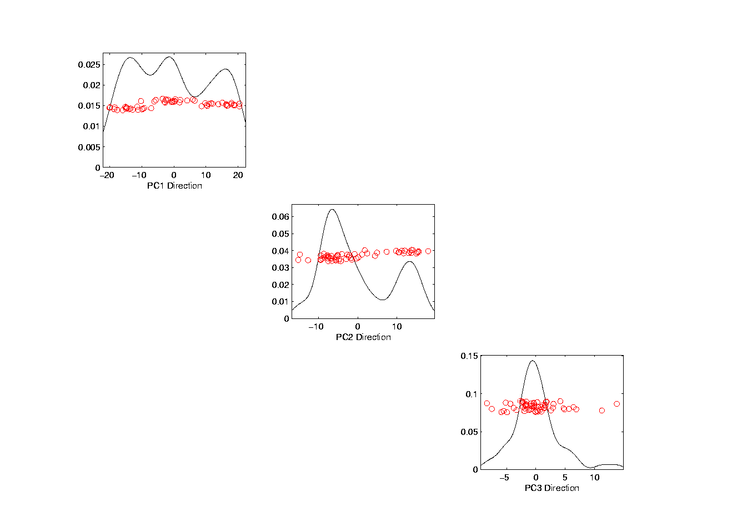
Illust’n of PCA View: Matrix with 1-d proj’ns on diag.
Notes:
EgView1p67proj1dPCAdiag.ps

Slide 48
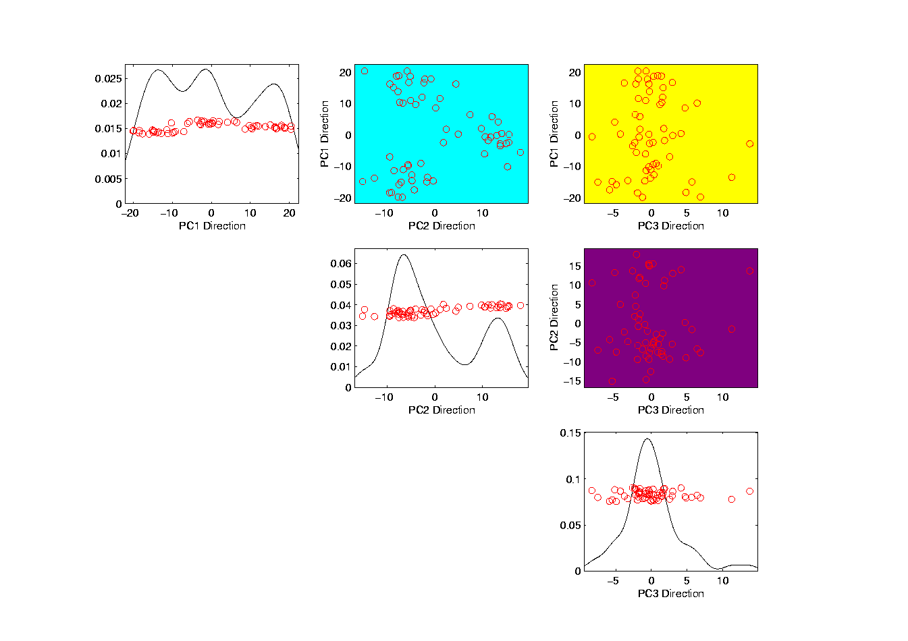
Illust’n of PCA: Add off-diagonals to matrix
Notes:
EgView1p68proj1n2dPCAcolor.ps

Slide 49
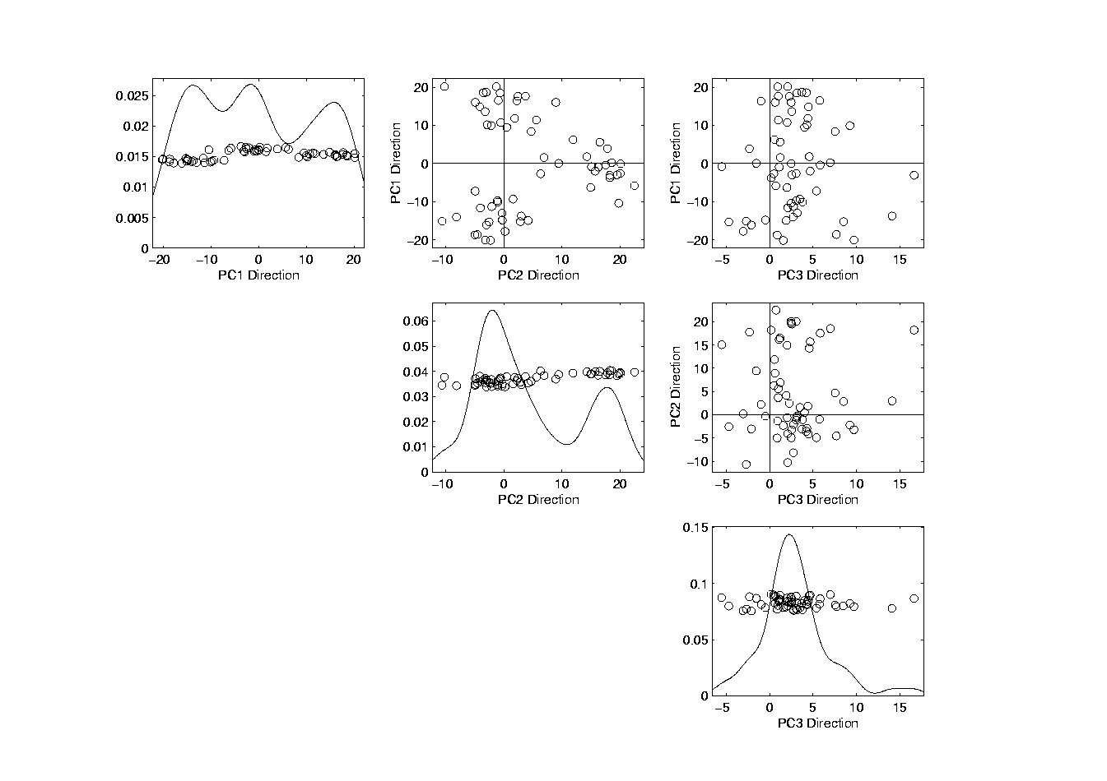
Illustration of PCA Scatterplot Matrix
Useful “3-d” Interpretation
Front View
Side View
Top View
Notes:
EgView1p69PCAScatPlot.ps

Slide 50
Illustration of PCA Scatterplot Matrix
Best View of
Clusters???
3 Cluster Centers Generate 2-d Plane
Essentially Discovered (Highlighted) by PCA
Signal “Compressed” into 2-d
Notes:
EgView1p69PCAScatPlot.ps

Slide 51
Comparison of Views
Highlight 3 Clusters
  In Previous 3-d Example
  Using Colors

Slide 52
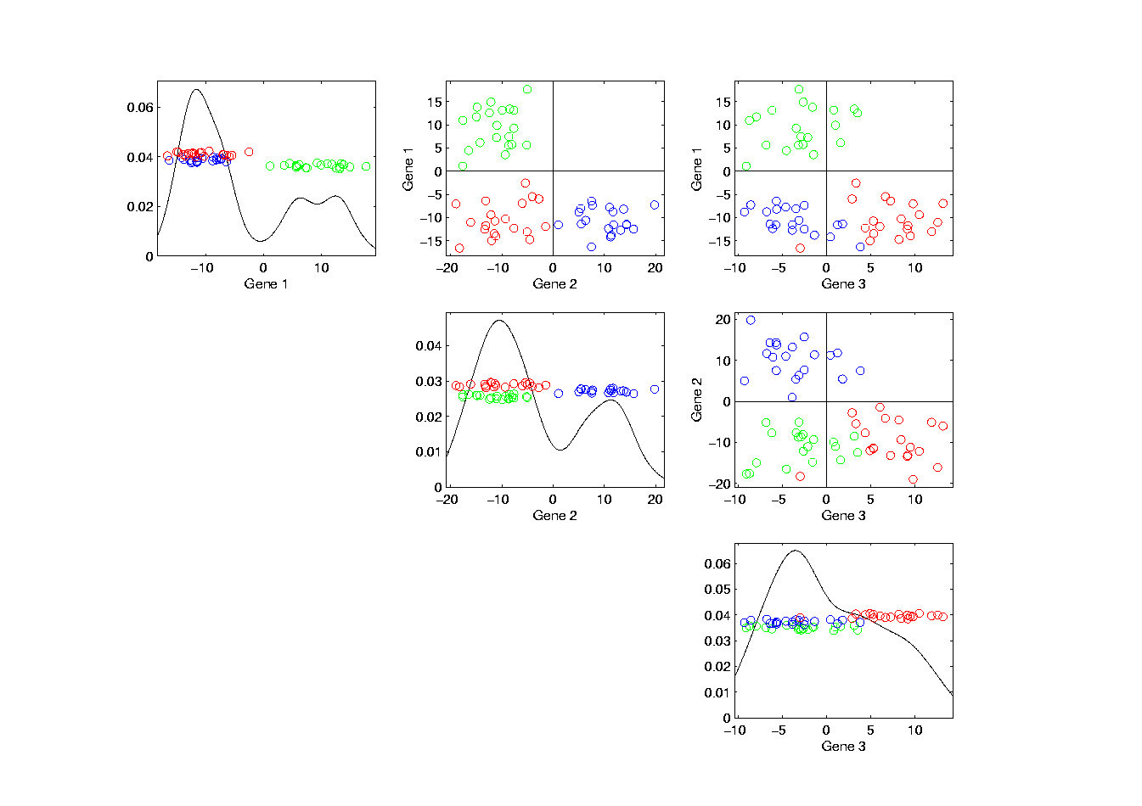
Illust’n of PCA View: Trait by Trait View
Note Colors Enhance
Impressions of Clusters
Cluster “Signal” spread over 3-d
Notes:
EgView1p71GeneViewClustColor.ps

Slide 53
Comparison of Views
Highlight 3 clusters (in previous 3-d example)
Trait by Trait View (above scatterplot matrix)
  Clusters appear in all 3 scatterplots
  But never very separated

Slide 54
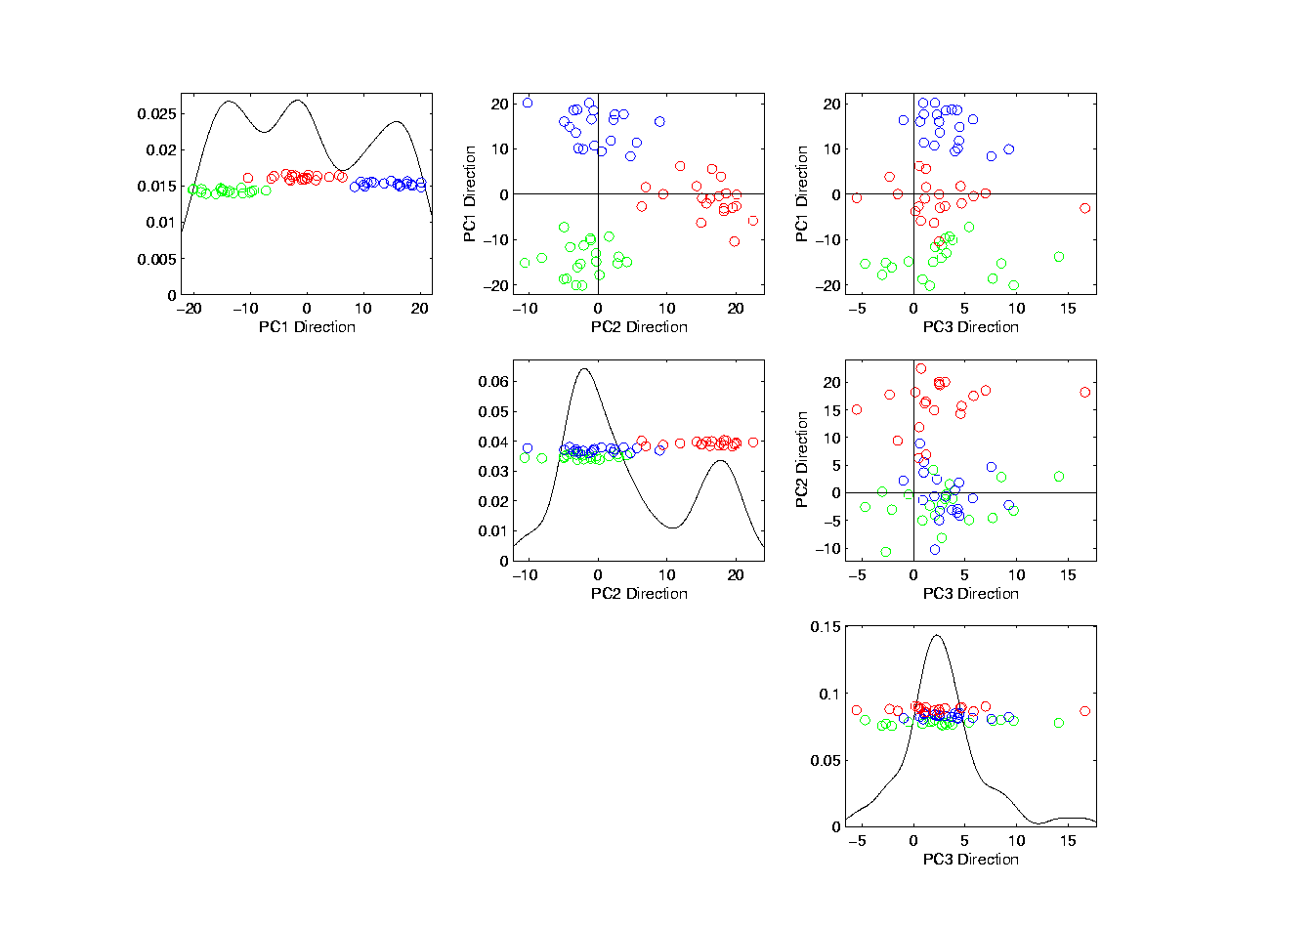
Illust’n of PCA View: PCA View
No Clusters in 3rd
Direction is Good,
Since Important
Aspects Appear
In Earlier Comp’ts
Clusters are “more distinct”
Since more “air space”
In between
Cluster “Signal” Compressed into 2-d
Notes:
EgView1p72PCAViewClustColor.ps

Slide 55
Comparison of Views
Highlight 3 clusters (in previous 3-d example)
Trait by Trait View (above scatterplot matrix)
  Clusters appear in all 3 scatterplots
  But never very separated
PCA View
  1st shows three distinct clusters
  Better separated than in gene view
  Clustering concentrated in 1st scatterplot
Effect is small, since only 3-d

Slide 56
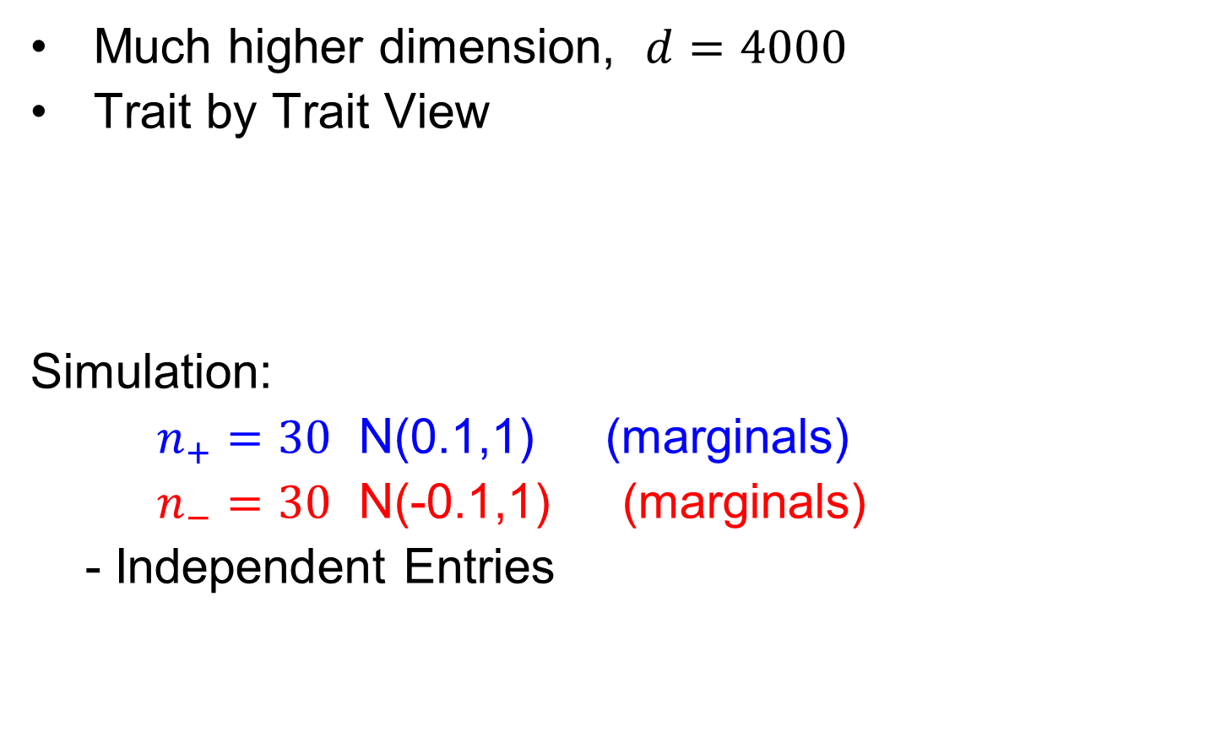
Another Comparison of Views
Much higher dimension, $d=4000$
Trait by Trait View
Simulation:
$n_{+}=30$ N(0.1,1) (marginals)
$n_{−}=30$ N(-0.1,1) (marginals)
- Independent Entries

Slide 57
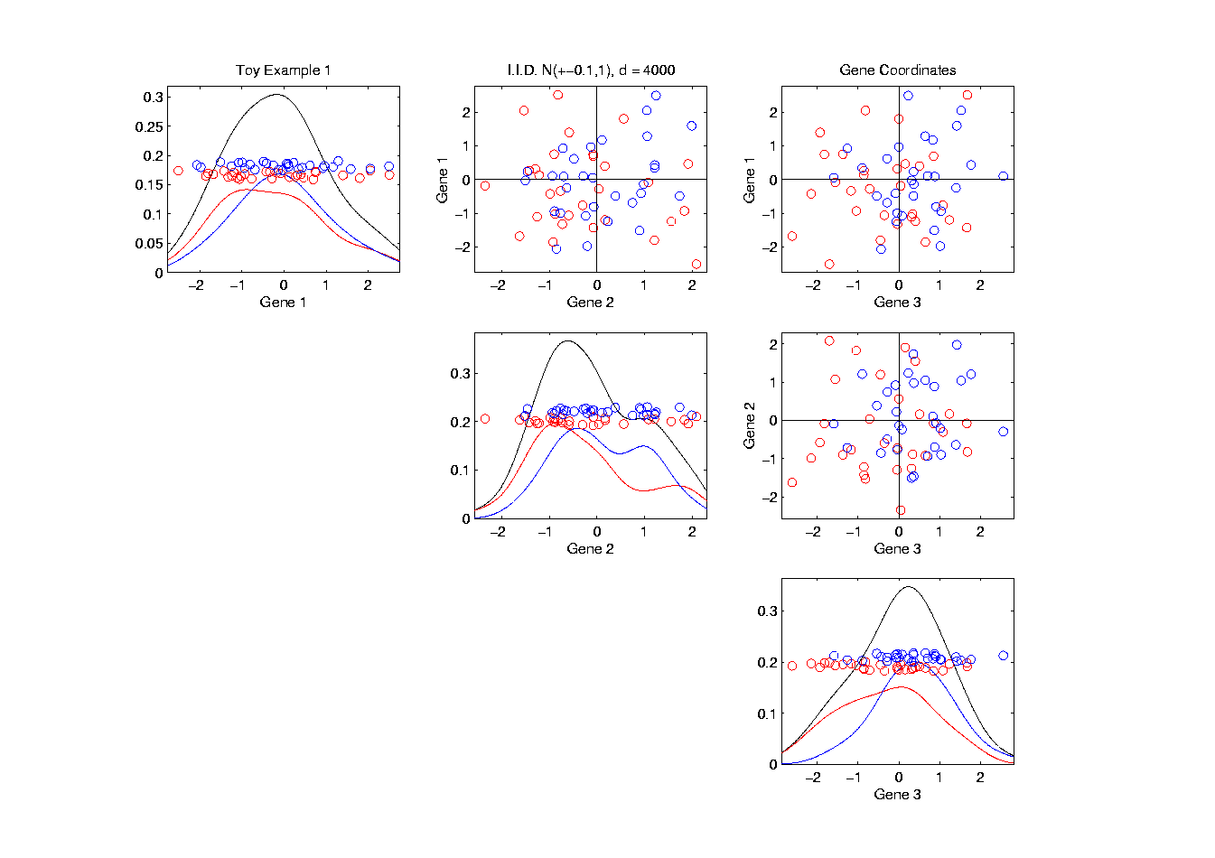
Another Comparison: Trait by Trait View
1st three of 4000 directions
Notes:
EgView2p1dat1GeneView.ps

Slide 58
Another Comparison: Trait by Trait View
Very Small Differences
Between Means
Notes:
EgView2p1dat1GeneView.ps

Slide 59

Another Comparison of Views
Much higher dimension, $d=4000$
Trait by Trait View
  Clusters very nearly the same
  Very slight difference in means

Slide 60

Another Comparison: PCA View
Note Directions of
Much More Variation
Notes:
EgView2p2dat1PCAView.ps

Slide 61

Another Comparison of Views
Much higher dimension, $d=4000$
Trait by Trait View
  Clusters very nearly the same
  Very slight difference in means
PCA View
  Huge difference in 1st PC Direction
  Magnification of clustering
  Lesson: Alternate views can show much more
  (especially in high dimensions, i.e. for many genes)
  Shows PC view can be very useful
Why so big???

Slide 62


Another Comparison: PCA View
Another Viewpoint:
Consider Vectors
$μ_{+}=\left(\begin{matrix}+0.1 \\ ⋮ \\ +0.1\end{matrix}\right)$
$$μ_{−}=\left(\begin{matrix}−0.1 \\ ⋮ \\ −0.1\end{matrix}\right)$$
Difference points in direction $\left(\begin{matrix}1 \\ ⋮ \\ 1\end{matrix}\right)$
Notes:
EgView2p2dat1PCAView.ps

Slide 63

Another Comparison: PCA View
High Dimensional
Space Is Slippery!
Interesting Issue:
How close is $\left(\begin{matrix}1 \\ ⋮ \\ 1\end{matrix}\right)$ to coordinate axes in $ℝ^{d}$?
Angle $= \cos^{−1}\left[\left(\begin{matrix}\frac{1}{\sqrt{d}} & ⋯ & \frac{1}{\sqrt{d}}\end{matrix}\right)\left(\begin{matrix}1 \\ 0 \\ \begin{matrix}⋮ \\ 0\end{matrix}\end{matrix}\right)\right]$
Which for $d=4000$ is ${89.1}^{°}$
Notes:
EgView2p2dat1PCAView.ps

Slide 64
Another Comparison: PCA View
Question for Later:
Why so Big???
Notes:
EgView2p2dat1PCAView.ps

Slide 65
Homework 2
For the Rotated Apple-Banana-Pear Data,
in Canvas/Files/AppleBananaPearSetII.xlsx
Make a trait by trait scatterplot matrix.
Make a PC scores scatterplot matrix.
Explain difference between those
Upload .pdf to Canvas
Due: Feb. 1,
12:30PM

Slide 66
Object Oriented Data Analysis
Three Major Phases of OODA:
I. Object Definition
“What are the Data Objects?”
Exploratory Analysis
“What Is Data Structure / Drivers?”
III. Confirmatory Analysis / Validation
Is it Really There (vs. Noise Artifact)?

Slide 67
Basics of OODA
Useful Conceptual Framework:
Object Space ←→ Trait Space
Text, Sec. 3.1.2
(Where data
objects live)
(How they are
represented)

Slide 68

Basics of OODA
Object Space ←→ Trait Space
Curves $ℝ^{d}$
Images $ℝ^{d×d}$
Shapes Manifolds
Trees Graph Space
Movies

Slide 69


Basics of OODA
Object Space ←→ Trait Space
Simple $d=2$ Toy Example:
Enables Visualization of BOTH Spaces

Slide 70

Basics of OODA
Simple $d=2$ Toy Example:
Each Curve is a Point

Slide 71


Basics of OODA
Simple $d=2$ Toy Example:
Each Curve is a Point
Mean is shown as well (part of analysis)
Can Compute
Mean in $ℝ^{2}$
Or Equivalently Pointwise in Object Space

Slide 72


Basics of OODA
Simple $d=2$ Toy Example:
Best Rank 1 Approximation (PC 1)
As Curves
and as Points

Slide 73

Basics of OODA
Simple $d=2$ Toy Example:
Computed as Projections onto
Eigen-direction centered at Mean

Slide 74

Basics of OODA
Simple $d=2$ Toy Example:
Interpretation:
1st Mode of Variation

Slide 75


Basics of OODA
Simple $d=2$ Toy Example:
Second Best Rank 1 Approximation (PC 2)
As Curves
and as Points

Slide 76

Basics of OODA
Simple $d=2$ Toy Example:
Computed as Projections onto
Eigen-direction centered at Mean

Slide 77

Basics of OODA
Simple $d=2$ Toy Example:
Interpretation:
2nd Mode of Variation

Slide 78

Basics of OODA
Decomposition into Modes of Variation
Note Much More
Variation Here
Than Here

Slide 79
Basics of OODA
Decomposition into Modes of Variation
Sum of Squares
After Mean
Centering
Variance (not s.d.)
To Reflect Energy
Just as in ANOVA
Usual Quantification: Variance of Each, Expressed as %
98.3% of
Variation
1.7% of
Variation

Slide 80

Scree Plot
Text, Sec. 3.1.3
Idea: Visually Summarize Dist’n of Variance
Sometimes Also Useful
To Display Cumulative
98.3% of
Variation
1.7% of
Variation

Slide 81
Scree Plot
More Examples
Spanish Male
Mortality Data
2-d Toy Data

Slide 82

Scree Plot
Recall Spanish Male Mortality Data

Slide 83

Scree Plot
Recall Spanish Male Mortality Decomposition
95.8% of Variation
2.7% of
Variation
Don’t Believe It?
Check Axes!

Slide 84
Scree Plot
More Examples
95.8% of Variation
Spanish Male
Mortality Data
2-d Toy Data
2.7% of
Variation

Slide 85
Scree Plot
More Examples
Spanish Male
Mortality Data
2-d Toy Data
10-d Toy Data
Genetic Data
(Will Show Data Later)

Slide 86
Scree Plot
More Examples
Illustrates Common Use of Scree:
Separate “Signal” From “Noise”
Spanish Male
Mortality Data
2-d Toy Data
Look for “Elbow” (or “Knee”)
10-d Toy Data
Genetic Data
Common for Strong – Low d Signal + Noise

Slide 87
Scree Plot
More Examples
Spanish Male
Mortality Data
2-d Toy Data
Much More Common for Complex Data
Where Signal Appears in Many Comp’s
Really Not Much
Elbow or Knee!
10-d Toy Data
Genetic Data

Slide 88

Scree Plot
Etymology of term Scree:
Geological Feature
Pile Up of Rock
Fragments
(from Wikipedia)
Cattell (1966)

Slide 89
Basics of OODA
Recall Decomposition into Modes of Variation
& Elsewhere
As Well
Just What
Are They?

Slide 90
Basics of OODA
Text, Sec. 3.1.4
Definition of Mode of Variation
(of a sample of data objects)
A Set of Members of the Object Space That:
Summarize One Component of Variation
Is in Some Sense “One Dimensional”
(e.g. Indexed by a Single Real Parameter)

Slide 91
Basics of OODA
Recall Decomposition into Modes of Variation
Multiples Of A Single Curve

Slide 92
Basics of OODA
Recall Spanish Male Mortality Data
Multiples Of A Single Curve

Slide 93
Basics of OODA
Non-Linear Mode
of Variation
Recall Amplitude Phase Example
1-d Families of Curves

Slide 94


Basics of OODA
More Non-Linear
Modes of Variation
Recall Bladder Prostate Rectum Data
1-d Set of Members of Object Space

Slide 95
Basics of OODA
Recall Faces as Data Objects
1-d Set of
Members of
Object Space,
So Also a “Mode Of
Variation”
Mode of Variation
That “Best Separates”

Slide 96
Object Oriented Data Analysis
Three Major Phases of OODA:
I. Object Definition
“What are the Data Objects?”
Exploratory Analysis
“What Is Data Structure / Drivers?”
III. Confirmatory Analysis / Validation
Is it Really There (vs. Noise Artifact)?
Deeper Look at
Visualization

Slide 97

Representing Vectors as Curves
Visualization of Vectors as Data Objects:
$\left(\begin{matrix}x_{1} \\ ⋮ \\ x_{d}\end{matrix}\right)$

Slide 98


Representing Vectors as Curves
Visualization of Vectors as Data Objects:
$\left(\begin{matrix}x_{1} \\ ⋮ \\ x_{d}\end{matrix}\right)$
Called Parallel Coordinate View
by Inselberg (1985, 2005)
Connect with piece-wise lines

Slide 99

Parallel Coordinates
Proposed for Multivariate Data Visualization:
by Inselberg (1985, 2005)
E.g. Fisher Iris Data
d = 4
Named Variables
(thanks to Wikipedia)
Notes:
99

Slide 100
Parallel Coordinates
Proposed for Multivariate Data Visualization:
by Inselberg (1985, 2005)
E.g. Fisher Iris Data
d = 4
Named Variables
Curves are Data Objects
Vectors → Curves
Notes:
100

Slide 101
Representing Vectors as Curves
Summary of Approaches:
Parallel Coordinates
Fourier Basis
Orthogonal Polynomials
B-Splines
Wavelet Bases
Text, Sec. 3.3
Notes:
101

Slide 102

Representing Curves as Vectors
Summary of Approaches:
Parallel Coordinates
Fourier Basis
Orthogonal Polynomials
B-Splines
Wavelet Bases
Foundation of
Functional Data Analysis
Useful Duality: Vectors $↔$ Curves
Notes:
102

Slide 103

E.g. Curves As Data
“Tilted Parabolas” Example
10-d family of (digitized) curves
Object Space: bundles of curves
Trait Space = $ℝ^{10}$
(harder to visualize as point cloud,
but keep point cloud in mind)
PCA Modes of Variation:
Reveal “population structure”
Text, Sec. 4.1.1

Slide 104

Functional Data Analysis, Tilted Parabolas Data
Terminology:
“Modes of Variation” “Scores Plots”
Notes:
EGCD1Parabs.ps

Slide 105
Functional Data Analysis, Tilted Parabolas Data
OODA Conceptual Framework
Object
Space
Views
Trait
Space
Views
Notes:
EGCD1Parabs.ps

Slide 106
Functional Data Analysis, Tilted Parabolas Data
Get Quantitative With Sums of Squares
SS Explained
By Mean
Mean resid SS
PC1 Resid SS
(from Mean)
PC1 SS
(from Mean)
PC2 SS
(from Mean)
PC2 Resid SS
(from Above)
Notes:
EGCD1Parabs.ps

Slide 107
Functional Data Analysis, Tilted Parabolas Data
PC2 Resid SS
(from Above)
PC2 SS
(from Mean)
Simulated As:
Parabola
+Random Shift
PC3 Resid SS
(from Above)
PC3 SS
(from Mean)
+Random Tilt
+Gaussian Noise
PC4 SS
(from Mean)
PC4 Resid SS
(from Above)
Notes:
EGCD1Parabs.ps

Slide 108
Functional Data Analysis, Tilted Parabolas Data
Get Quantitative With Sums of Squares
SS Explained
By Mean
Mean resid SS
PC1 Resid SS
(from Mean)
PC1 SS
(from Mean)
Note Scree Plot, Already Shown Above,
To Summarize Distribution of Variation
PC2 SS
(from Mean)
PC2 Resid SS
(from Above)
Notes:
EGCD1Parabs.ps

Slide 109
Scree Plot
More Examples
Spanish Male
Mortality Data
2-d Toy Data
10-d Toy Data
Genetic Data

Slide 110
E.g. Tilted Parabolas Data
PCA: reveals “population structure”
Mean → Parabolic Structure
PC1 → Vertical Shift
PC2 → Tilt
higher PCs → Gaussian (spherical)
Decomposition into modes of variation

Slide 111

E.g. Tilted Parabolas Data
Useful Exploration:
Study “Signal vs. Noise” Issues
By Adding Differing Levels of Gaussian Noise
$$+N\left(0,σ^{2}\right)$$
(Independent)

Slide 112

Original Tilted Parabolas
Very Strong
PC1 Signal
Shape Comes
From Mean
Weaker
PC2 Signal
PC1 is
Vertical
Shift
PC2
is Tilt
PC3 is
Noise

Slide 113


Tilted Parabolas $+N\left(0,8^{2}\right)$
PC1 Now
Weaker
Mean
Remains
PC1 is
Mostly
There
PC2 Now
Drowned
Out

Slide 114


Tilted Parabolas $+N\left(0,{40}^{2}\right)$
Mean is
Impacted
Now Pure Noise
PC1 Now
Drowned Out

Slide 115
E.g. Curves As Data
Two Clusters Example
10-d curves again

Slide 116

Functional Data Analysis, Two Clusters
Notes:
EGCD1Clust2.ps

Slide 117
E.g. Curves As Data
Two Clusters Example
10-d curves again
Two big clusters
Revealed by 1-d scores plot (right side)
Note: Cluster Difference is not orthogonal
to Vertical Shift
PCA Modes of Variation:
Reveal “population structure”

Slide 118
E.g. Curves As Data
“Twin Arches” Example
50-d curves
Text, Sec. 4.1.2

Slide 119

Functional Data Analysis, Twin Arches
Notes:
EGCD1Clust4a.ps

Slide 120

Functional Data Analysis, Twin Arches
Notes:
EGCD1Clust4aDP2d.ps

Slide 121
E.g. Curves As Data
Twin Arches Example
50-d curves
Pop’n structure hard to see in 1-d
2-d projections make structure clear
Joint Dist’ns More than Marginals
PCA: reveals “population structure”

