Slide 1
Statistics – O. R. 881
Object Oriented Data Analysis
Steve Marron
Dept. of Statistics and Operations Research
University of North Carolina

Slide 2
Current Sections in Textbook
Today:
Sections 7.1, 7.2, 1.2, 5.2, 8.4
Next Class:
Sections 8.1, 8.2, 8.3

Slide 3
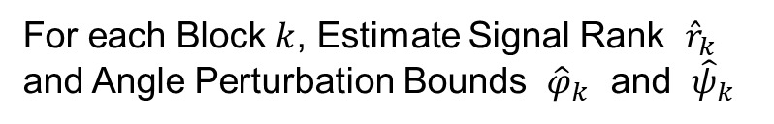

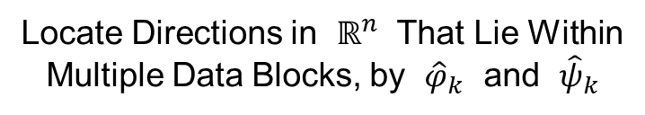
Last Class: DIVAS Algorithm
Three Major Steps:
Signal Subspace Extraction
Joint Subspace Estimation
Signal Reconstruction
Something Like
Initial SVD in AJIVE,
But More Automatic
For each Block $k$, Estimate Signal Rank ${\hat{r}}_{k}$
and Angle Perturbation Bounds ${\hat{φ}}_{k}$ and ${\hat{ψ}}_{k}$
Locate Directions in $ℝ^{n}$ That Lie Within
Multiple Data Blocks, by ${\hat{φ}}_{k}$ and ${\hat{ψ}}_{k}$
In Spirit of Loadings
Projection in AJIVE
Reconstruct Partially Shared Joint
Components of $X_{k}$, Especially Loadings

Slide 4
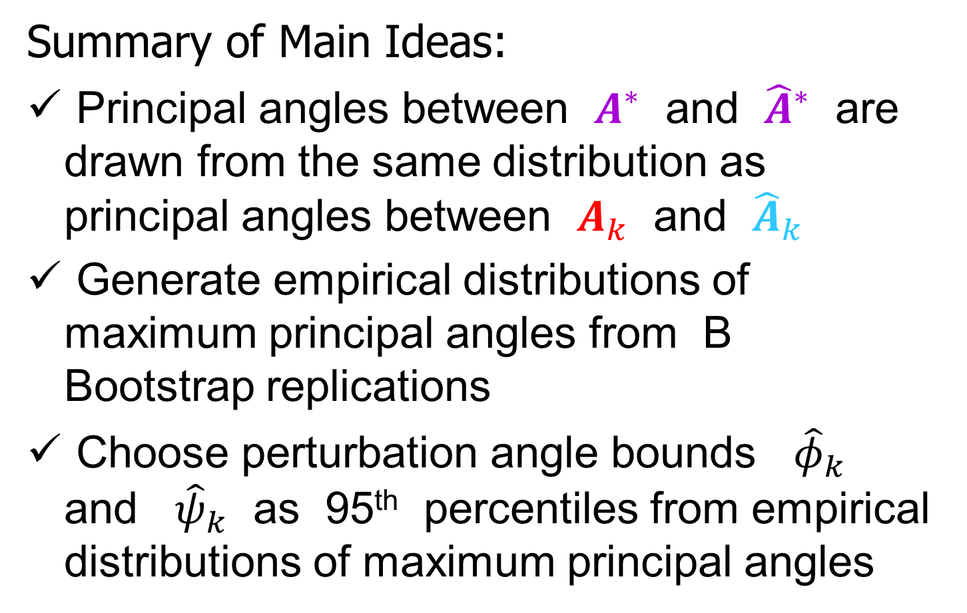
Last Class: 1. Signal Subs. Ext.
Summary of Main Ideas:
Principal angles between $A^{∗}$ and ${\hat{A}}^{∗}$ are drawn from the same distribution as principal angles between $A_{k}$ and ${\hat{A}}_{k}$
Generate empirical distributions of maximum principal angles from B Bootstrap replications
Choose perturbation angle bounds ${\hat{φ}}_{k}$ and ${\hat{ψ}}_{k}$ as 95th percentiles from empirical distributions of maximum principal angles

Slide 5
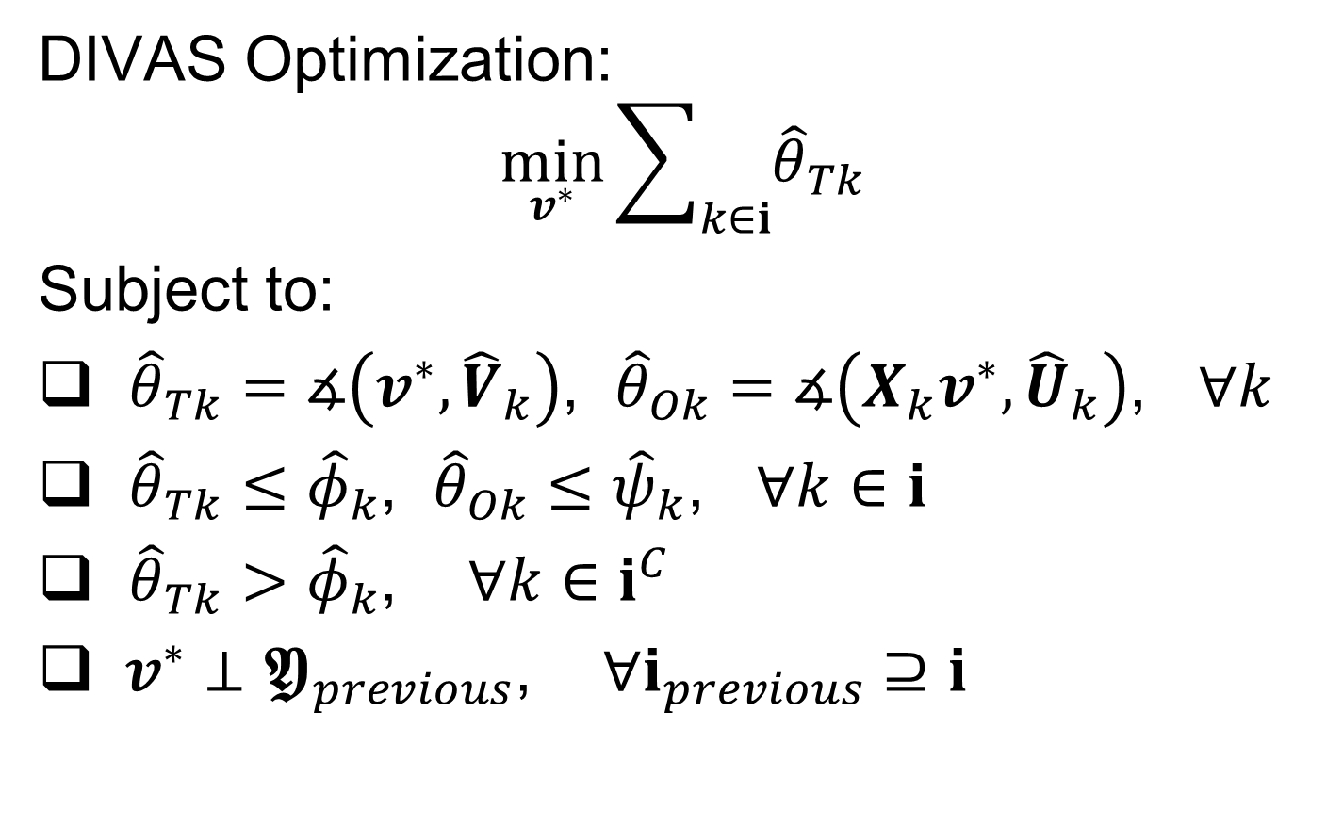
Last Class: 2. Joint Subs. Est’n
DIVAS Optimization:
$$\min_{v^{∗}}{\sum_{k∈i}{{\hat{θ}}_{Tk}}}$$
Subject to:
${\hat{θ}}_{Tk}=∡\left(v^{∗},{\hat{V}}_{k}\right)$, ${\hat{θ}}_{Ok}=∡\left(X_{k}v^{∗},{\hat{U}}_{k}\right)$, $∀k$
${\hat{θ}}_{Tk}≤{\hat{φ}}_{k}$, ${\hat{θ}}_{Ok}≤{\hat{ψ}}_{k}$, $∀k∈i$
${\hat{θ}}_{Tk}>{\hat{φ}}_{k}$, $∀k∈i^{C}$
$v^{∗}⊥𝖄_{previous}$, $∀i_{previous}⊇i$

Slide 6
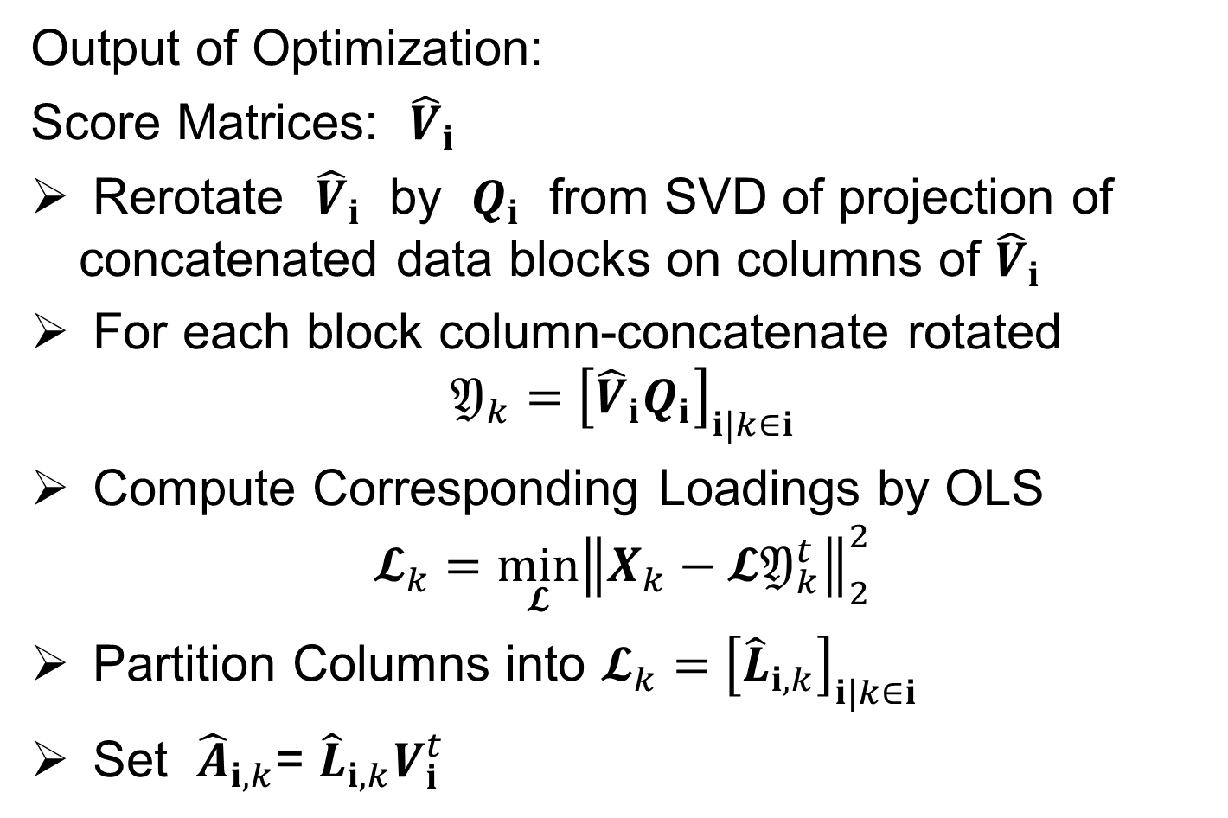
Last Class: 3. Signal Recon.
Output of Optimization:
Score Matrices: ${\hat{V}}_{i}$
Rerotate ${\hat{V}}_{i}$ by $Q_{i}$ from SVD of projection of concatenated data blocks on columns of ${\hat{V}}_{i}$
For each block column-concatenate rotated
$$𝔜_{k}={\left[{\hat{V}}_{i}Q_{i}\right]}_{i|k∈i}$$
Compute Corresponding Loadings by OLS
$$𝓛_{k}=\min_{𝓛}{{\left\|X_{k}−𝓛𝔜_{k}^{t}\right\|}_{2}^{2}}$$
Partition Columns into $𝓛_{k}={\left[{\hat{L}}_{i,k}\right]}_{i|k∈i}$
Set ${\hat{A}}_{i,k}$= ${\hat{L}}_{i,k}V_{i}^{t}$

Slide 7
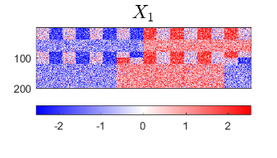
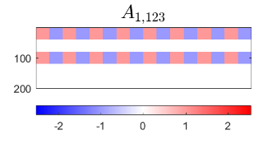
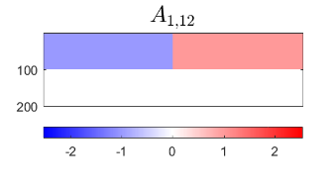
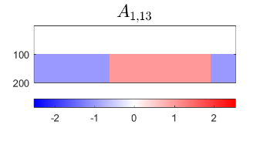
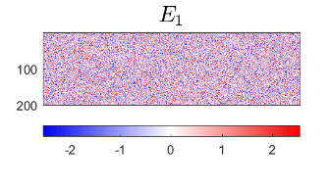
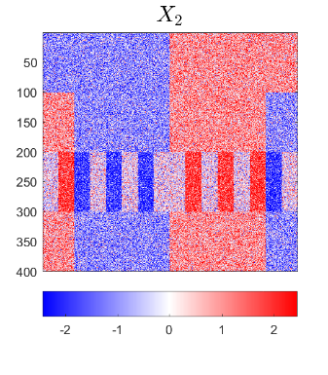
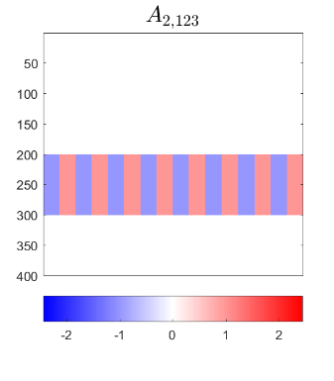
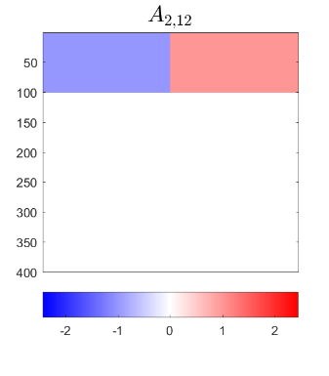
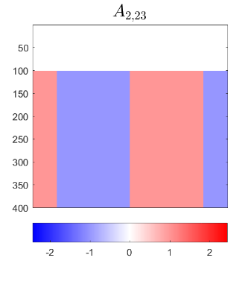
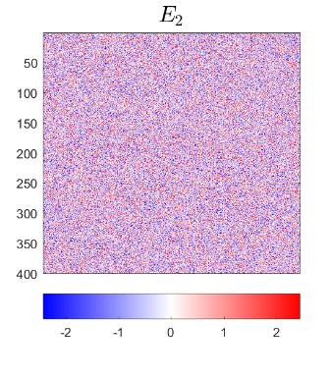
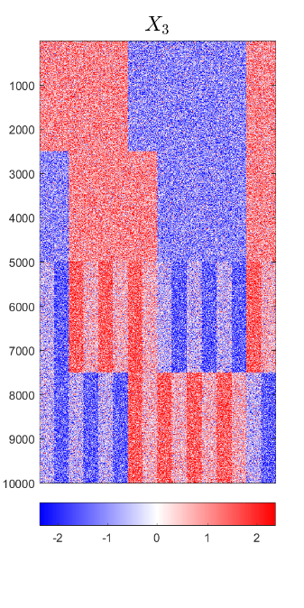
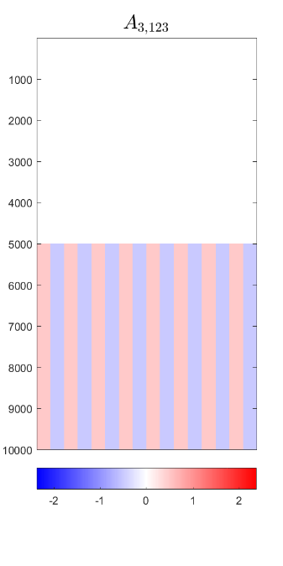
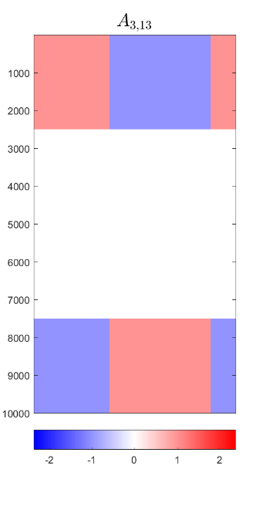
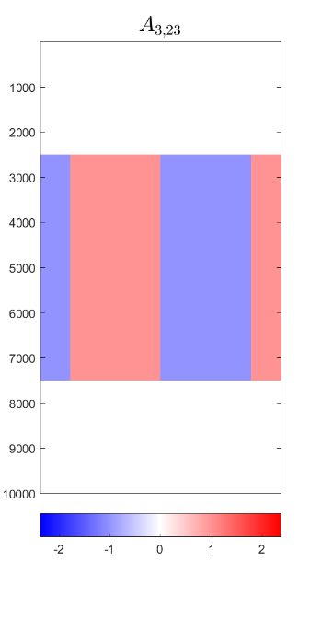
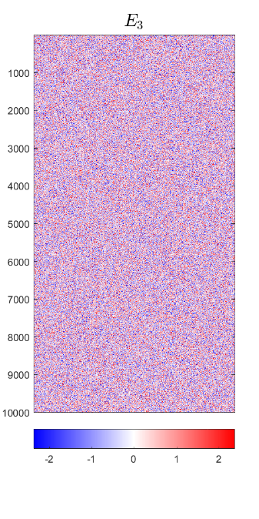









Last Class: Toy Example
Relate to Previous Notation
$$X_{1}$$
$$A_{1}$$
$$E_{1}$$
$$X_{2}$$
$$A_{2}$$
$$E_{2}$$
$$X_{3}$$
$$A_{3}$$
$$E_{3}$$

Slide 8


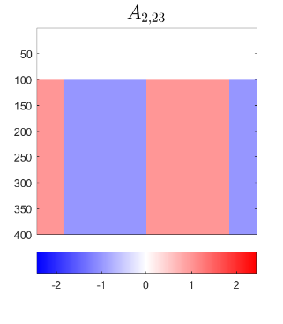

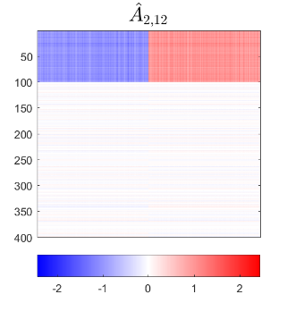
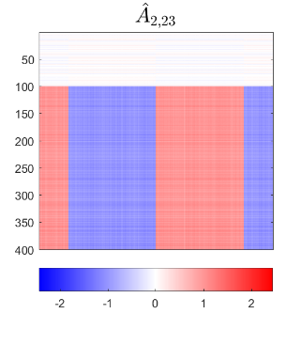
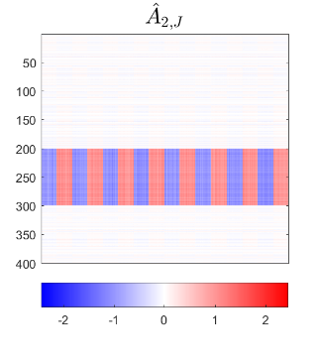
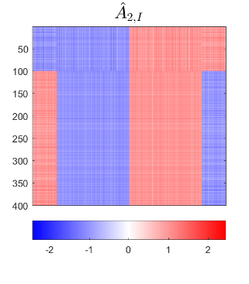
Last Class: Toy Example
Deeper Look at Estimation of 2nd Block
Target
DIVAS
AJIVE
DIVAS
Again
Gives
Better
Estimation
2.76°
5.00°
2.11°
4.23°
5.79°
3.76°

Slide 9
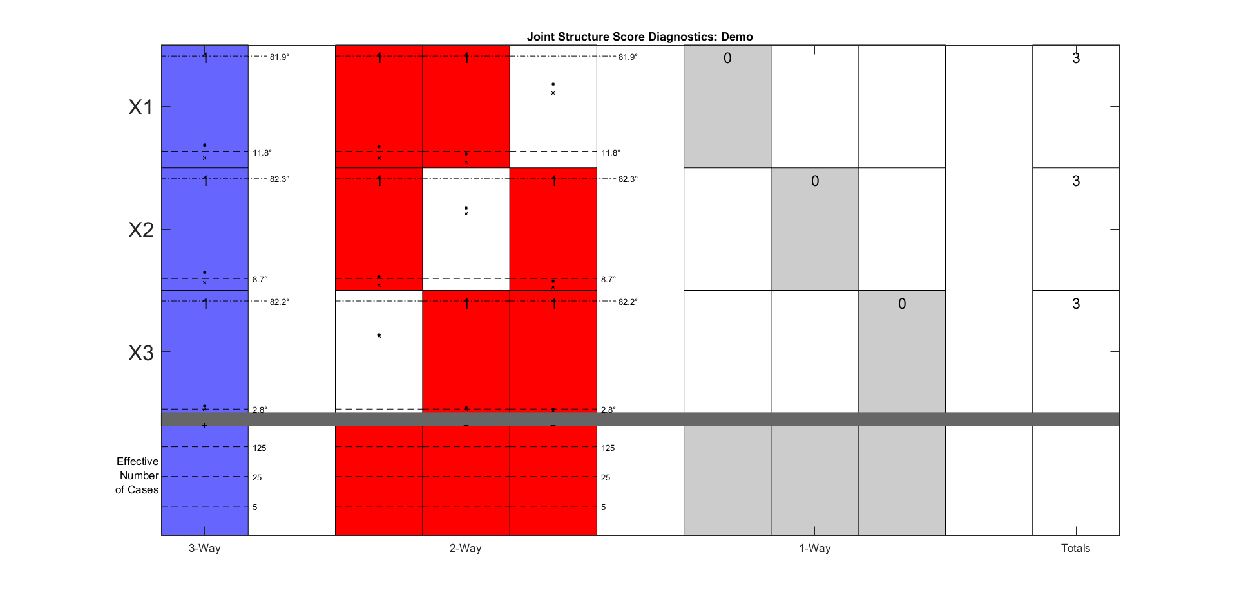

Last Class: Toy Example
Diagnostic Plot (Scores, i. e. Trait Space)
Columns are Share Types, With Components $𝖄_{i,k}$, indexed by $i∈2^{\left\{1,2,3\right\}}$
No Significant
Individual Blocks
Rows are Data Blocks, $k=1,2,3$
Three (Each rank 1) 2-way Blocks
Single (rank 1) 3-way Block

Slide 10
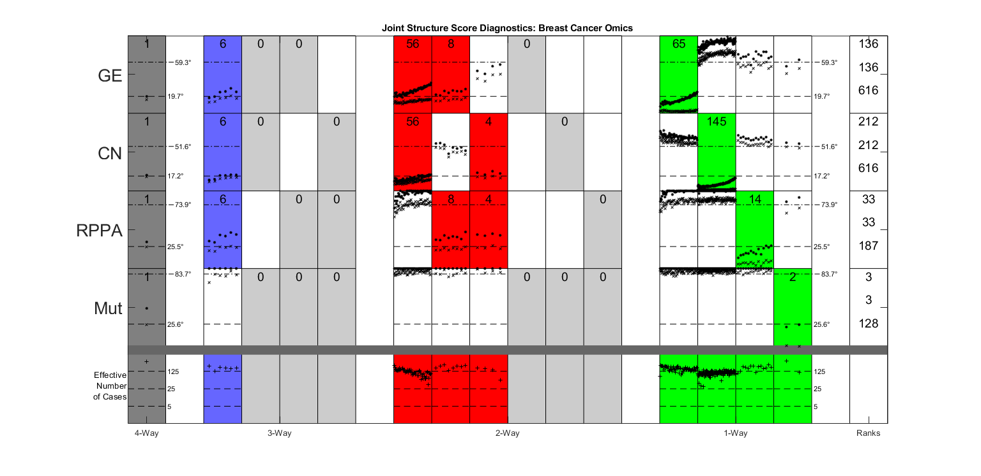

Last Class: TCGA Data
6 CN$→$GE$→$Protein Modes
Statistical Significance Summary
Single 4-way mode, as in AJIVE Analysis
Little Systematic
Mutation Variation

Slide 11


Last Class: TCGA Data
GE or CN$→$ Proteins
Statistical Significance Summary
Major CN$→$GE Variation
No Pairwise Mut Variation
Many Modes of
Individual Var’n

Slide 12
Last Class: Mortality Data
Data Blocks:
Swiss Males
Spanish Males
Swiss Females
Spanish Females
Expected Differences:
Record Keeping, War
Expected Commonalities:
Overall Improvement,
Pandemic, Automobiles
Explore Gender Issues

Slide 13
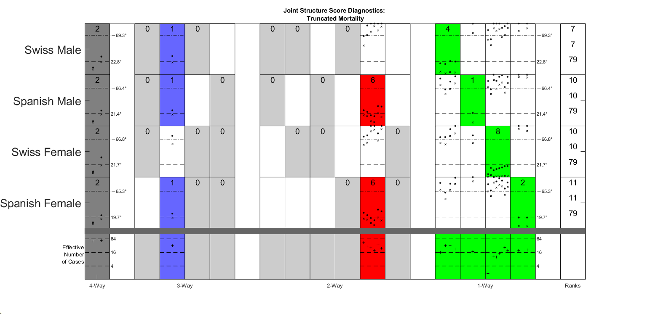
Last Class: Mortality Data
DIVAS Result:
6 Two-way Spanish
Male – Female Modes
2 Four-way Modes
1 Three-way Mode

Slide 14
Last Class: Distance Methods
Main Idea:
Approach to Data Lying in Complicated Space
(PCA Makes No Sense In Nonlinear Spaces)
However, Often Have Notion of “Distance”
I.e. Metric on Metric Space
So Base Analysis on Distances
Text: Chp. 7

Slide 15

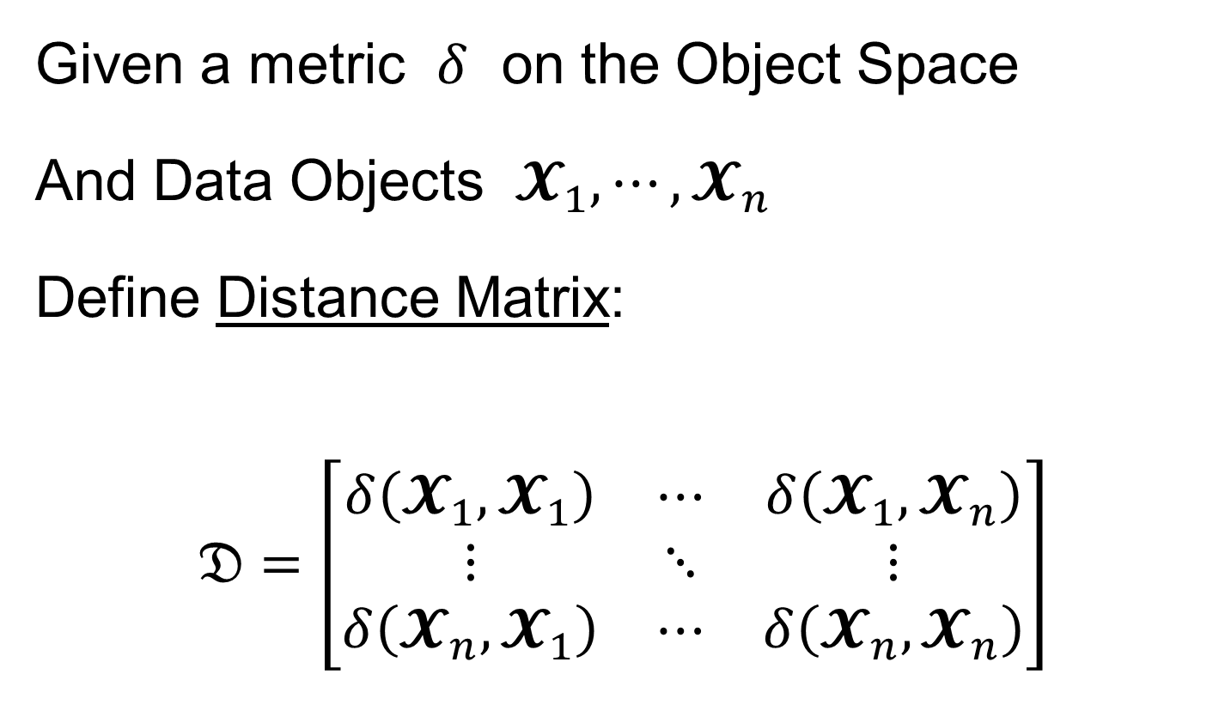
Last Class: Distance Methods
Given a metric $δ$ on the Object Space
And Data Objects $𝓧_{1},⋯,𝓧_{n}$
Define Distance Matrix:
$$𝔇=\left[\begin{matrix}δ\left(𝓧_{1},𝓧_{1}\right) & ⋯ & δ\left(𝓧_{1},𝓧_{n}\right) \\ ⋮ & ⋱ & ⋮ \\ δ\left(𝓧_{n},𝓧_{1}\right) & ⋯ & δ\left(𝓧_{n},𝓧_{n}\right)\end{matrix}\right]$$
Script $𝓧$ Denotes
Arbitrary Data Objects

Slide 16
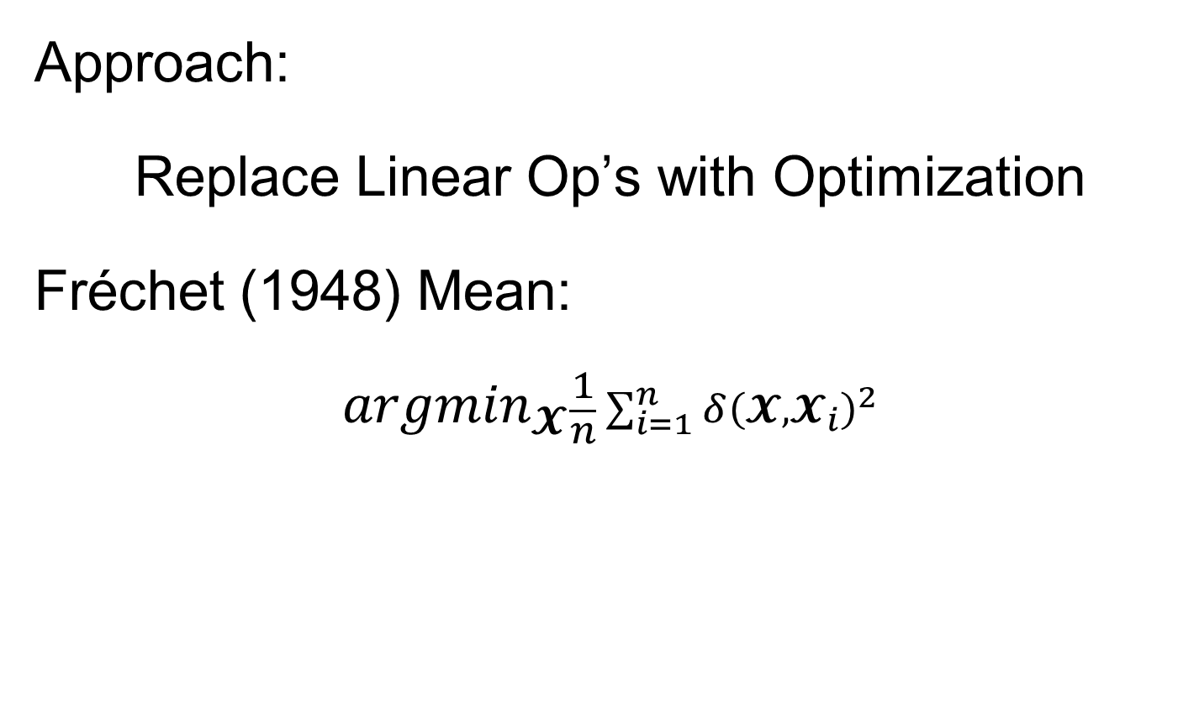
Last Class: Distance Methods
Approach:
Replace Linear Op’s with Optimization
Fréchet (1948) Mean:
$${argmin}_{𝓧}\frac{1}{n}\sum_{i=1}^{n}{{δ\left(𝓧,𝓧_{i}\right)}^{2}}$$
Start With Candidate Point
Move Around to Min
Sum of Squared Dist’s

Slide 17
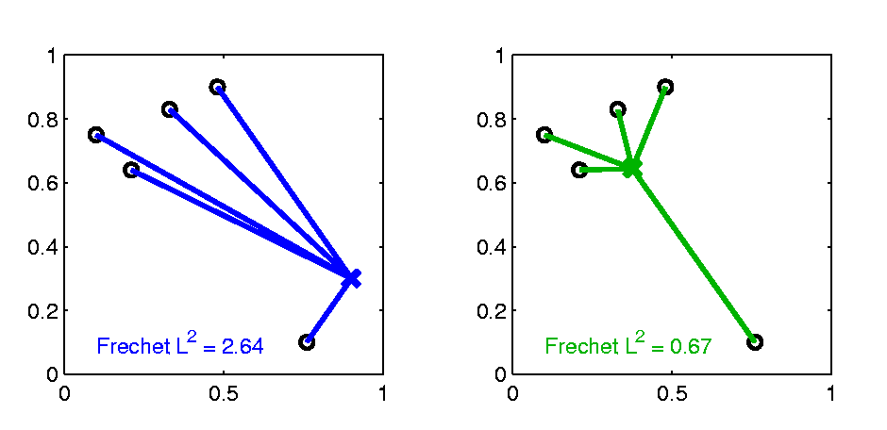

Last Class: Distance Methods
Fréchet Sample Mean, $ℝ^{2}$ Toy Example
(Use Metric $δ=δ_{2}$)
Min Looks Like
Sample Mean???
Note: Outlier Pulls Mean Out of
Convex Hull Of Other 4 Points
Recall “Center
Of Mass”
Interpretretation
Known Problem with Mean: Not Robust Against Outliers

Slide 18
Distance Methods
Fréchet Means & Medians Allow Many Variations
Usually Studied in “Robust Statistics”
Might Look Deeper Later On (Text Chapter 16)
“Every Dog Has His Day”

Slide 19
Distance Methods
Recall General Approach:
Replace Linear Op’s with Optimization
Distance Based Version of PCA?
Text Sec. 7.2

Slide 20
Distance Methods
Multi Dimensional Scaling (MDS)
Name & Psychometric References:
Torgersen (1952, 1958), Gower (1966)
Earlier Versions of Ideas:
Eckart & Young (1936), Young and Householder (1938)

Slide 21
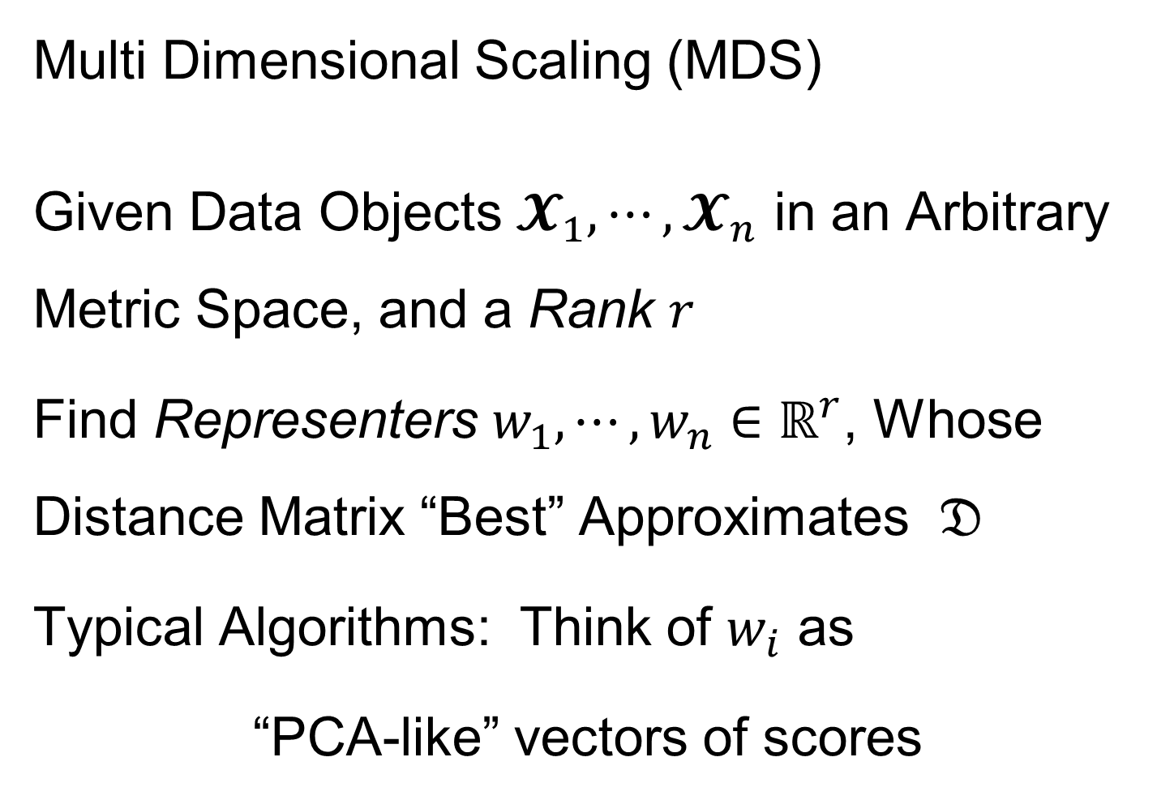
Distance Methods
Note: This
Representation
Is Called
“Auto-Encoder”
In AI literature
Multi Dimensional Scaling (MDS)
Given Data Objects $𝓧_{1},⋯,𝓧_{n}$ in an Arbitrary Metric Space, and a Rank $r$
Find Representers $w_{1},⋯,w_{n}∈ℝ^{r}$, Whose Distance Matrix “Best” Approximates $𝔇$
Typical Algorithms: Think of $w_{i}$ as
“PCA-like” vectors of scores

Slide 22
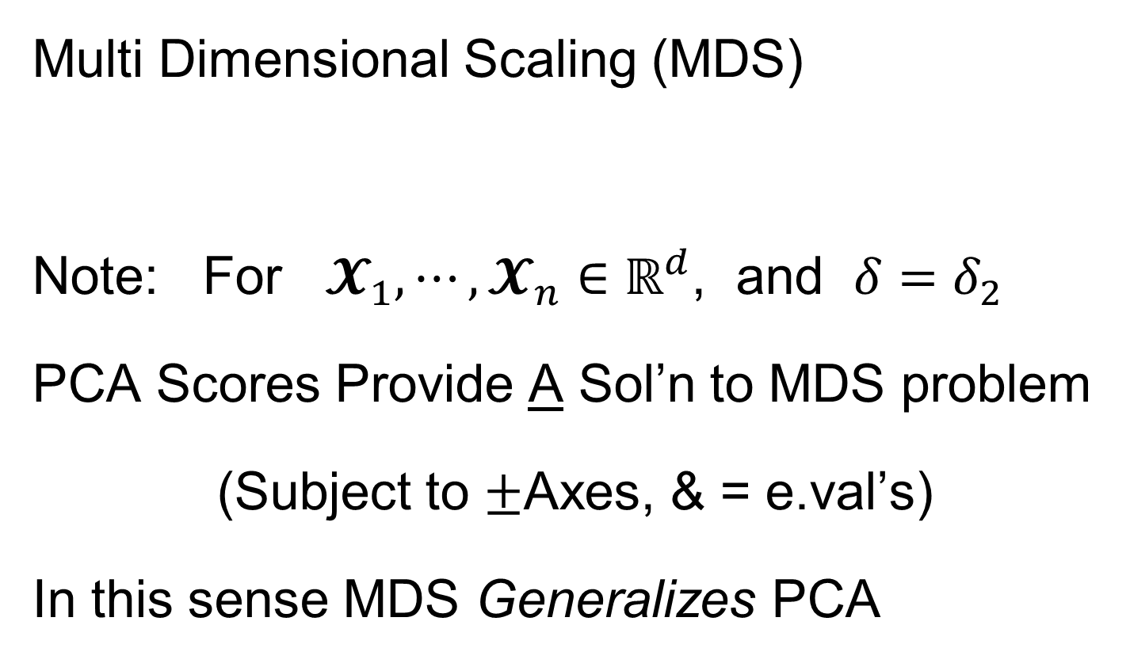
Distance Methods
Multi Dimensional Scaling (MDS)
Note: For $𝓧_{1},⋯,𝓧_{n}∈ℝ^{d}$, and $δ=δ_{2}$
PCA Scores Provide A Sol’n to MDS problem
(Subject to $±$Axes, & = e.val’s)
In this sense MDS Generalizes PCA

Slide 23
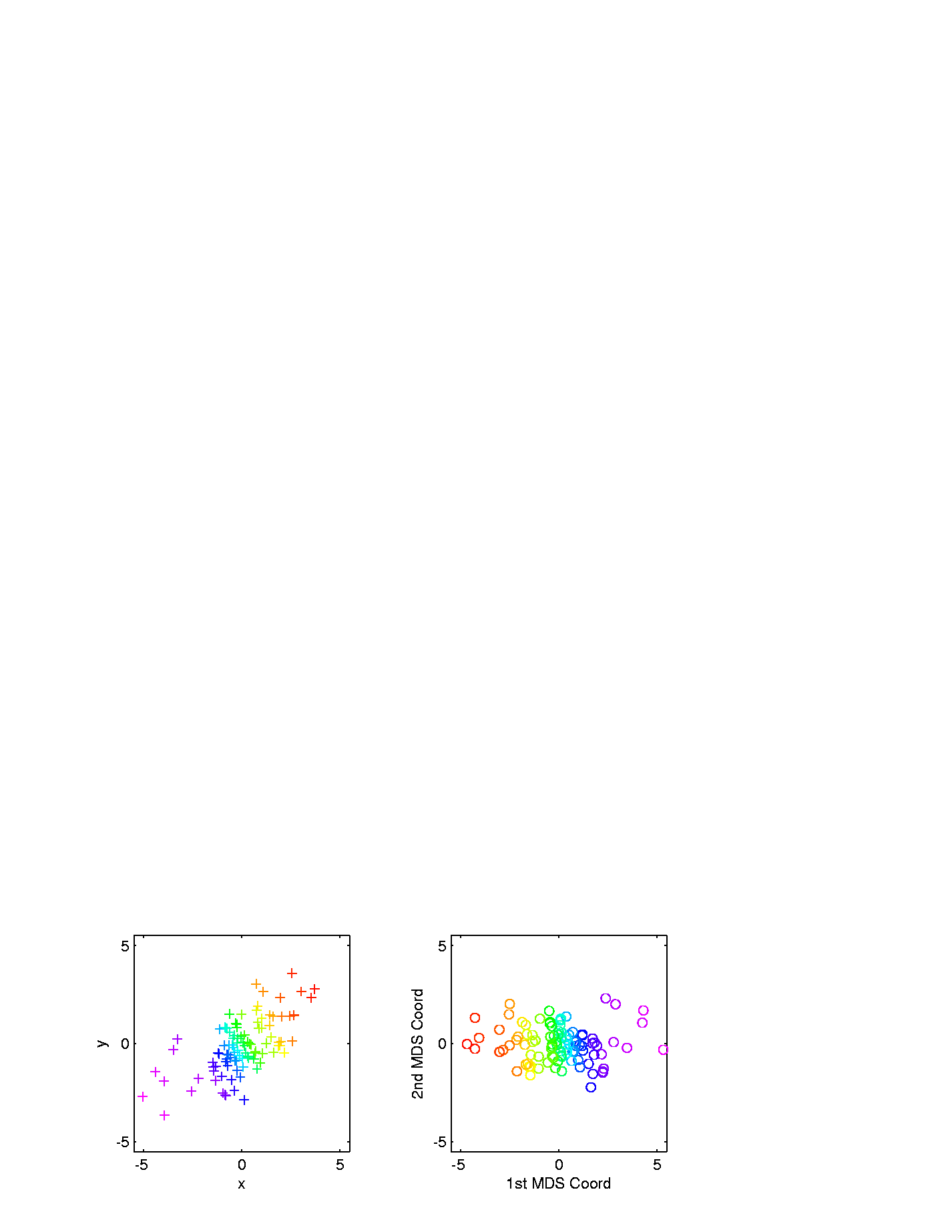
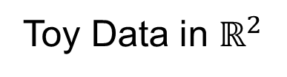
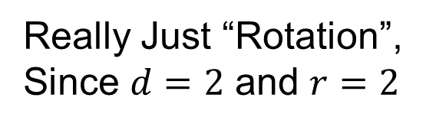
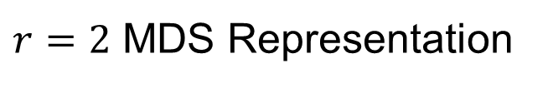
Distance Methods
Multi Dimensional Scaling (MDS)
Toy Data in $ℝ^{2}$
$r=2$ MDS Representation
Really Just “Rotation”,
Since $d=2$ and $r=2$
Track Corresponding
Points with Colors
Follows PC1 Axis (Flipped)

Slide 24
Distance Methods
Drawbacks of MDS relative to PCA
Only Gives Scores (Interpret Relationships)
But No Loadings (Explore Drivers)
Not Full Modes of Variation
Can Have Serious Distortions (Nonlin. Case)
Which Can be “Good” or “Bad”

Slide 25
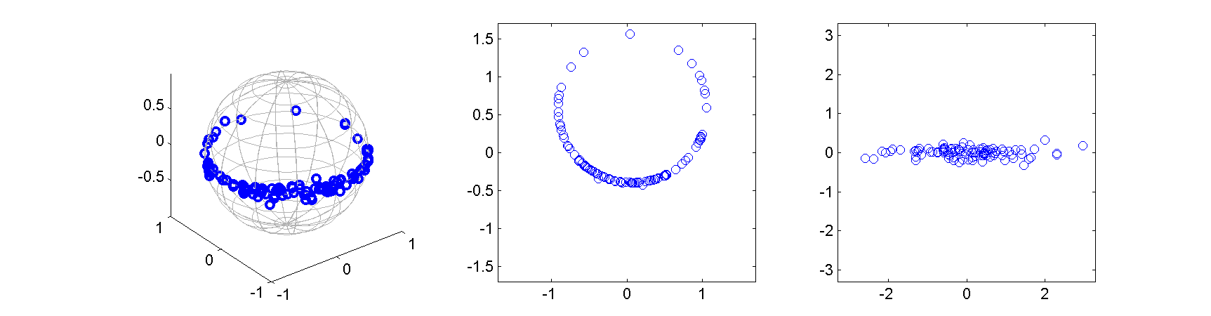
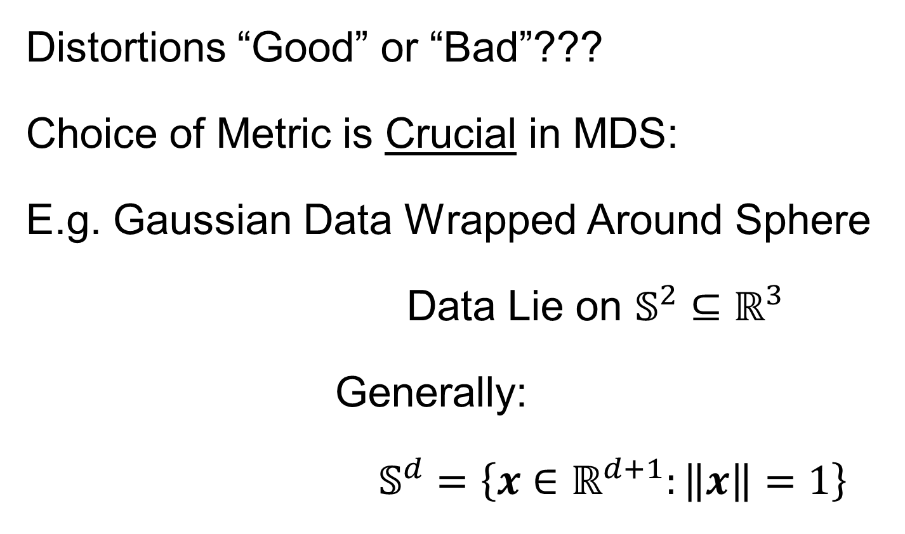
Distance Methods
Distortions “Good” or “Bad”???
Choice of Metric is Crucial in MDS:
E.g. Gaussian Data Wrapped Around Sphere
Data Lie on $𝕊^{2}⊆ℝ^{3}$
Generally:
$𝕊^{d}=\left\{x∈ℝ^{d+1}:\left\|x\right\|=1\right\}$
Called
“Embedding
Space”

Slide 26
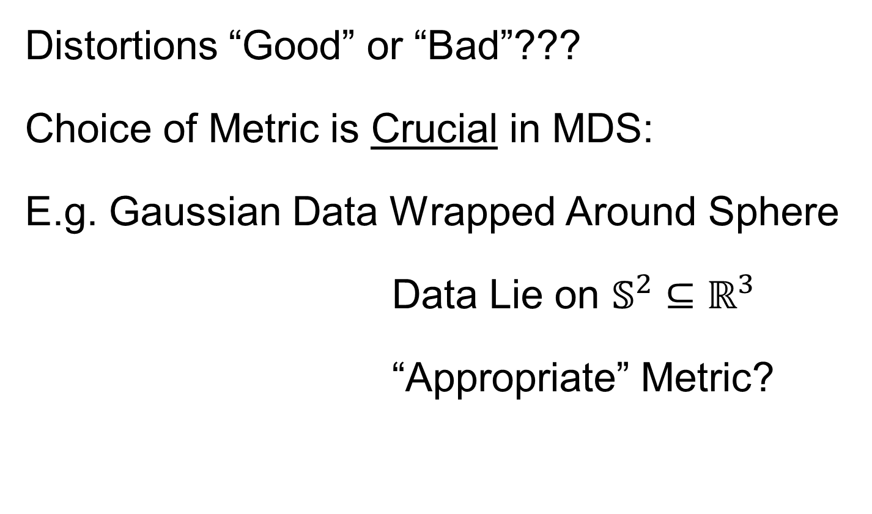
Distance Methods
Distortions “Good” or “Bad”???
Choice of Metric is Crucial in MDS:
E.g. Gaussian Data Wrapped Around Sphere
Data Lie on $𝕊^{2}⊆ℝ^{3}$
“Appropriate” Metric?
Fundamental Point:
One Major Mode of Variation

Slide 27

Distance Methods
E.g. Gaussian Data Wrapped Around Sphere
MDS, based on Euclidean ($ℝ^{3}$) Metric
Equivalent to PCA in $ℝ^{3}$
Bad News:
Needs 2 PCs (Modes of Variation) to
Model Data

Slide 28
Distance Methods
Think Airplane
Distances on Earth
E.g. Gaussian Data Wrapped Around Sphere
Better Distance Choice: “Geodesic Distance”
Measured Along Surface of Sphere
MDS Based on
Geodesic Distance
Major Variation
Described with 1 Mode

Slide 29

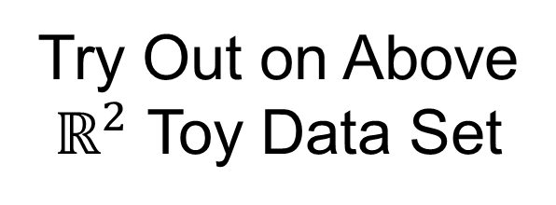
Distance Methods
Less Attractive Approach to $𝔇$ Based PCA:
Treat Columns of $𝔇$ as Data Objects
And Do Euclidean PCA on Those
Survey in Duin and Pekalska (2005)
Try Out on Above
$ℝ^{2}$ Toy Data Set

Slide 30
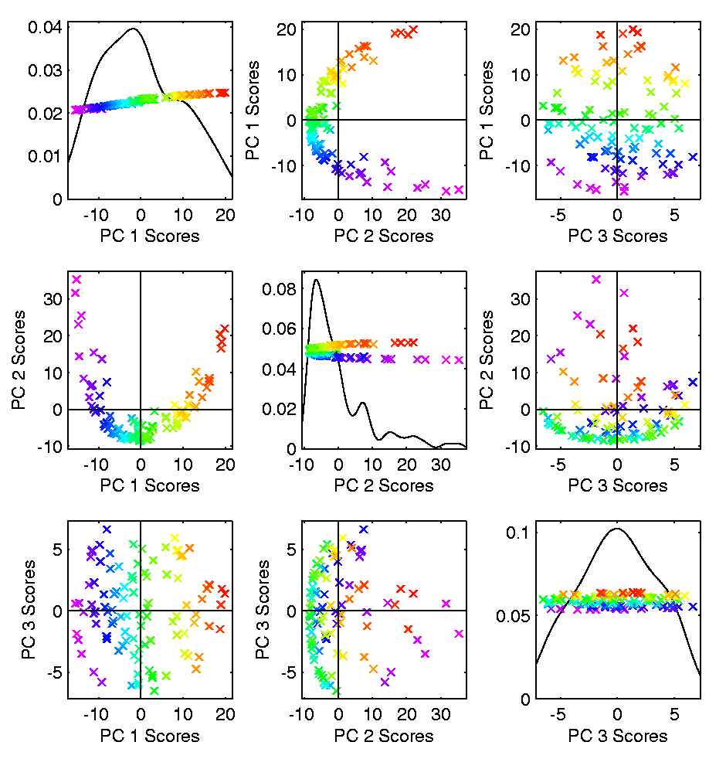

Distance Methods
Columns of $𝔇$ as Data Objects
1st PC Looks
Sensible
As Do 1st & 3rd
But 2nd Suffers From
Strong Distortion???
Again Single Mode
Requires 2 Comp’s

Slide 31
Distance Methods
Columns of $𝔇$ as Data Objects
Called
“Horseshoe Effect”
Serious Problem
in Microbiome
Literature:
“MDS” called “PCoA”
See Morton, et al. (2017)

Slide 32
Distance Methods
Columns of $𝔇$ as Data Objects
Called
“Horseshoe Effect”
Elegant Analysis:
Diaconis et al. (2008)
Main Idea Illustrated
In Text: Fig. 7.8

Slide 33
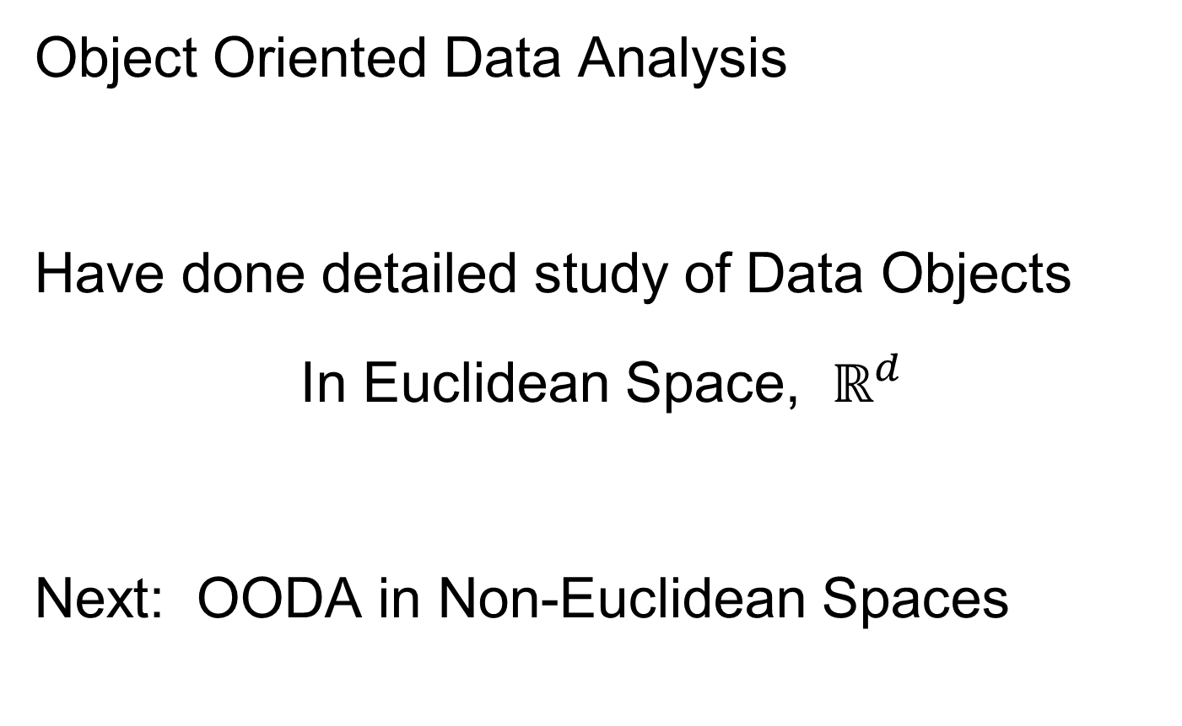
Big Picture
Object Oriented Data Analysis
Have done detailed study of Data Objects
In Euclidean Space, $ℝ^{d}$
Next: OODA in Non-Euclidean Spaces

Slide 34
OODA in Image Analysis
First Generation Problems:
Denoising
Segmentation
Registration
(all about single images,
still interesting challenges)

Slide 35
OODA in Image Analysis
Second Generation Problems:
Populations of Images
  Understanding Population Variation
  Discrimination (a.k.a. Classification)
Complex Data Structures (& Spaces)
HDLSS Statistics
Text,
Chp. 11
Will Study,
Text Sec. 14.2
High Dimension, Low Sample Size

Slide 36
OODA in Image Analysis
Common Goal in Image Analysis:
Focus on Shapes Within Images
I.e. Shapes Become the Data Objects
E.g. Organs Within a Medical Image

Slide 37
Shapes As Data Objects
Several Different Notions of Shape
Oldest and Best Known (in Statistics):
Landmark Based
Text, Sec. 1.2, 5.2

Slide 38
Shape Representations
Major Approaches for Shape Data Objects:
Landmark Representations
Boundary Representations
Skeletal Representations

Slide 39
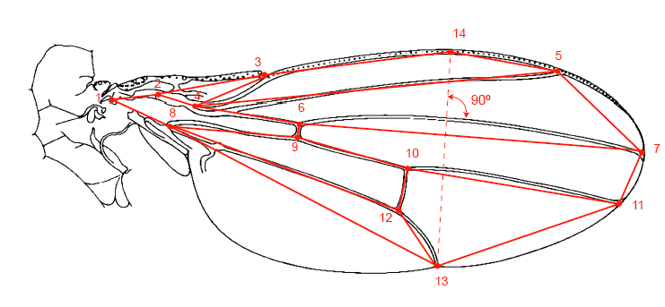
Landmark Representations
Landmarks for Fly Wing Data:
Thanks to George Gilchrist

Slide 40
Landmark Representations
Major Drawback of Landmarks:
Need to always find each landmark
Need same relationship
I.e. Landmarks need to correspond
Often fails for medical images
E.g. How many corresponding landmarks on a set of kidneys, livers or brains???
Much More on Math’s of Landmark
Shape Analysis in Text, Sec. 8.4

Slide 41
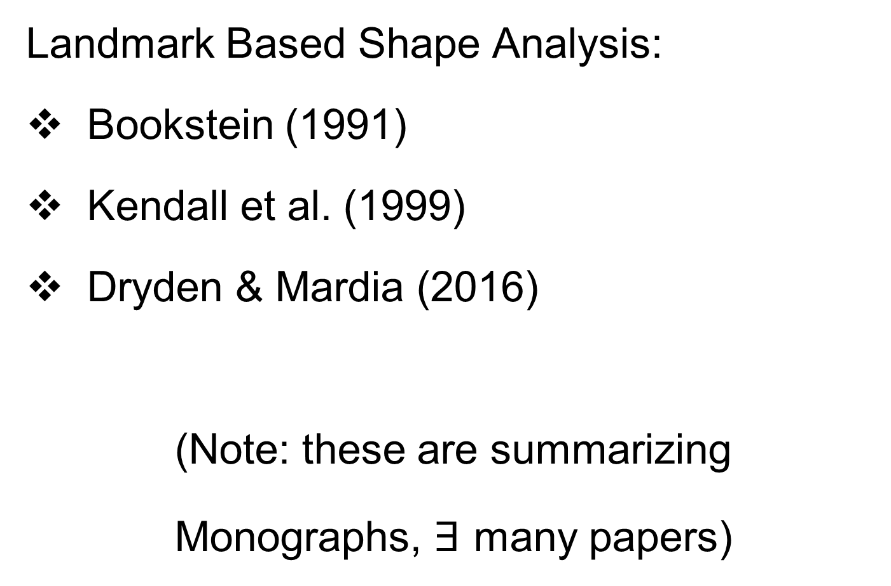
Shapes As Data Objects
Landmark Based Shape Analysis:
Bookstein (1991)
Kendall et al. (1999)
Dryden & Mardia (2016)
(Note: these are summarizing
Monographs, $∃$ many papers)
Recommended
For Accessibility

Slide 42
Landmark Based Shape Analysis
Start by Representing Shapes
Data Object

Slide 43





Landmark Based Shape Analysis
Start by Representing Shapes by
Landmarks (points in $ℝ^{2}$ or $ℝ^{3}$)
$$\left(x_{1},y_{1}\right)$$
$$\left[\begin{matrix}\begin{matrix}x_{1} \\ y_{1}\end{matrix} \\ \begin{matrix}x_{2} \\ y_{2}\end{matrix} \\ \begin{matrix}x_{3} \\ y_{3}\end{matrix}\end{matrix}\right]∈ℝ^{6}$$
$$\left(x_{2},y_{2}\right)$$
$$\left(x_{3},y_{3}\right)$$
Data Object Vector

Slide 44
Landmark Based Shape Analysis
Clearly different shapes:

Slide 45
Landmark Based Shape Analysis
Clearly different shapes:
But what about: ?

Slide 46
Landmark Based Shape Analysis
Clearly different shapes:
But what about: ?
(just translation and rotation of ,
but different points in R⁶)

Slide 47
Landmark Based Shape Analysis
Note: Shape should be same over different:
Translations

Slide 48
Landmark Based Shape Analysis
Note: Shape should be same over different:
Translations
Rotations

Slide 49
Landmark Based Shape Analysis
Note: Shape should be same over different:
Translations
Rotations
Scalings (maybe)

Slide 50
Landmark Based Shape Analysis
Approach: Identify objects that are:
Translations
Rotations
Scalings (maybe)
of each other

Slide 51
Landmark Based Shape Analysis
Approach: Identify objects that are:
Translations
Rotations
Scalings (maybe)
of each other
Mathematics: Equivalence Relation

Slide 52
Equivalence Relations
Useful Mathematical Device
Weaker generalization of “=” for a set
Main consequence:
  Partitions Set Into Equivalence Classes
  For “=”, Equivalence Classes Are Singletons
Sets of Objects That are
“Identified” (i.e. are Equivalent)

Slide 53


Equivalence Relations
Common Example: Modulo Arithmetic
(E.g. Clock Arithmetic, mod 12)
3 hours after 11:00 is 2:00 …
Hours are equivalence classes:
{1} = {1:00, 13:00, …}
{2} = {2:00, 14:00, …}
$$⋮$$
Start at 1:00, and
add multiples of 12

Slide 54


Equivalence Relations
Common Example: Modulo Arithmetic
General Formulation
For $a, b, c ∈ ℤ$, Say $a≡b (mod c)$
When $\left(b −a\right)$ is divisible by $c$
Clock e.g. $14−2=12$, so $14≡2 (mod 12)$
i.e. 14:00 is “identified with” 2:00
Go From $a$ to $b$, by a multiple of $c$

Slide 55

Equivalence Relations
For $a, b, c ∈ ℤ$, Say $a≡b (mod c)$
When $\left(b −a\right)$ is divisible by $c$
E.g. Binary Arithmetic, mod $2$ (i.e. $c=2$)
Equivalence classes:
$\left\{0\right\}=\left\{⋯,−2,0,2,4,⋯\right\}$
$$\left\{1\right\}=\left\{⋯,−1,1,3,5,⋯\right\}$$
(just evens and odds)
Start at 0, and add
multiples of 2

Slide 56


Equivalence Relations
Another Example: Vector Subspaces of $ℝ^{2}$
E.g. Say $\left(\begin{matrix}x_{1} \\ y_{1}\end{matrix}\right)≈\left(\begin{matrix}x_{2} \\ y_{2}\end{matrix}\right)$ when $y_{1}=y_{2}$
Equiv. Classes are indexed by $y∈ℝ^{1},$
And are: $\left\{y\right\}=\left\{\left(\begin{matrix}x \\ y\end{matrix}\right)∈ℝ^{2}:x∈ℝ^{1}\right\}$
i.e. Horizontal lines (same $y$ coordinate)
Equivalent points have
the same $y$ coordinate
The common value

Slide 57
Equivalence Relations
Deeper Example: Transformation Groups
Set of Transformations
(e.g. Translations, Rotations, …)
Group Operation = Composition

Slide 58

Equivalence Relations
Deeper Example: Transformation Groups
For $g∈G$, operating on a set $S$
Say $s_{1}≈s_{2}$ when $∃$ $g$ where $g\left(s_{1}\right)=s_{2}$
Equivalence Classes:
$$\left\{s_{i}\right\}=\left\{s_{j}∈S:s_{j}=g\left(s_{i}\right), for some g∈G\right\}$$
Terminology: Also called orbits

Slide 59



Equivalence Relations
Deeper Example: Transformation Groups
Above Examples Are Special Cases
Modulo Arithmetic
$$G= \left\{g:ℤ→ℤ :g\left(z\right)=z+kc, for k∈ℤ\right\}$$
(Orbits are $\left\{0\right\},\left\{1\right\},⋯,\left\{c−1\right\}$)
Add Multiples of $c$
Note the orbit $\left\{c\right\}$ is just $\left\{0\right\}$

Slide 60


Equivalence Relations
Deeper Example: Transformation Groups
Above Examples Are Special Cases
Modulo Arithmetic
Vector Subspace of $ℝ^{2}$
$$G=\left\{g:ℝ^{2}{→ℝ}^{2} :g\left(\begin{matrix}x \\ y\end{matrix}\right)=\left(\begin{matrix}x′ \\ y\end{matrix}\right), x′∈ℝ\right\}$$
(Orbits are horizontal lines, shifts of $ℝ$)
Slides Points
Horizontally
Indexed by $y$

Slide 61



Equivalence Relations
Deeper Example: Transformation Groups
Above Examples Are Special Cases
Modulo Arithmetic
Vector Subspace of $ℝ^{2}$
General Vector Subspace $V$
$G$ maps $V$ into $V$ and preserves $V^{⊥}$
(Orbits are Shifts of $V$, indexed by $V^{⊥}$)
$x$-axis in above
$ℝ^{2}$ example
$y$-axis in above
$ℝ^{2}$ example

Slide 62

Equivalence Relations
Deeper Example: Transformation Groups
Above Examples Are Special Cases
Modulo Arithmetic
Vector Subspace of $ℝ^{2}$
General Vector Subspace $V$
Shape: $G=$ Group of “Similarities”
(translations, rotations, scalings)

Slide 63


Equivalence Relations
Deeper Example: Transformation Groups
Mathematical Terminology:
Quotient Operation
Set of Equiv. Classes = Quotient Space
Denoted $S/G$
(“Shape Space” will be of this form)
For Operation of Representing
Equivalence Classes Induced by $G$

Slide 64

Equivalence Relations
Quotient Spaces in Examples:
Modulo Arithmetic
  $S=ℤ$,
  $G= \left\{g:ℤ→ℤ :g\left(z\right)=z+kc, for k∈ℤ\right\}$
  $S/G$ is $1,⋯,c$, modulo $c$

Slide 65



Equivalence Relations
Quotient Spaces in Examples:
Modulo Arithmetic
Vector Subspace of $ℝ^{2}$
  $S=ℝ^{2}$,
  $G=\left\{g:ℝ^{2}{→ℝ}^{2} :g\left(\begin{matrix}x \\ y\end{matrix}\right)=\left(\begin{matrix}x′ \\ y\end{matrix}\right), x′∈ℝ\right\}≅ℝ^{1}$
  $S/G$ is $ℝ^{1}$
Think Horizontal Axis in $ℝ^{2}$
Think Vertical Axis in $ℝ^{2}$

Slide 66

Equivalence Relations
Quotient Spaces in Examples:
Modulo Arithmetic
Vector Subspace of $ℝ^{2}$
General Vector Subspace $V$
  $S=ℝ^{d}$,
  $G=\left\{g:V→V :V^{⊥} is preserved\right\}≅ℝ^{1}$
  $S/G$ is $V^{⊥}$

Slide 67

Equivalence Relations
Quotient Spaces in Examples:
Modulo Arithmetic
Vector Subspace of $ℝ^{2}$
General Vector Subspace $V$
Shape: $G=$ Group of “Similarities”
  $S=ℝ^{d}$,
  $G= \left\{Translations, Rotations, scalings\right\}$
  $S/G$ is “Shapes”

Slide 68
Landmark Based Shape Analysis
Approach: Identify objects that are:
Translations
Rotations
Scalings
of each other
Group of Transformations

Slide 69
Landmark Based Shape Analysis
Approach: Identify objects that are:
Translations
Rotations
Scalings
of each other
Mathematics: Equivalence Relation
Results in: Equivalence Classes (i.e. Orbits)
Which become the Data Objects

Slide 70
Landmark Based Shape Analysis
Equivalence Classes become Data Objects
Mathematics: Called “Quotient Space”
Intuitive Representation: Manifold
(curved surface)

Slide 71
Landmark Based Shape Analysis
Triangle Shape Space: Represent as Sphere

Slide 72

Landmark Based Shape Analysis
Triangle Shape Space: Represent as Sphere
$ℝ^{6}$ → $ℝ^{4}$
Translation

Slide 73

Landmark Based Shape Analysis
Triangle Shape Space: Represent as Sphere
$ℝ^{6}$ → $ℝ^{4}$ → $ℝ^{3}$
rotation

Slide 74



Landmark Based Shape Analysis
Triangle Shape Space: Represent as Sphere
$ℝ^{6}$ → $ℝ^{4}$ → $ℝ^{3}$ →
scaling
(thanks to Wikipedia)
$$𝕊^{2}$$

Slide 75
Landmark Based Shape Analysis
Triangle Shape Space: Represent as Sphere
Equilateral
Triangles
Hemispheres
Are
Reflections
Co-Linear
Point Triples
Deeper Discussion in
Sec. 4.3.4, of Dryden
and Mardia (2016)

Slide 76
Quotient Space Folklore
Many Quotient Operations Result in Space that is a Curved Manifold
Rigorous Theory Available Through
Induced Metric

Slide 77
Variation on Landmark Based Shape
Typical Viewpoint:
Variation in Shape is Goal
Other Variation+ is Nuisance
Recall Main Idea:
Represent Shapes as Coordinates
“Mod Out” Transl’n, Rotat’n, Scale
Shapes (Equiv. Classes) as Data Objects

Slide 78
Variation on Landmark Based Shape
Typical Viewpoint:
Variation in Shape is Goal
Other Variation+ is Nuisance
Interesting Alternative:
Study Variation in Transformation
Treat Shape as Nuisance
To be
Modded
Out!

Slide 79
Variation on Landmark Based Shape
Context: Study of Tectonic Plates
Movement of Earth’s Crust (over time)
Take Motions as Data Objects
Interesting Alternative:
Study Variation in Transformation
Treat Shape as Nuisance

Slide 80

Variation on Landmark Based Shape
Context: Study of Tectonic Plates
Movement of Earth’s Crust (over time)
Take Motions as Data Objects
Chang (1988)
Royer & Chang (1991)
Thanks to Wikipedia

Slide 81
Shape Representations
Major Approaches for Shape Data Objects:
Landmark Representations
Boundary Representations
Skeletal Representations

Slide 82
Boundary Representations
Traditional Major Sets of Ideas:
Triangular Meshes
  Survey: Owen (1998)
Active Shape Models
  Cootes, et al (1993)
Fourier Boundary Representations
  Keleman, et al (1997 & 1999)

Slide 83

Boundary Representations
Example of triangular mesh rep’n:
From:www.geometry.caltech.edu/pubs.html

Slide 84
Boundary Representations
Main Drawback:
Correspondence
For OODA (on vectors of parameters):
Need to “match up points”
Easy to find triangular mesh
  Lots of research on this driven by gamers
Challenge to match mesh across objects
  There are some interesting ideas…
Notes:
84

Slide 85
Boundary Representations
Correspondence for Mesh Objects:
Active Shape Models (PCA – like)
Cootes, et al (1993)
Automatic Landmark Choice
Cates, et al (2007)
Based on Optimization Problem:
Good Correspondence & Separation
(Formulate via Entropy)
Used in Analysis of
Childhood Development
Data In Earlier Class
Notes:
85

Slide 86
Shape Representations
Major Approaches for Shape Data Objects:
Landmark Representations
Boundary Representations
Skeletal Representations

Slide 87
Participant Presentation
HyungGyu Min:
Finding Gene Program
Using Consensus NMF

