Slide 1
Statistics – O. R. 881 Object Oriented Data Analysis
Steve Marron
Dept. of Statistics and Operations Research
University of North Carolina

Slide 2
Current Sections in Textbook
Today:
Sections 17.2, 7.1, 7.2, 1.2
Next Class:
Sections 5.2, 8.4, 8.1, 8.2, 8.3

Slide 3
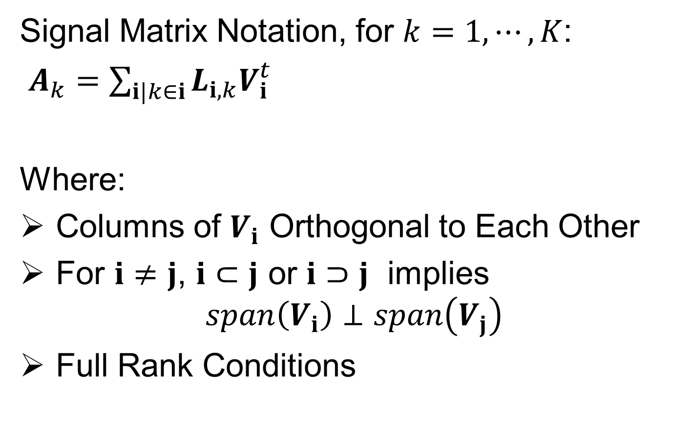

Last Class: DIVAS Data Model
Signal Matrix Notation, for $k=1,⋯,K$:
$A_{k}=\sum_{i|k∈i}{L_{i,k}V_{i}^{t}}$
Where:
Columns of $V_{i}$ Orthogonal to Each Other
For $i≠j$, $i⊂j$ or $i⊃j$ implies
$$span\left(V_{i}\right)⊥span\left(V_{j}\right)$$
Full Rank Conditions
These Products, i.e. Low Rank
Approximations, Are Called $𝔜_{i,k}$
Loadings
Scores
Indexed Only by 𝐢

Slide 4
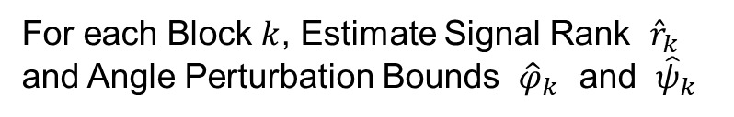

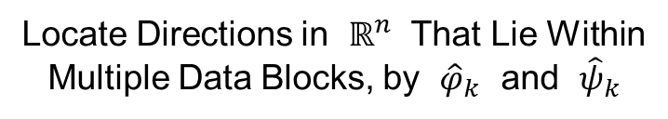
Last Class: DIVAS Algorithm
Three Major Steps:
Signal Subspace Extraction
Joint Subspace Estimation
Signal Reconstruction
Something Like
Initial SVD in AJIVE,
But More Automatic
For each Block $k$, Estimate Signal Rank ${\hat{r}}_{k}$
and Angle Perturbation Bounds ${\hat{φ}}_{k}$ and ${\hat{ψ}}_{k}$
Locate Directions in $ℝ^{n}$ That Lie Within
Multiple Data Blocks, by ${\hat{φ}}_{k}$ and ${\hat{ψ}}_{k}$
In Spirit of Loadings
Projection in AJIVE
Reconstruct Partially Shared Joint
Components of $X_{k}$, Especially Loadings

Slide 5
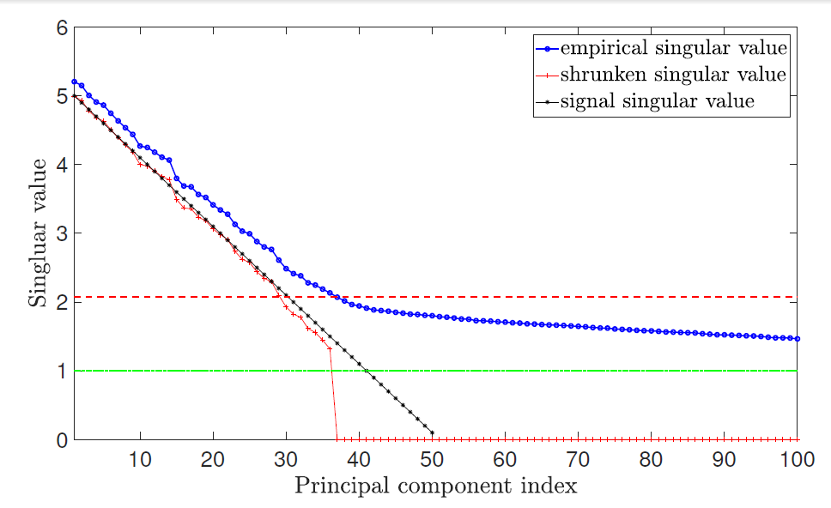



Last Class: 1. Signal Subs. Ext.
Improved (over AJIVE) Initial Rank Choice
Bigger since
= Signal + Noise
Similar to Scree Plot
(square root scale)
Underlying
Low Rank
Signal, $A_{b}$
Signal plus Gaussian
Noise, $d=1000$
$N\left(0,1\right)$ Noise
Impossible
To Recover

Slide 6
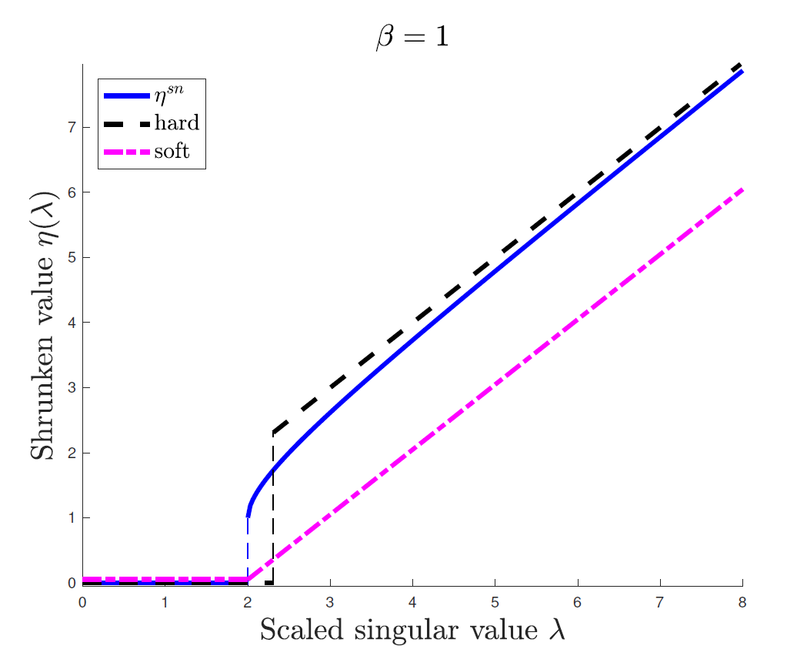
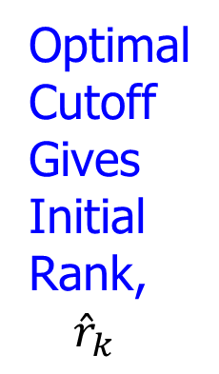
Last Class: 1. Signal Subs. Ext.
Shabalin Nobel Shrinkage (For Denoising)
Optimized
For
Marcenko
Pasteur
Optimal
Cutoff
Gives
Initial
Rank,
${\hat{r}}_{k}$
Vs. Trial & Error
And Crude
Bounds in AJIVE

Slide 7
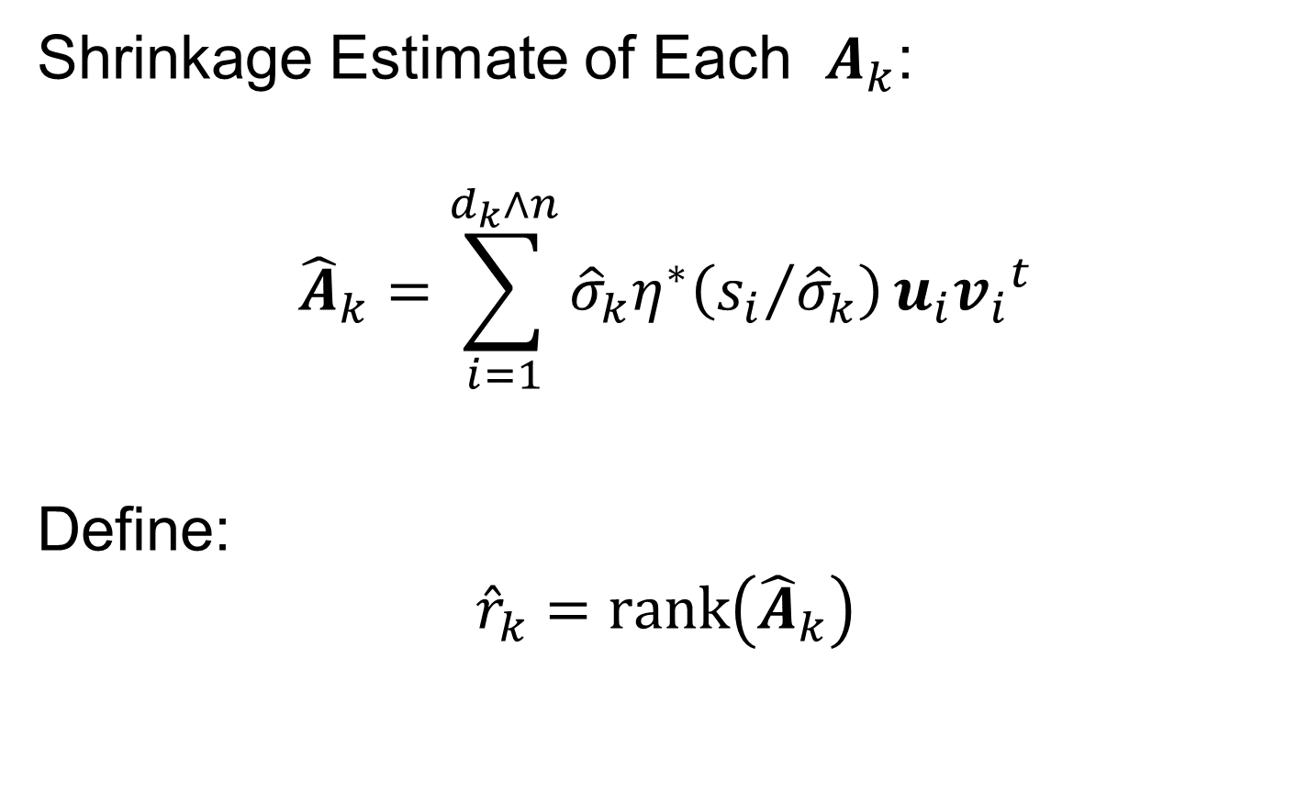
Last Class: 1. Signal Subs. Ext.
Shrinkage Estimate of Each $A_{k}$:
$${\hat{A}}_{k}=\sum_{i=1}^{d_{k}∧n}{{\hat{σ}}_{k}η^{∗}\left({s_{i}}/{{\hat{σ}}_{k}}\right)}u_{i}{v_{i}}^{t}$$
Define:
$${\hat{r}}_{k}=rank\left({\hat{A}}_{k}\right)$$
Put On Unit Scale For Shrinkage
Return to Original Scale
(Rank of Low Rank Approximation,
After 0-ing Out Small Values)

Slide 8
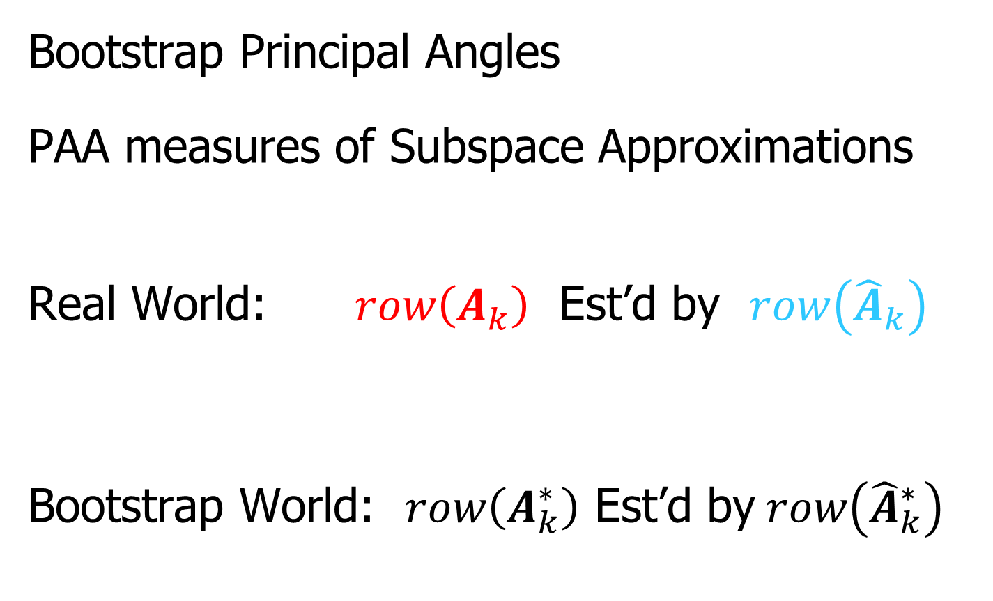
Last Class: 1. Signal Subs. Ext.
Bootstrap Principal Angles
PAA measures of Subspace Approximations
Real World: $row\left(A_{k}\right)$ Est’d by $row\left({\hat{A}}_{k}\right)$
Bootstrap World: $row\left(A_{k}^{∗}\right)$ Est’d by$row\left({\hat{A}}_{k}^{∗}\right)$
“Relative Isotropy” Makes This Work
≈

Slide 9






Last Class: 1. Signal Subs. Ext.
Find Bounds on Angles $θ_{k}$ and ${\hat{θ}}_{k}$:
Next Find Upper Bound on $θ_{k}$
Define $θ_{2}^{∗}=∡\left({\hat{v}}_{proj}^{∗}, row(A_{k})\right)$
Triangle Ineq.: $θ_{k}≤{\hat{θ}}_{k}+θ_{2}^{∗}$
Lower & Upper Bounds on $θ_{k}$
$${\left({\hat{θ}}_{k}−θ_{1}^{∗}\right)}_{+}≤ θ_{k}≤{\hat{θ}}_{k}+θ_{2}^{∗}$$

Slide 10
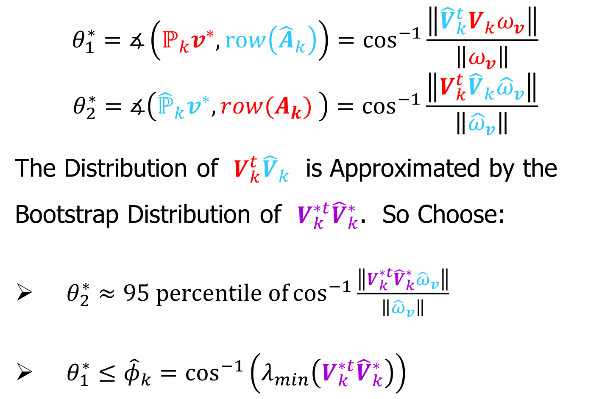

Last Class: 1. Signal Subs. Ext.
$$θ_{1}^{∗}=∡\left(ℙ_{k}v^{∗},row\left({\hat{A}}_{k}\right)\right)=\cos^{−1}{\frac{\left\|{\hat{V}}_{k}^{t}V_{k}ω_{v}\right\|}{\left\|ω_{v}\right\|}}$$
$$θ_{2}^{∗}=∡\left({\hat{ℙ}}_{k}v^{∗},row(A_{k}) \right)=\cos^{−1}{\frac{\left\|V_{k}^{t}{\hat{V}}_{k}{\hat{ω}}_{v}\right\|}{\left\|{\hat{ω}}_{v}\right\|}}$$
The Distribution of $V_{k}^{t}{\hat{V}}_{k}$ is Approximated by the Bootstrap Distribution of $V_{k}^{∗t}{\hat{V}}_{k}^{∗}$. So Choose:
$θ_{2}^{∗}≈95 percentile of\cos^{−1}{\frac{\left\|V_{k}^{∗t}{\hat{V}}_{k}^{∗}{\hat{ω}}_{v}\right\|}{\left\|{\hat{ω}}_{v}\right\|}}$
$θ_{1}^{∗}≤{\hat{φ}}_{k}=\cos^{−1}\left(λ_{min}\left(V_{k}^{∗t}{\hat{V}}_{k}^{∗}\right)\right)$
Drawn from B (often 1000)
Bootstrap Replications
Smallest Singular Value,
Since${ ω}_{v}$ Is Not Observable

Slide 11
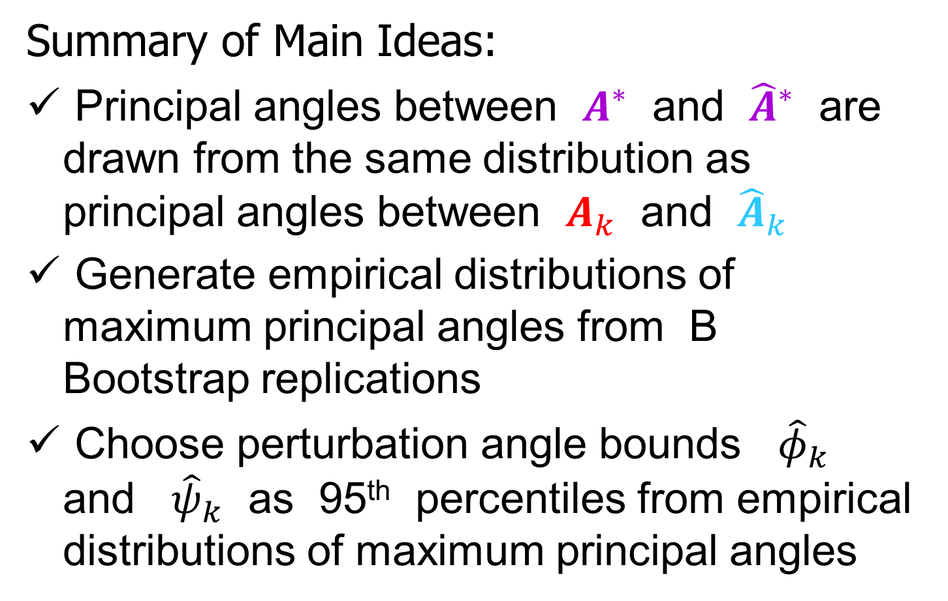
Last Class: 1. Signal Subs. Ext.
Summary of Main Ideas:
Principal angles between $A^{∗}$ and ${\hat{A}}^{∗}$ are drawn from the same distribution as principal angles between $A_{k}$ and ${\hat{A}}_{k}$
Generate empirical distributions of maximum principal angles from B Bootstrap replications
Choose perturbation angle bounds ${\hat{φ}}_{k}$ and ${\hat{ψ}}_{k}$ as 95th percentiles from empirical distributions of maximum principal angles

Slide 12
1. Signal Subspace Extraction
Angle Perturbation:
Two Major Parts:
Bootstrap Measure of Uncertainty
Random Direction Bound

Slide 13
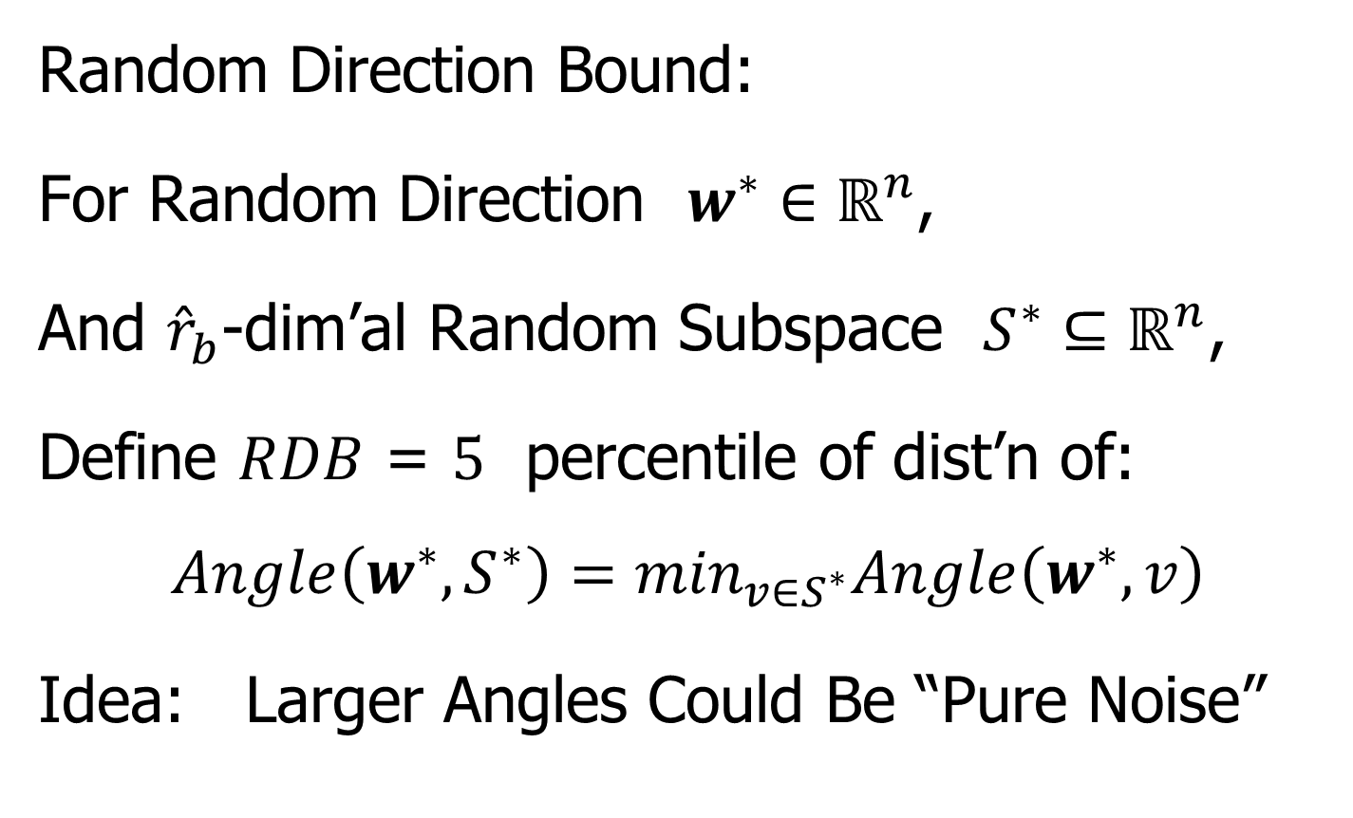

1. Signal Subspace Extraction
Random Direction Bound:
For Random Direction $w^{∗}∈ℝ^{n}$,
And ${\hat{r}}_{b}$-dim’al Random Subspace $S^{∗}⊆ℝ^{n}$,
Define $RDB$ = $5$ percentile of dist’n of:
$$Angle\left(w^{∗},S^{∗}\right)=\min_{v∈S^{∗}}Angle\left(w^{∗},v\right)$$
Idea: Larger Angles Could Be “Pure Noise”
Surprisingly Big For
Low Dimensional $S^{∗}$

Slide 14
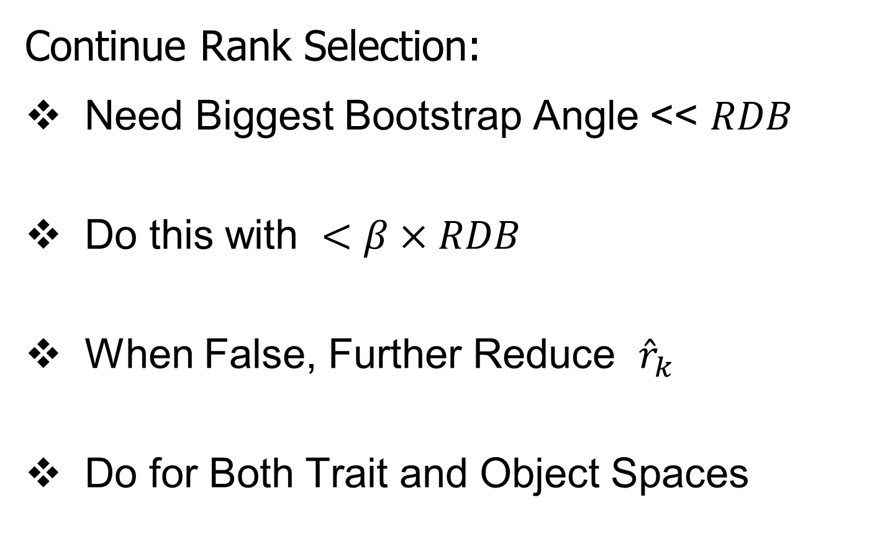
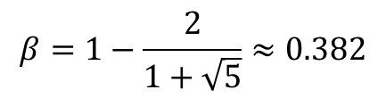

1. Signal Subspace Extraction
Continue Rank Selection:
Need Biggest Bootstrap Angle << $RDB$
Do this with $<β×RDB$
When False, Further Reduce ${\hat{r}}_{k}$
Do for Both Trait and Object Spaces
Gap Between “Signal” & “Noise”
$$β=1−\frac{2}{1+\sqrt{5}}≈0.382$$
$$β∈(0,0.5]$$
Default: Golden Ratio Based
Called FilterPerc in Matlab code

Slide 15
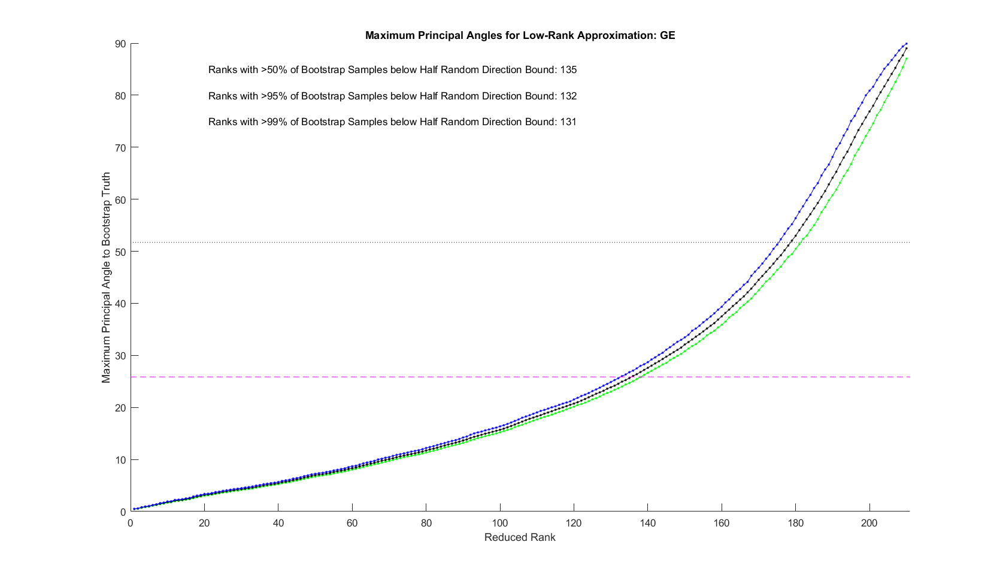
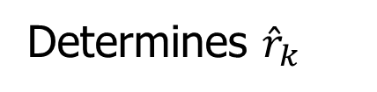
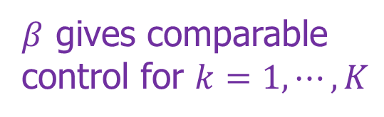
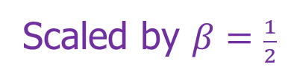
1. Signal Subspace Extraction
Initial Rank Selection (Bootstrap Inference):
Random Direction Bound
Scaled by $β=\frac{1}{2}$
$β$ gives comparable
control for $k=1,⋯,K$
Determines ${\hat{r}}_{k}$

Slide 16
DIVAS Algorithm
Three Major Steps:
Signal Subspace Extraction
Joint Subspace Estimation
Signal Reconstruction

Slide 17
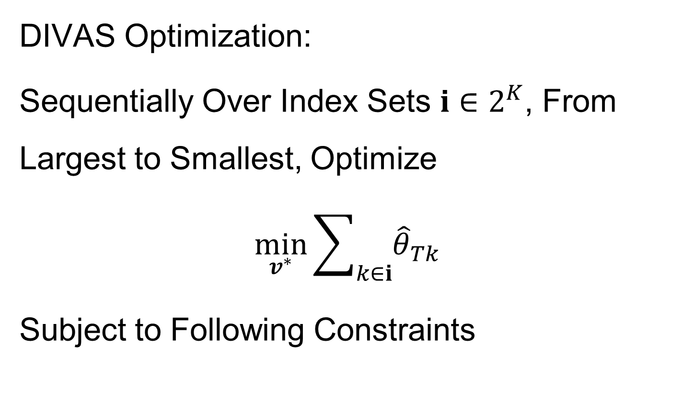

2. Joint Subspace Estimation
DIVAS Optimization:
Sequentially Over Index Sets $i∈2^{K}$, From Largest to Smallest, Optimize
$$\min_{v^{∗}}{\sum_{k∈i}{{\hat{θ}}_{Tk}}}$$
Subject to Following Constraints
Trait Space Angle, ${\hat{θ}}_{Tk}=∡\left(v^{∗},{\hat{V}}_{k}\right)$

Slide 18
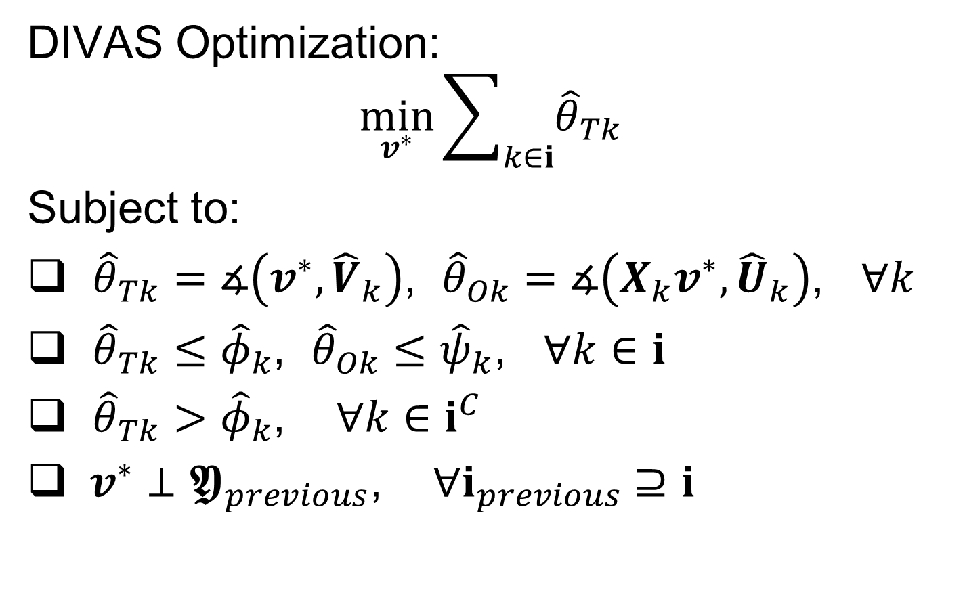
2. Joint Subspace Estimation
DIVAS Optimization:
$$\min_{v^{∗}}{\sum_{k∈i}{{\hat{θ}}_{Tk}}}$$
Subject to:
${\hat{θ}}_{Tk}=∡\left(v^{∗},{\hat{V}}_{k}\right)$, ${\hat{θ}}_{Ok}=∡\left(X_{k}v^{∗},{\hat{U}}_{k}\right)$, $∀k$
${\hat{θ}}_{Tk}≤{\hat{φ}}_{k}$, ${\hat{θ}}_{Ok}≤{\hat{ψ}}_{k}$, $∀k∈i$
${\hat{θ}}_{Tk}>{\hat{φ}}_{k}$, $∀k∈i^{C}$
$v^{∗}⊥𝖄_{previous}$, $∀i_{previous}⊇i$

Slide 19
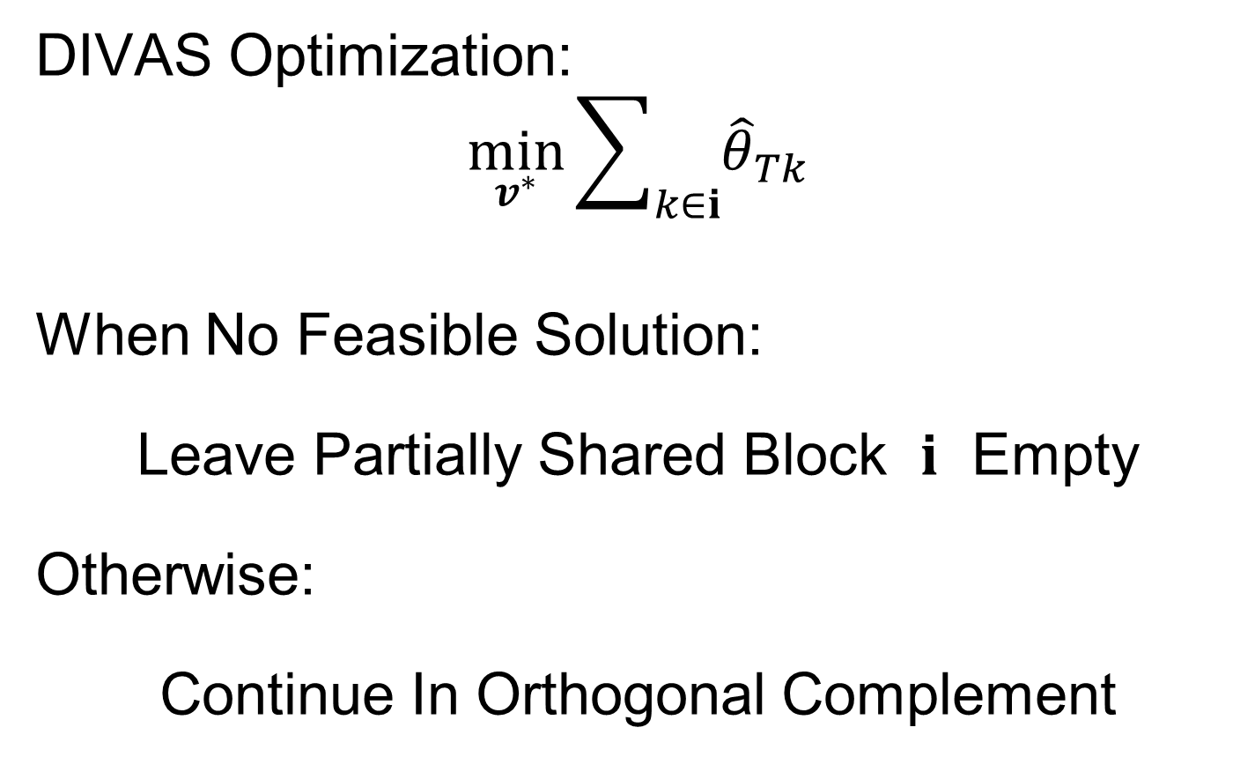
2. Joint Subspace Estimation
DIVAS Optimization:
$$\min_{v^{∗}}{\sum_{k∈i}{{\hat{θ}}_{Tk}}}$$
When No Feasible Solution:
Leave Partially Shared Block $i$ Empty
Otherwise:
Continue In Orthogonal Complement

Slide 20
2. Joint Subspace Estimation
DIVAS Optimization:
Reformulate to difference of convex function programming
Solve using Penalty CCP algorithm (Ismailova & Lu, 2016)
Skip Components Without Feasible Solution

Slide 21
DIVAS Algorithm
Three Major Steps:
Signal Subspace Extraction
Joint Subspace Estimation
Signal Reconstruction

Slide 22
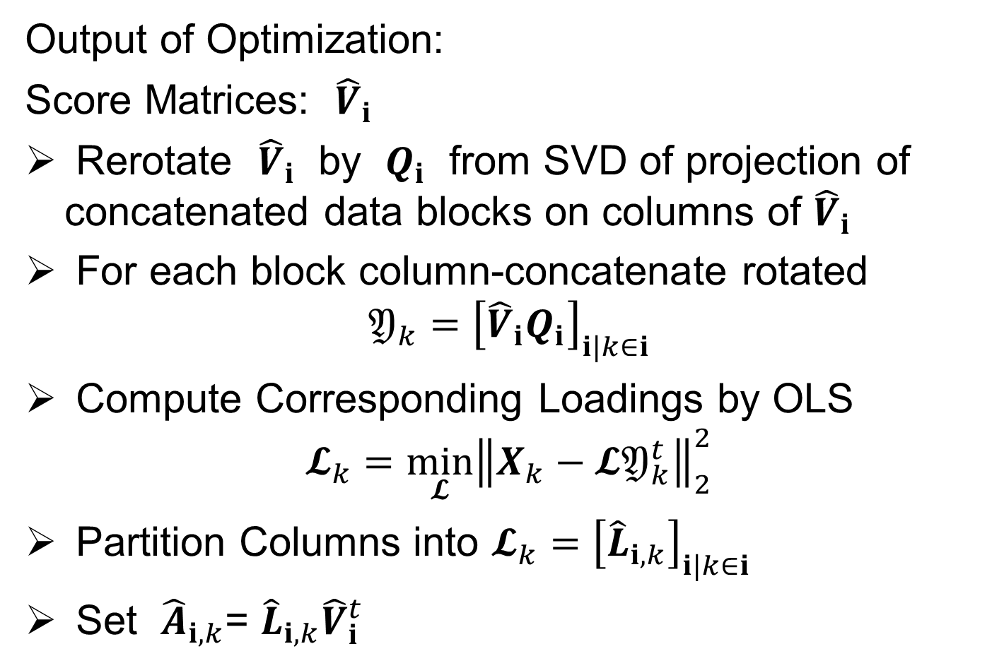
3. Signal Reconstructions
Output of Optimization:
Score Matrices: ${\hat{V}}_{i}$
Rerotate ${\hat{V}}_{i}$ by $Q_{i}$ from SVD of projection of concatenated data blocks on columns of ${\hat{V}}_{i}$
For each block column-concatenate rotated
$$𝔜_{k}={\left[{\hat{V}}_{i}Q_{i}\right]}_{i|k∈i}$$
Compute Corresponding Loadings by OLS
$$𝓛_{k}=\min_{𝓛}{{\left\|X_{k}−𝓛𝔜_{k}^{t}\right\|}_{2}^{2}}$$
Partition Columns into $𝓛_{k}={\left[{\hat{L}}_{i,k}\right]}_{i|k∈i}$
Set ${\hat{A}}_{i,k}$= ${\hat{L}}_{i,k}{\hat{V}}_{i}^{t}$

Slide 23
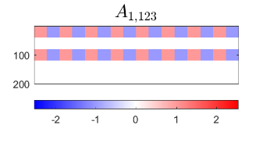
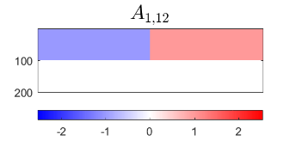
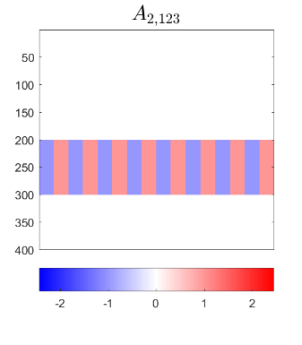
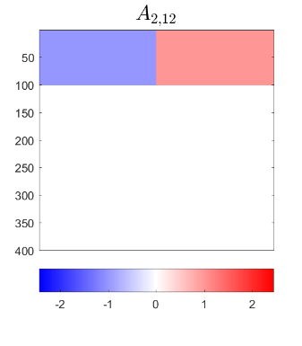
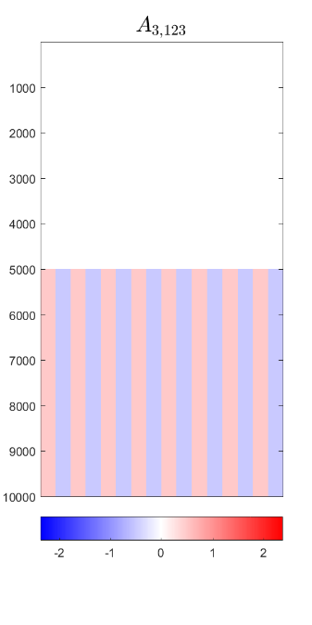
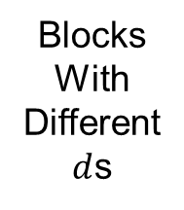

DIVAS – 3 Block Toy Example
Construct From Additive Components
$$n=400$$
1-2 Joint Comp, Rank 1
1-2 Scores
Orthogonal to
1-2-3 Scores
Blocks
With
Different
$d$s
1-2-3 Joint Component, Rank 1

Slide 24
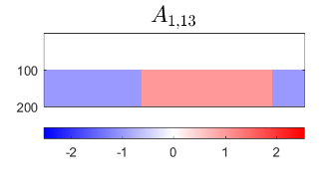
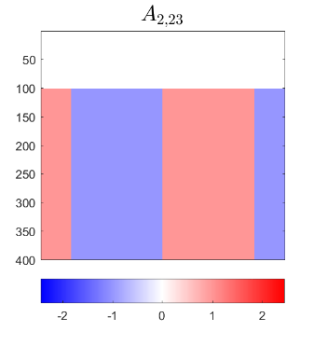
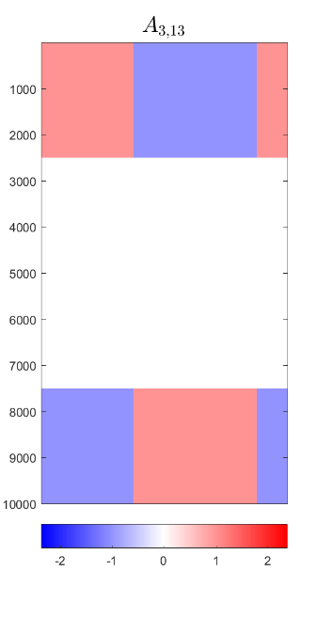
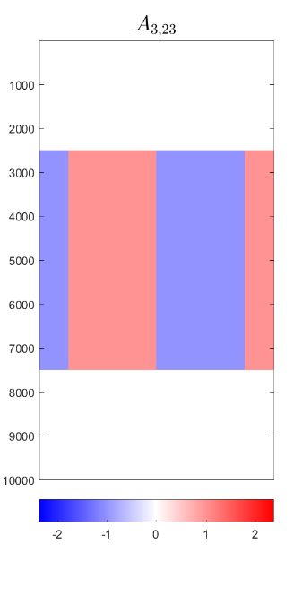


DIVAS – 3 Block Toy Example
Construct From Additive Components
1-3 Comps.
2-3 Comps.
Both $⊥$ to Joint
And All three ${60}^{°}$ Apart

Slide 25
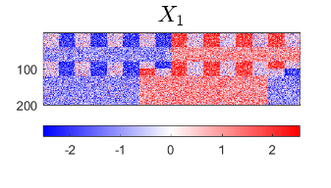
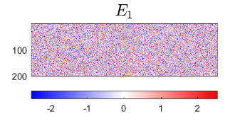
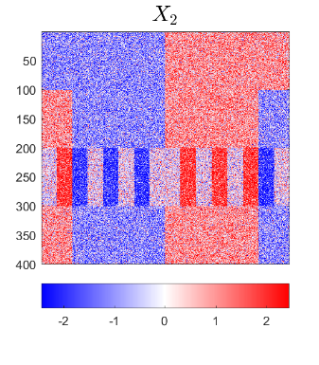
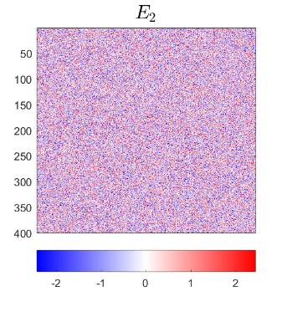
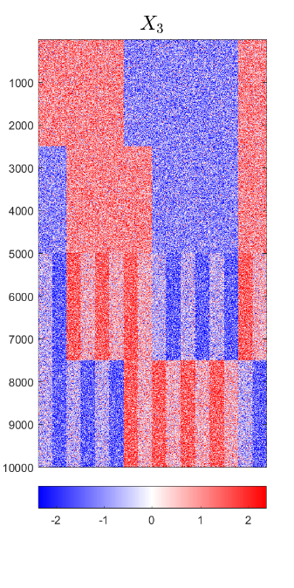
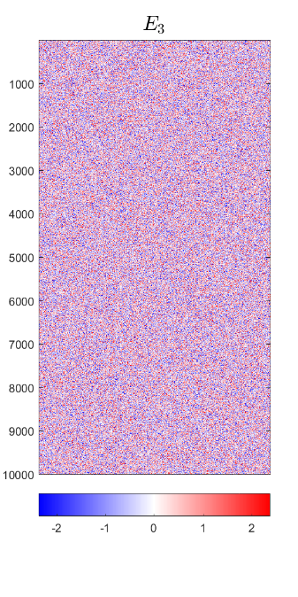
DIVAS – 3 Block Toy Example
Construct From Additive Components
Input to DIVAS: Sum of ALL
IID Gaussian Noise

Slide 26









DIVAS – 3 Block Toy Example
Relate to Previous Notation
$$X_{1}$$
$$A_{1}$$
$$E_{1}$$
$$X_{2}$$
$$A_{2}$$
$$E_{2}$$
$$X_{3}$$
$$A_{3}$$
$$E_{3}$$

Slide 27
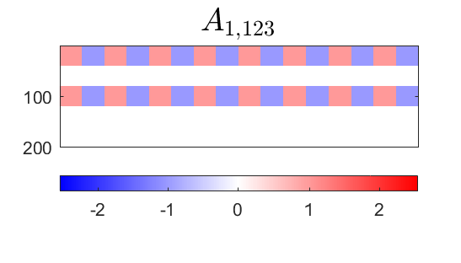
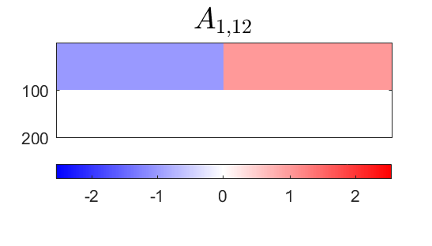
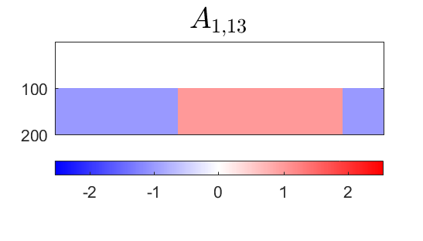
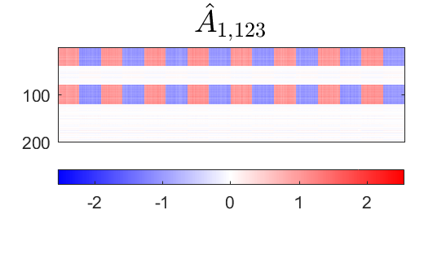

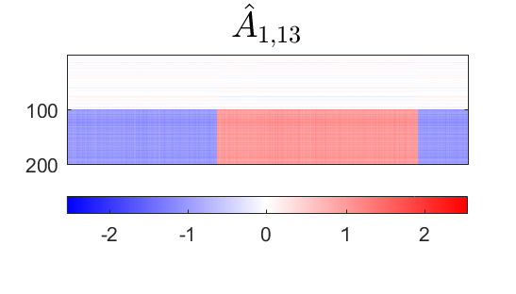
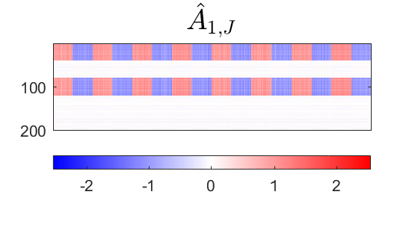
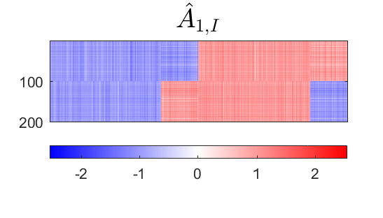


DIVAS – 3 Block Toy Example
Deeper Look at Estimation of 1st Block, i.e. $A_{1}$
Target
DIVAS
AJIVE
Large $\hat{A}$ to $A$ Angles $≈$ Worse Estimation
2.76°
5.01°
1.71°
4.23°
7.89°
7.14°

Slide 28


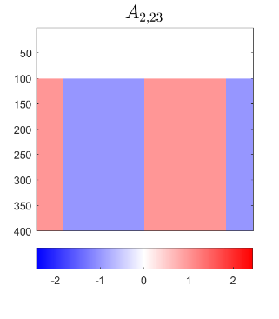

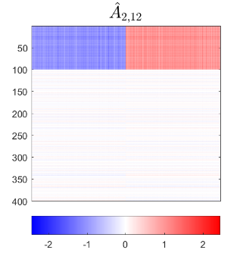
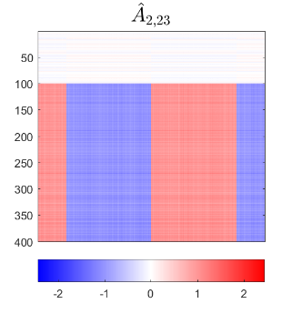


DIVAS – 3 Block Toy Example
Deeper Look at Estimation of 2nd Block
Target
DIVAS
AJIVE
DIVAS
Again
Gives
Better
Estimation
2.76°
5.00°
2.11°
4.23°
5.79°
3.76°

Slide 29



DIVAS – 3 Block Toy Example
Deeper 3rd Block - Target

Slide 30



DIVAS – 3 Block Toy Example
Deeper 3rd Block - DIVAS
2.76°
1.71°
2.11°

Slide 31


DIVAS – 3 Block Toy Example
Deeper 3rd Block - AJIVE
4.23°
1.43°
2.47°

Slide 32


DIVAS – 3 Block Toy Example
Diagnostic Plot (Scores, i. e. Trait Space)
Columns are Share Types, With Components $𝖄_{i,k}$, indexed by $i∈2^{\left\{1,2,3\right\}}$
Color Empty Components Gray
Rows are Data Blocks, $k=1,2,3$
Numbers are ranks
Bright Colors for Active Components

Slide 33
DIVAS – 3 Block Toy Example
Diagnostic Plot (Scores, i. e. Trait Space)
Columns are Share Types, With Components $𝖄_{i,k}$, indexed by $i∈2^{\left\{1,2,3\right\}}$
No Significant
Individual Blocks
Rows are Data Blocks, $k=1,2,3$
Three (each rank 1) 2-way Blocks
Single (rank 1) 3-way Block

Slide 34
DIVAS – 3 Block Toy Example
Diagnostic Plot (Scores, i. e. Trait Space)
Cumulative
Block Rank
Zoom In Here

Slide 35




DIVAS – 3 Block Toy Example
Diagnostic Plot (Scores), Zoomed In
Upper
Bound
$${\hat{θ}}_{k}+θ_{2}^{∗}$$
$${\hat{θ}}_{k}$$
Cone
Width
$${\hat{φ}}_{k}$$
Same ${\hat{φ}}_{k}$ for All
Share Types

Slide 36

DIVAS – 3 Block Toy Example
Diagnostic Plot (Scores), Zoomed In
Random Direction
Bound (RDB)
Same Over Share Types,
Since Share Ranks All 1
Large ${\hat{θ}}_{k}$ for Block
Not in This Share

Slide 37
DIVAS – 3 Block Toy Example
Diagnostic Plot (Scores, i. e. Trait Space)
Zoom In Here

Slide 38



DIVAS – 3 Block Toy Example
Diagnostic Plot (Scores), Zoomed In
ENC $=n$ When All $v_{j}=±\frac{1}{\sqrt{n}}$
ENC $=\frac{1}{\sum_{j}{v_{j}^{4}}}$
for $v^{∗}=\left(\begin{matrix}v_{1} \\ ⋮ \\ v_{n}\end{matrix}\right)$,
with $\left\|v^{∗}\right\|=1$
ENC $=1$ When Single $v_{j}=1$

Slide 39


DIVAS – 3 Block Toy Example
Diagnostic Plot (Loadings, i.e. Object Space)
Similar to Scores
Diagnostic
$${\hat{ψ}}_{k}$$

Slide 40
DIVAS – 3 Block Toy Example
Diagnostic Plot (Loadings, i.e. Object Space)
Zoom In Here

Slide 41
DIVAS – 3 Block Toy Example
Diagnostic Plot (Loadings)
Varies
Over
Blocks
Same Summary Applied to Loading Variables

Slide 42



DIVAS – 3 Block Toy Example
$$\frac{2}{5}$$
$$\frac{1}{4}$$
Relate Effective Number of
Traits to Underlying Example
$$\frac{1}{2}$$

Slide 43

DIVAS Modes of Variation from TCGA
TCGA Breast Cancer Data:
Data Blocks ($∩$s & Carefully Cleaned)
mRNA (GE): 16615×616
Copy Number (CN): 24174×616
Rev. Phase Protein Array (RPPA): 187×616
Gene mutation (Mutation): 18256×616

Slide 44

DIVAS on TCGA Data
Color Coded Share Types
Statistical Significance Summary

Slide 45

DIVAS on TCGA Data
6 CN$→$GE$→$Protein Modes
Statistical Significance Summary
Single 4-way mode, as in AJIVE Analysis
Little Systematic
Mutation Variation

Slide 46


DIVAS on TCGA Data
GE or CN$→$ Proteins
Statistical Significance Summary
Major CN$→$GE Variation
No Pairwise Mut Variation
Many Modes of
Individual Var’n

Slide 47
DIVAS on TCGA Data
Statistical Significance Summary
Final Rank
Filtered Rank
Maximal Rank

Slide 48
DIVAS on TCGA Data
Statistical Significance Summary
Number of Cases
Involved in Direction
Can Reveal Modes Driven by Outliers

Slide 49

DIVAS Modes of Variation from TCGA
TCGA Breast Cancer Data:
Data Blocks ($∩$s & Carefully Cleaned)
mRNA (GE): 16615×616
Copy Number (CN): 24174×616
Rev. Phase Protein Array (RPPA): 187×616
Gene mutation (Mutation): 18256×616
Tumor Subtypes
Basal-like: ⊲
HER2-like: ∗
Luminal A: +
Luminal B: ×

Slide 50

DIVAS Modes of Variation from TCGA
Gene Exp. PCA Modes of Variation (Scores)
Strong Basal Separation
Other Differences
Not So Apparent
Lum B & HER2 Separation

Slide 51


DIVAS Modes of Variation from TCGA
Gene Exp. PCA Modes of Varia’n (Loadings)
PAM 50 Genes
5
1

Slide 52


DIVAS Modes of Variation from TCGA
Gene Exp. PCA Modes of Varia’n (Loadings)
0
5

Slide 53

DIVAS Modes of Variation from TCGA
DIVAS 4-way & 3-Way Modes (Scores)
Luminals vs. Others
Basals vs. HER2s
HER2s vs. Lum Bs

Slide 54


DIVAS Modes of Variation from TCGA
DIVAS 4-way & 3-Way Modes (GE Loadings)
More PAM 50 Genes

Slide 55
DIVAS on Mortality Data
Data Blocks:
Swiss Males
Spanish Males
Swiss Females
Spanish Females
Expected Differences:
Record Keeping, War
Expected Commonalities:
Overall Improvement,
Pandemic, Automobiles
Explore Gender Issues

Slide 56

DIVAS on Mortality Data
DIVAS Result:
6 Two-way Spanish
Male – Female Modes
2 Four-way Modes
1 Three-way Mode

Slide 57

DIVAS on Mortality Data
Double Mean Centering,
i.e. Flat Mode Removed
Note: Age Rounding in Spain
Show Overall Improvement,
Four-Way Modes
Pandemic & Automotive Effects
To Avoid 0s
Start at 15

Slide 58

DIVAS on Mortality Data
Three-Way Mode
AIDS Epidemic?

Slide 59

DIVAS on Mortality Data
Civil War
Record Keeping
Two-Way Modes (Spanish Males & Females)

Slide 60
Next Time
Add movement like toy example from:
\Research\Bioinf\GeneArray\JIVE\Movement

Slide 61
Distance Methods
Main Idea:
Approach to Data Lying in Complicated Space
(PCA Makes No Sense In Nonlinear Spaces)
However, Often Have Notion of “Distance”
I.e. Metric on Metric Space
So Base Analysis on Distances
Text: Chp. 7

Slide 62


Distance Methods
Given a metric $δ$ on the Object Space
And Data Objects $𝓧_{1},⋯,𝓧_{n}$
Define Distance Matrix:
$$𝔇=\left[\begin{matrix}δ\left(𝓧_{1},𝓧_{1}\right) & ⋯ & δ\left(𝓧_{1},𝓧_{n}\right) \\ ⋮ & ⋱ & ⋮ \\ δ\left(𝓧_{n},𝓧_{1}\right) & ⋯ & δ\left(𝓧_{n},𝓧_{n}\right)\end{matrix}\right]$$
Script $𝓧$ Denotes
Arbitrary Data Objects

Slide 63

Distance Methods
Common Choices of Metric $δ$ (on $ℝ^{d}$):
$δ_{2}\left(x,y\right)={\left\|x−y\right\|}_{2}={\left(\sum_{j=1}^{d}{{\left(x_{j}−y_{j}\right)}^{2}}\right)}^{1/2}$
$δ_{1}\left(x,y\right)={\left\|x−y\right\|}_{1}=\sum_{j=1}^{d}{\left|x_{j}−y_{j}\right|}$
$δ_{C}\left(x,y\right)=1−\frac{2}{π}\cos^{−1}{\frac{x^{t}y}{{\left\|x\right\|}_{2}{\left\|y\right\|}_{2}}}$
Classical & Corresponds to Intuition
Very Good at Downweighting Outliers
Think Polar Coordinates, Focus on Angular Component and Ignore Radii

Slide 64

Distance Methods
Major Consumers of $𝔇$ Based Analyses
Early Machine Learning
Call Related Analyses “Kernel Trick”
(Discuss More Later)

Slide 65

Distance Methods
Notions of Sample Centerpoint?
Conventional Sample Mean in $ℝ^{d}$:
$${\overline{x}}_{co}=\frac{1}{n}\sum_{i=1}^{n}{x_{i}}=\left(\begin{matrix}\frac{1}{n}\sum_{i=1}^{n}{x_{1,i}} \\ ⋮ \\ \frac{1}{n}\sum_{i=1}^{n}{x_{d,i}}\end{matrix}\right)$$
Text Sec. 7.1
Note: Uses Linear Operations,
Not Available in General

Slide 66

Distance Methods
Approach:
Replace Linear Op’s with Optimization
Fréchet (1948) Mean:
$${argmin}_{𝓧}\frac{1}{n}\sum_{i=1}^{n}{{δ\left(𝓧,𝓧_{i}\right)}^{2}}$$
Start With Candidate Point
Move Around to Min
Sum of Squared Dist’s

Slide 67

Distance Methods
Why Squared Distance?
In $ℝ^{d}$, Using Metric $δ_{2}$, Can Show
Fréchet Mean = ${\overline{x}}_{co}$
I. e. Fréchet Mean is Generalization of Sample Mean

Slide 68


Distance Methods
Fréchet Sample Mean, $ℝ^{2}$ Toy Example
(Use Metric $δ=δ_{2}$)
Move Around to Min
Sum of Squared Dist’s
Start With Candidate Point

Slide 69
Distance Methods
Fréchet Sample Mean, $ℝ^{2}$ Toy Example
(Use Metric $δ=δ_{2}$)
Min Looks Like
Sample Mean???
Note: Outlier Pulls Mean Out of
Convex Hull Of Other 4 Points
Recall “Center
Of Mass”
Interpretretation
Known Problem with Mean: Not Robust Against Outliers

Slide 70

Distance Methods
Robust Variation: Fréchet (1948) Median:
$${argmin}_{𝓧}\frac{1}{n}\sum_{i=1}^{n}{δ\left(𝓧,𝓧_{i}\right)}$$
Again Start With Candidate Point
Move Around to Min
Sum of Distances

Slide 71


Distance Methods
Fréchet Sample Median, $ℝ^{2}$ Toy Example
(Use Metric $δ=δ_{2}$)
Move Around to Min
Sum of Distances
Start With Candidate Point

Slide 72
Distance Methods
Fréchet Sample Median, $ℝ^{2}$ Toy Example
(Use Metric $δ=δ_{2}$)
Better Robustness?
Note: Median Now Inside
Convex Hull Of Other 4 Points

Slide 73

Distance Methods
Now Recall Fréchet Means & Medians Are Defined for Any Metric
How About Other Metrics?
In Toy Example, Replace $δ_{2}$ With $δ_{1}$

Slide 74


Distance Methods
$δ_{1}$ Fréchet Sample Median, $ℝ^{2}$ Toy Example
(Now Use Metric $δ=δ_{1}$)
Distance Depends on
Coordinates, Called
“Manhattan Distance”
Result Is Also
Rather Robust
Note: This is the
Coordinate-wise
Median

